Slide 1
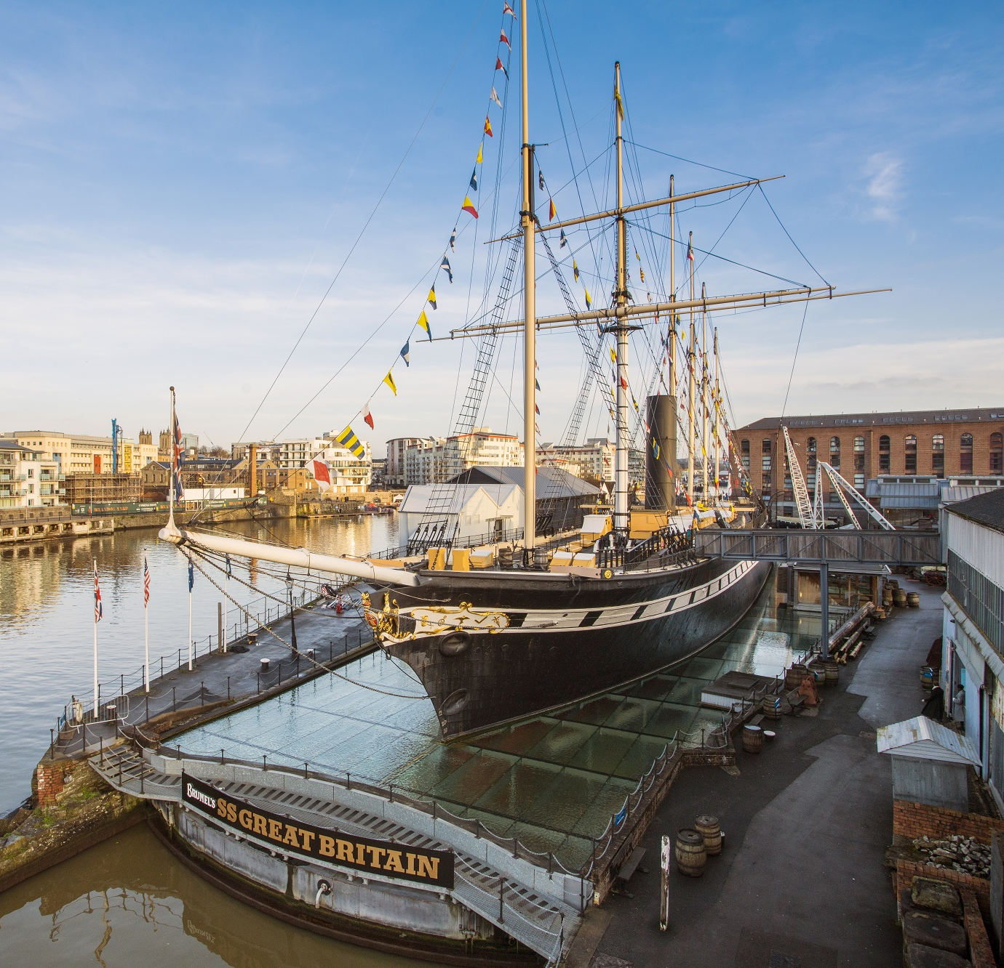

Preparing
for your
visit
Sounds and Smells Onboard
Christmas 2024

Slide 2
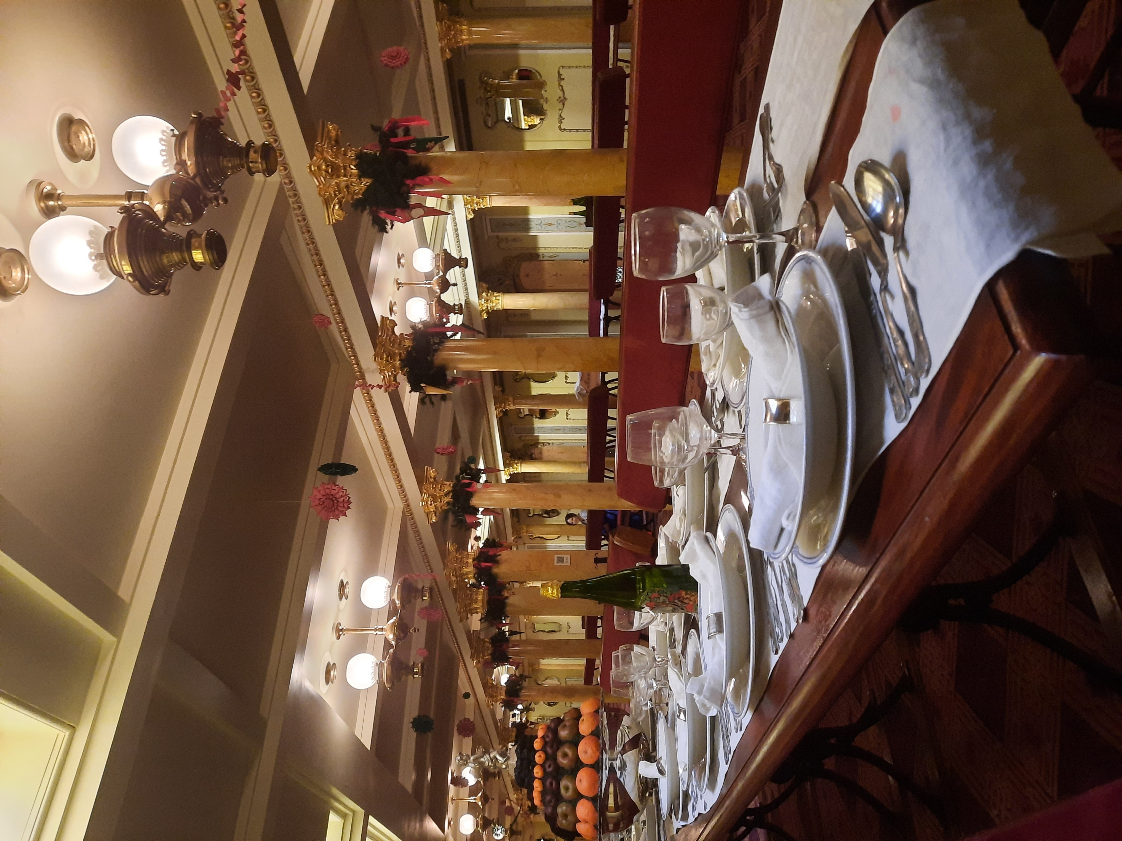

This guide describes the smells and sounds you will find in different parts of the ship during December 2024.
There are recorded sounds and artificial smells to help us imagine what life was like on the ship when it was sailing around the world from 1840s to 1880s.
In many of the rooms you will hear lots of different sounds at the same time.
The sounds can also pass through the doorways and gaps in the floorboards, so can you can hear them in more than one room.
Celebrating Christmas was important for the Victorians, so we have added lots of Christmas decorations to the SS Great Britain including some additional festive sounds and smells, which have been included in this guide.

Slide 3
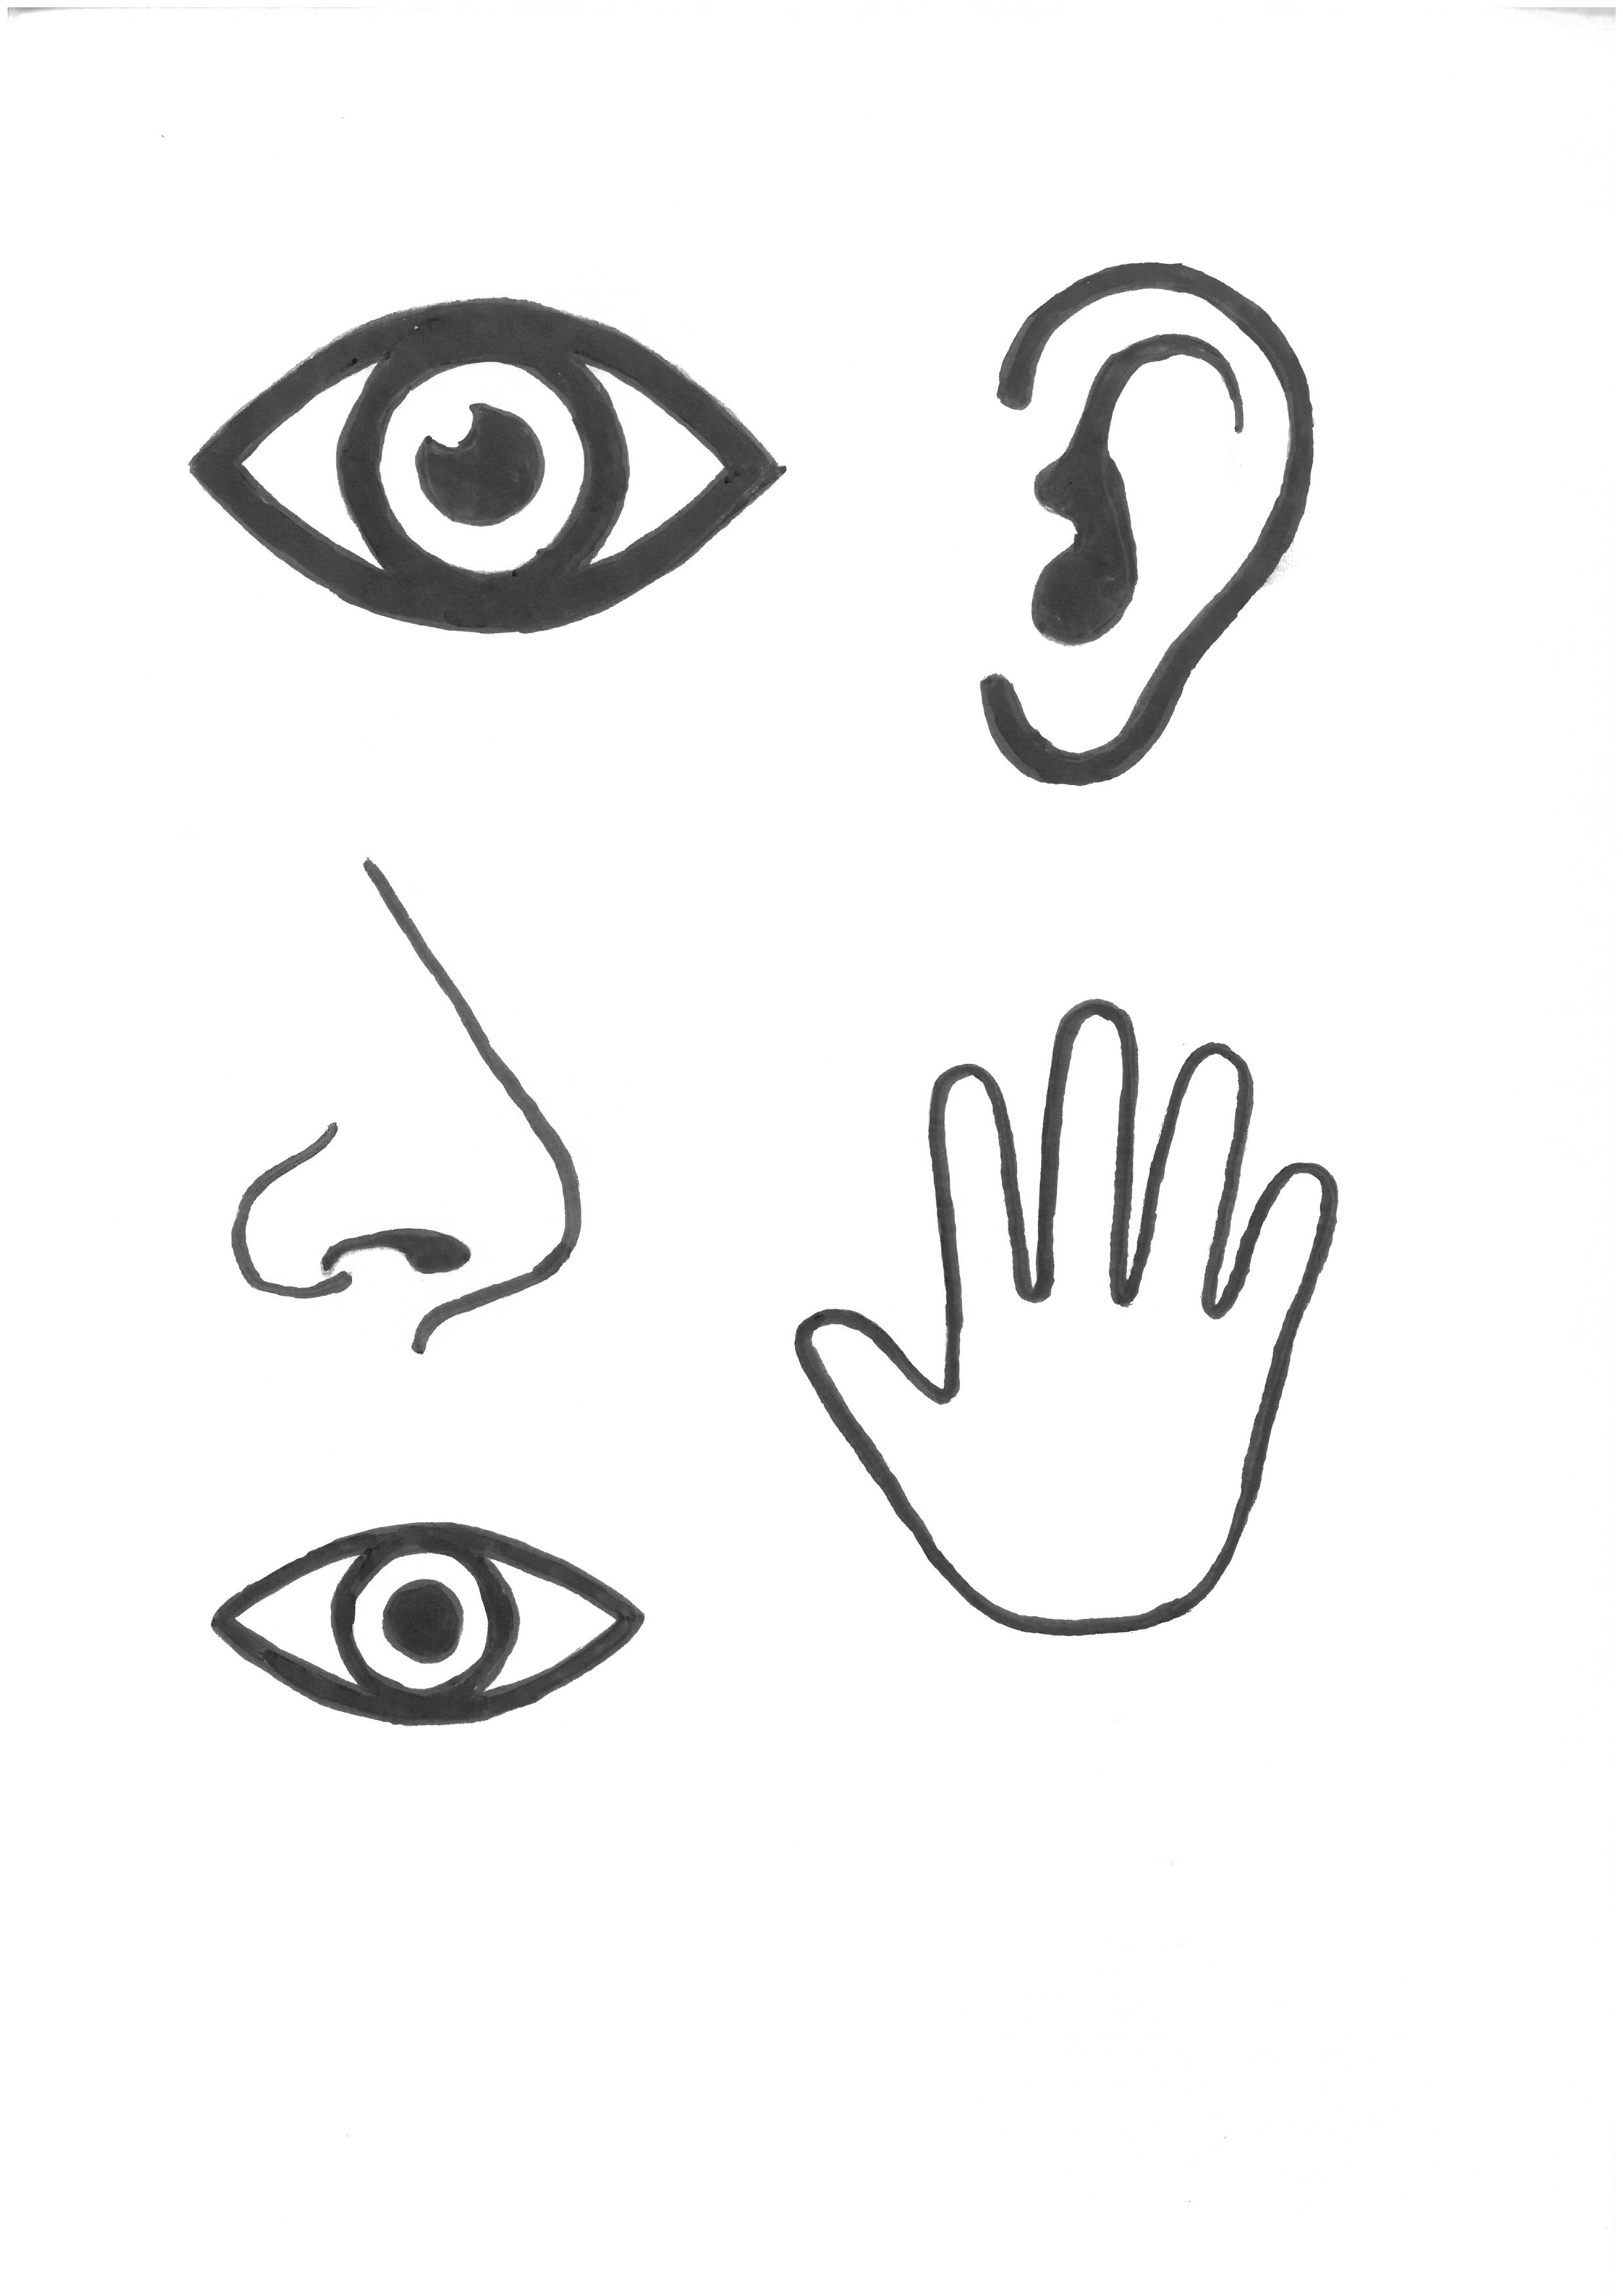
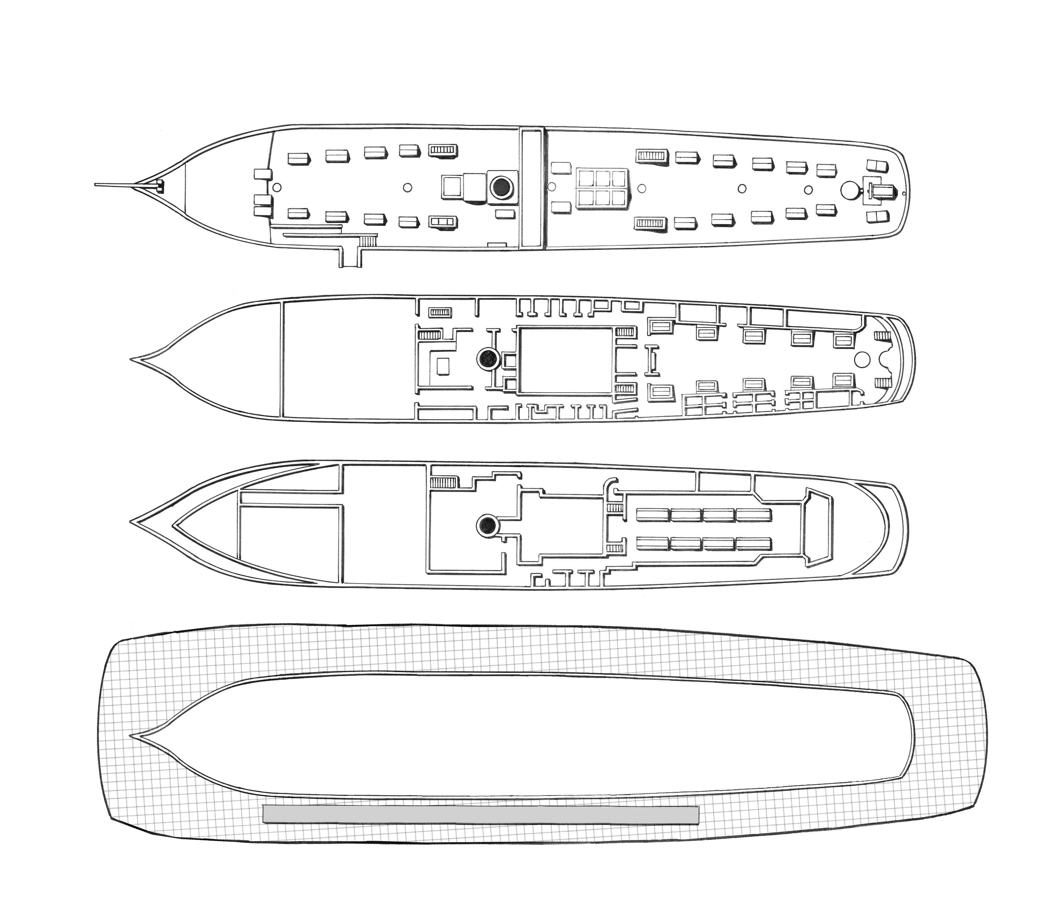
Top Deck - Sounds
Recorded sounds you will hear:
Chains rattling
Cow and pig

Slide 4
Top Deck - Smells
Horse Manure

Slide 5
Middle Deck - Sounds
Galley:
Fire crackling
Clattering of pots
Talking
Cat and rats
Bakery:
Fire crackling
Engine Room:
Engine moving
Fire crackling
People shovelling coal and shouting
Talking Toilet:
If you try to open the door a recorded voice of someone talking is triggered
Steerage:
Folk band playing music
People singing Christmas carols
People talking
Children playing
Ladies’ Boudoir:
Vomiting
Promenade Saloon:
People eating
A passenger reading an extract of A Christmas Carol
Whistling
Jingling bells
Fainting sound of a sleigh landing on the deck above

Slide 6
Middle Deck - Smells
Galley:
Smokey bacon
Bakery:
Bread
Talking Toilet:
Urine
Prom Deck:
Carbolic soap
Prom Deck:
Festive citrus and spice
Prom Deck:
Rum
Steerage:
Dirty linen
Musty old inn
Engine Room:
Coal
Ladies’ Boudoir:
Vomit
Prom Deck:
Carbolic soap

Slide 7

Lower Deck - Sounds
Forward Hold:
Horses
You can also hear sounds from steerage above e.g. the baby crying
Low hum from the dehumidifier
Dining Saloon:
The sea
The ship’s engine, propeller and bell
People moving and talking
Seasick passengers
Chinking of tableware moving
Musicians warming up

Slide 8
Lower Deck - Smells
Forward Hold:
Horse manure
Dining Saloon:
Dark chocolate
Orange

