Slide 1
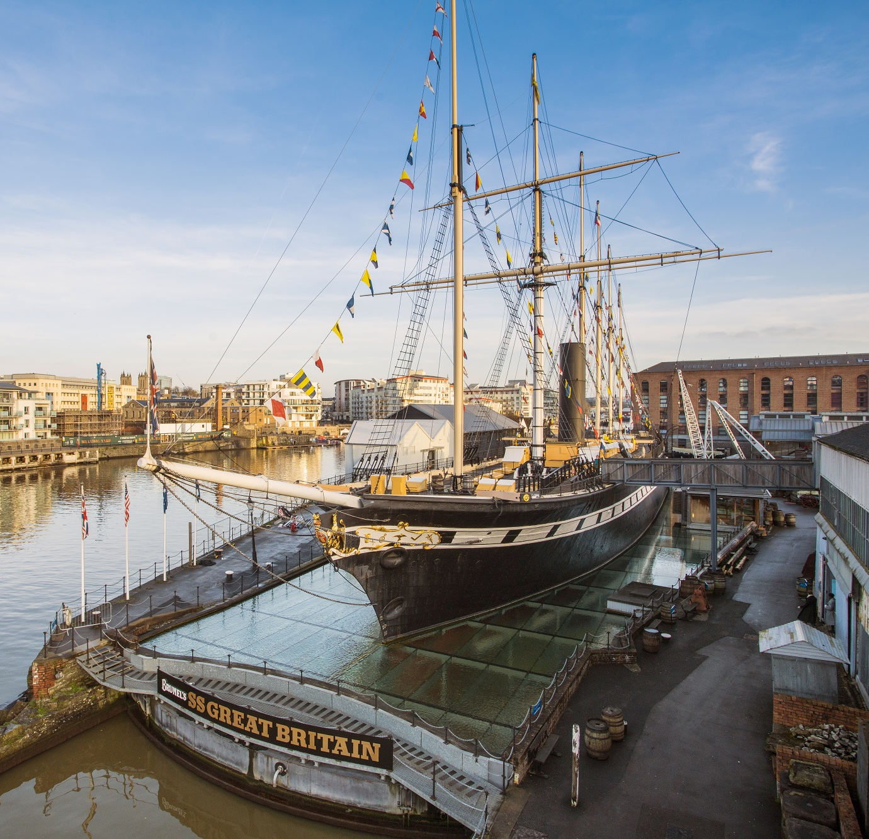

School
Workshop
Guide
Life at Sea

Slide 2
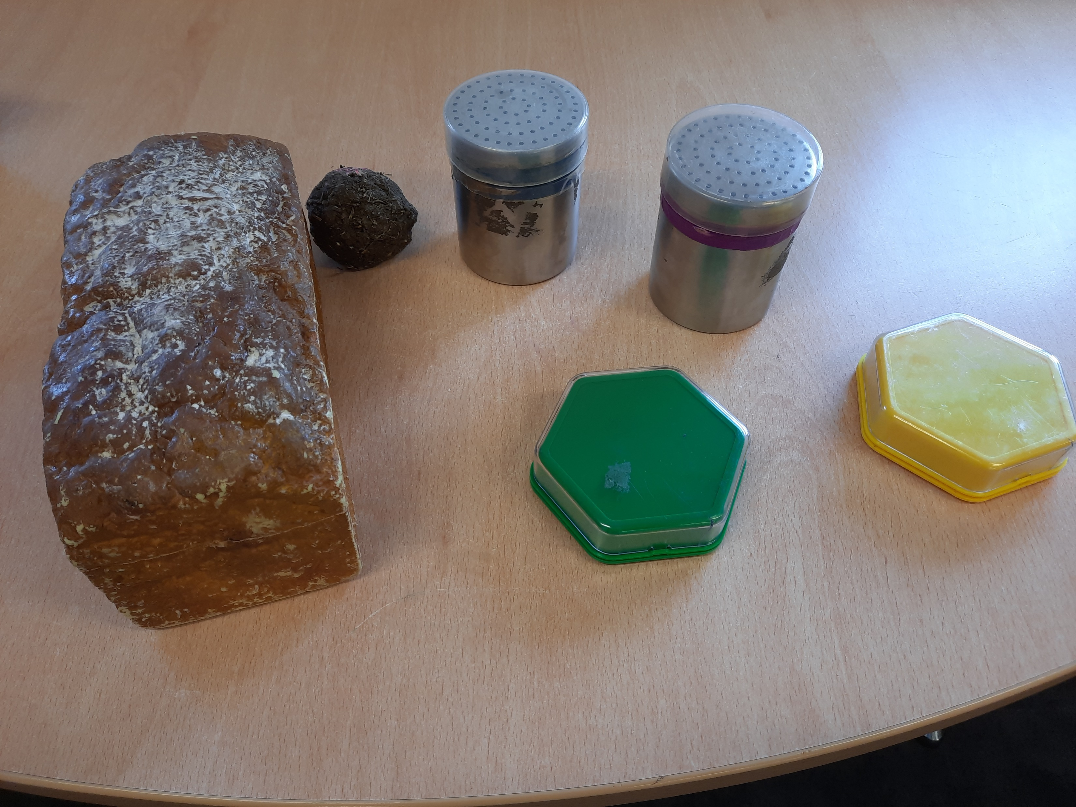
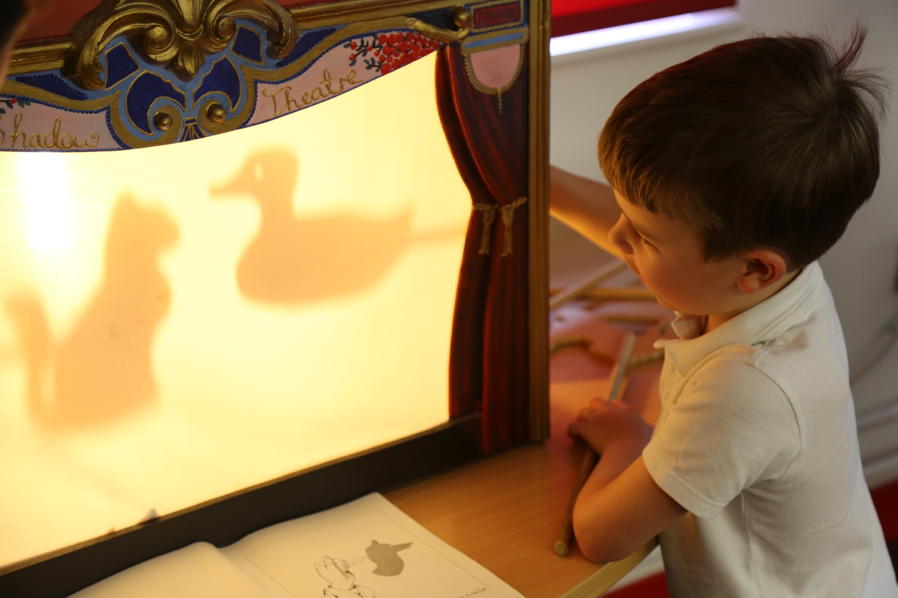
During our visit, we are going to find out what people did and experienced while travelling on the SS Great Britain in the Victorian times.
We will discover some of the sounds and smells passengers experienced.
We will dress up and play games.

Slide 3
To discuss specific access or educational needs please call 0117 926 0680 and ask to speak to the Education Team.
Brunel’s SS Great Britain
Great Western Dockyard
Bristol England
United Kingdom
BS1 6TY
Tel: 0117 926 0680
Email: learning@ssgreatbritain.org
Web: ssgreatbritain.org
Photographs by: Lottie Morris

