Slide 1
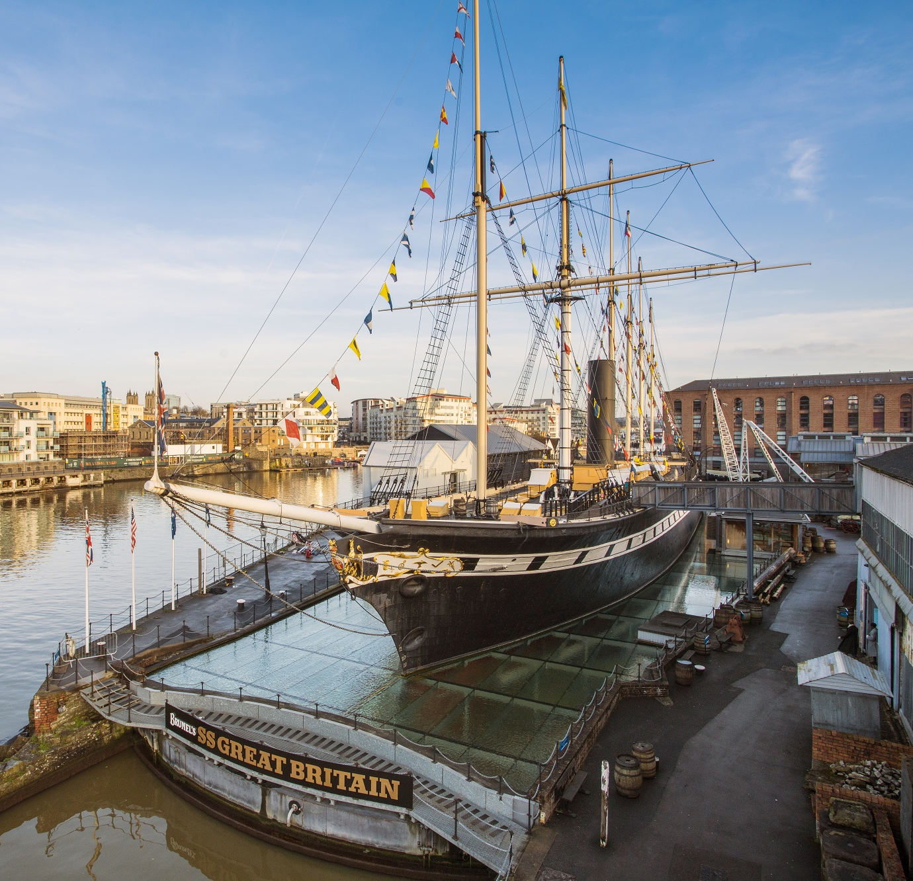

Preparing
for your
school visit
Visual Story

Slide 2
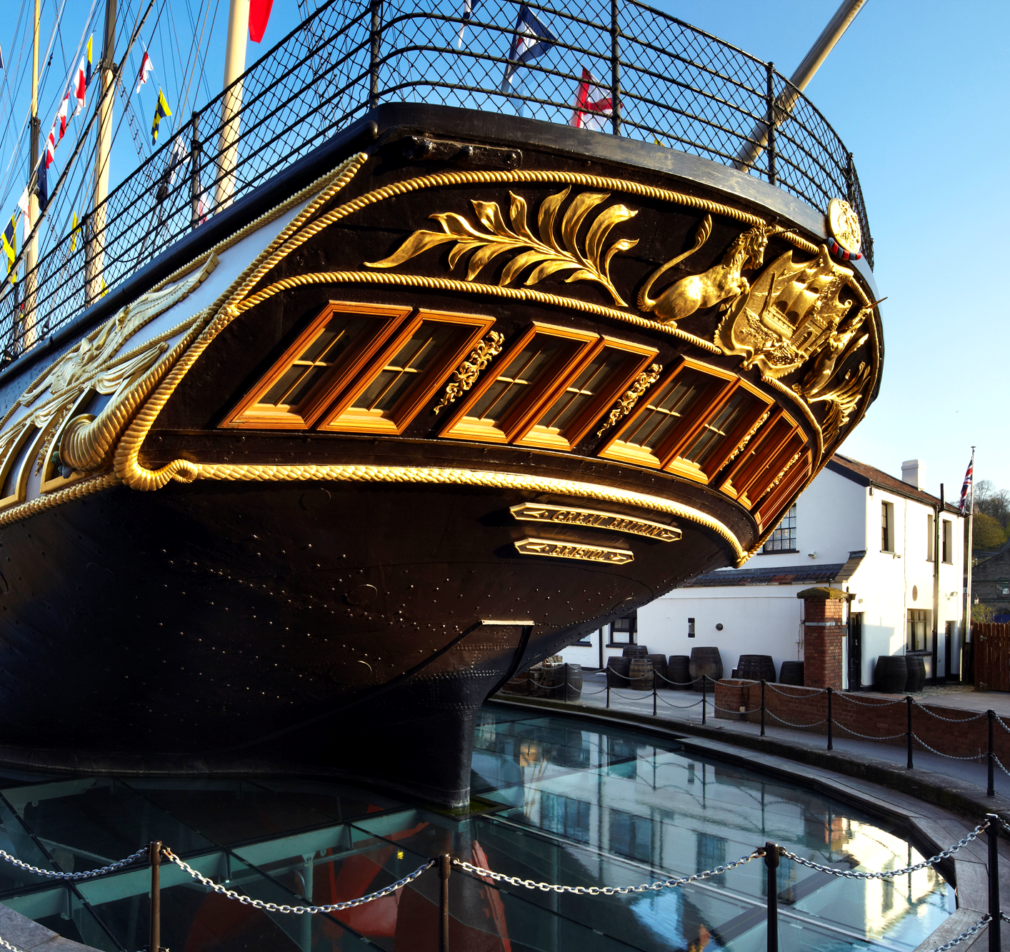
We are going to visit a ship called the SS Great Britain.
We can go on the ship and see what life was like for people in the past. We can also go into the dry dock and in the museums.

Slide 3
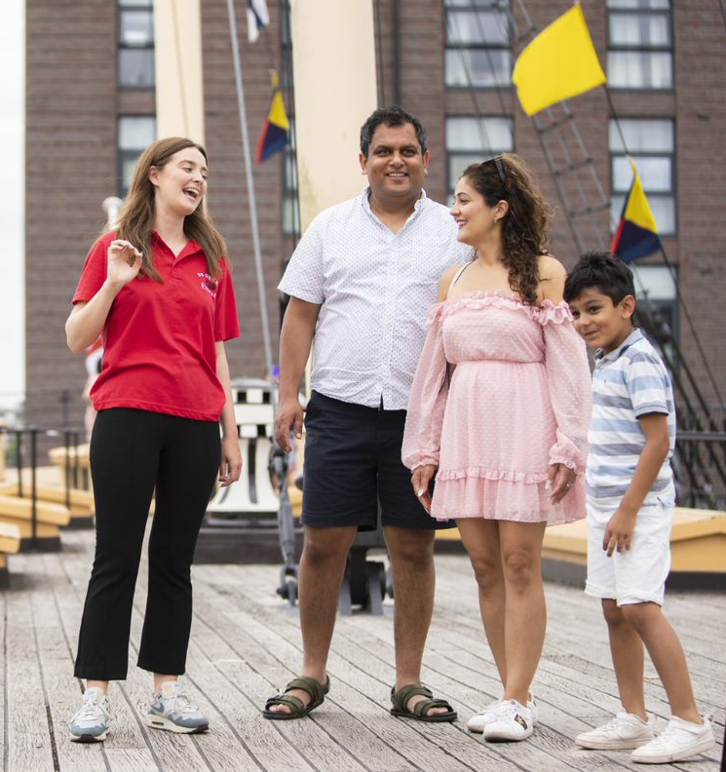
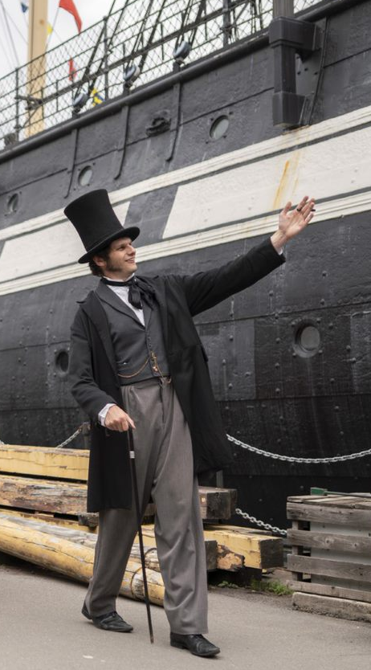
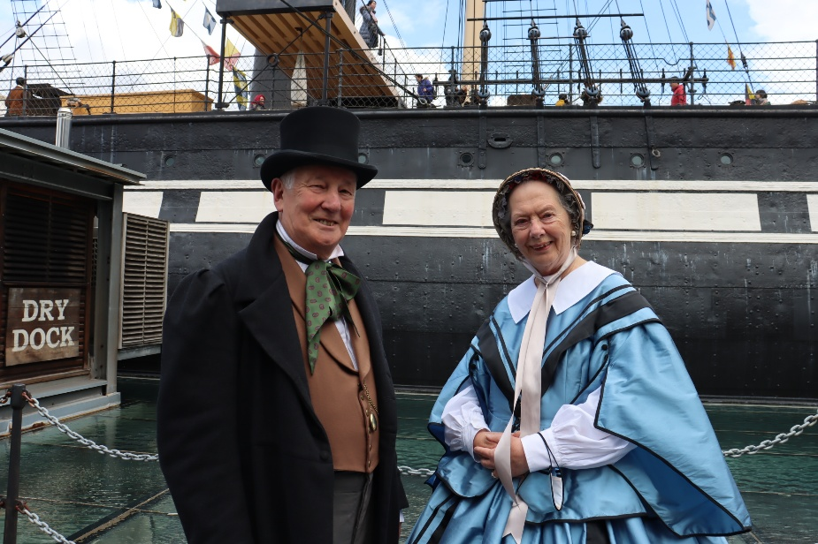
People who can help us
Most staff and volunteers wear red and black uniforms and also wear a name badge.
There are sometimes people dressed in Victorian costume. You might meet someone dressed as Isambard Kingdom Brunel, the engineer who designed the ship.

Slide 4
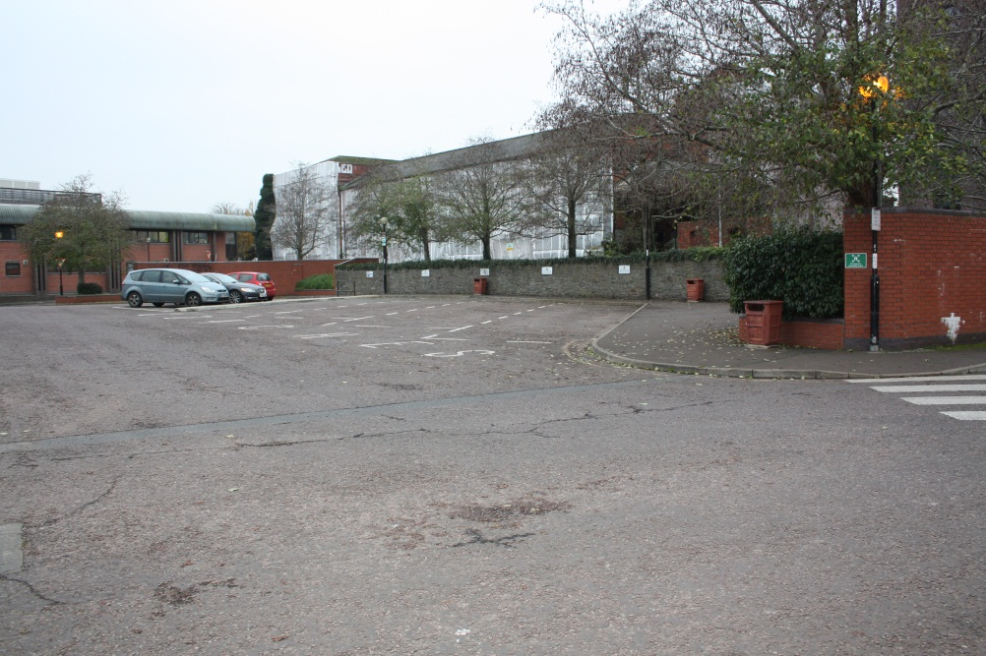
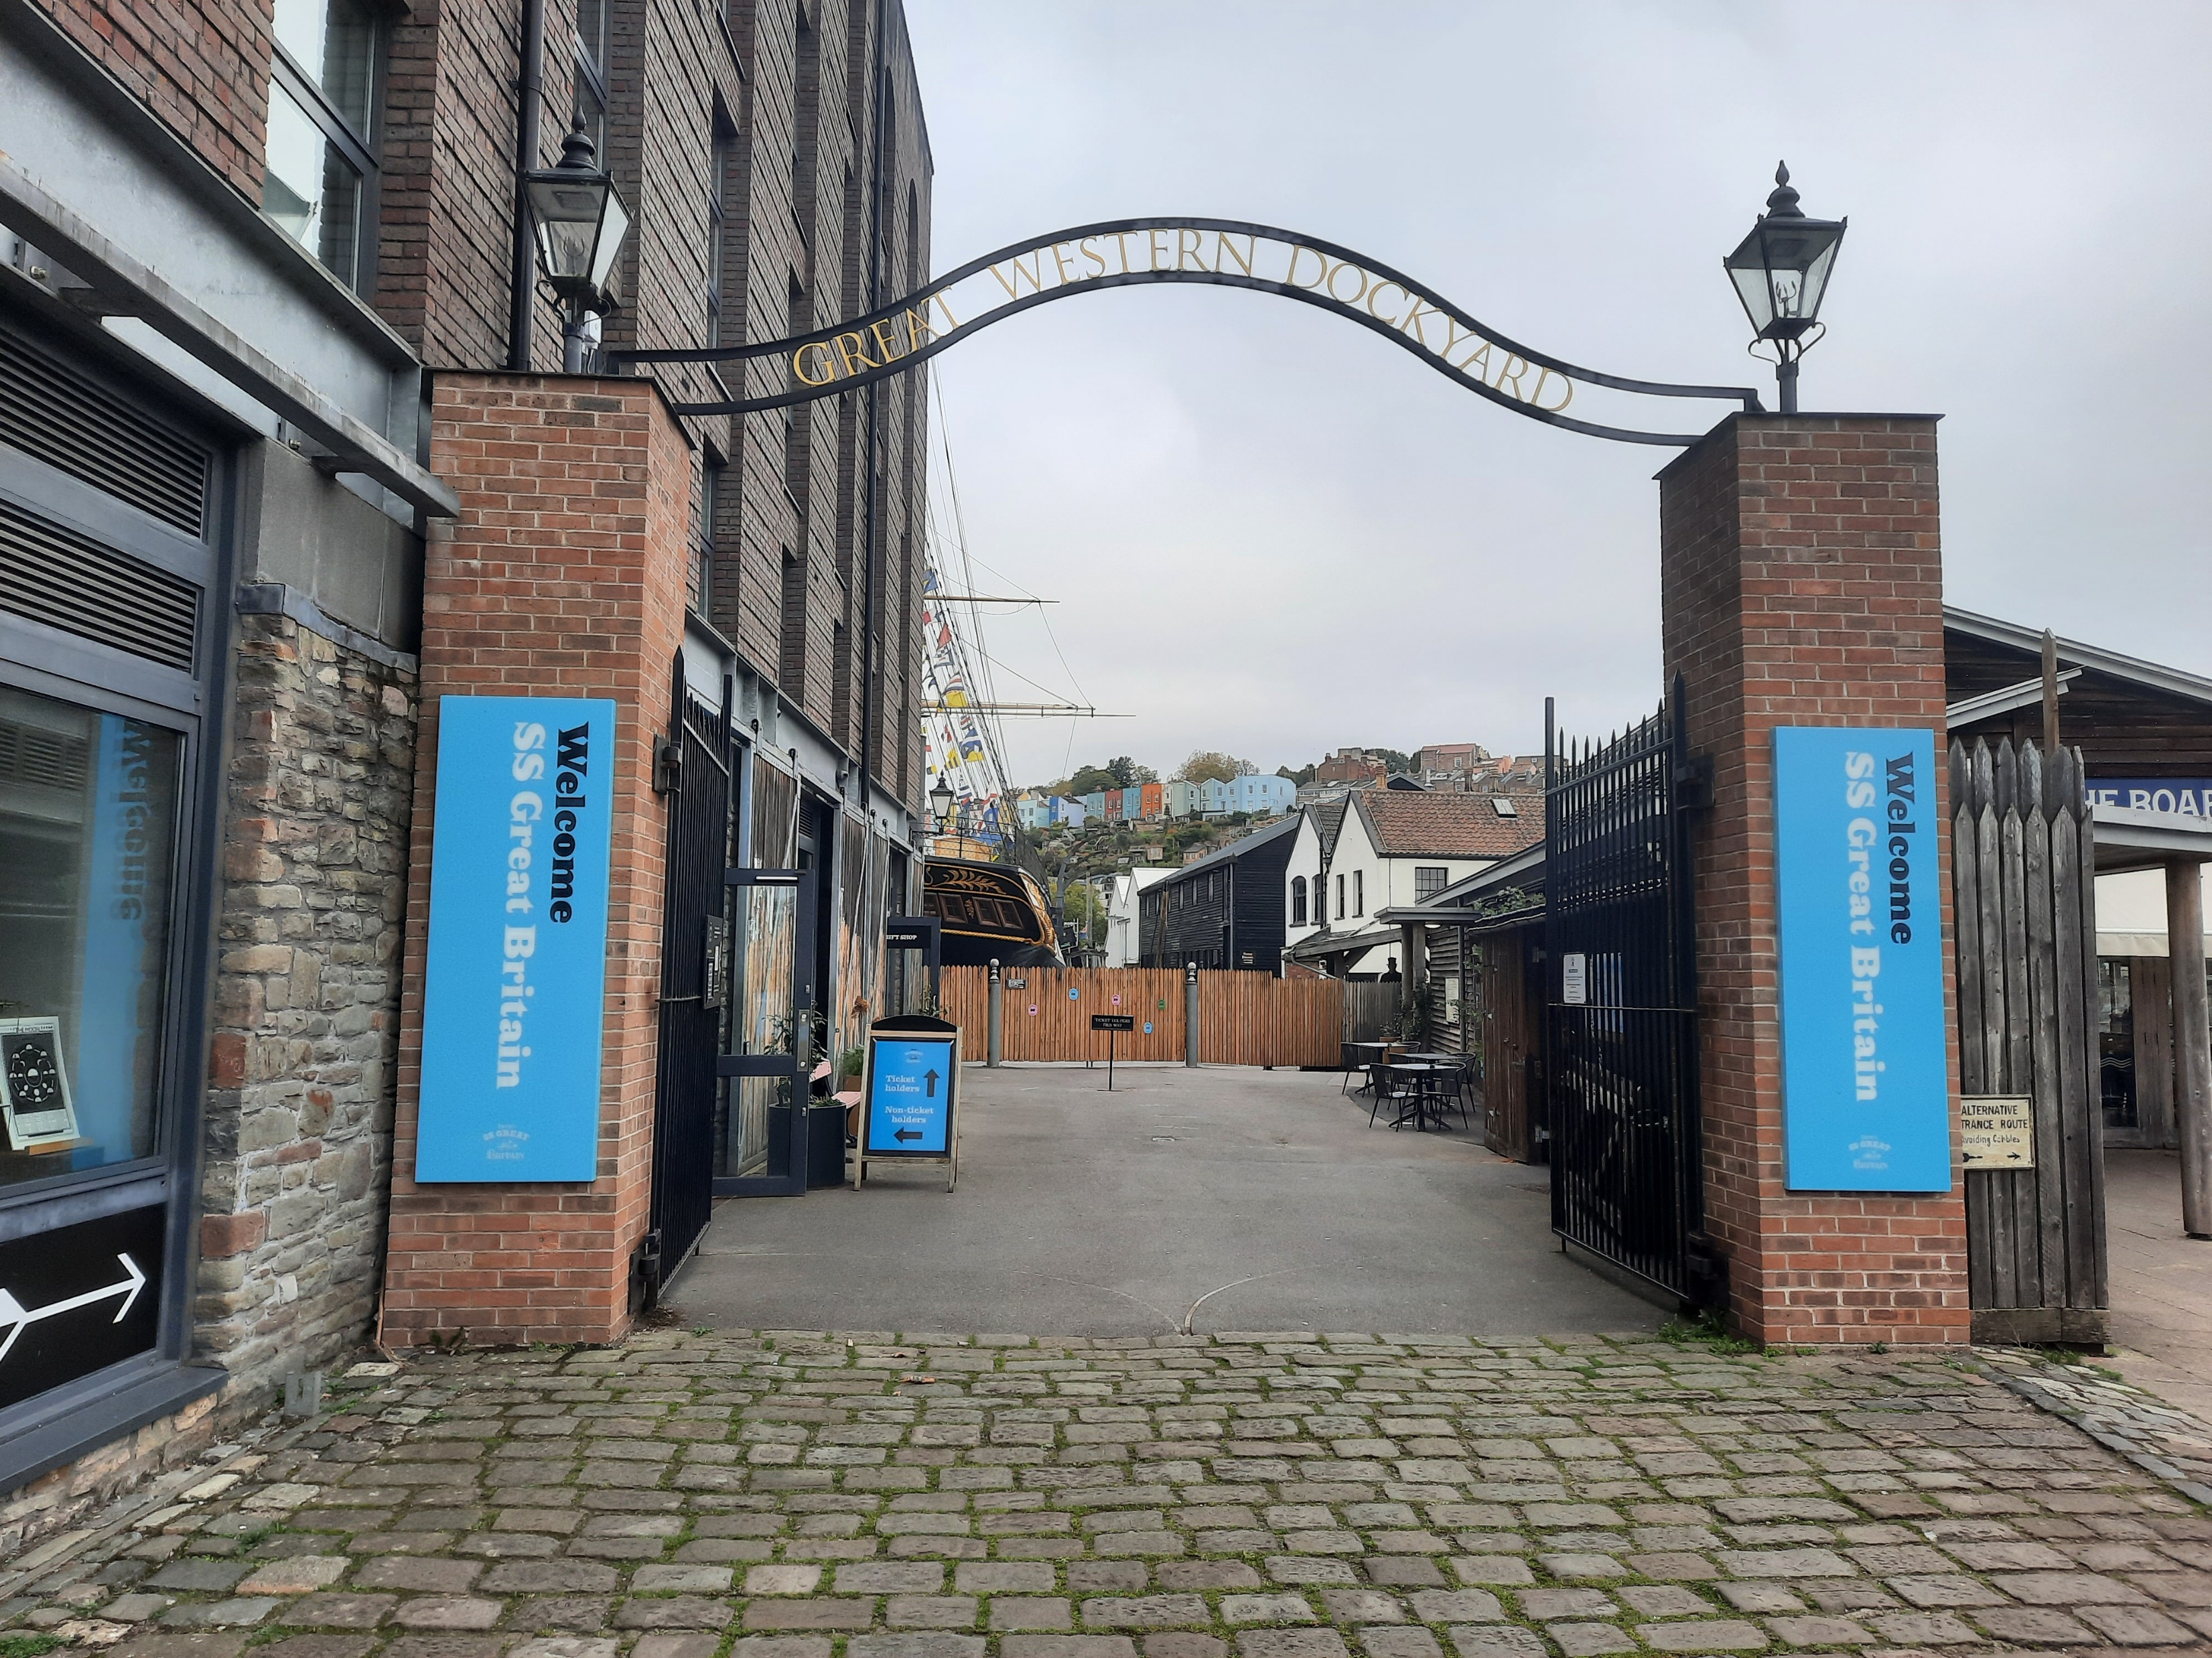
When we arrive
We will arrive at the car park.
First, we will walk to the entrance.
Then we might need to wait for a few minutes by the big gates.
Someone might meet us and welcome us to the SS Great Britain.

Slide 5
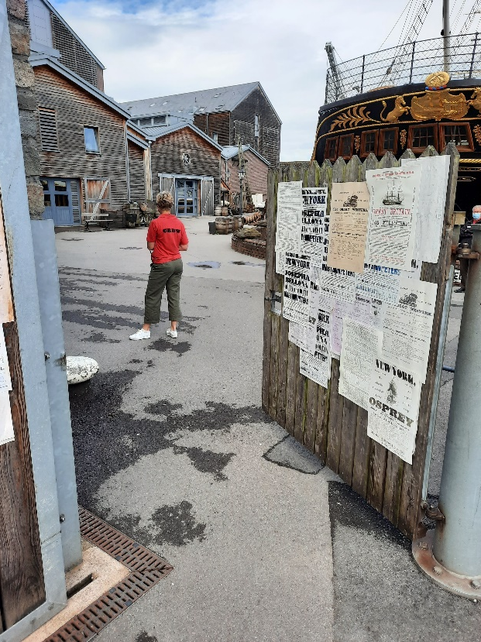
When we go in
First, we will go through the entrance.
Then it will be time to listen to some important things to help with our visit.
There might be lots of people visiting so we need to stay with our helpers.

Slide 6
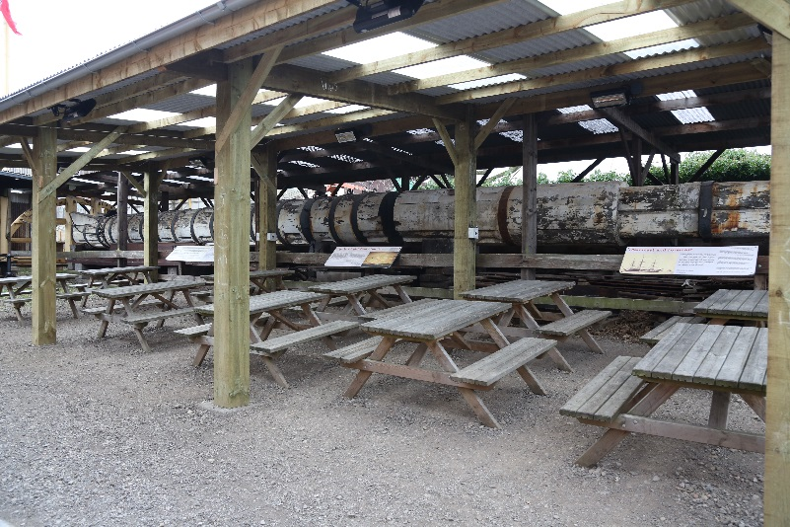
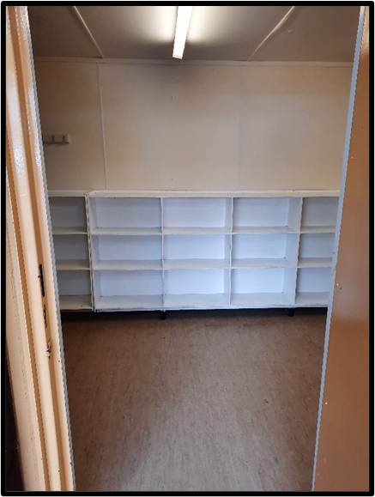
Our group might then go to the lunch area so we can leave our bags and lunch in a bag storeroom.

Slide 7
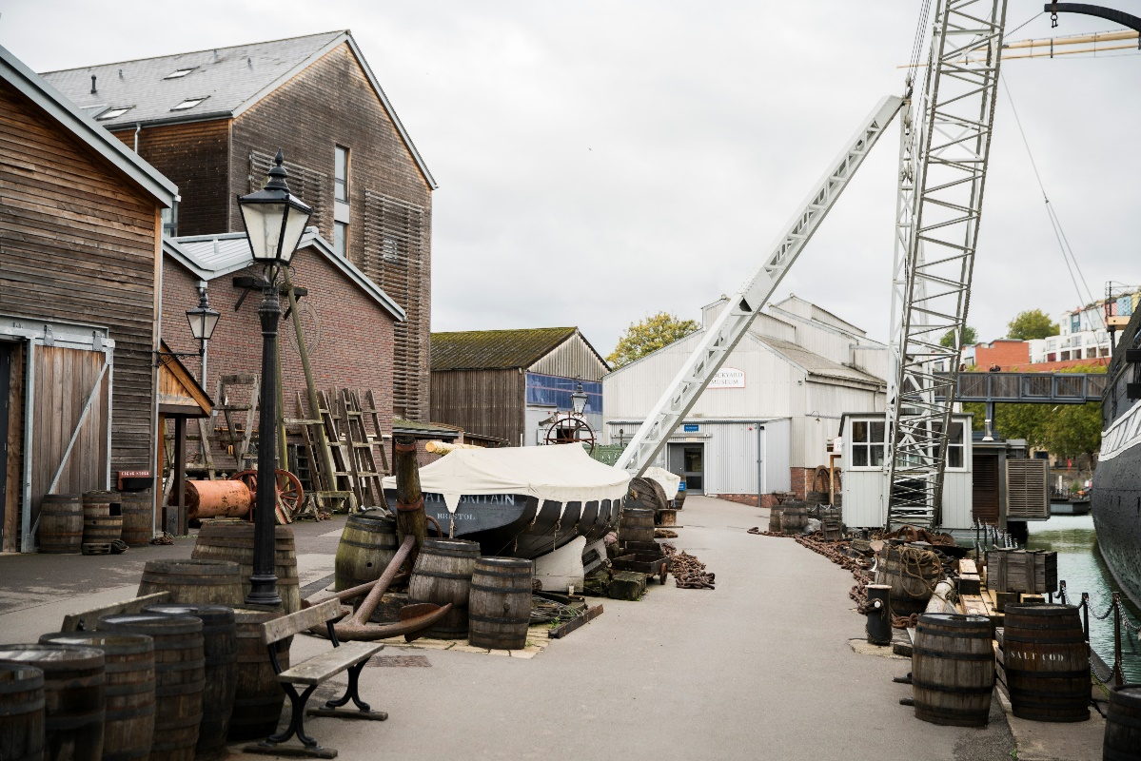
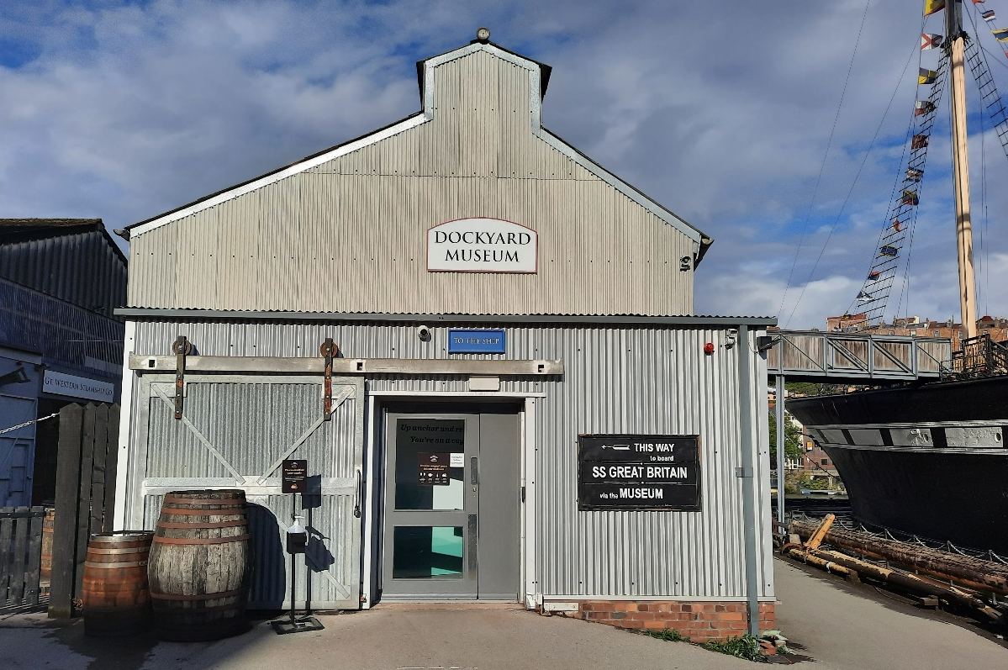
Places we might see or go
The area around the ship is the Great Western Dockyard.
There are barrels, anchors, chains - and lots of other things we can find.
This is the Dockyard Museum. We go through the Museum to get onto the ship.

Slide 8
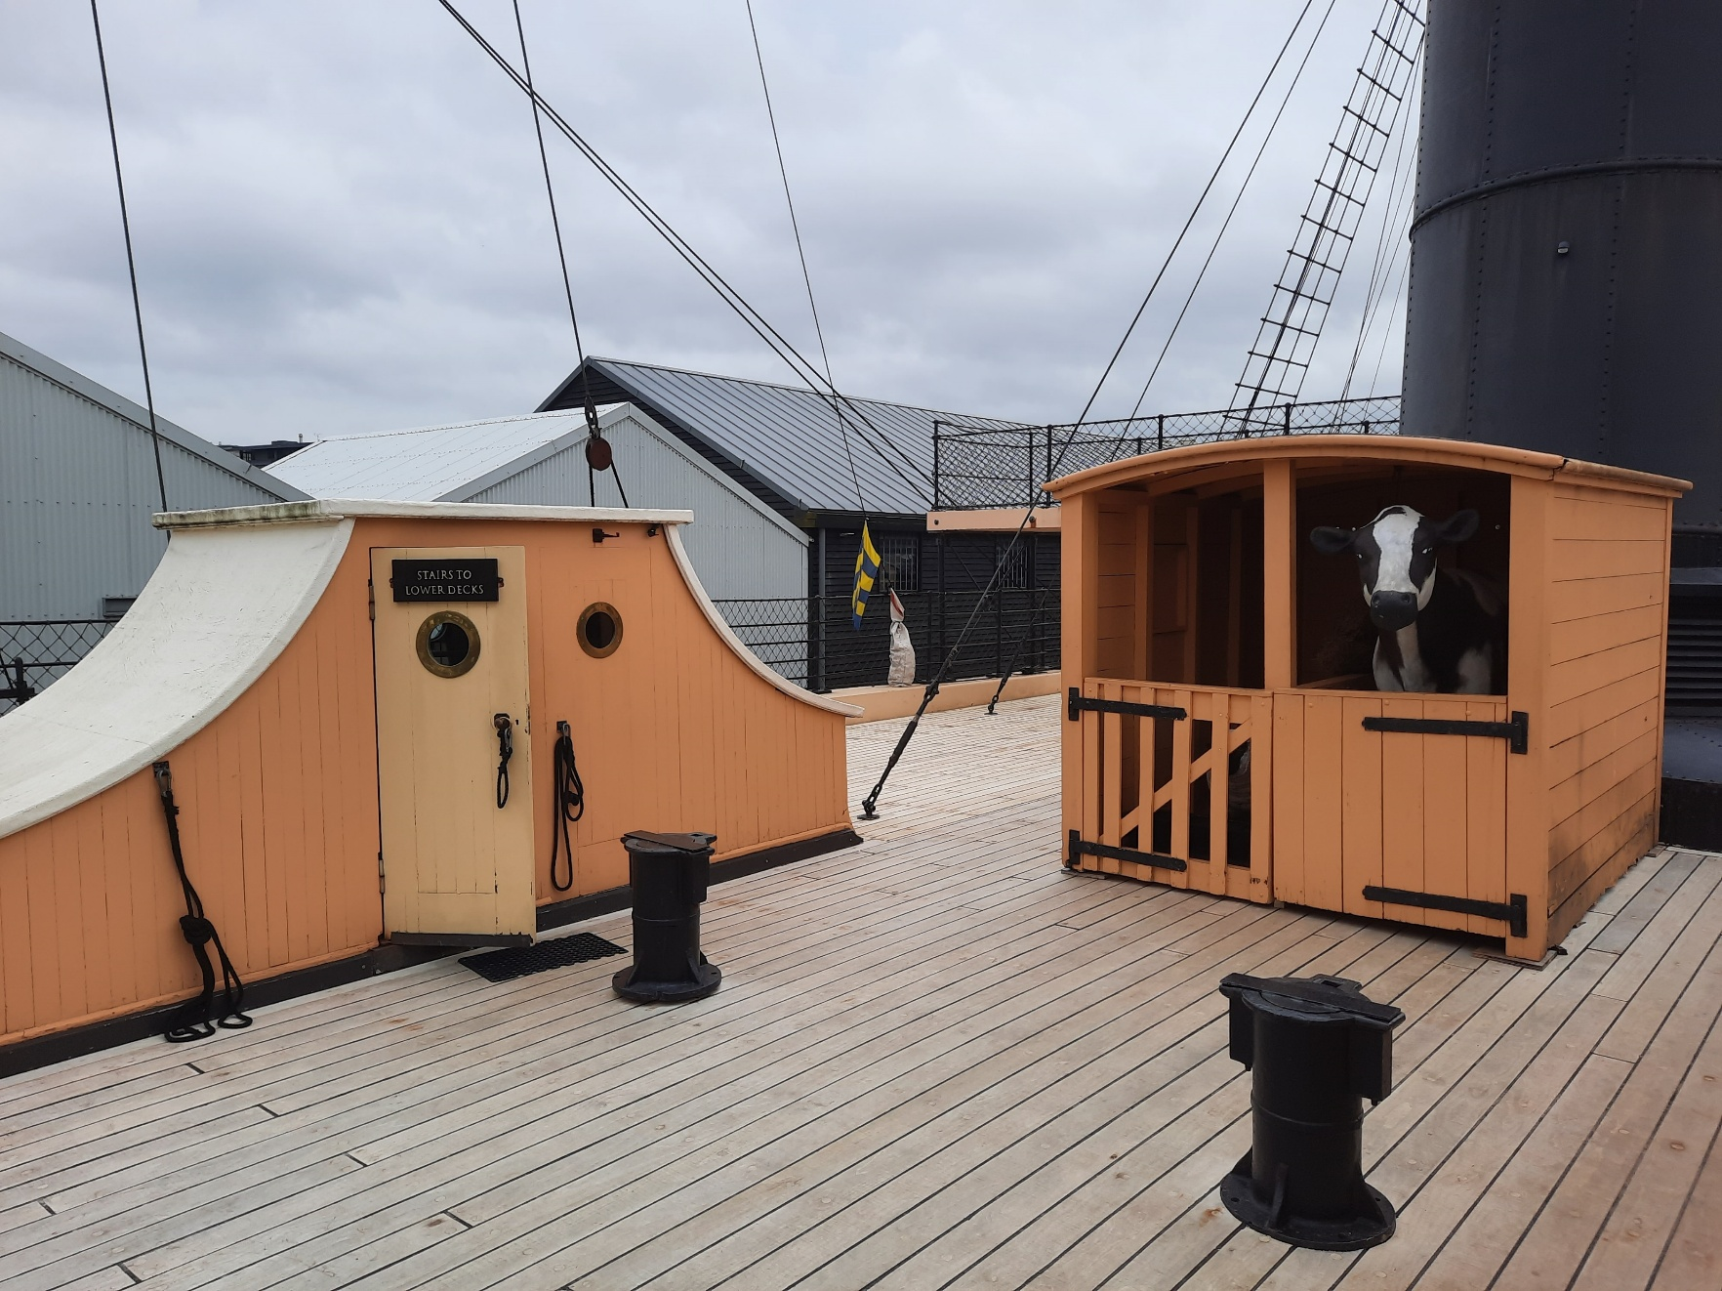
Places we might see or go to
We can go on the ship.
This is the weather deck, which is outside. We can also go inside the ship and explore two more decks.

Slide 9
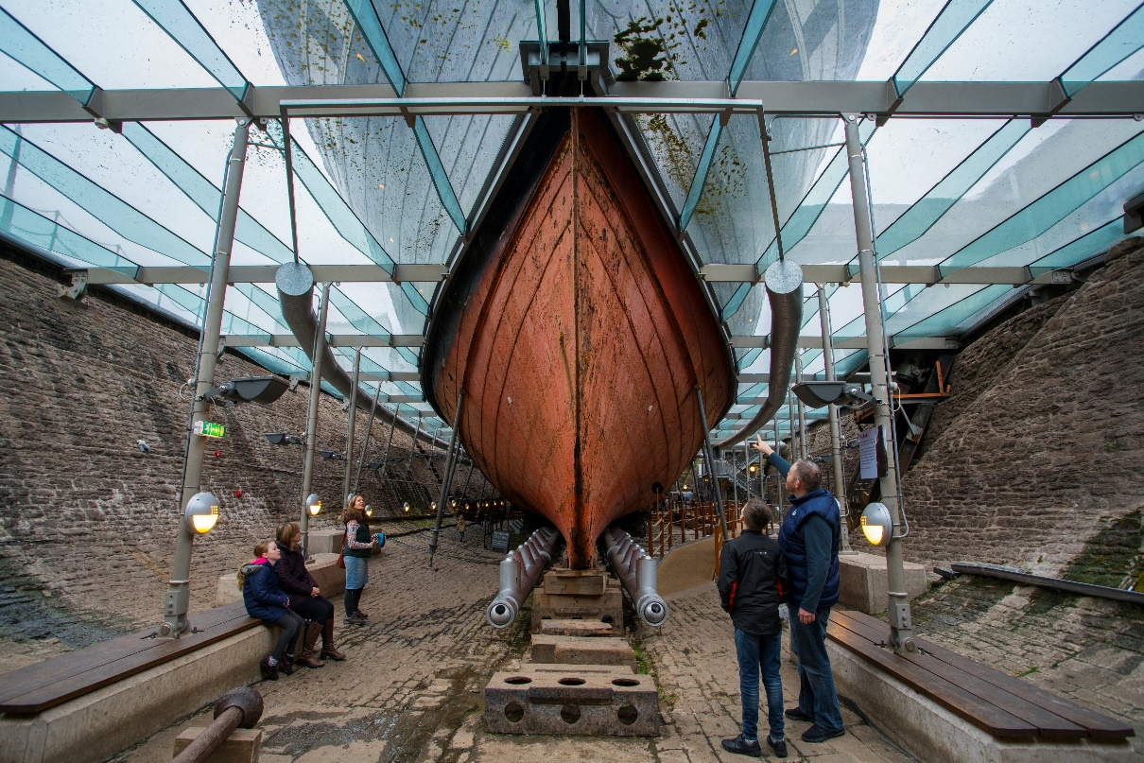
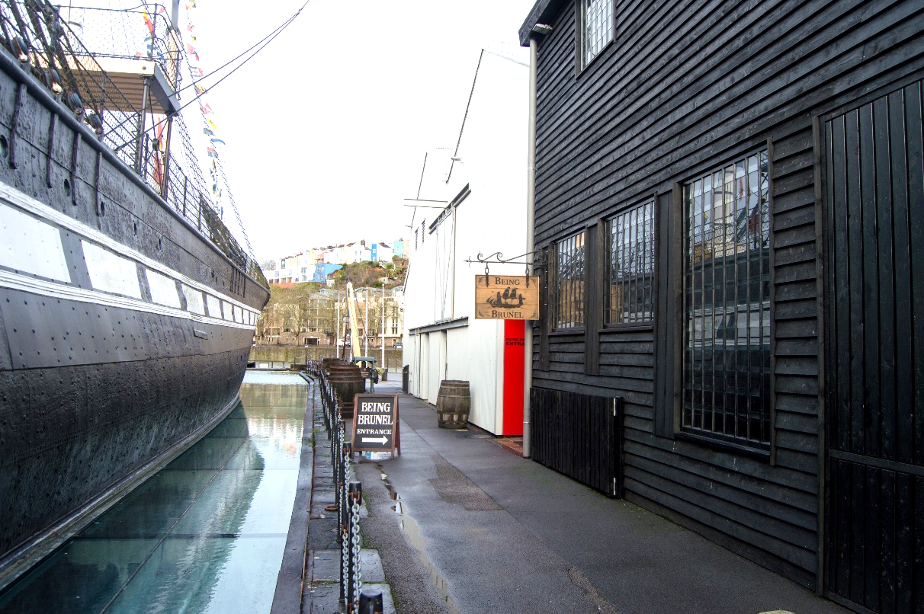
Places we might see or go to
We can go down into the Dry Dock underneath the ship.
We can see the hull of the ship up close and the propellor and feel the warm air protecting the ship.
This is the entrance to Being Brunel. In here we can find out more about Isambard Kingdom Brunel.

Slide 10
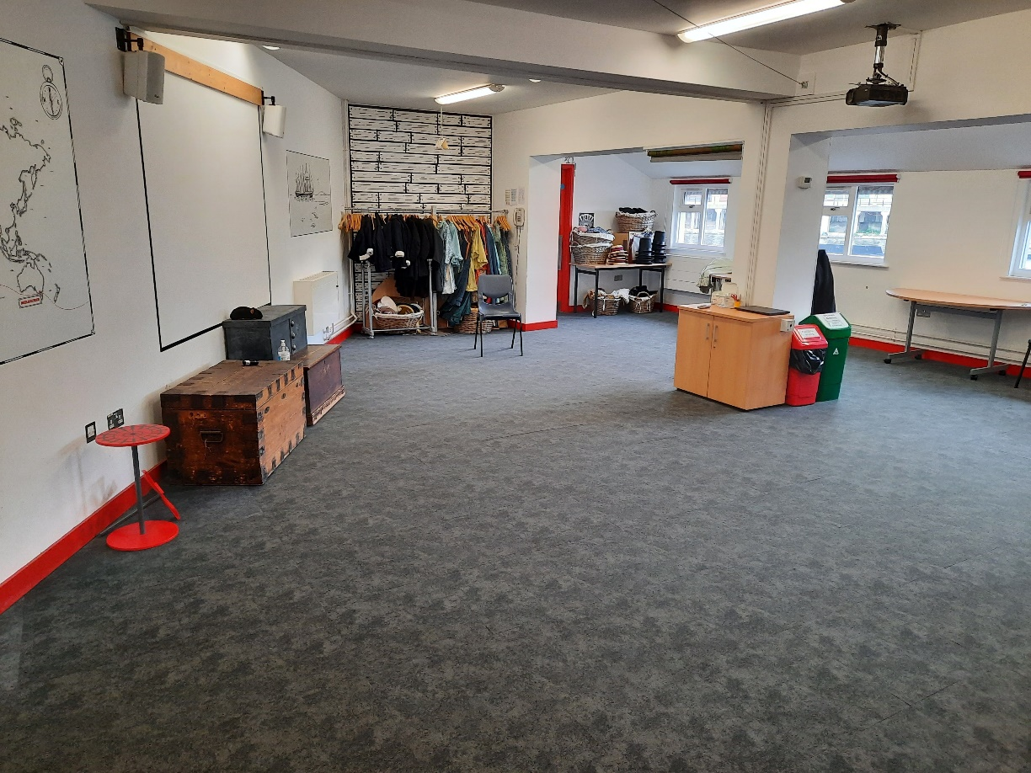
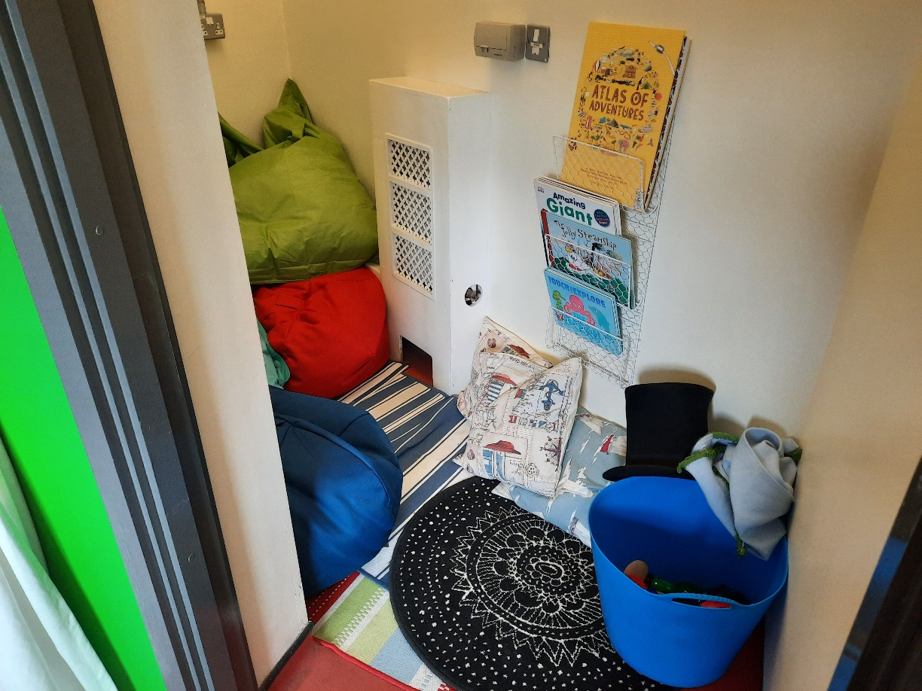
Places we might see or go to
This is the classroom. We might go in here to take part in a workshop with our class.
If we need a break there is a Quiet Room we can use.

Slide 11
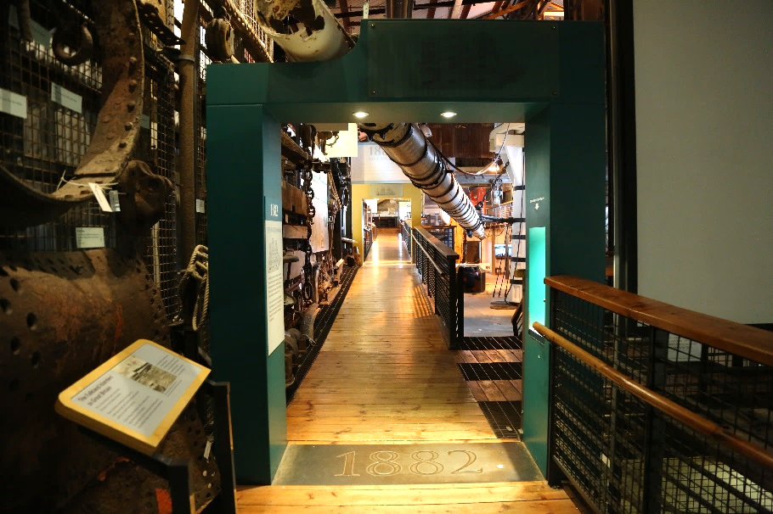
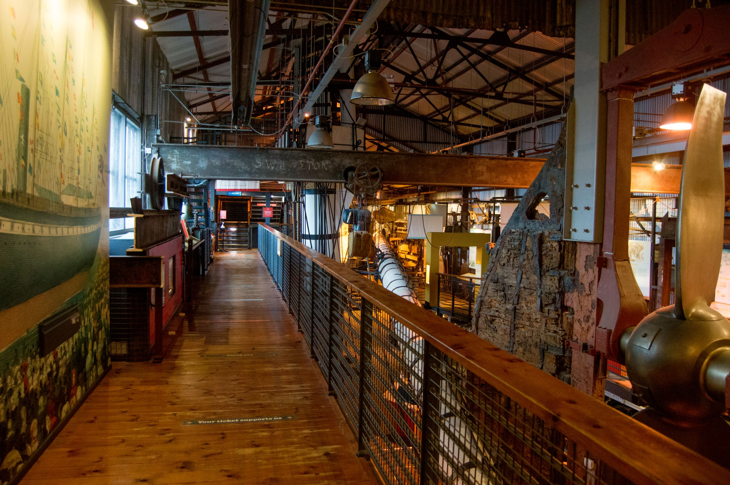
Inside the Dockyard Museum
The Dockyard Museum contains objects and pictures that tell us the story of the ship. We can dress up in Flash, Bang Wallop and climb steps to the crows’ nest at the top of the main mast.
We will follow the walkway then use the stairs or lift to reach the bridge which crosses over onto the ship.

Slide 12
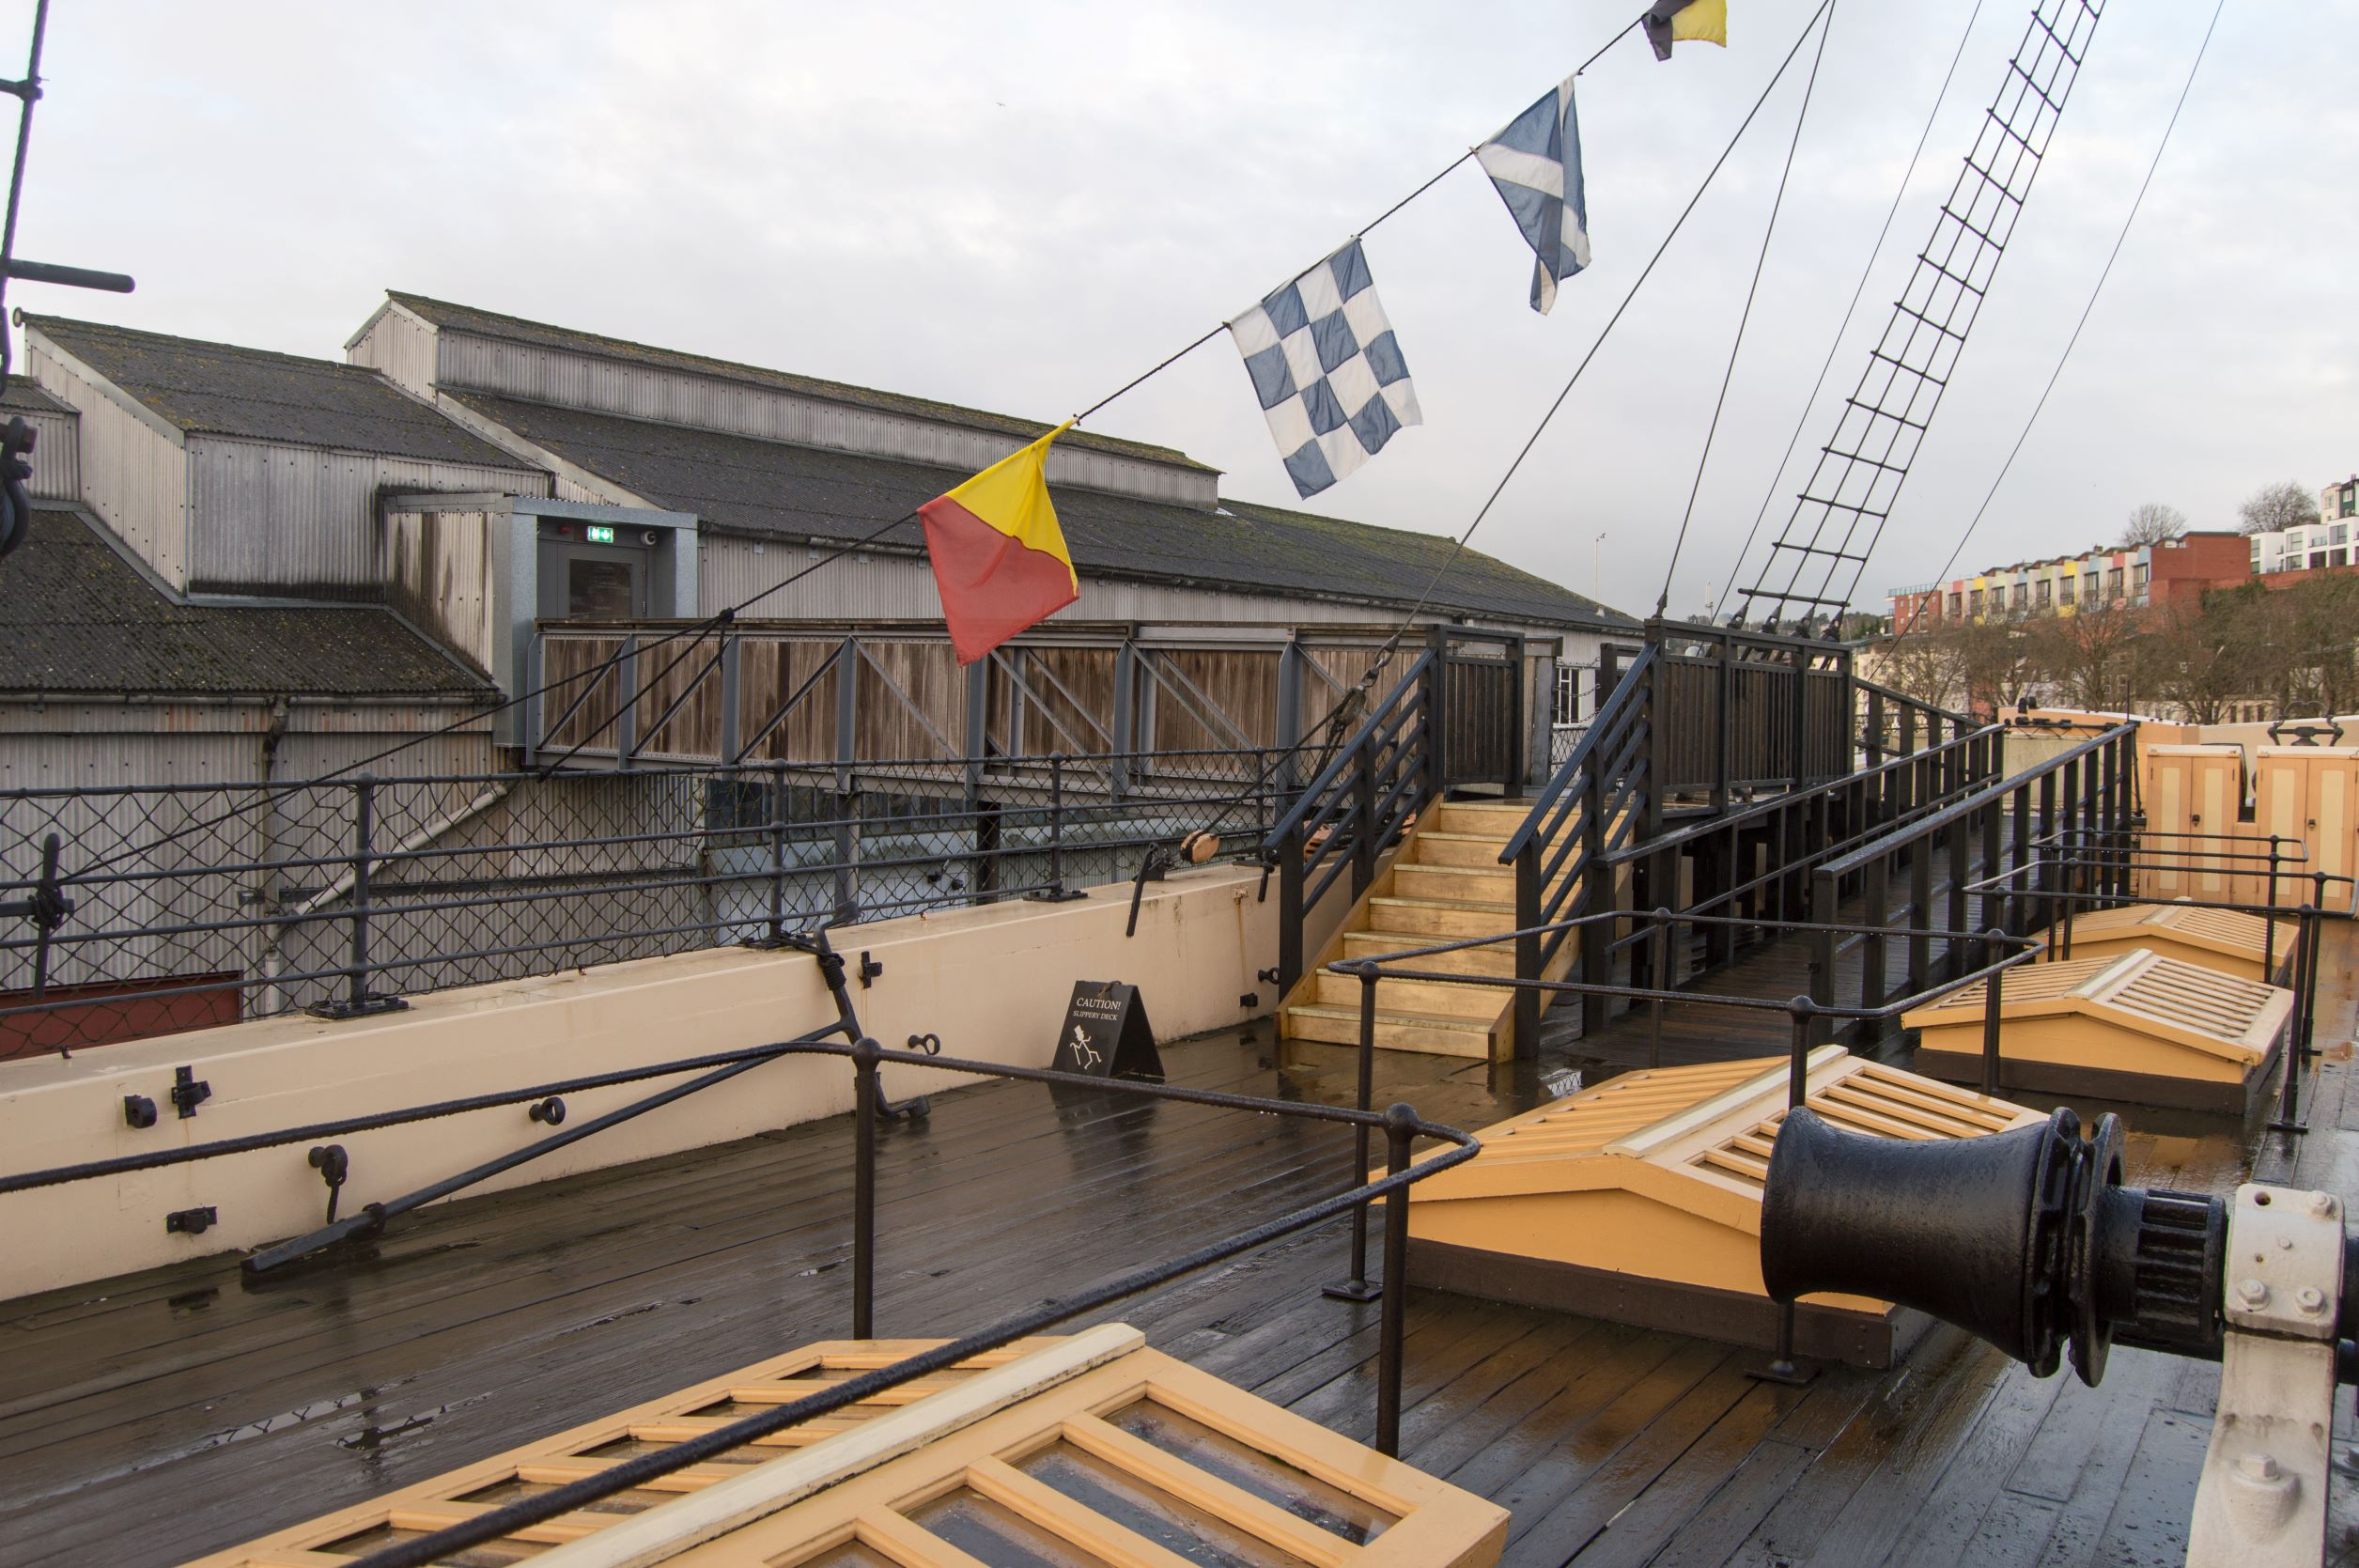

On the ship
This is the Weather deck. We can walk around the deck. We might find some plastic animals, see signal flags and Bristol Harbour.
We can go through a door like this one to get inside the ship. Steep steps lead us down to the promenade deck. There is a lift which also goes to the promenade deck.

Slide 13
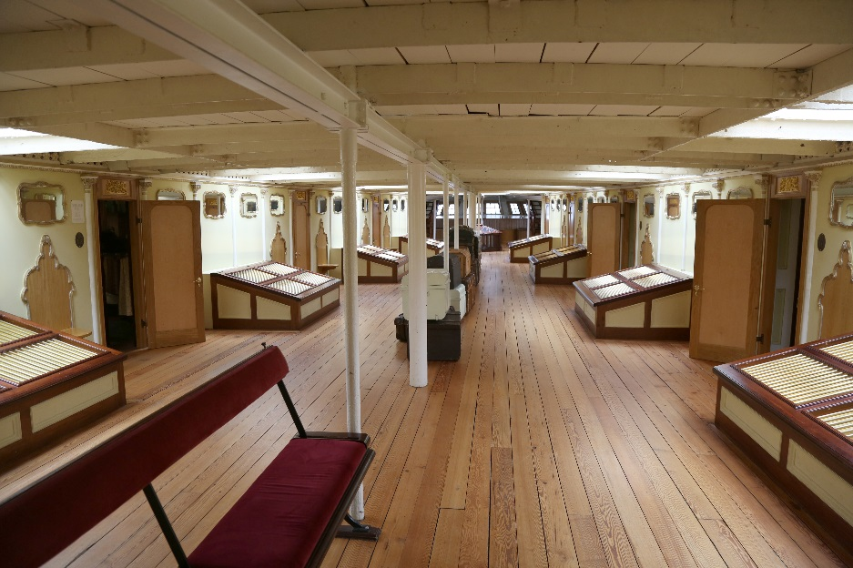
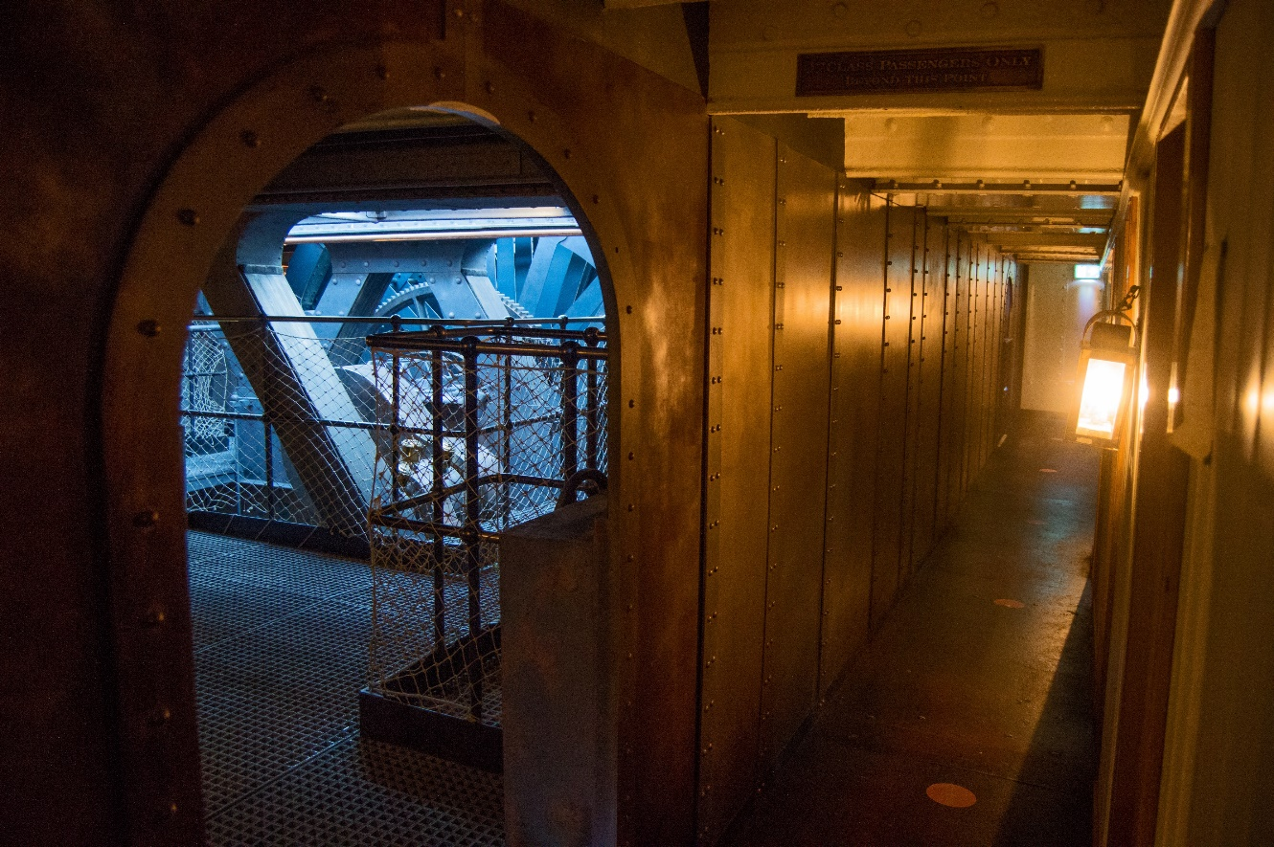
Some parts of the ship are light and open. This is the Promenade Saloon.
The floors are made of wooden planks which are sometimes uneven and have gaps between them but are completely safe.
Other parts might be dark and narrow.
This is the engine room. The floors here are made of metal.

Slide 14
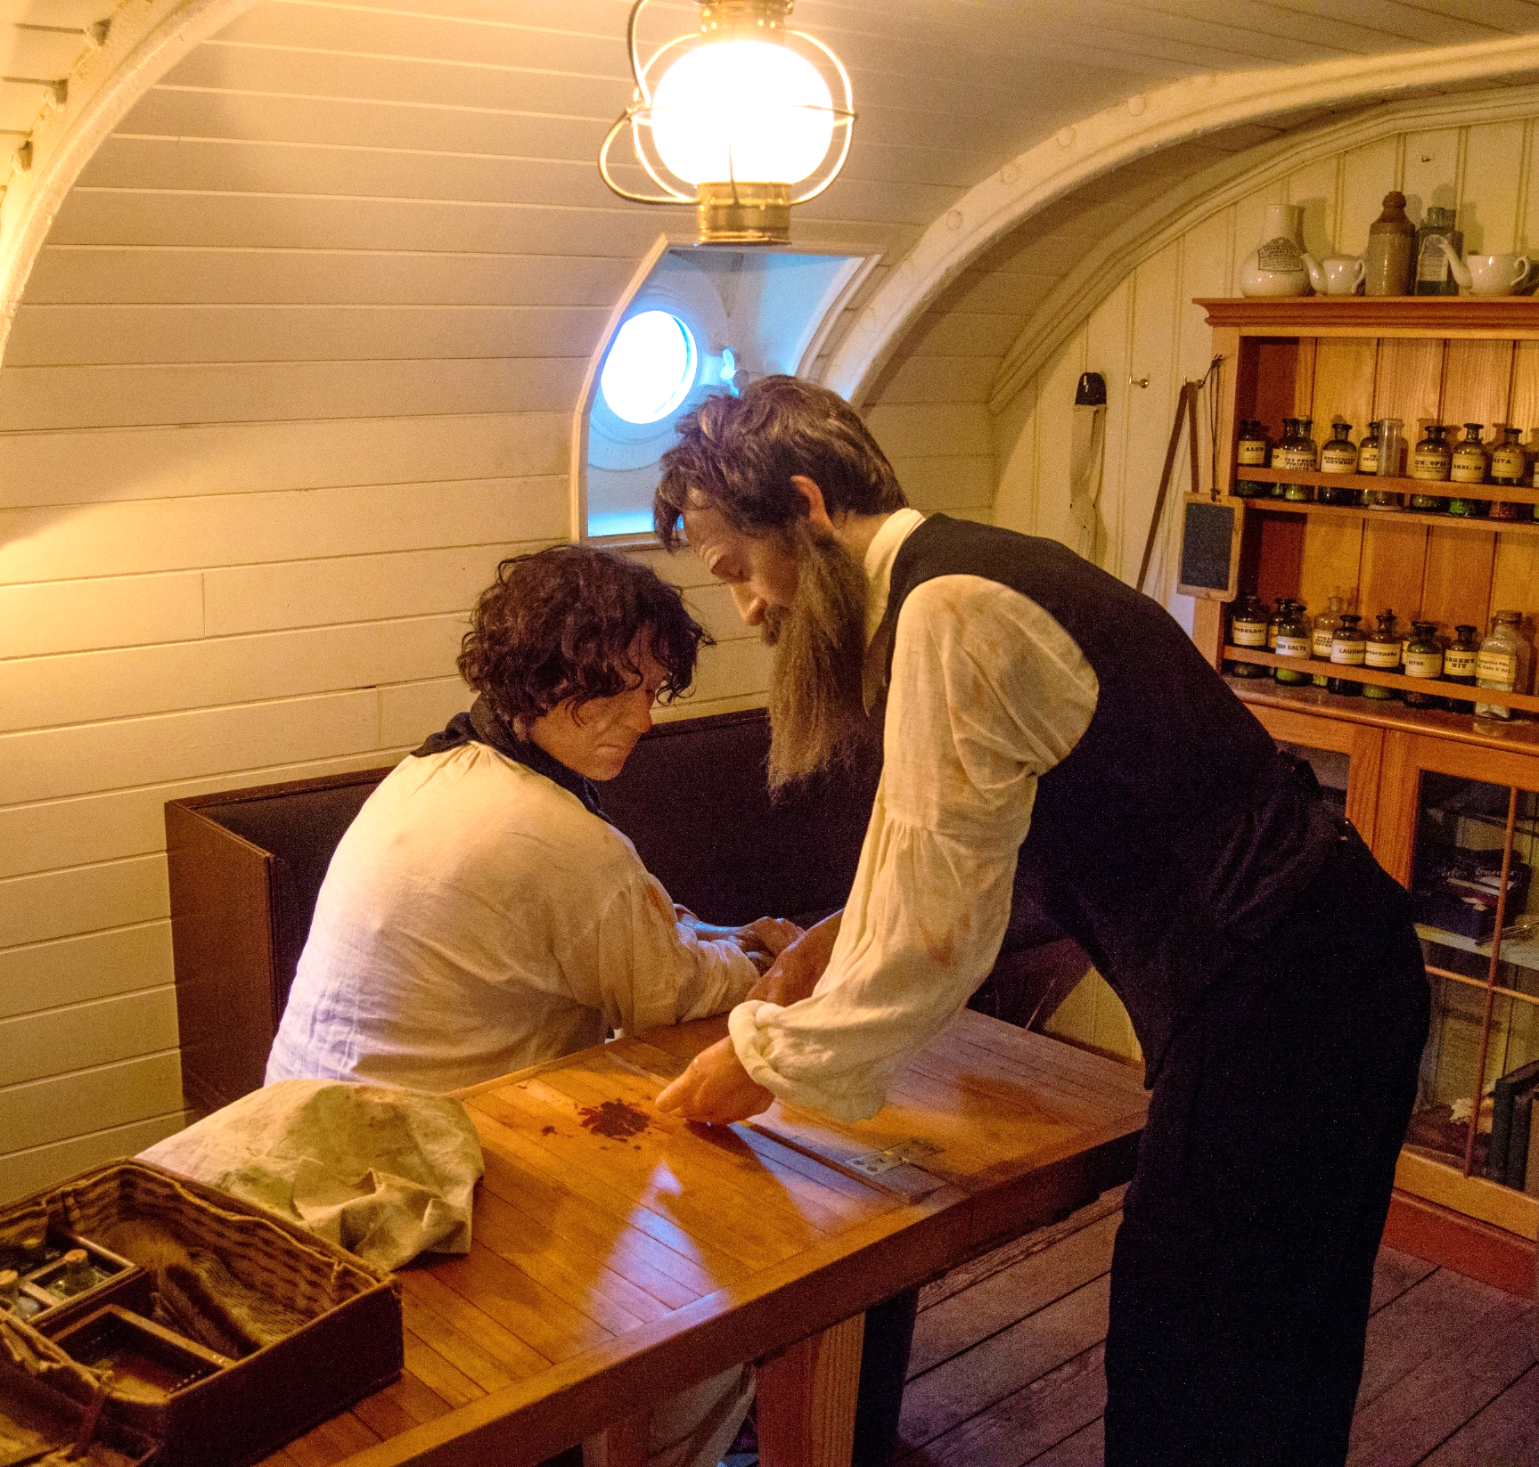
There are mannequins in many rooms on the ship. They represent real people who travelled on the ship in the past.
They are made of plastic and cannot move or speak.
The mannequin in this picture is of a doctor called Samuel Archer who travelled on the ship.

Slide 15
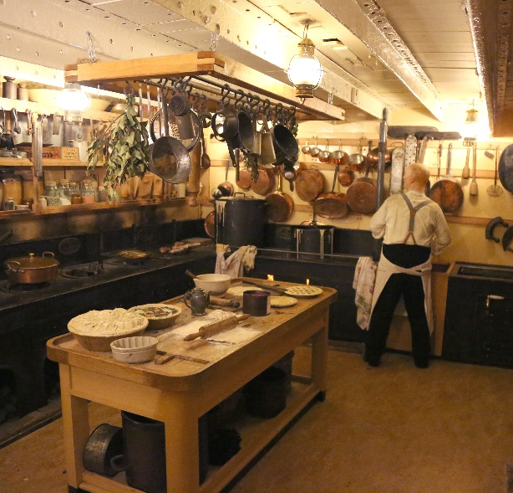
We will hear recordings of sounds like people talking, violins playing and babies crying.
We will smell unusual smells. These are designed to help us imagine what life was like in the past.
There are sounds and smells in most rooms. Some of the sounds play automatically and some are trigged by sensors as we pass by.

Slide 16
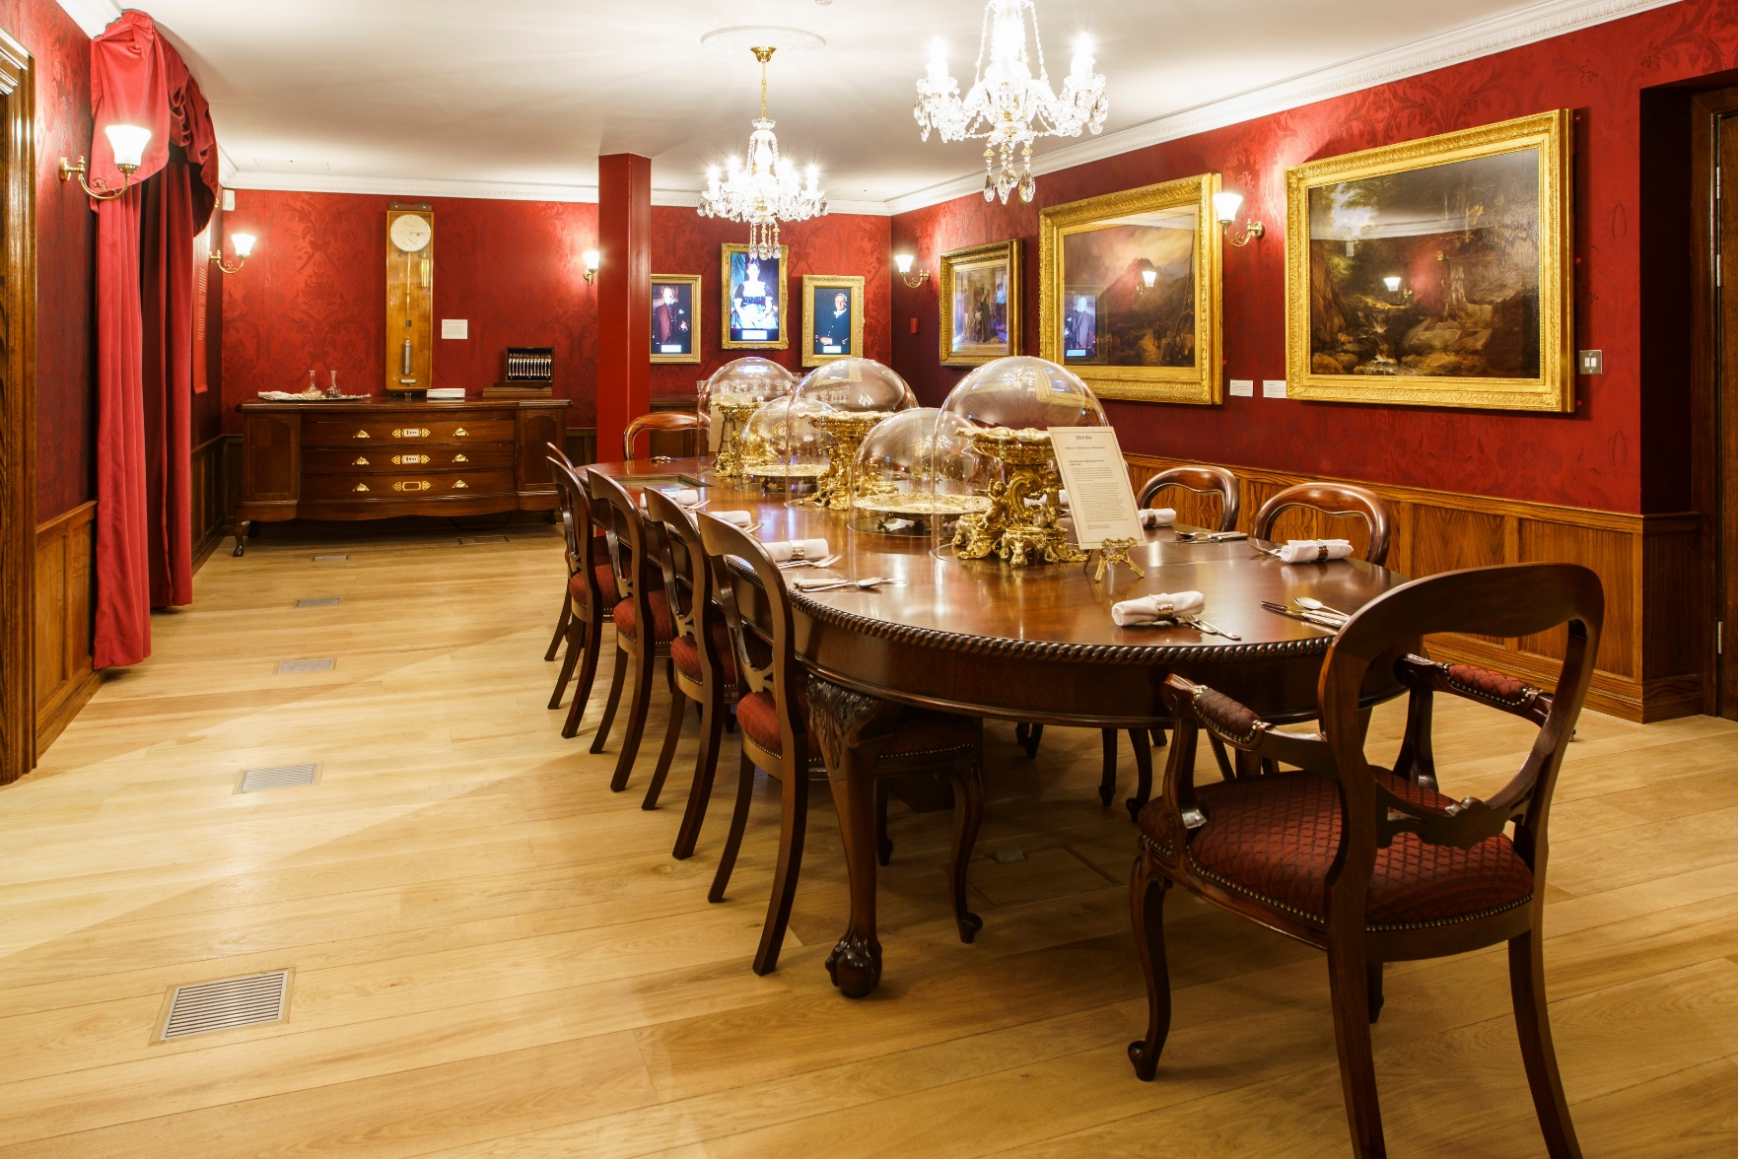
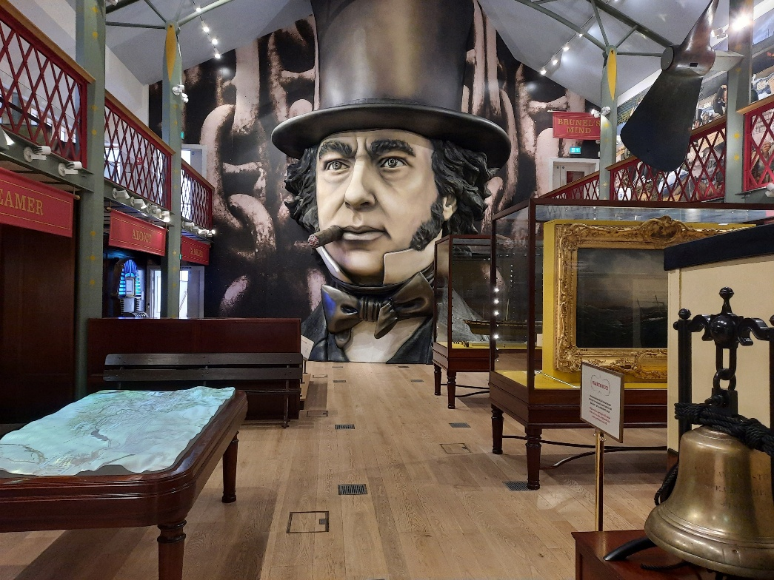
Inside Being Brunel
This is the first room in the museum. It is a recreation of Brunel’s Dining Room at his house in London.
We can watch videos of actors playing his family members and play games on computers in the table.
This is the main room in the museum. We can learn about Brunel’s projects.
There are drawers we can open and there is a railway carriage we can go inside that slowly rocks as if it was moving on a railway line.

Slide 17
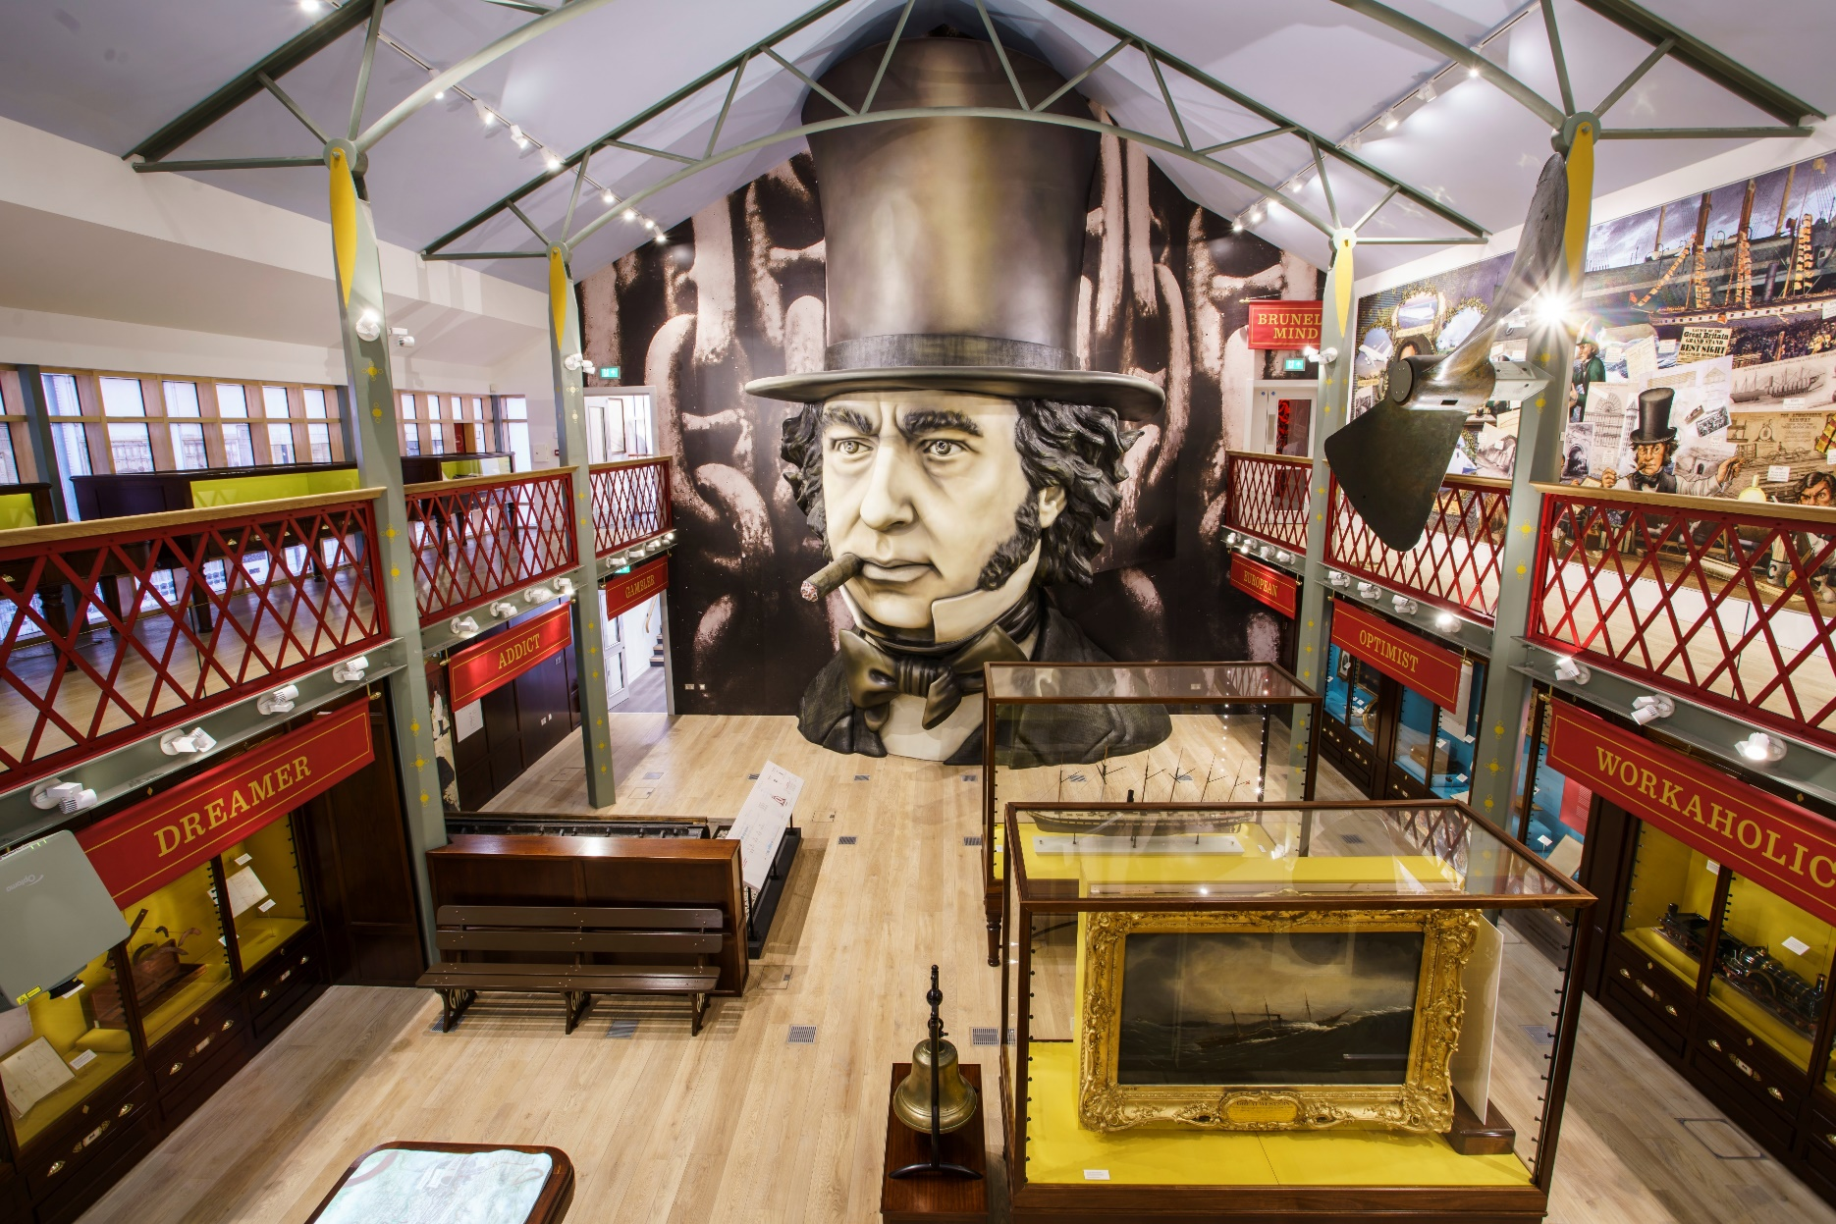
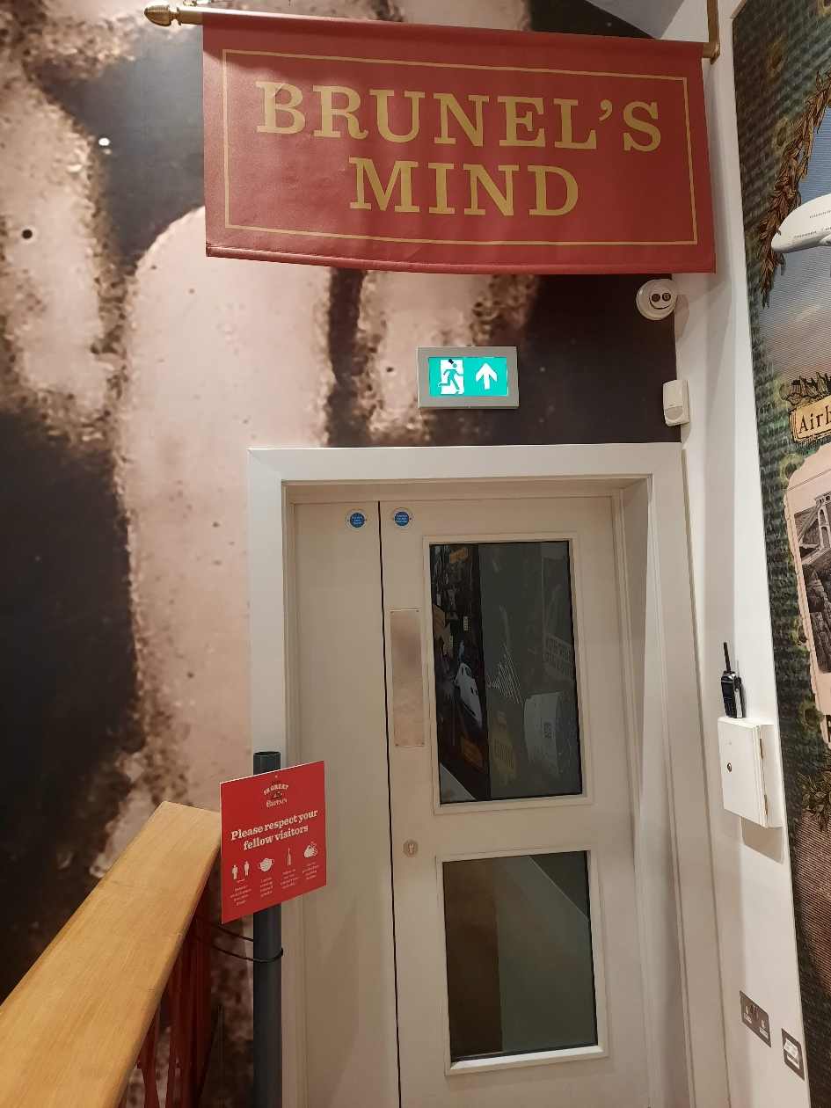
On the first floor of the main room, we have a choice where to explore next.
There is always a member of staff or a volunteer in the museum, and they can help us, and our helpers, choose which parts of the museum to explore next.
With our helpers we can choose to go through the door and watch a video about Brunel.

Slide 18
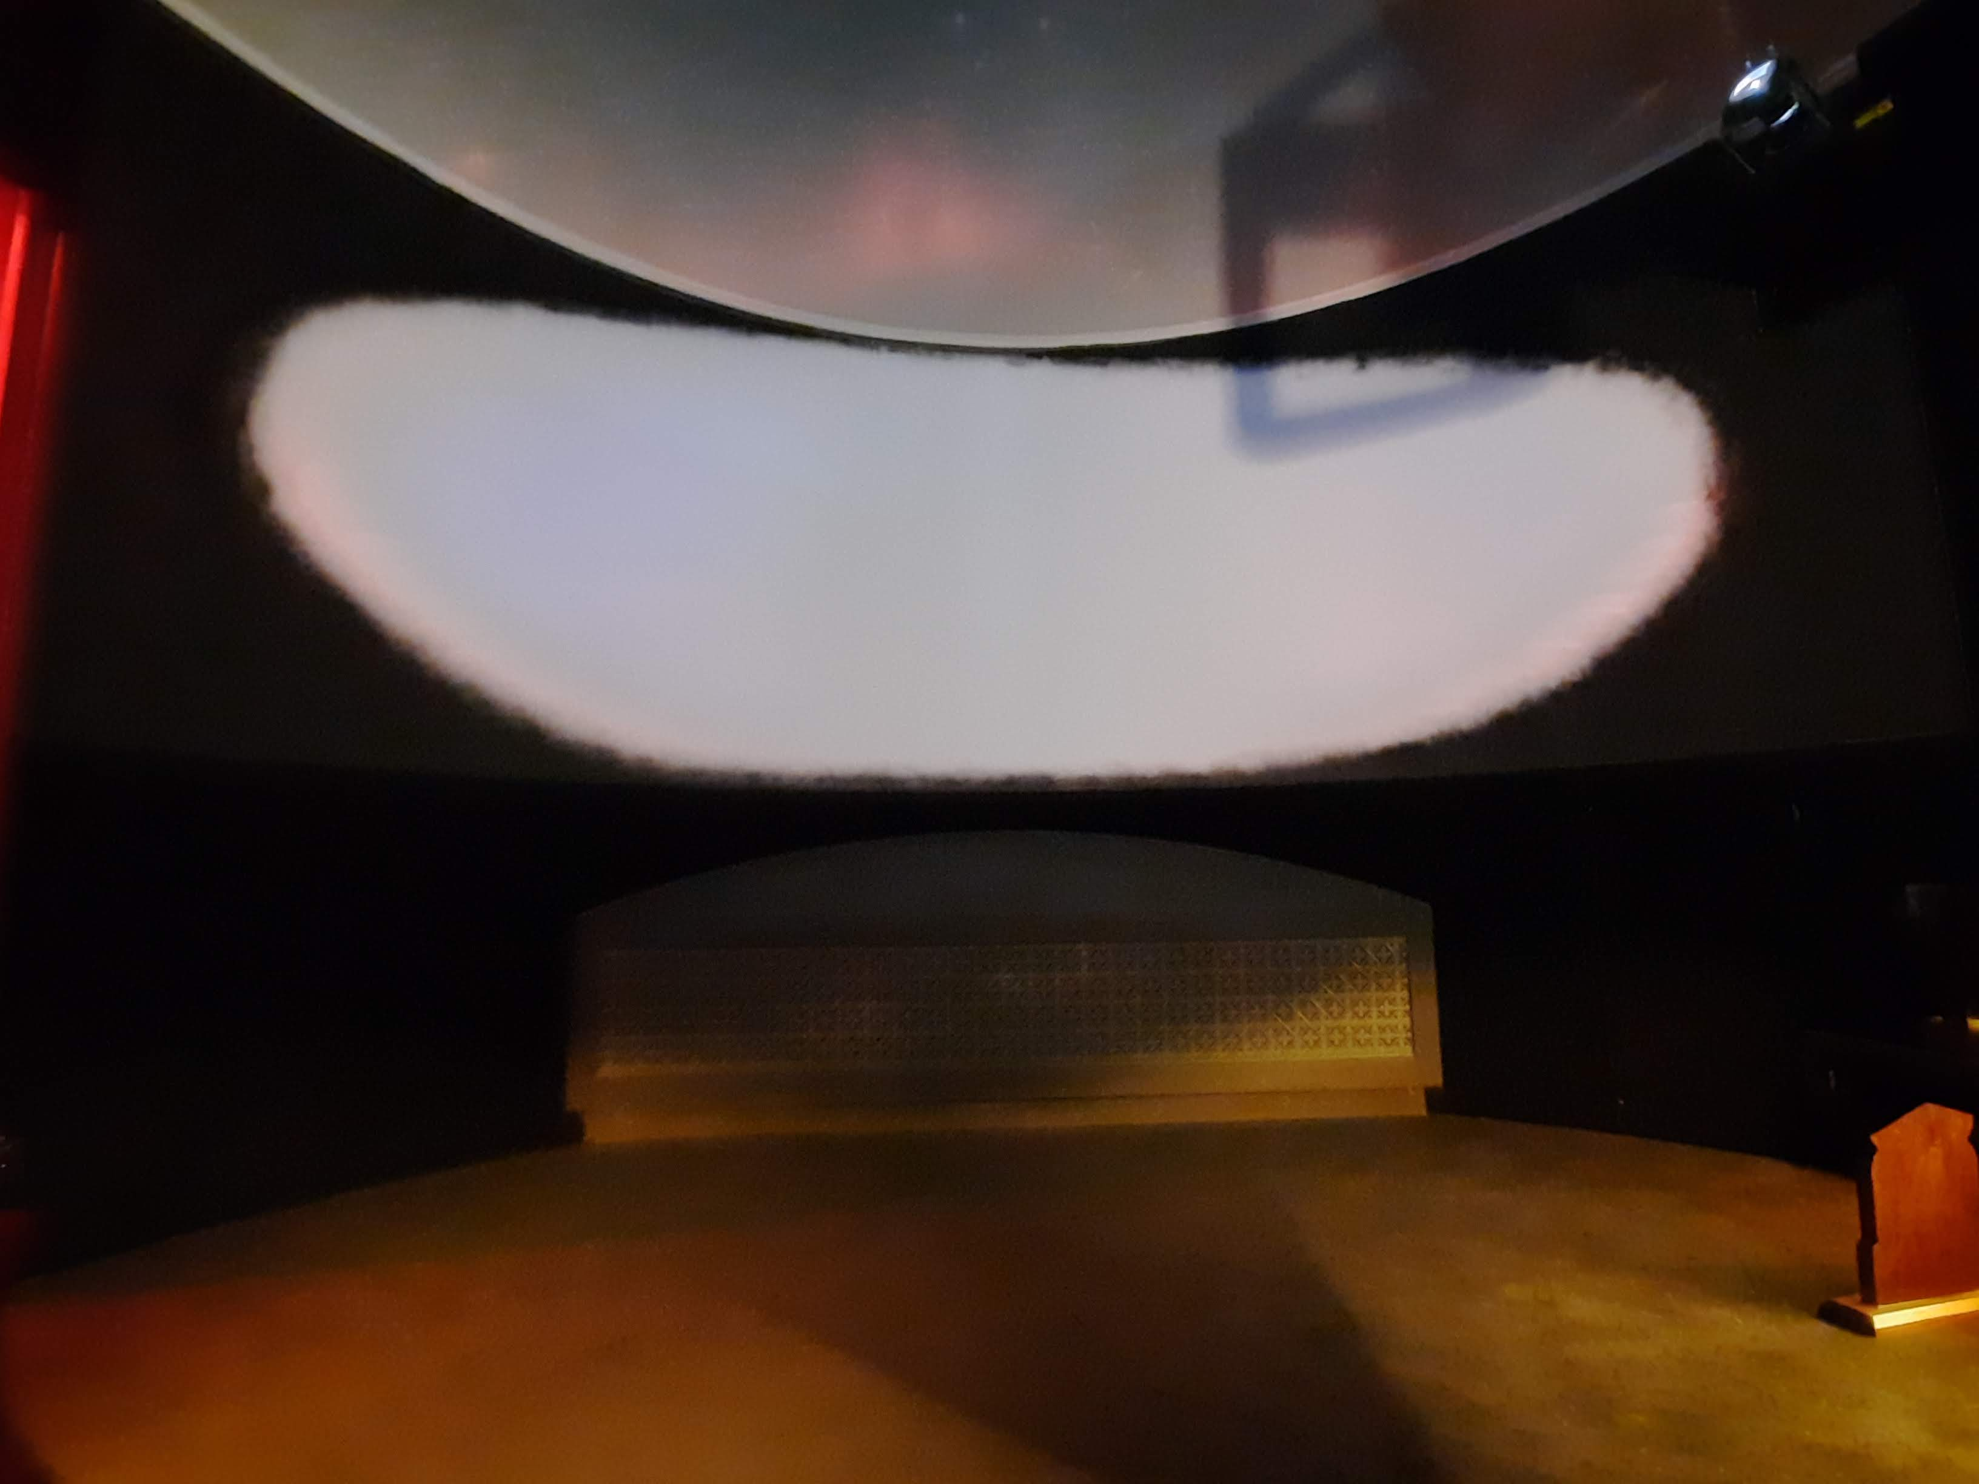
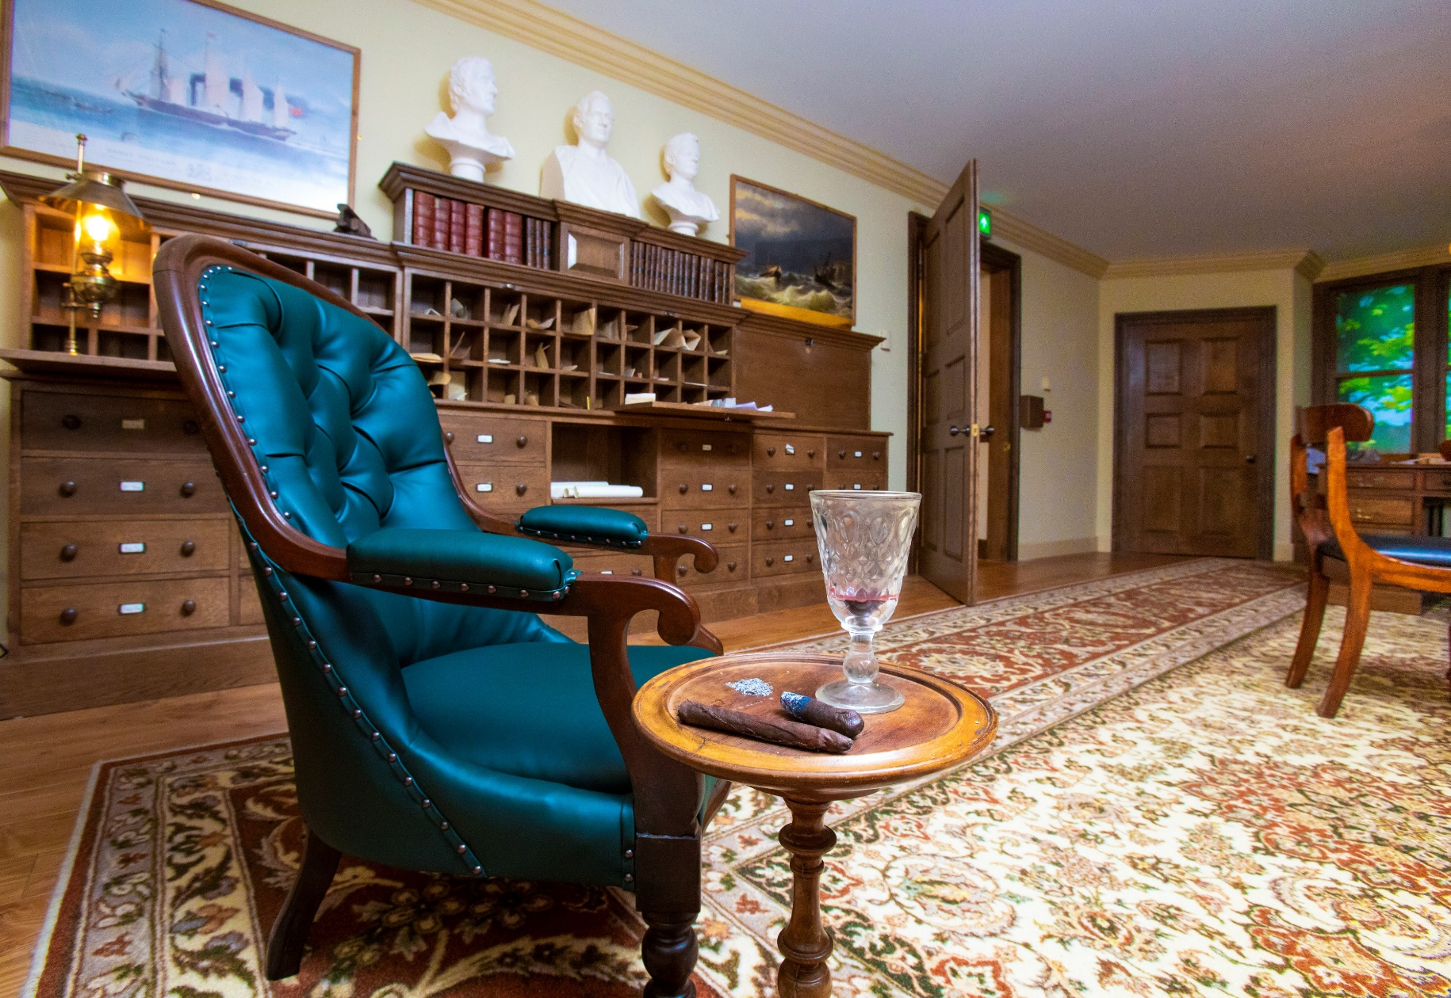
Inside Brunel’s Mind, the room is dark, and the video is from Brunel’s point of view and features flashing lights and smoke effects.
If we don’t want to watch the video, we can walk through and into the next room.
We might choose to visit Brunel’s office. We can sit in his chair and read his letters.

Slide 19
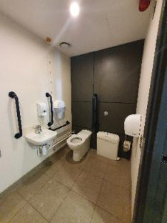
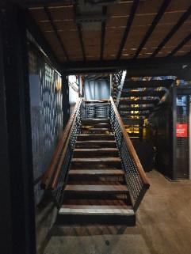
Useful Places
There are male, female and accessible toilets in the Visitor Centre, Dockyard Museum and on the lowest deck of the ship. There is an accessible toilet in the entrance to Being Brunel.
In the Visitor Centre toilets there are both paper towels and hand driers.
There are lots of wooden stairs, like these in the Dockyard Museum.

Slide 20
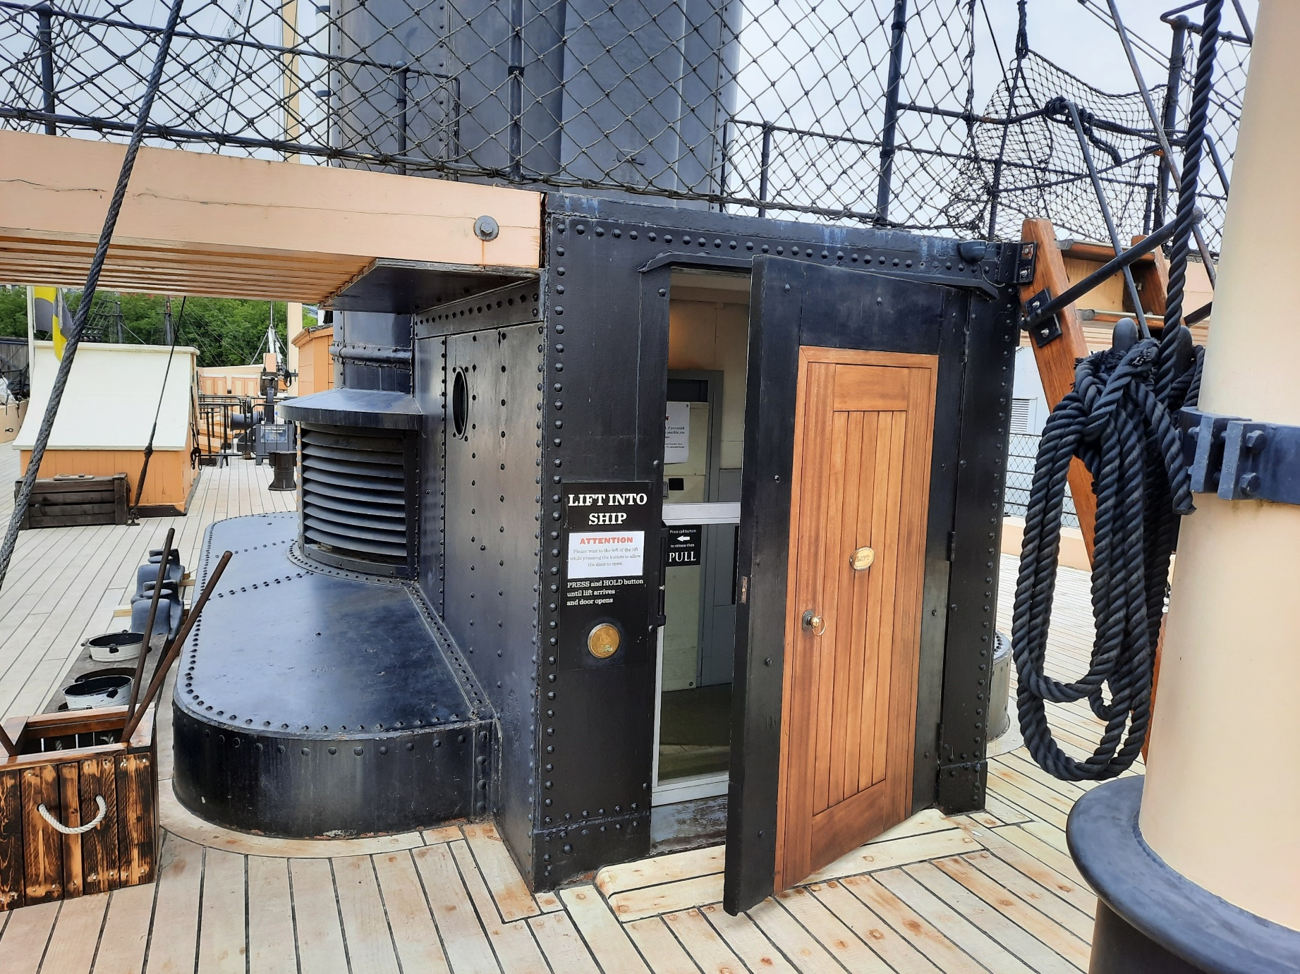
All areas can be accessed by lifts, like this one on the weather deck of the ship.
If we hear a loud alarm at any point in our visit, we should stand still, quietly and calmly. A member of staff will tell us what to do and where to go.

Slide 21
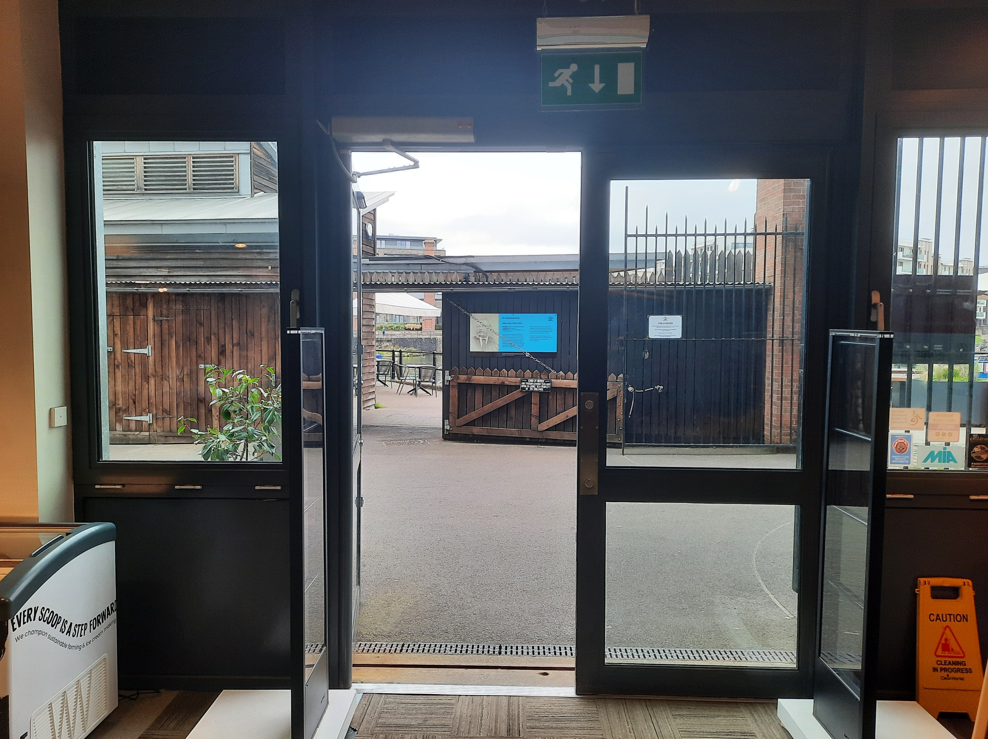

When it is time to go back to school
We will leave together by walking through the shop.
Then we will walk to the bus in the car park.
The bus will then take us back to school.

Slide 22
To discuss specific access or educational needs please call 0117 926 0680 and ask to speak to the Education Team.
Brunel’s SS Great Britain
Great Western Dockyard
Bristol England
United Kingdom
BS1 6TY
Tel: 0117 926 0680
Email: learning@ssgreatbritain.org
Web: ssgreatbritain.org
Photographs by: Adam Gasson, Lottie Morris, Leila Nichols, John Polatch and Sarah Trubshawe
Registered Charity - No. 262158

