Slide 1
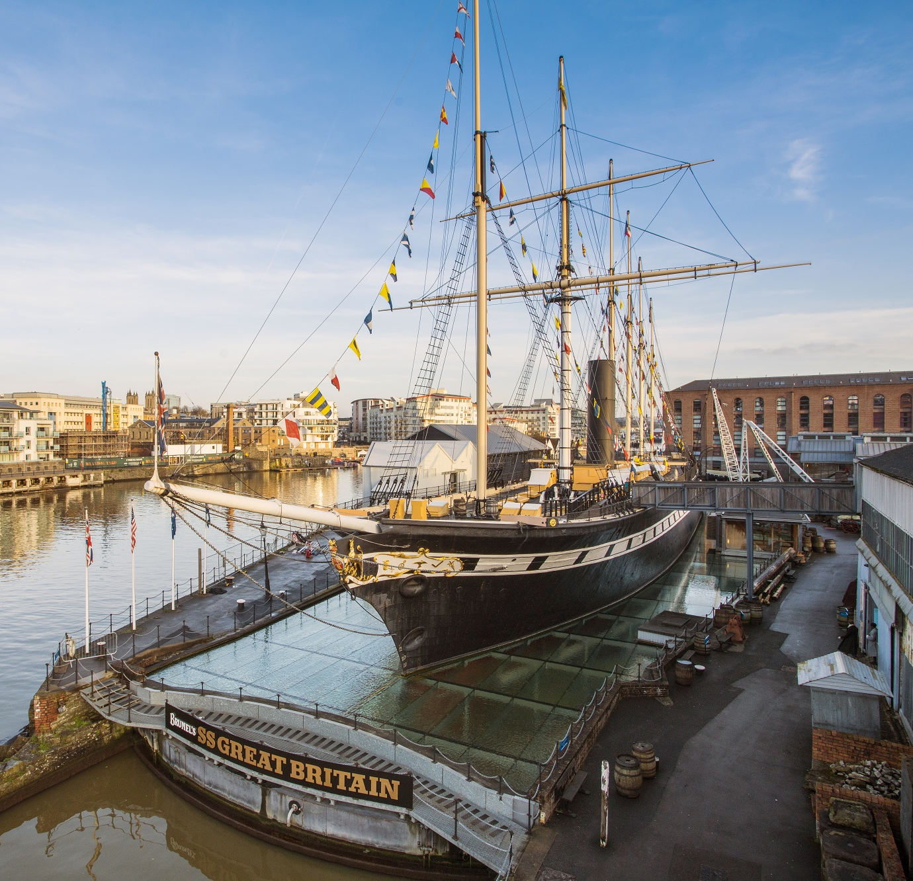
Visual Timetable

Slide 2
Visual Timetable: Information for grown ups
The images on the next page can be used for a visual timetable.
They can either be edited and used digitally or printed off and cut out.
There are timetable templates on pages 4 – 6, or you can use an existing timetable.

Slide 3
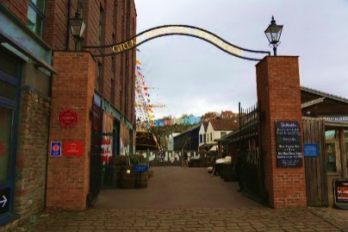
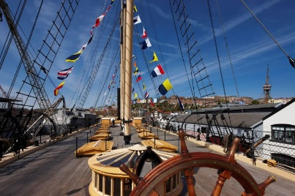
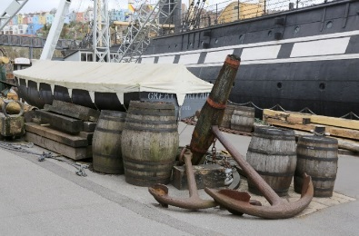
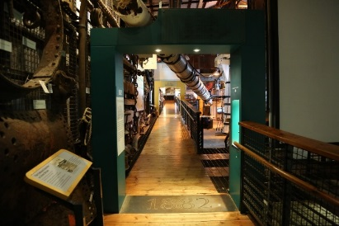
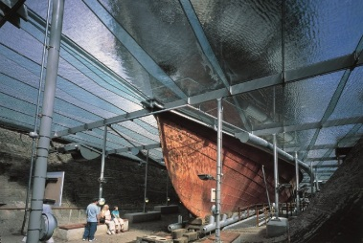
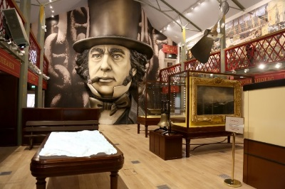
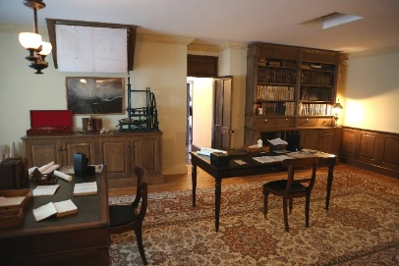
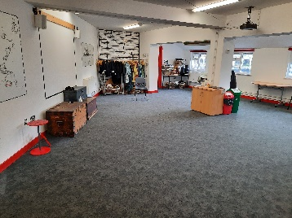
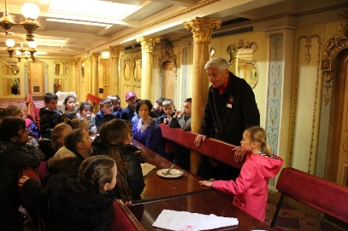
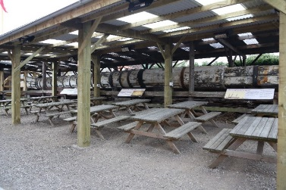
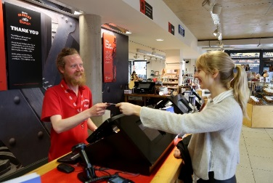
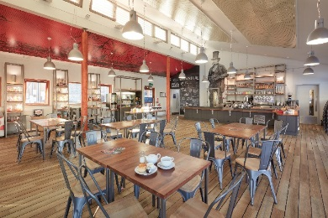
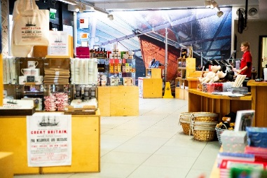
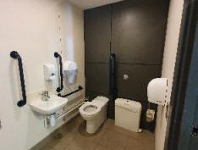
SS Great Britain Entrance
The Ship
The Great Western Dockyard
The Dockyard Museum
Dry Dock
Being Brunel Museum
Dock Office
School Workshop
Guided Tour
Lunch Area
Visitor Centre
Harbourside Kitchen
Shop
Toilet

Slide 4
Today I will visit the SS Great Britain

Slide 5
Today I will visit the SS Great Britain
First: | Next: | Then:

Slide 6
Today I will visit the SS Great Britain

