Slide 1
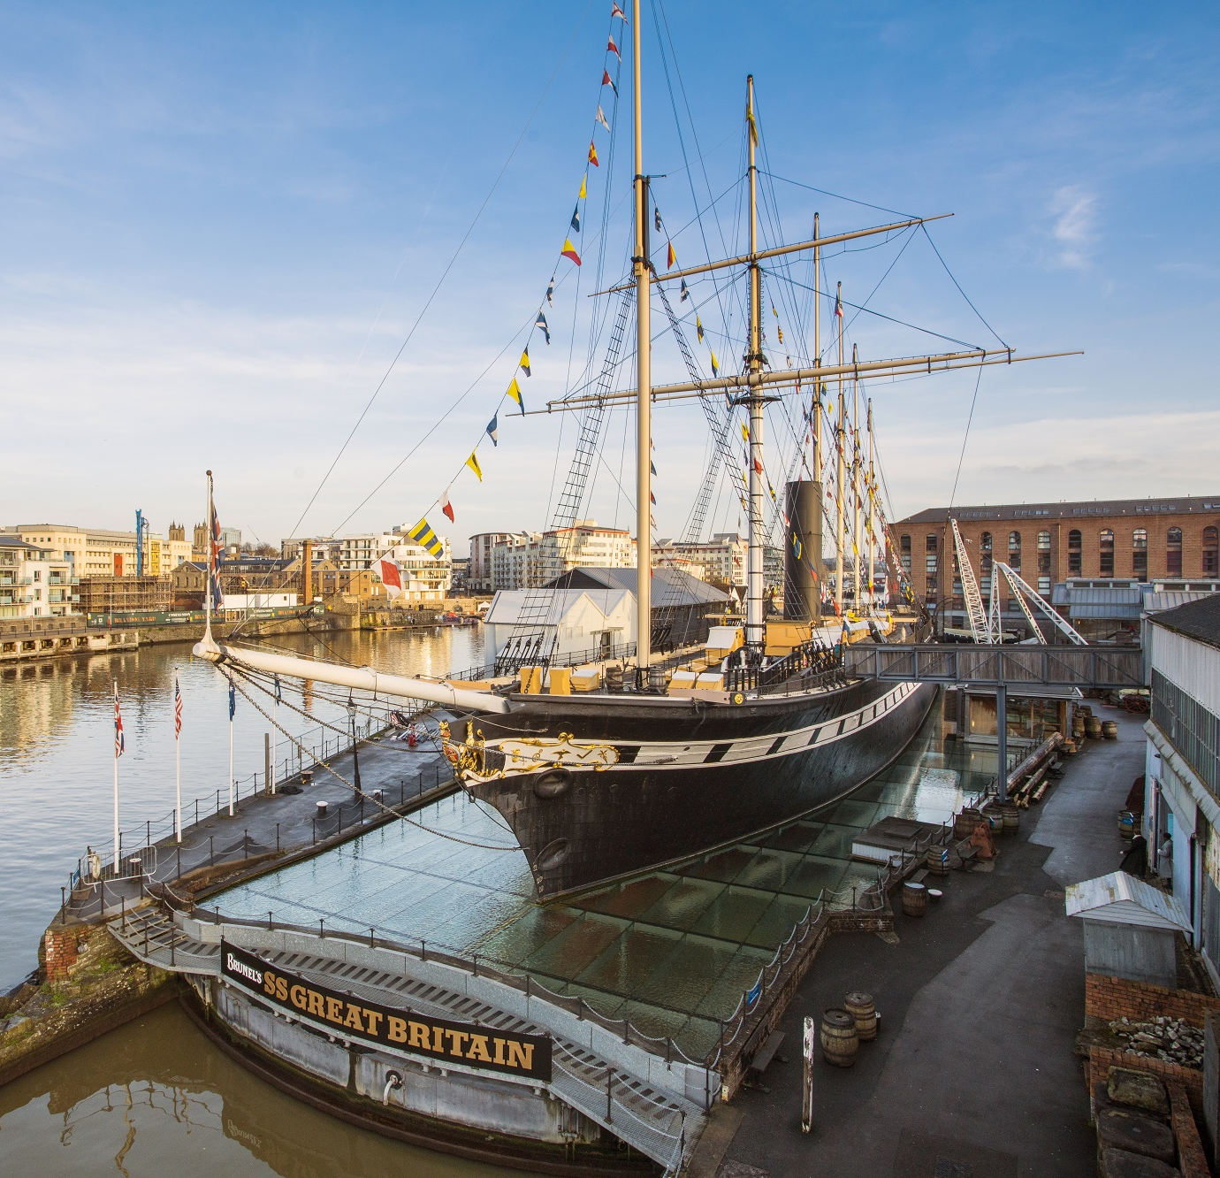

PREPARING
FOR YOUR
VISIT
Visual Timetable

Slide 2
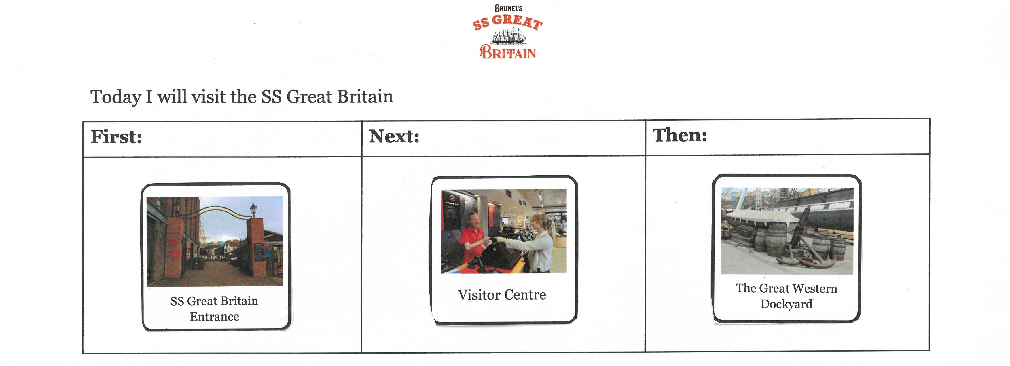
Visual Timetable: Information for grown ups
The images on the next page can be used for a visual timetable.
They can either be edited and used digitally or printed off and cut out.
There are timetable templates on pages 4 – 6, or you can use an existing timetable.

Slide 3
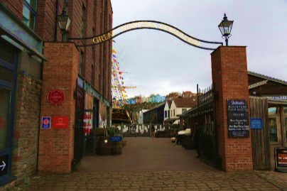
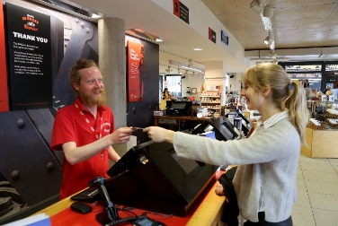
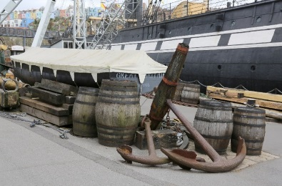
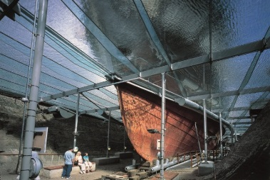
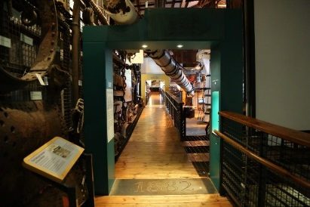
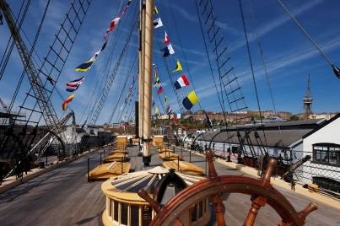
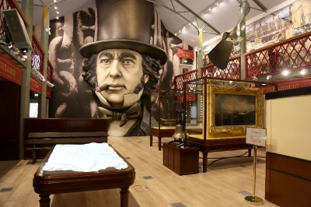
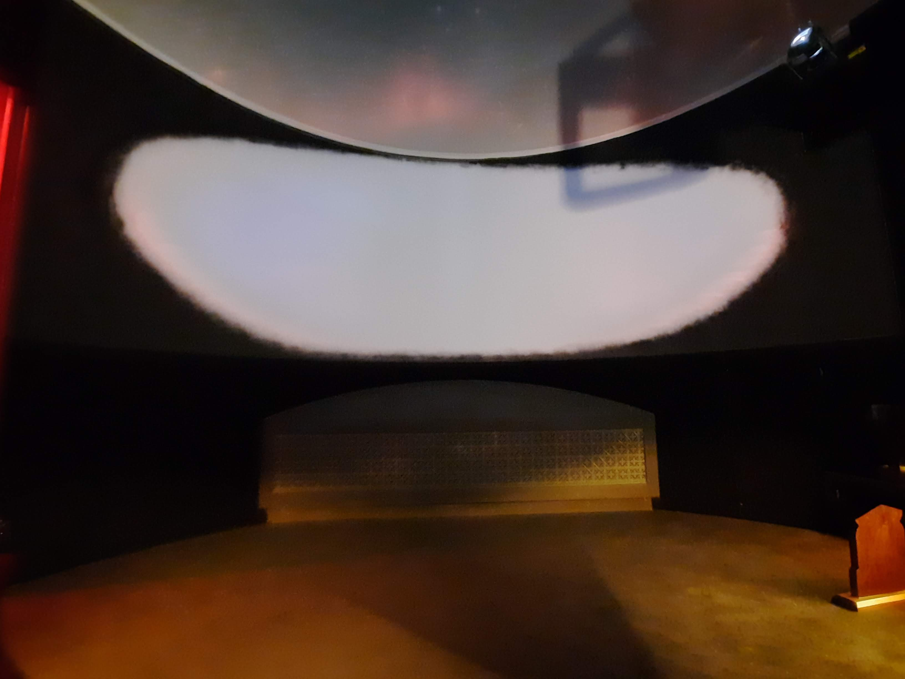
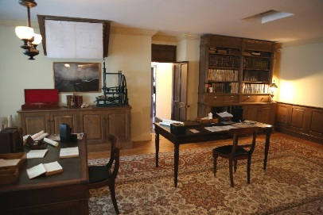
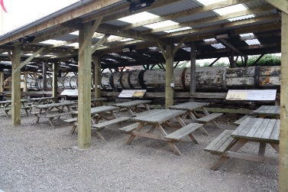
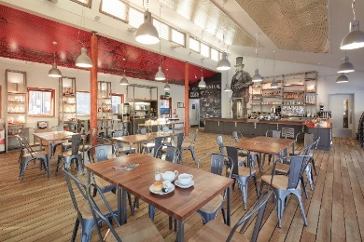
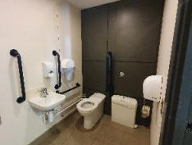
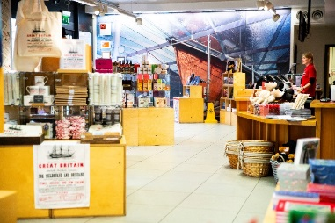
SS Great Britain Entrance
Visitor Centre
The Great Western Dockyard
Dry Dock
The Dockyard Museum
The Ship
Being Brunel Museum
The Mind
Dock Office
Lunch Area
Harbourside Kitchen
Toilet
Shop

Slide 4

Today I will visit the SS Great Britain

Slide 5
Today I will visit the SS Great Britain
First: | Next: | Then:

Slide 6
Today I will visit the SS Great Britain

