Slide 1
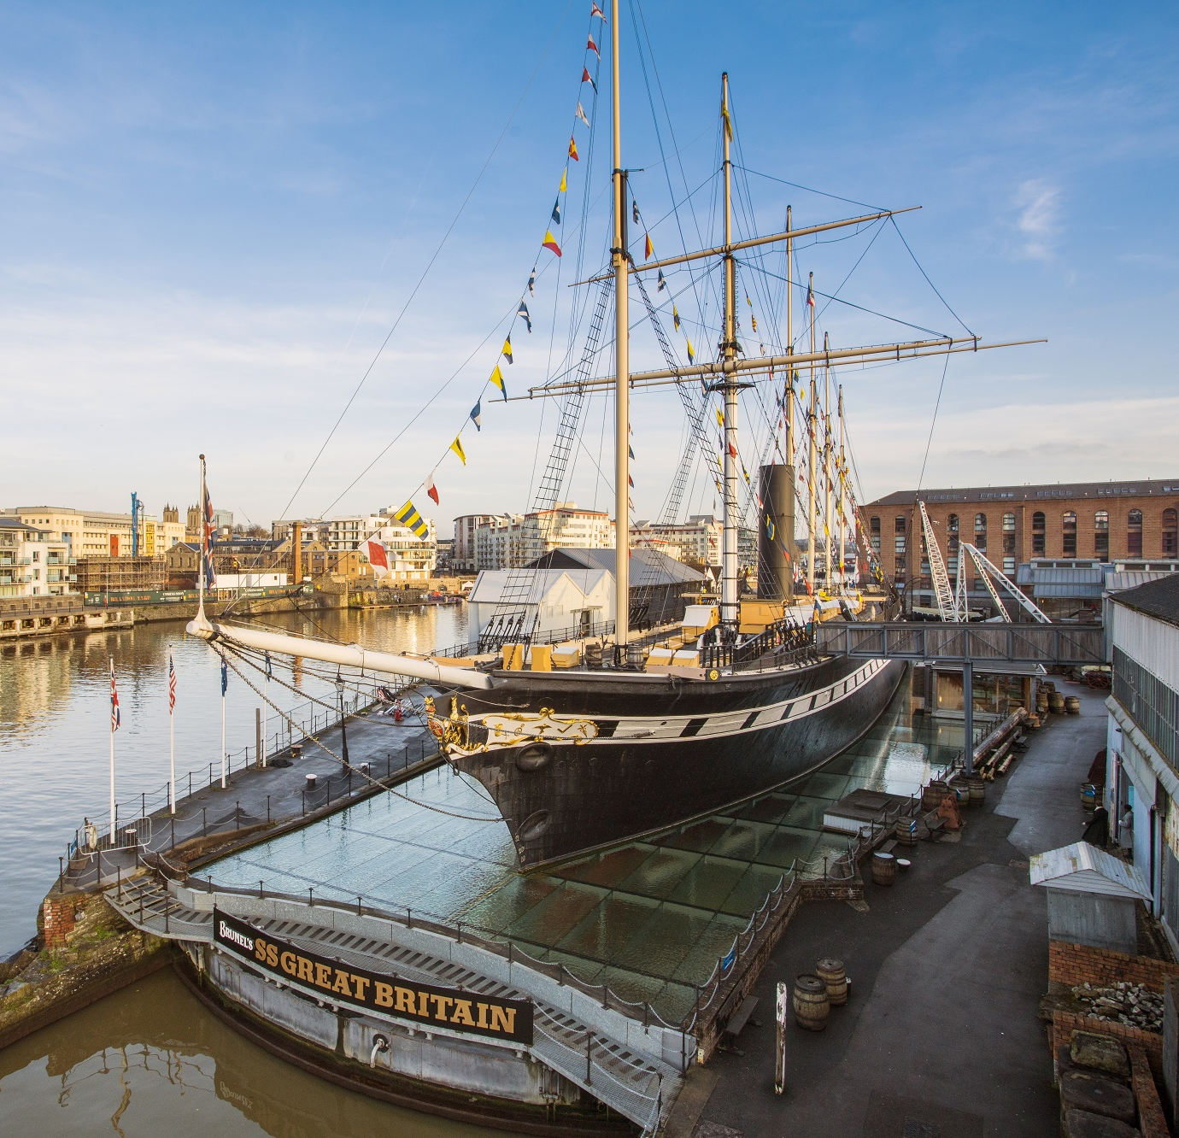
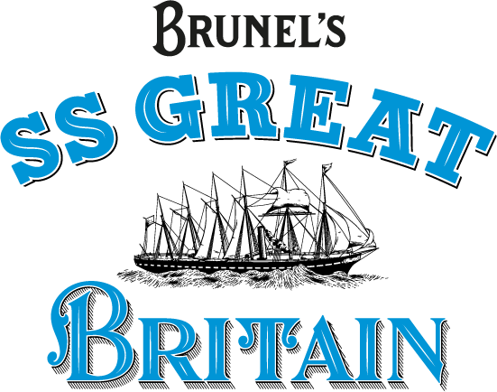
Preparing
for your
visit
Mannequin Map
Registered Charity - No. 262158

Slide 2
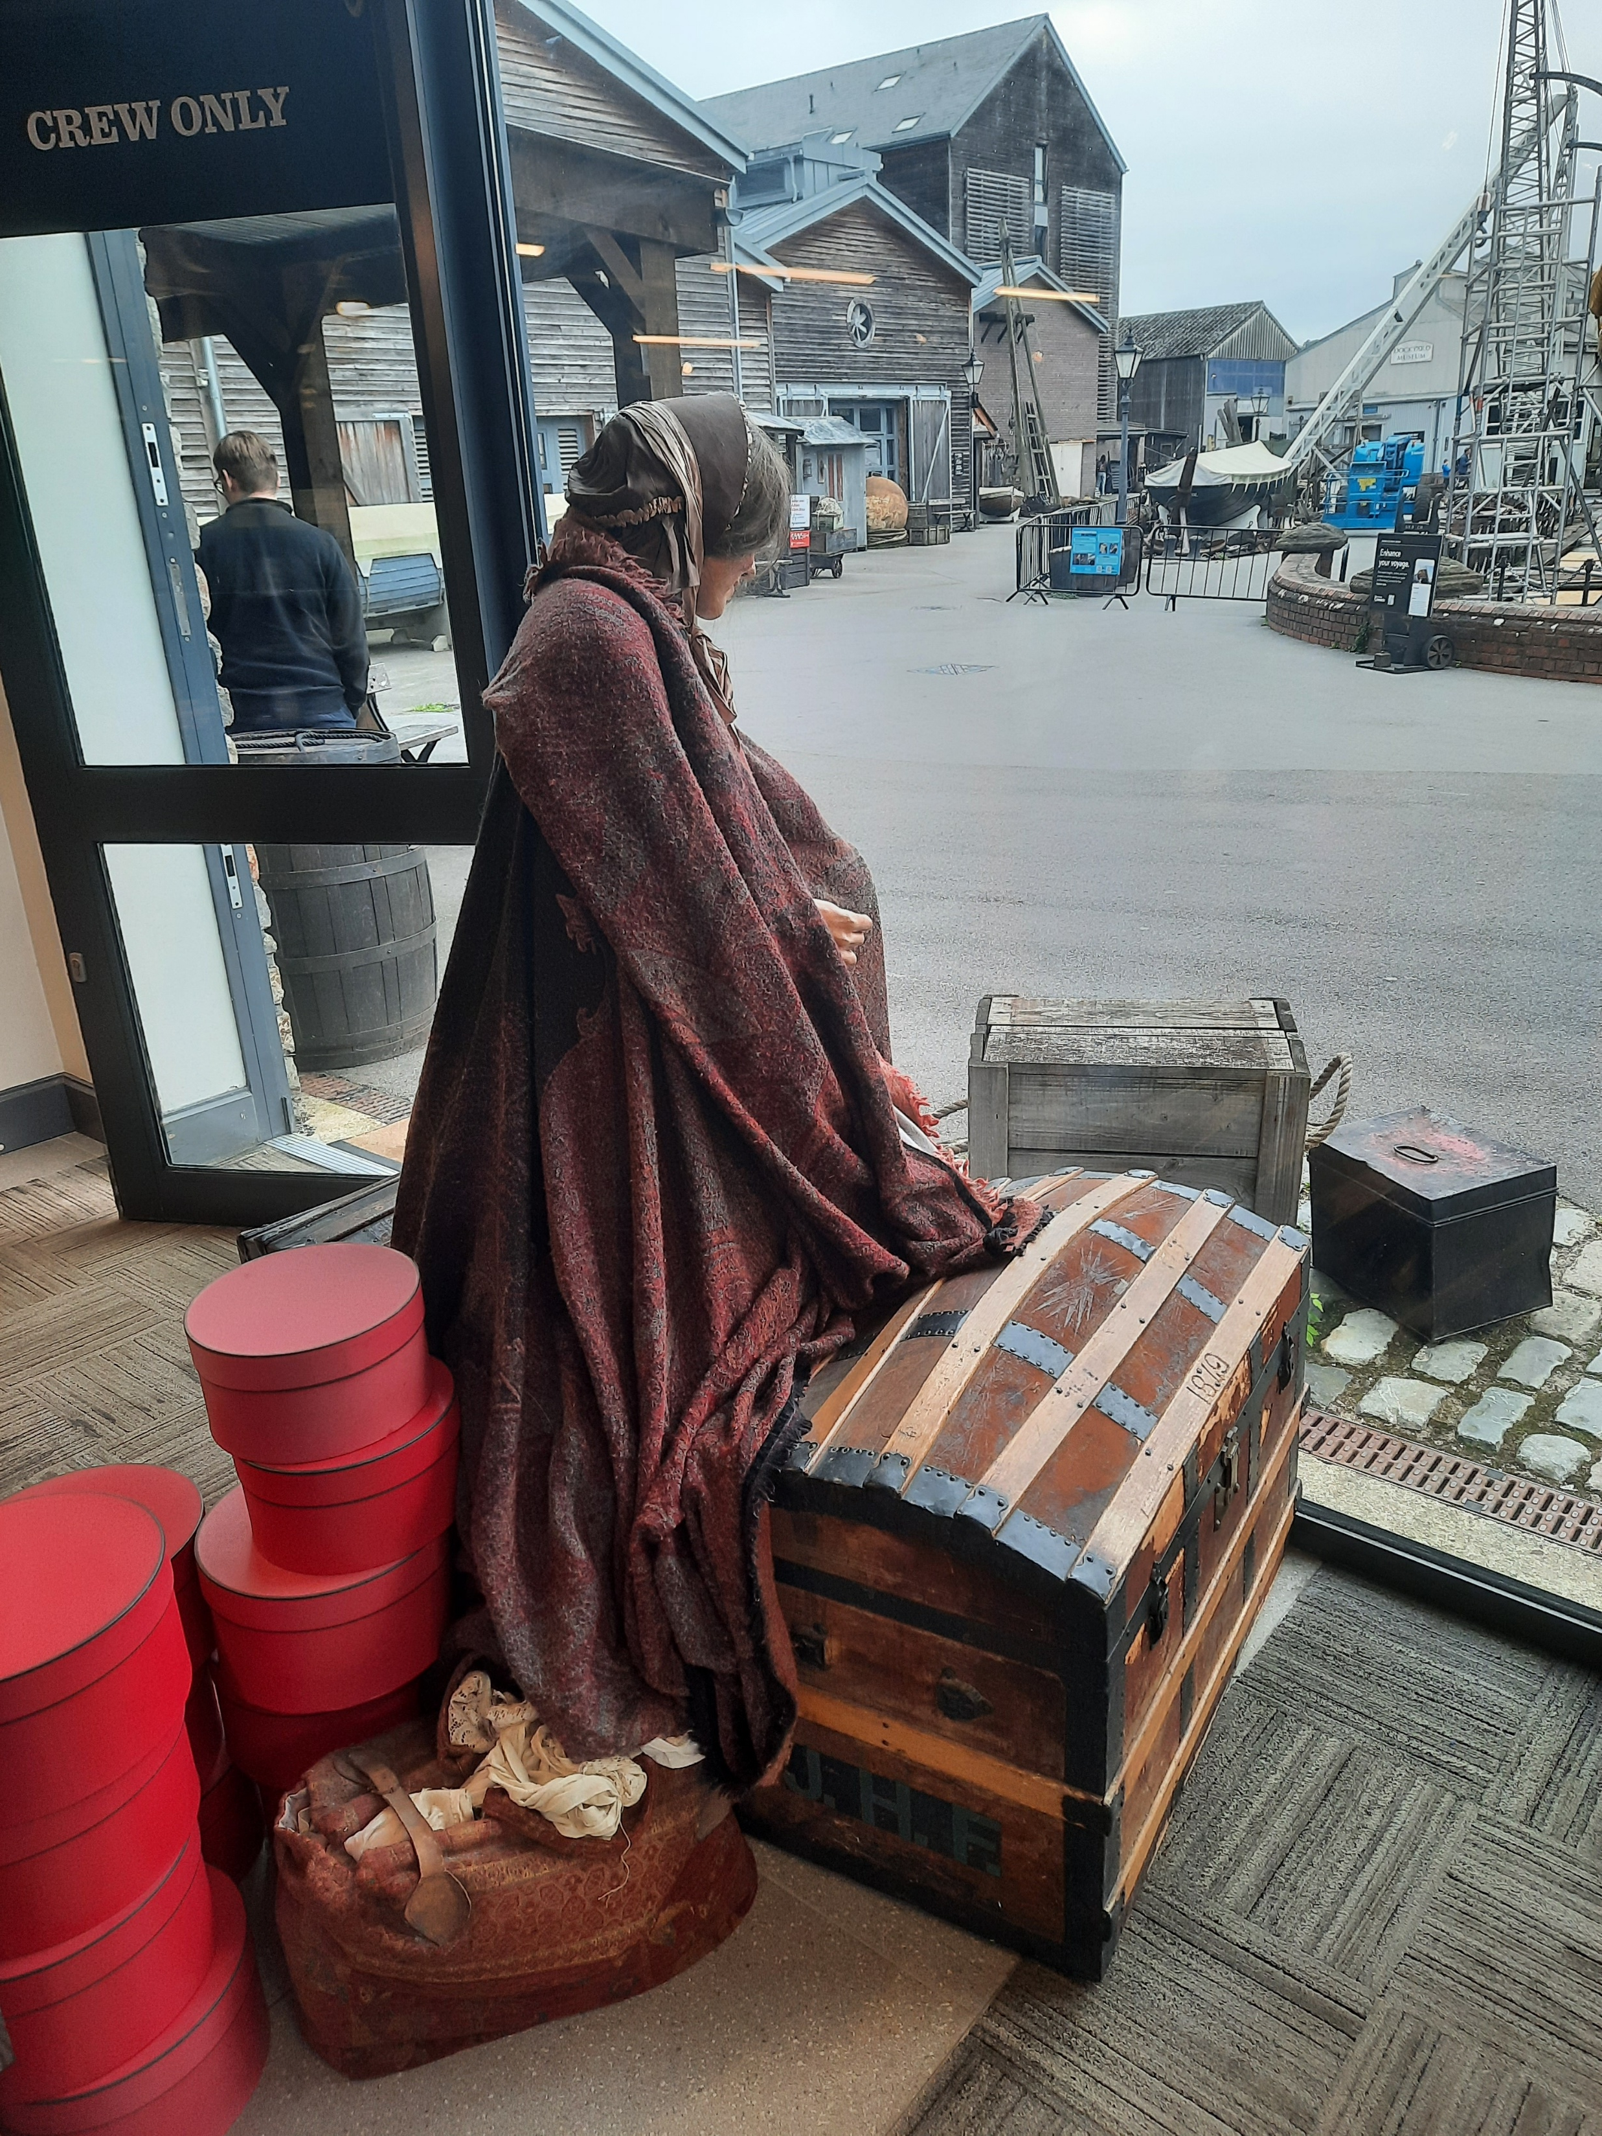

There are lots of mannequins at the SS Great Britain, they represent real people who travelled on the ship in the past.
They are made of plastic and cannot move.
This mannequin of a woman is by the door to the Dockyard in the Visitor Centre.
If you would like to find out more about the people who travelled on the SS Great Britain, you can use the Global Stories Database: https://globalstories.ssgreatbritain.org/

Slide 3
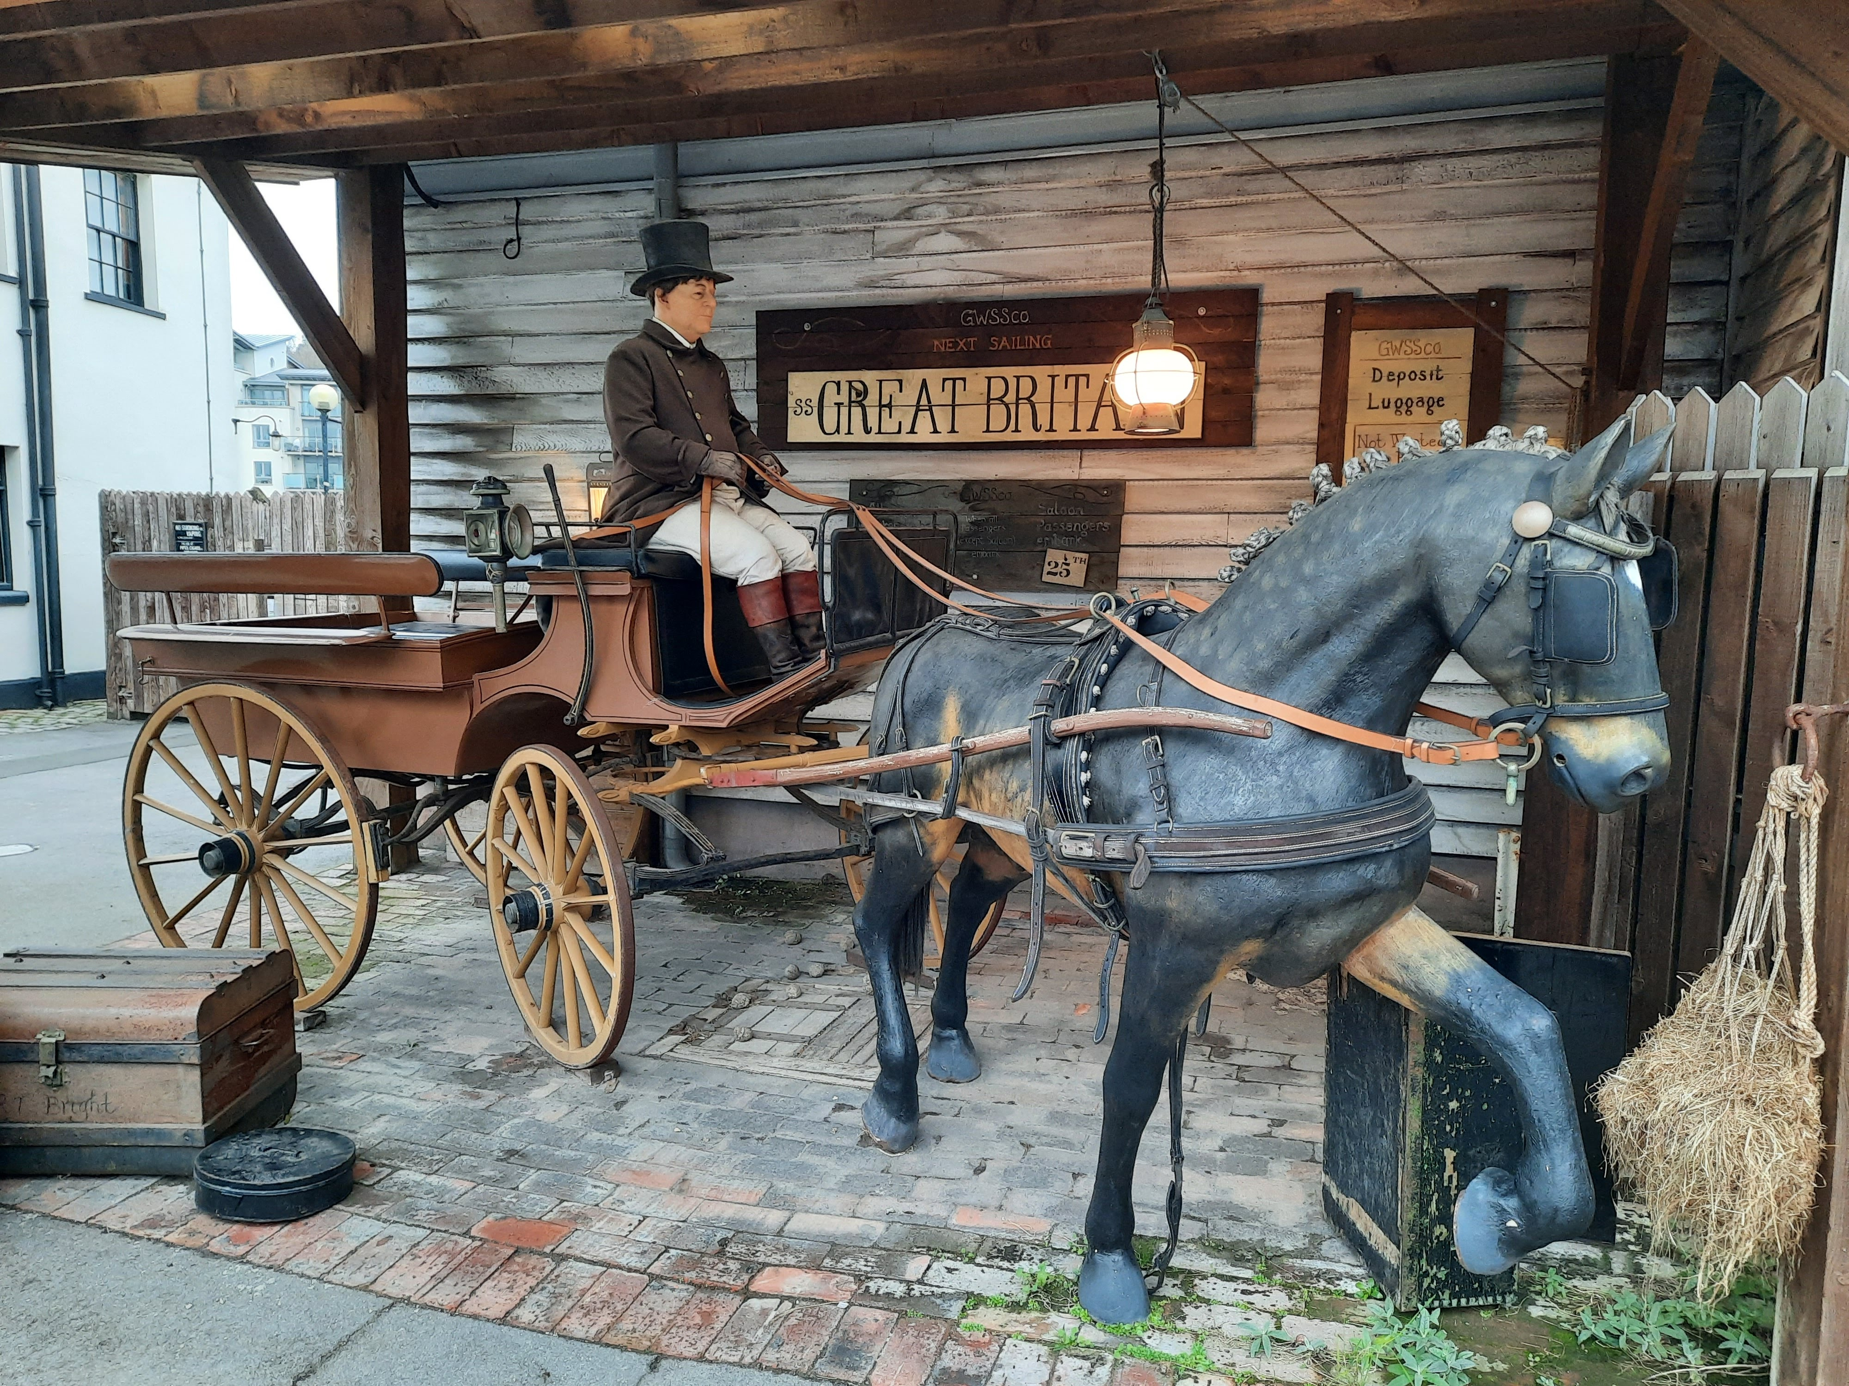
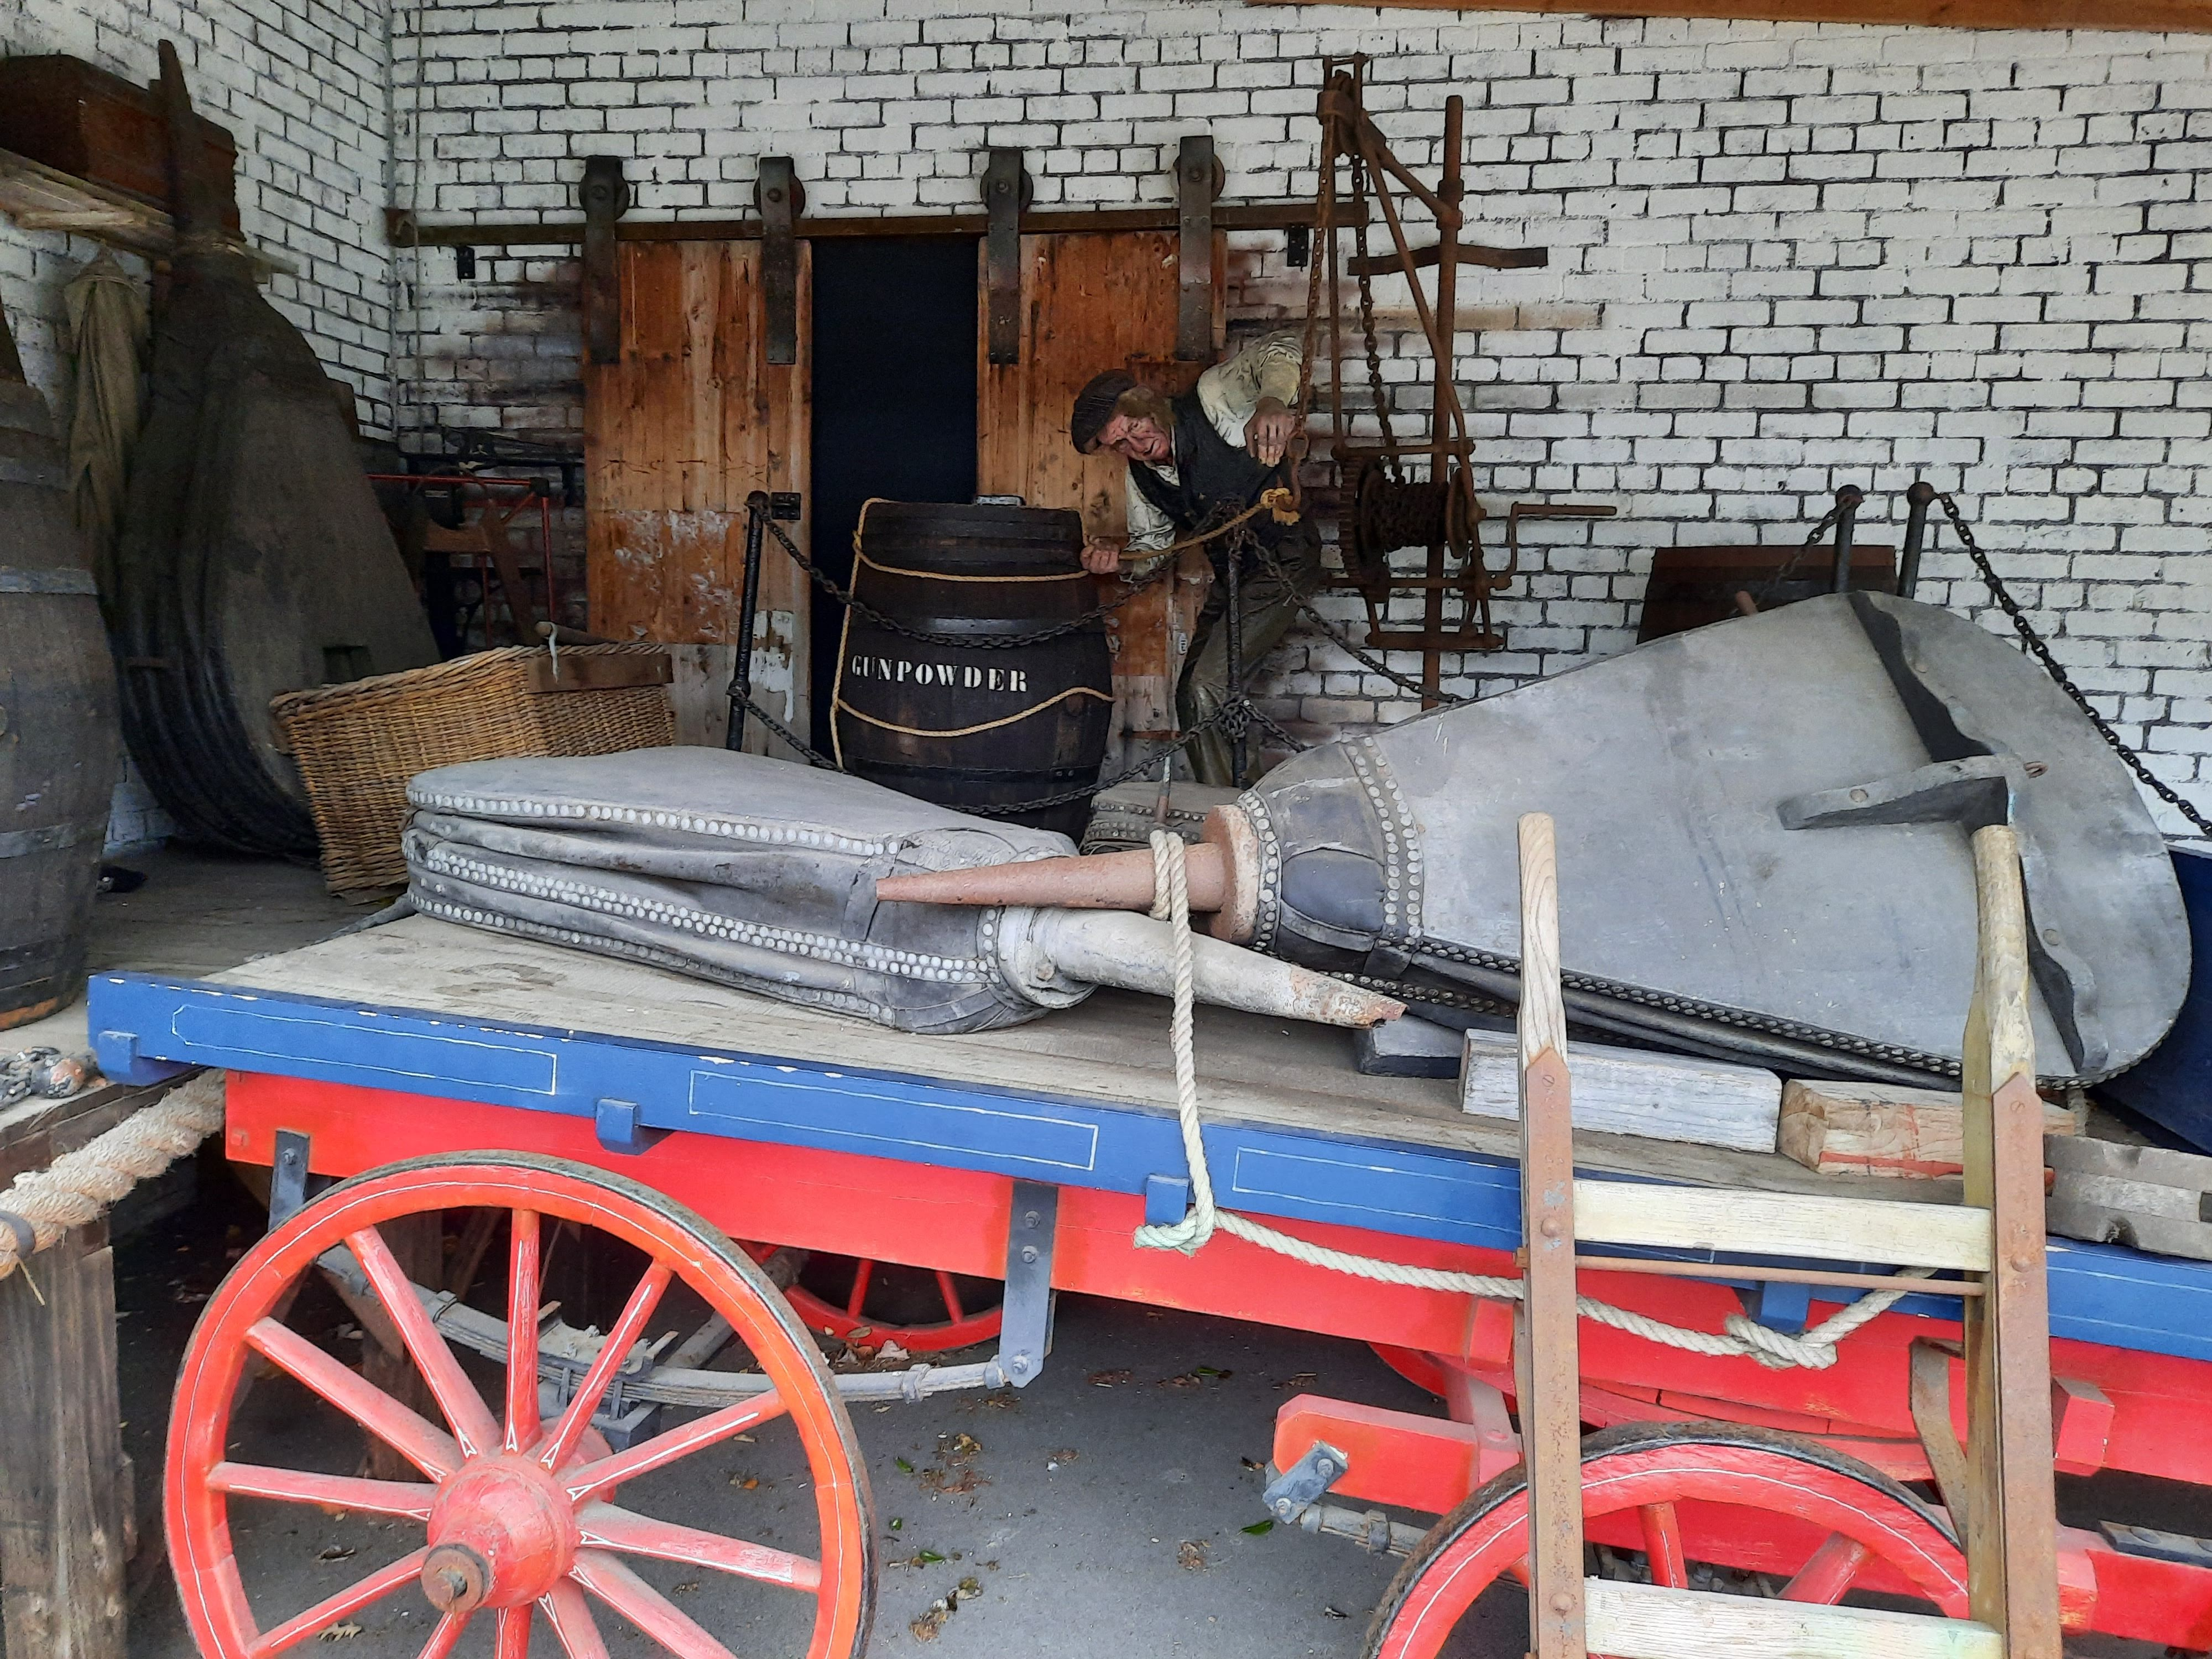
Dockyard Mannequins
Carriage driver, on your right as you exit the Visitor Centre
Dock worker loading a barrel onto a cart. On your left near the entrance to the Dockyard Museum
There are no mannequins in the Dockyard Museum or Dry Dock.

Slide 4
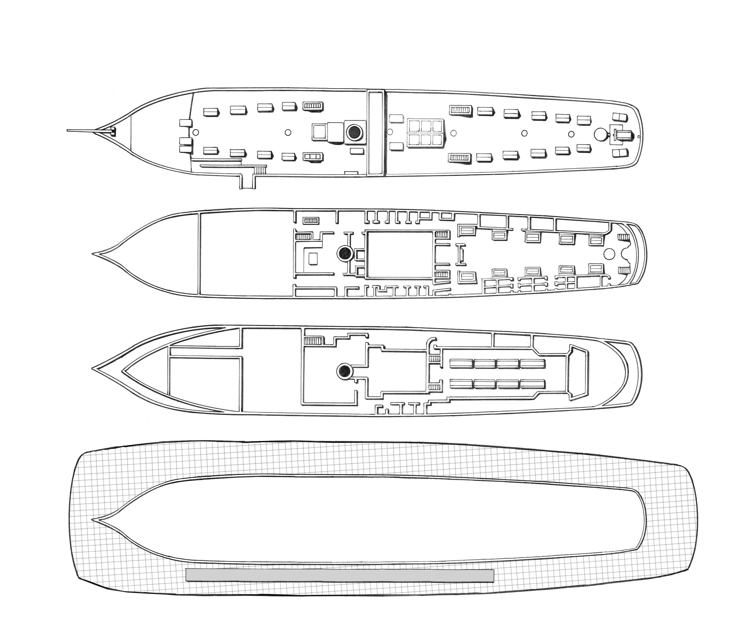
Top Deck
There are no mannequins on the top deck of the ship.

Slide 5
Middle Deck
4
13
3
1
2
6
14
5
10
7
8
9
12
11
The numbers show which spaces the mannequins are in. Pictures and information on each one can be found on the following pages.

Slide 6
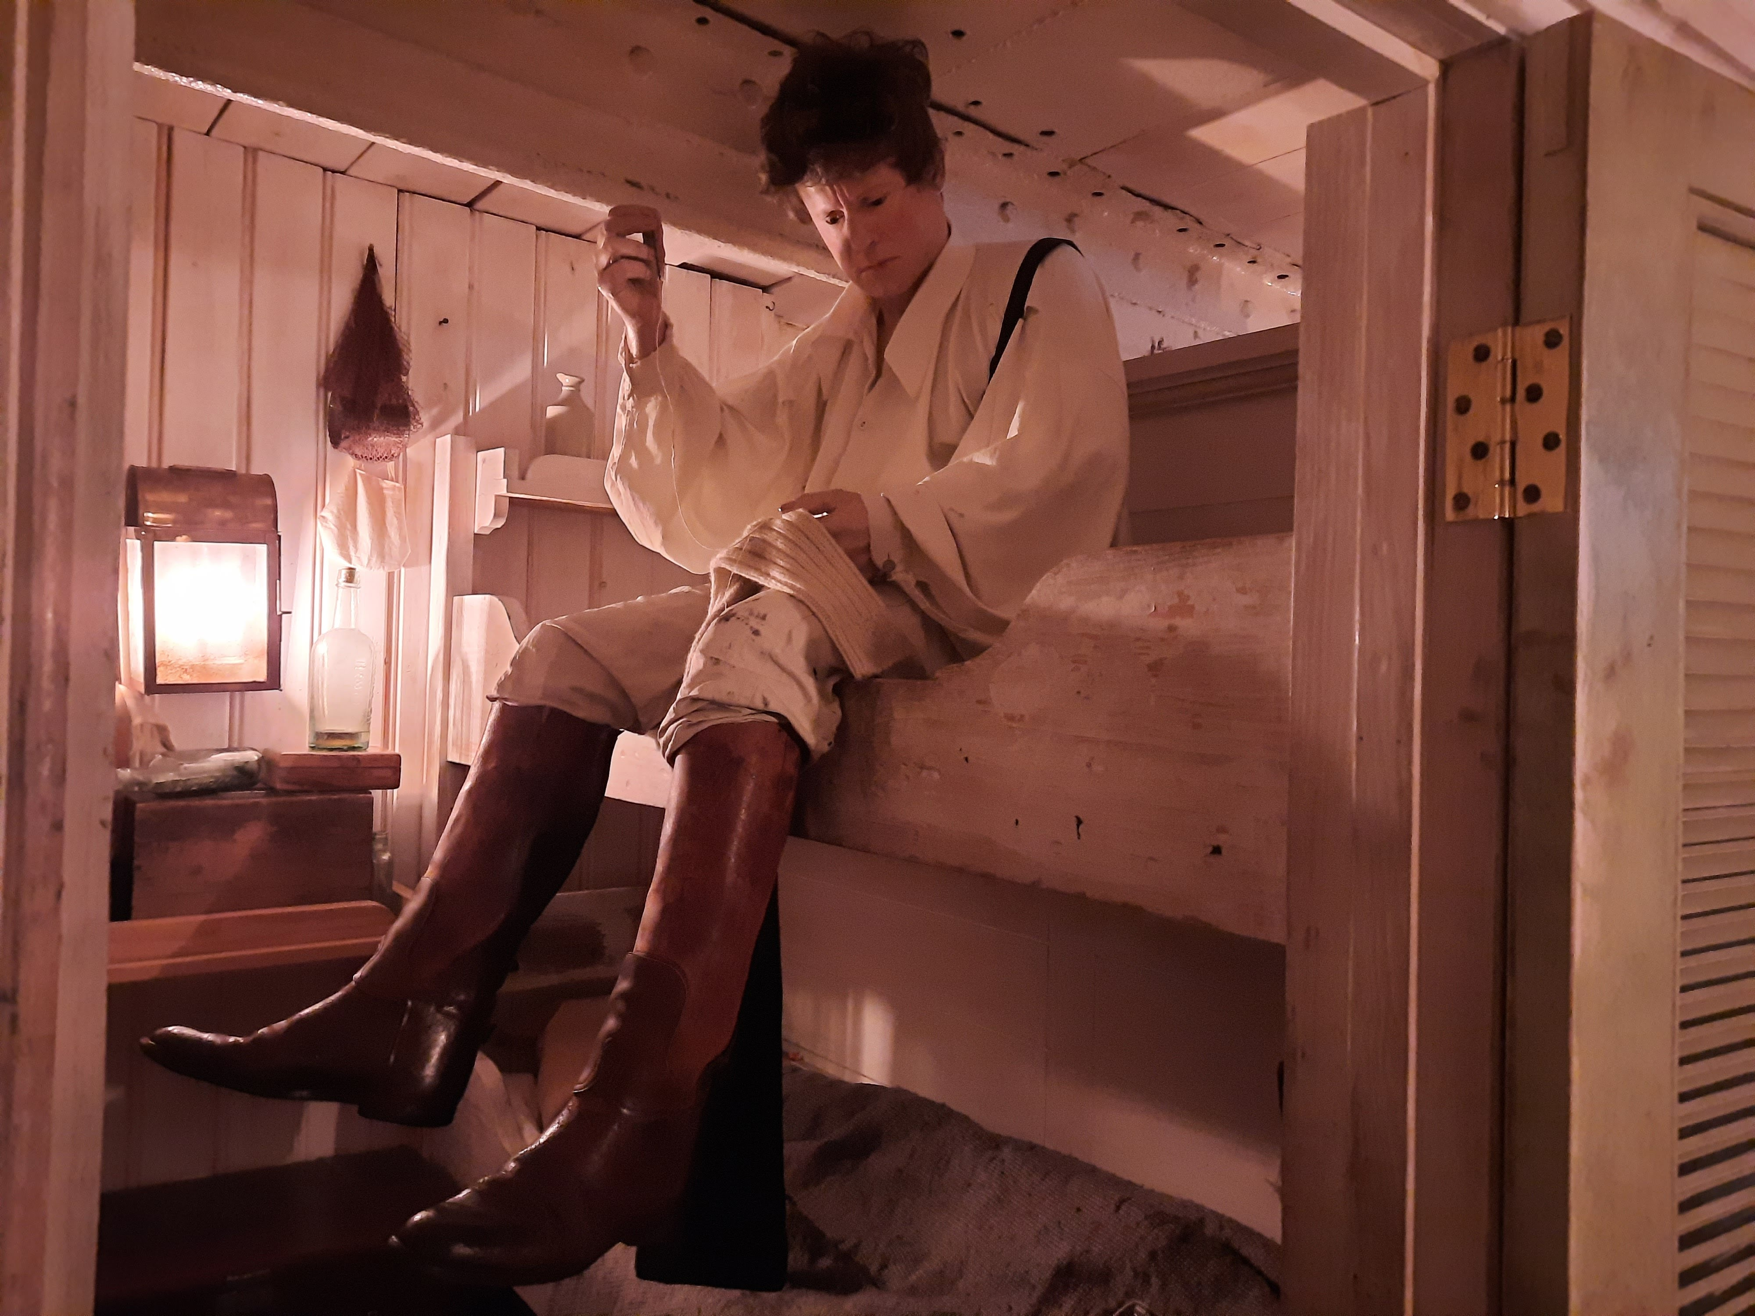
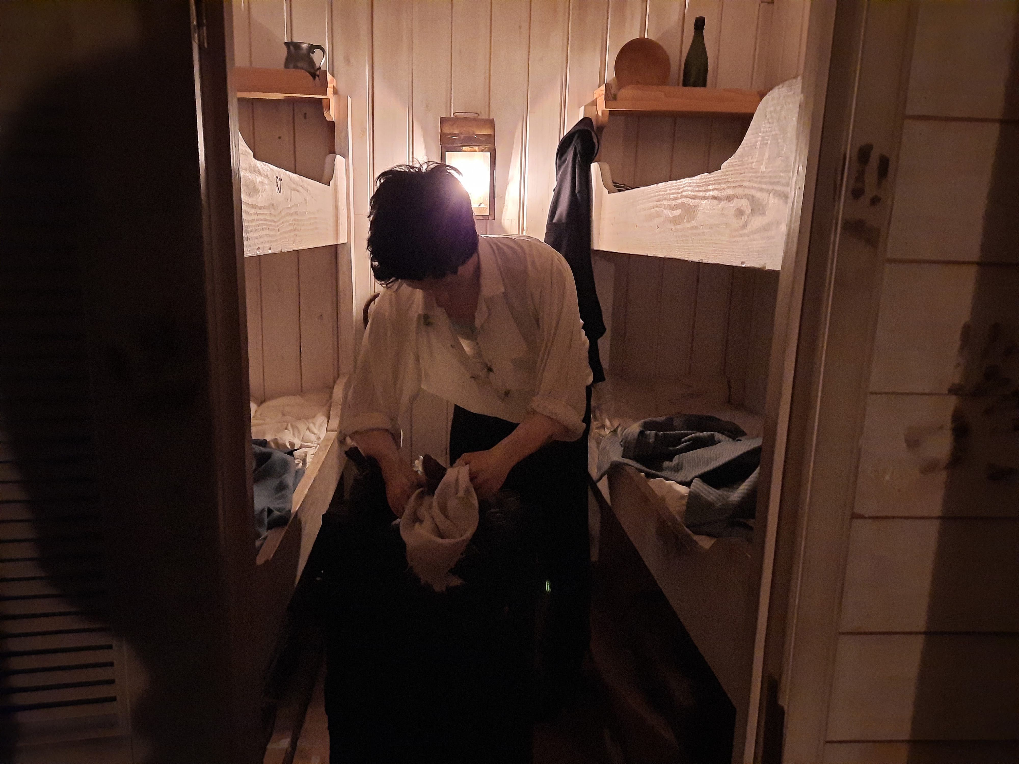
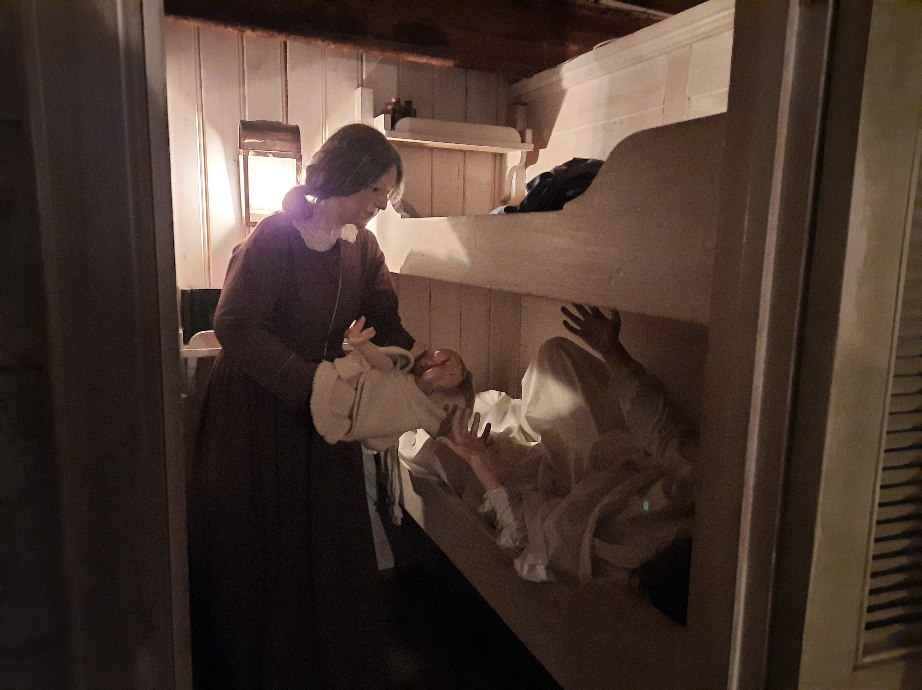
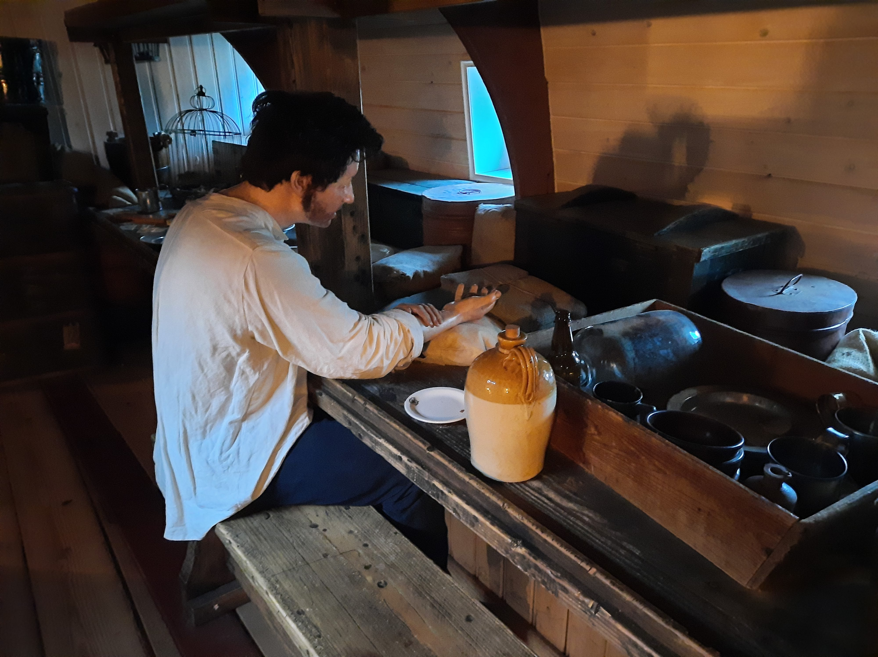
Middle Deck Mannequins
1. Allan Gilmour mending a sock
2. Red Nolan cleaning shoes
3. Midwife, new born baby and mother
4. Daniel Higson looking at a locket of his girlfriend.

Slide 7
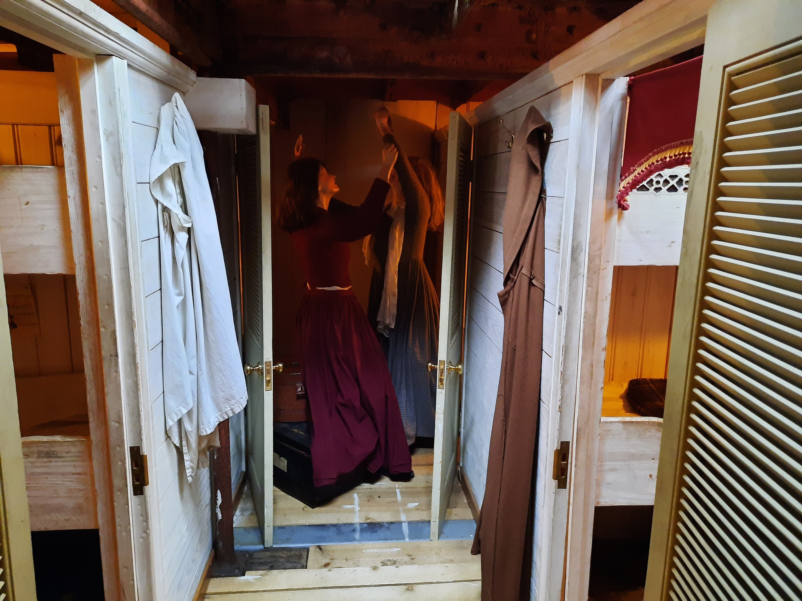
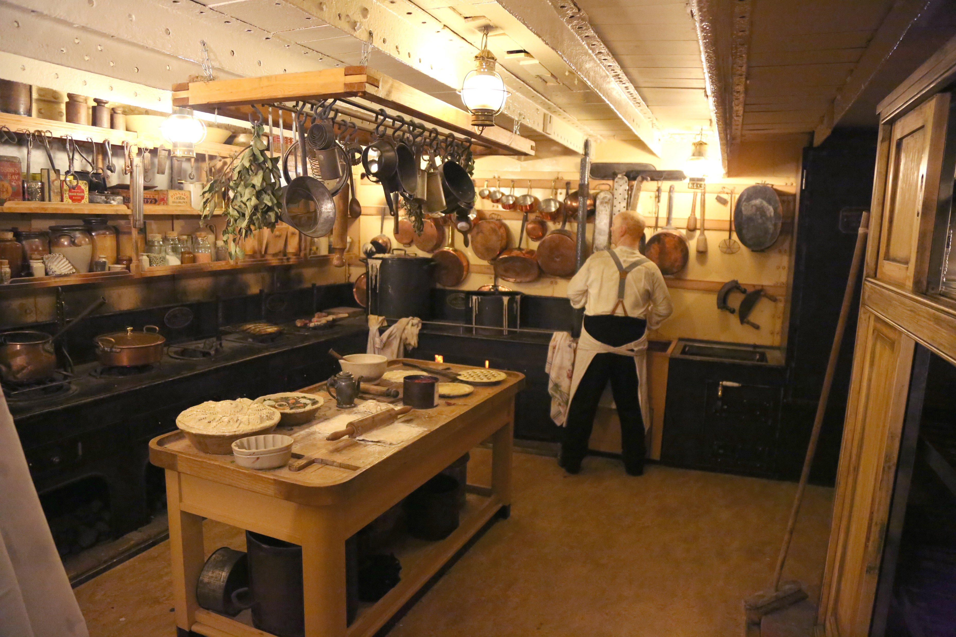
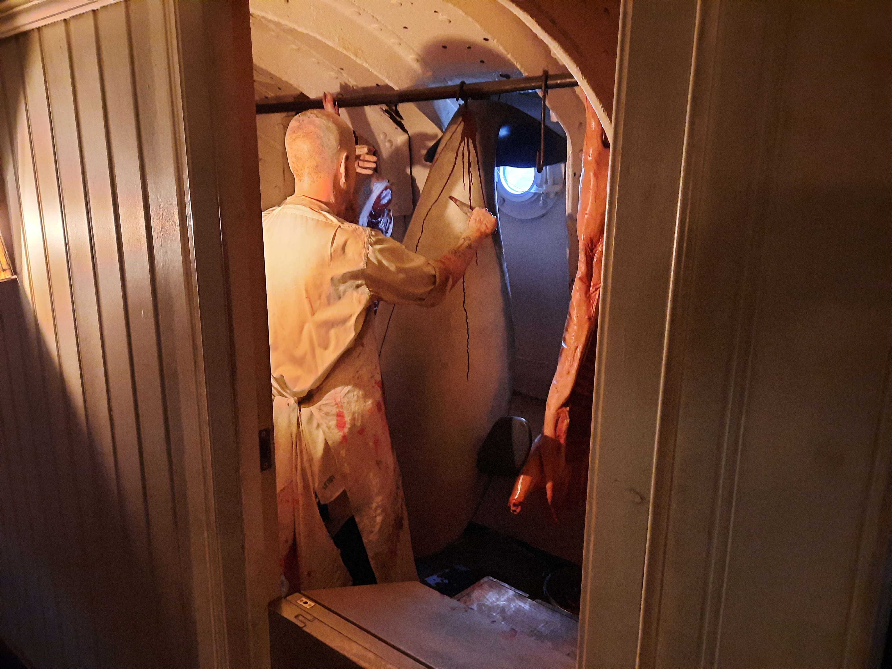
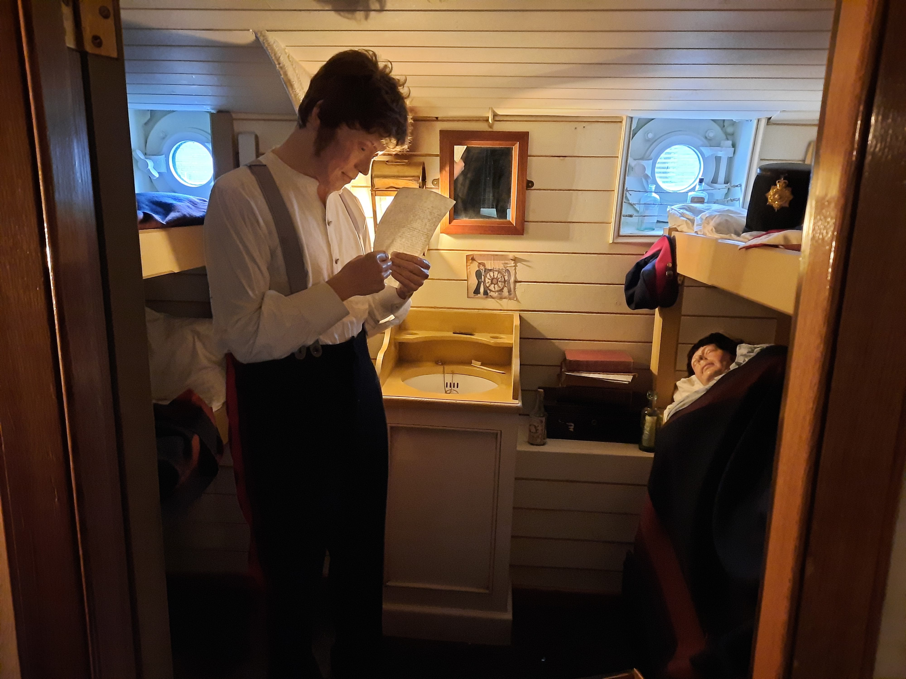
Middle Deck Mannequins
5. Two women fighting
6. Cook cutting up fishes
7. Butcher cutting up a porpoise
8. Soldiers on their way to the Crimean War

Slide 8
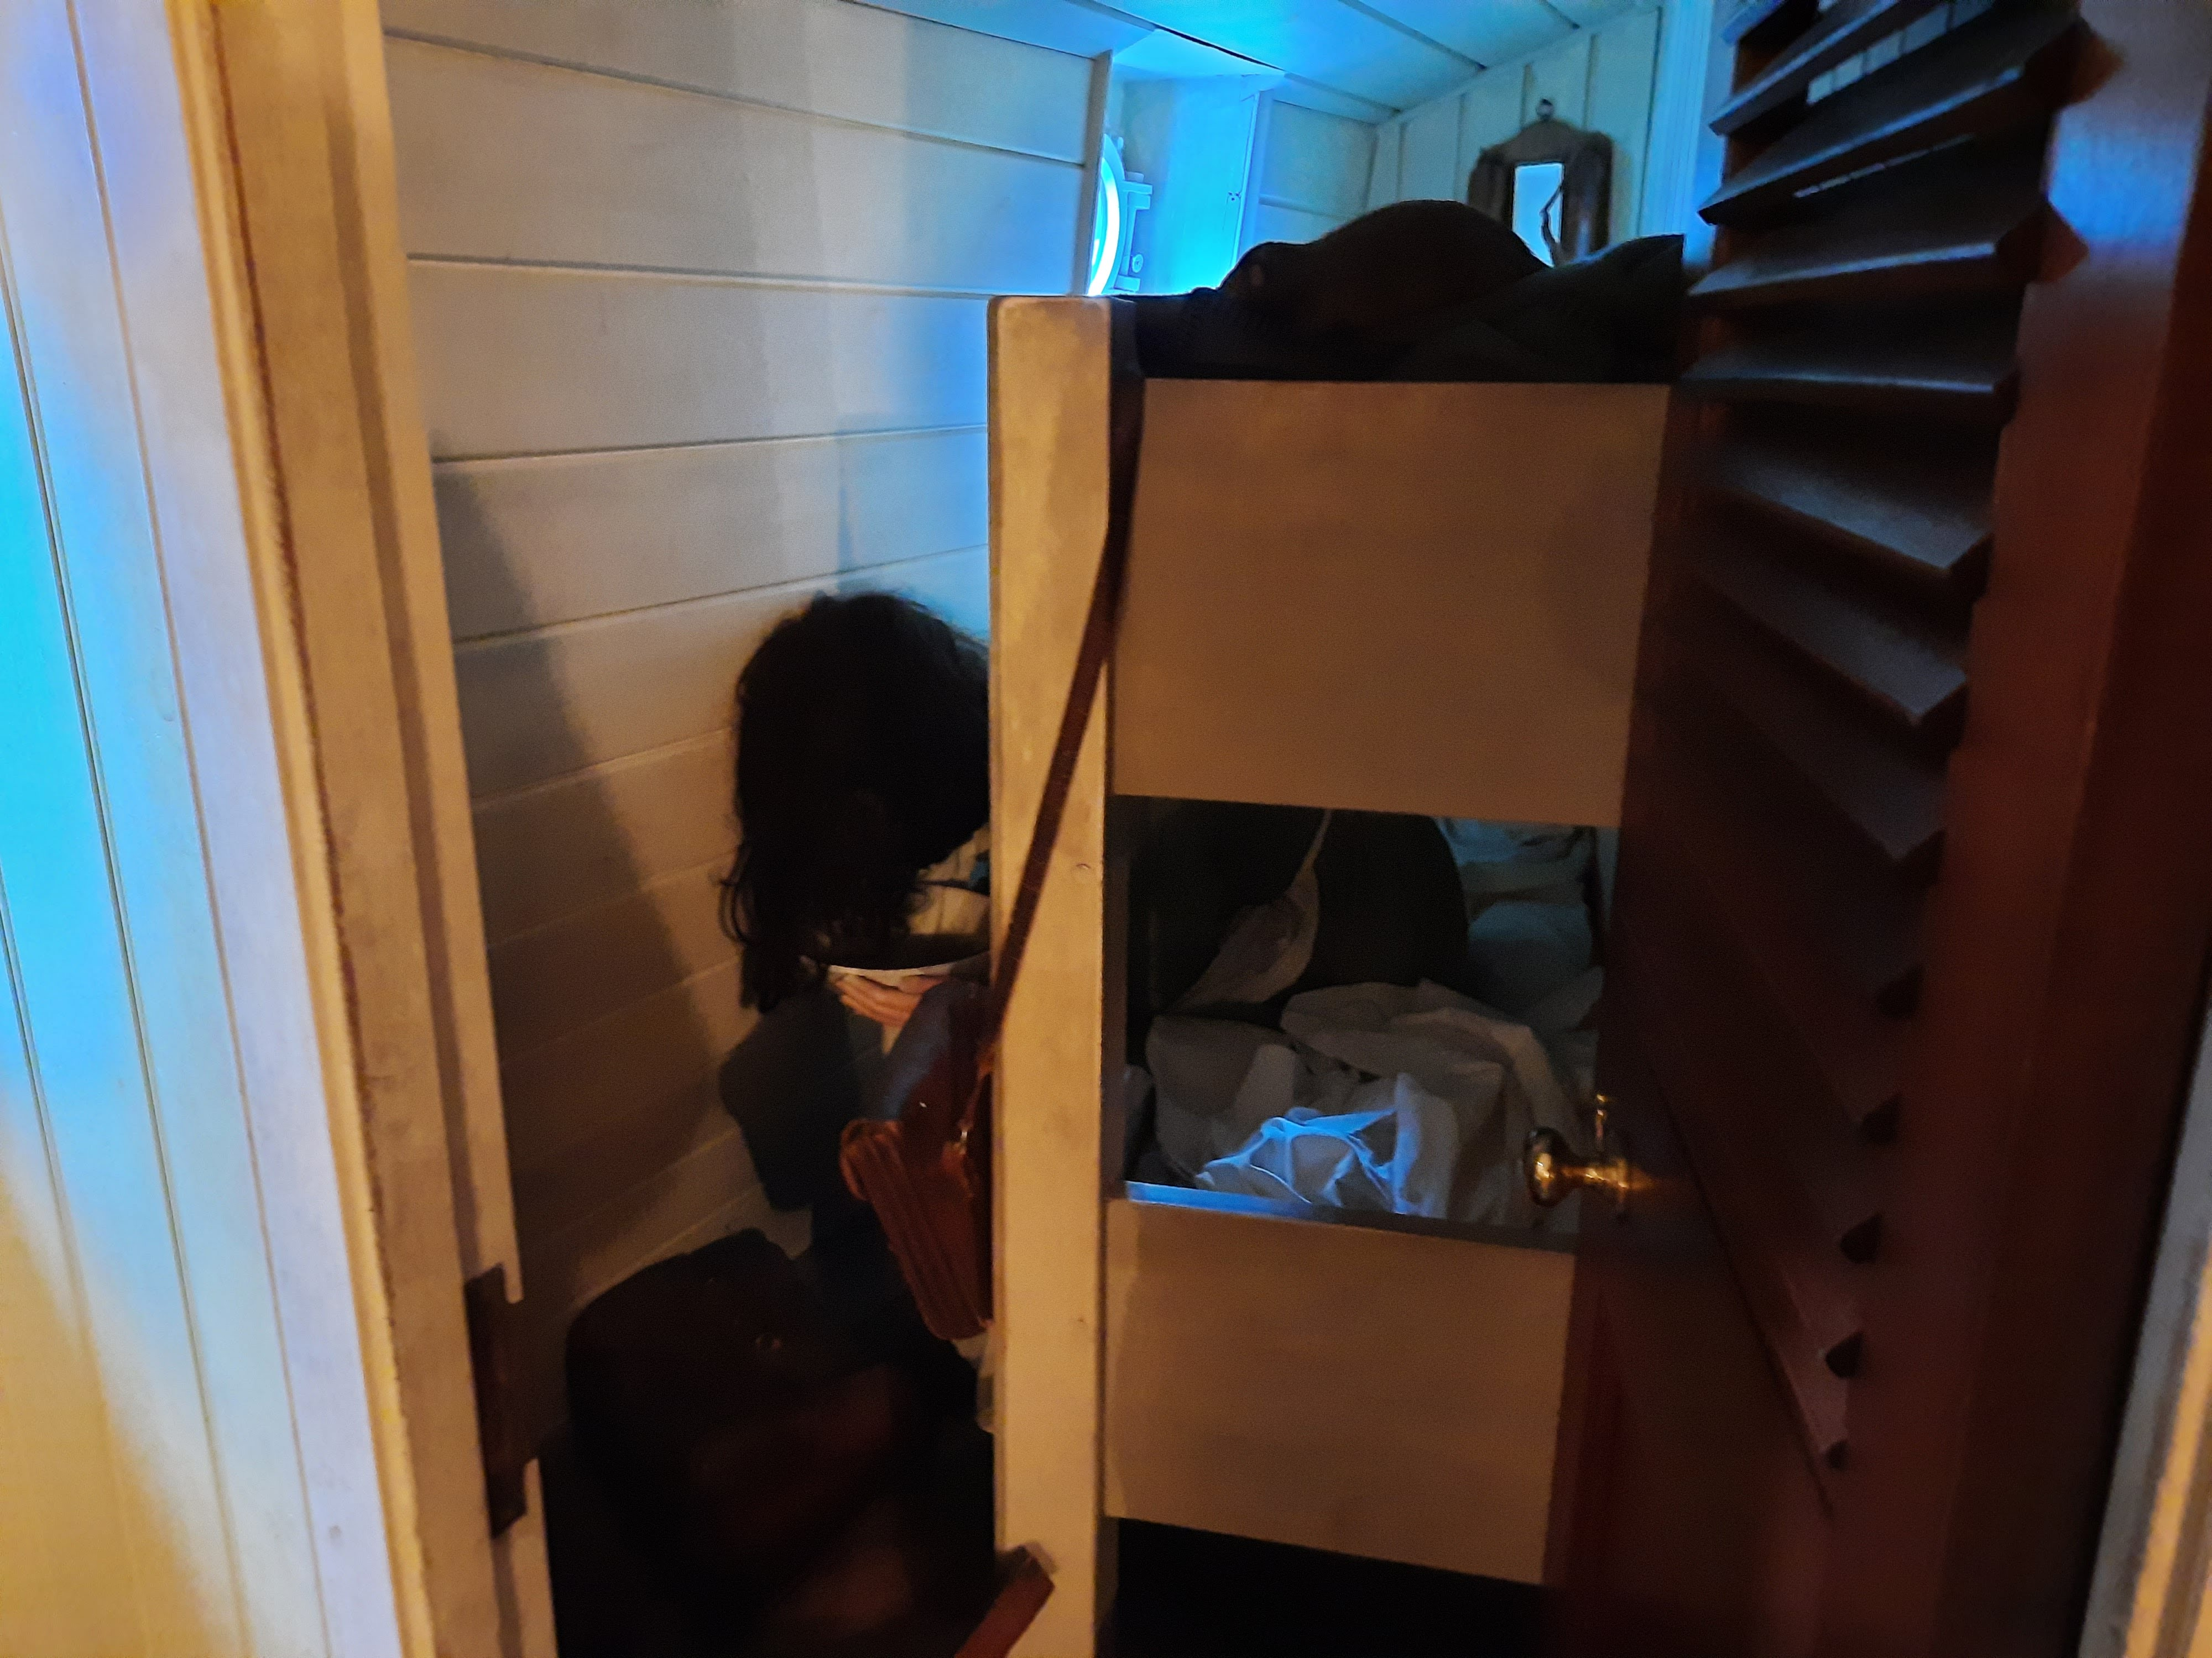
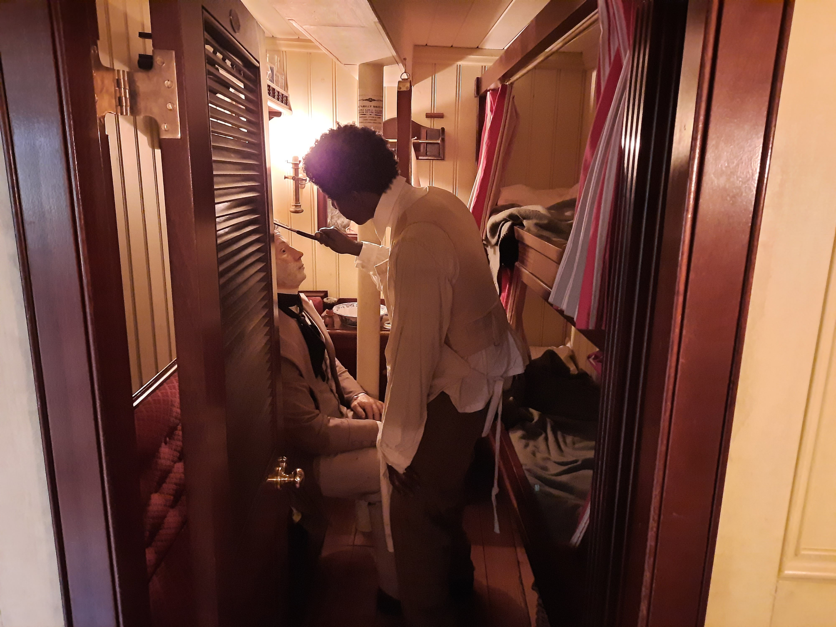
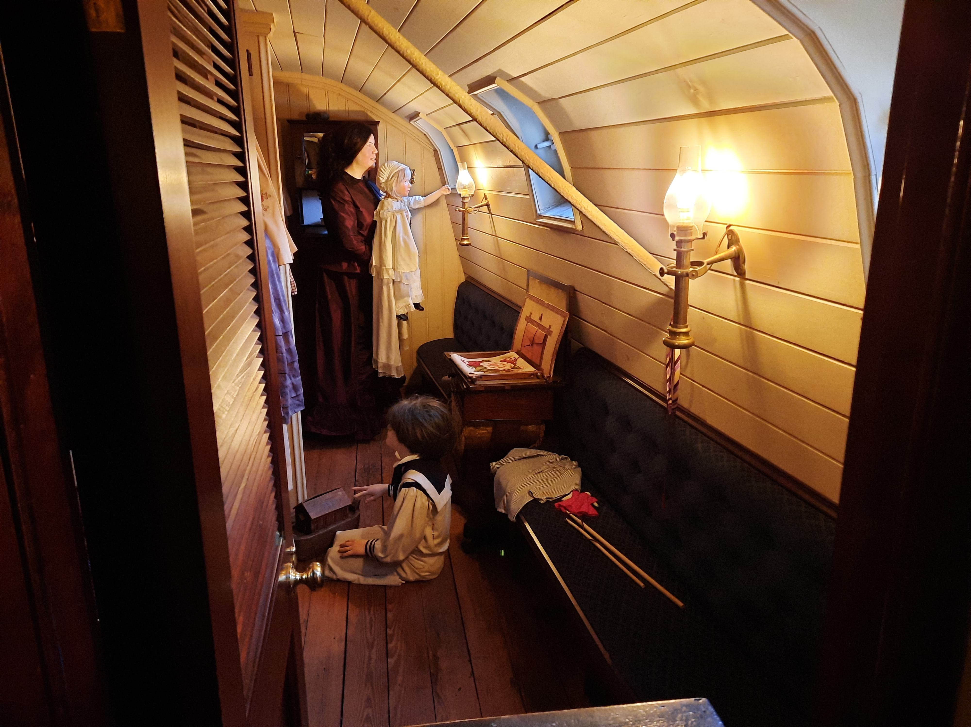
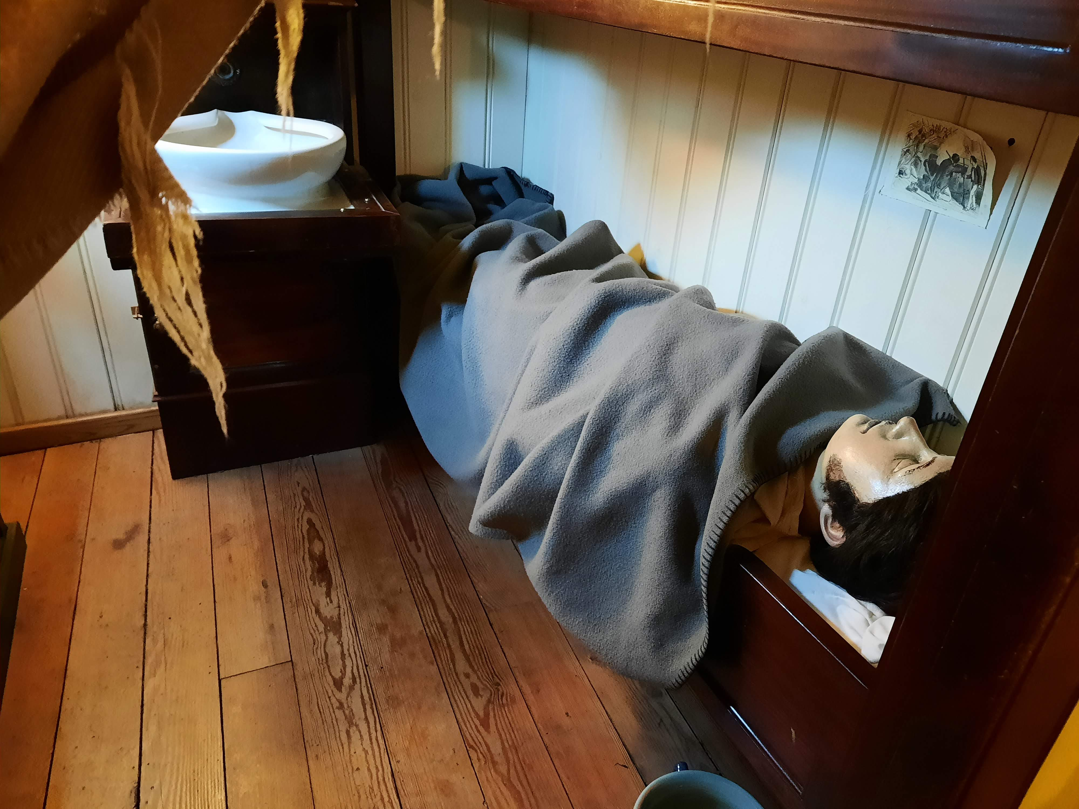
Middle Deck Mannequins
9. Annie Green being seasick
10. Barber William Jones, shaving a fellow passenger
11. Anna-Maria Georgina Bright and child looking out the window. Another child plays on the floor.
12. Robin Bright dying of typhoid fever

Slide 9
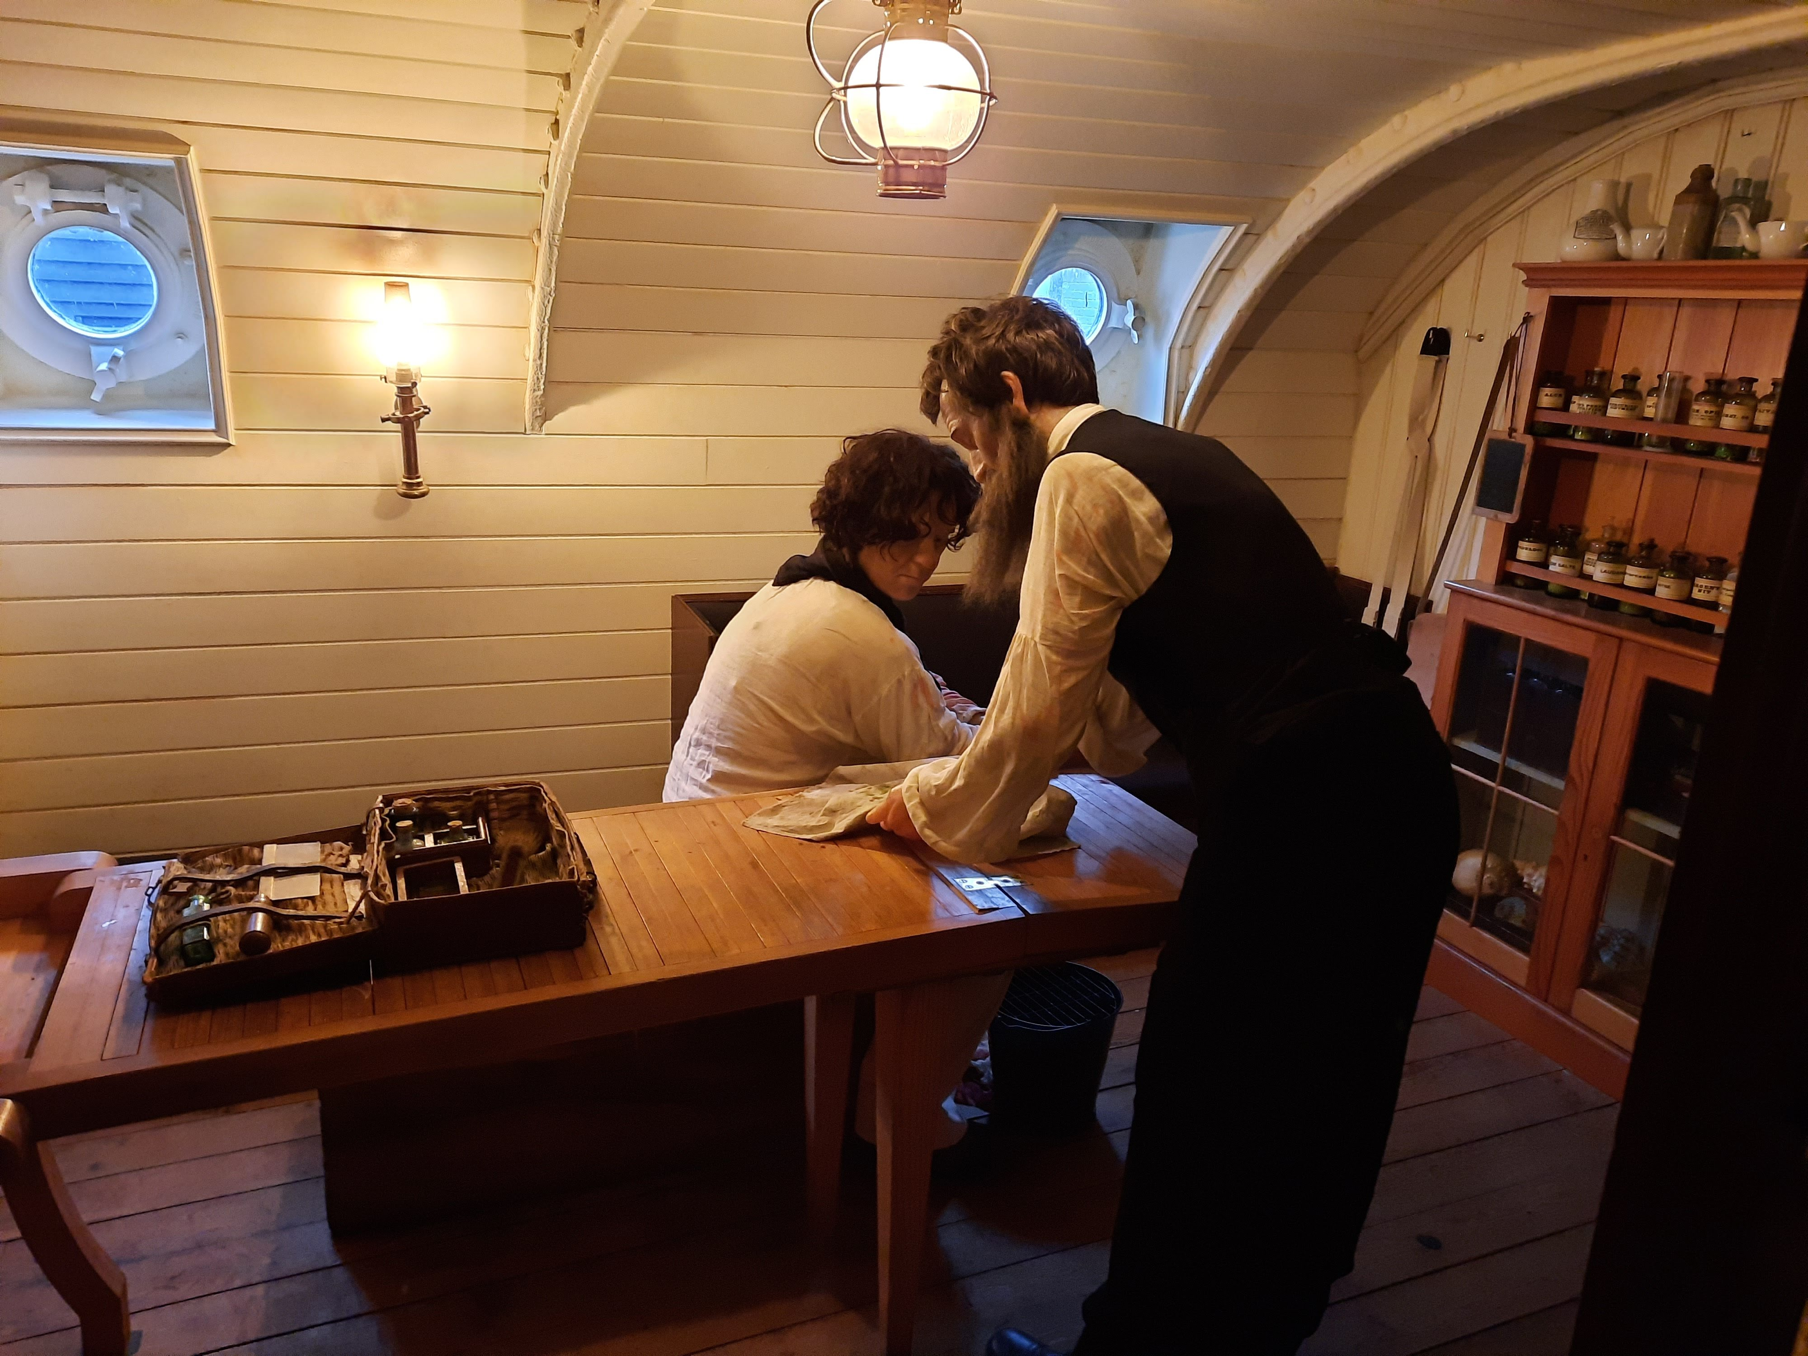
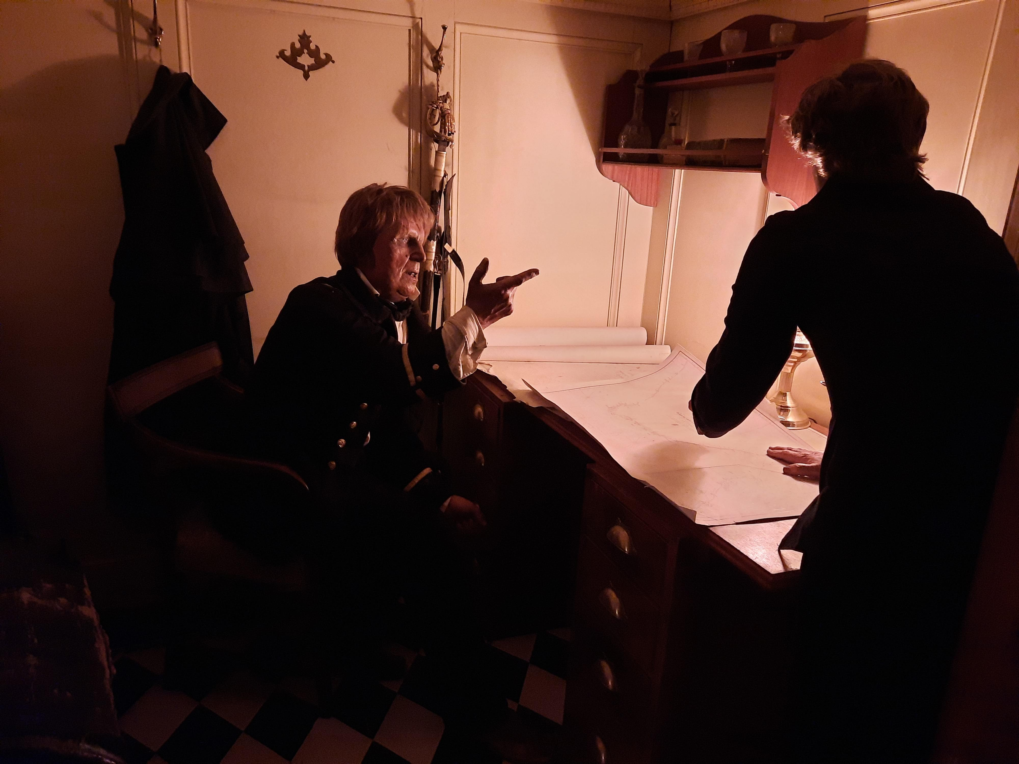
Middle Deck Mannequins
13. Surgeon Samuel Archer treating a sailor who has been bitten by a monkey
14. Captain Matthews arguing with the chief engineer about the need for more coal

Slide 10

Lower Deck
3
2
1
The numbers show which spaces the mannequins are in. Pictures and information on each one can be found on the following page.

Slide 11
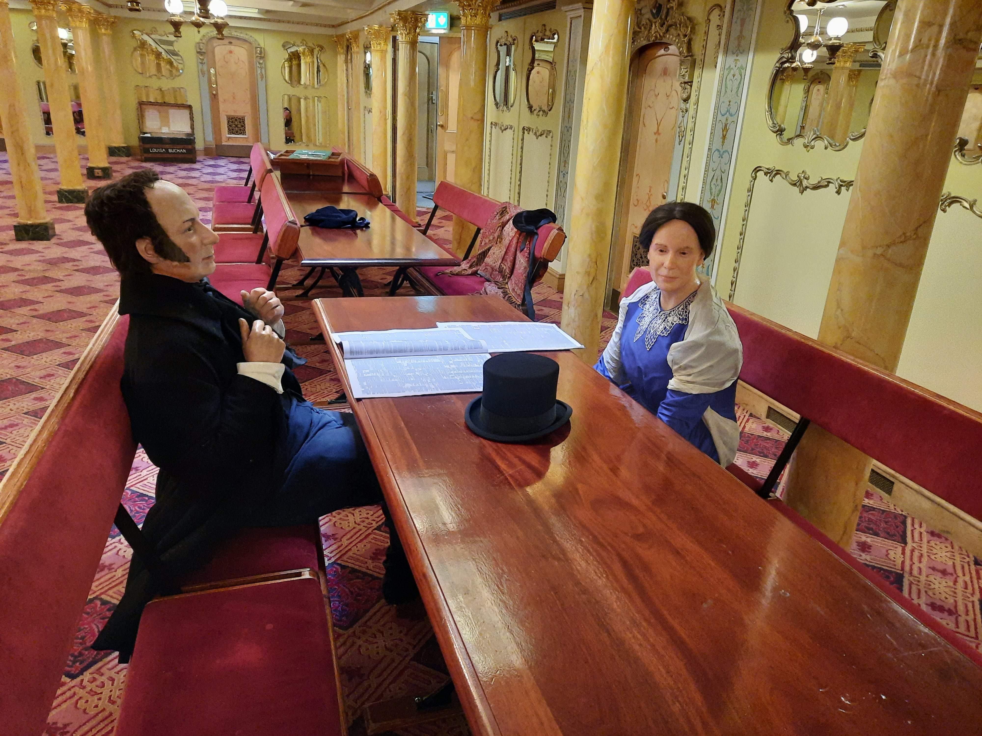
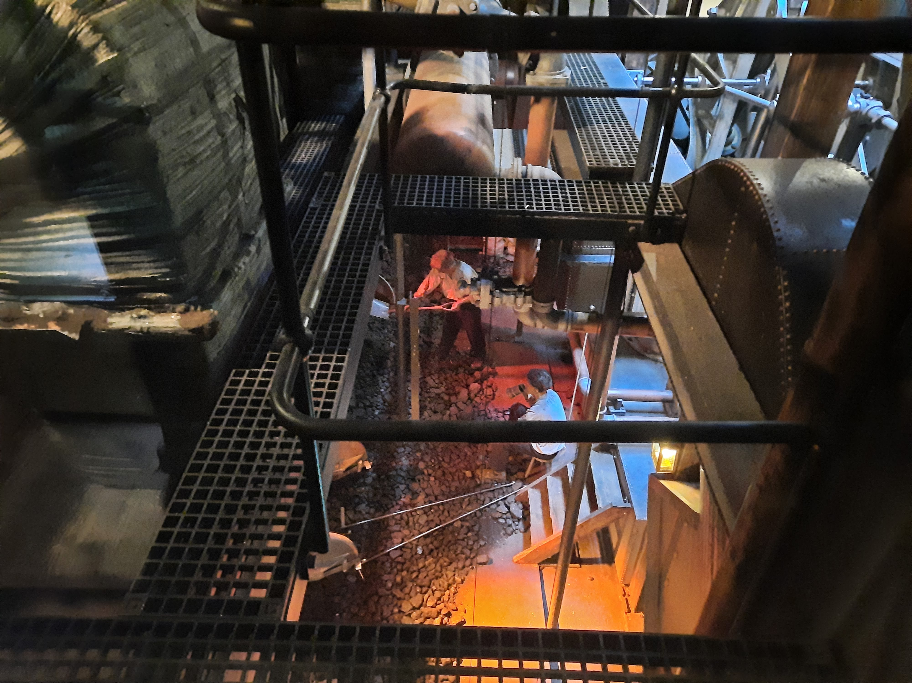
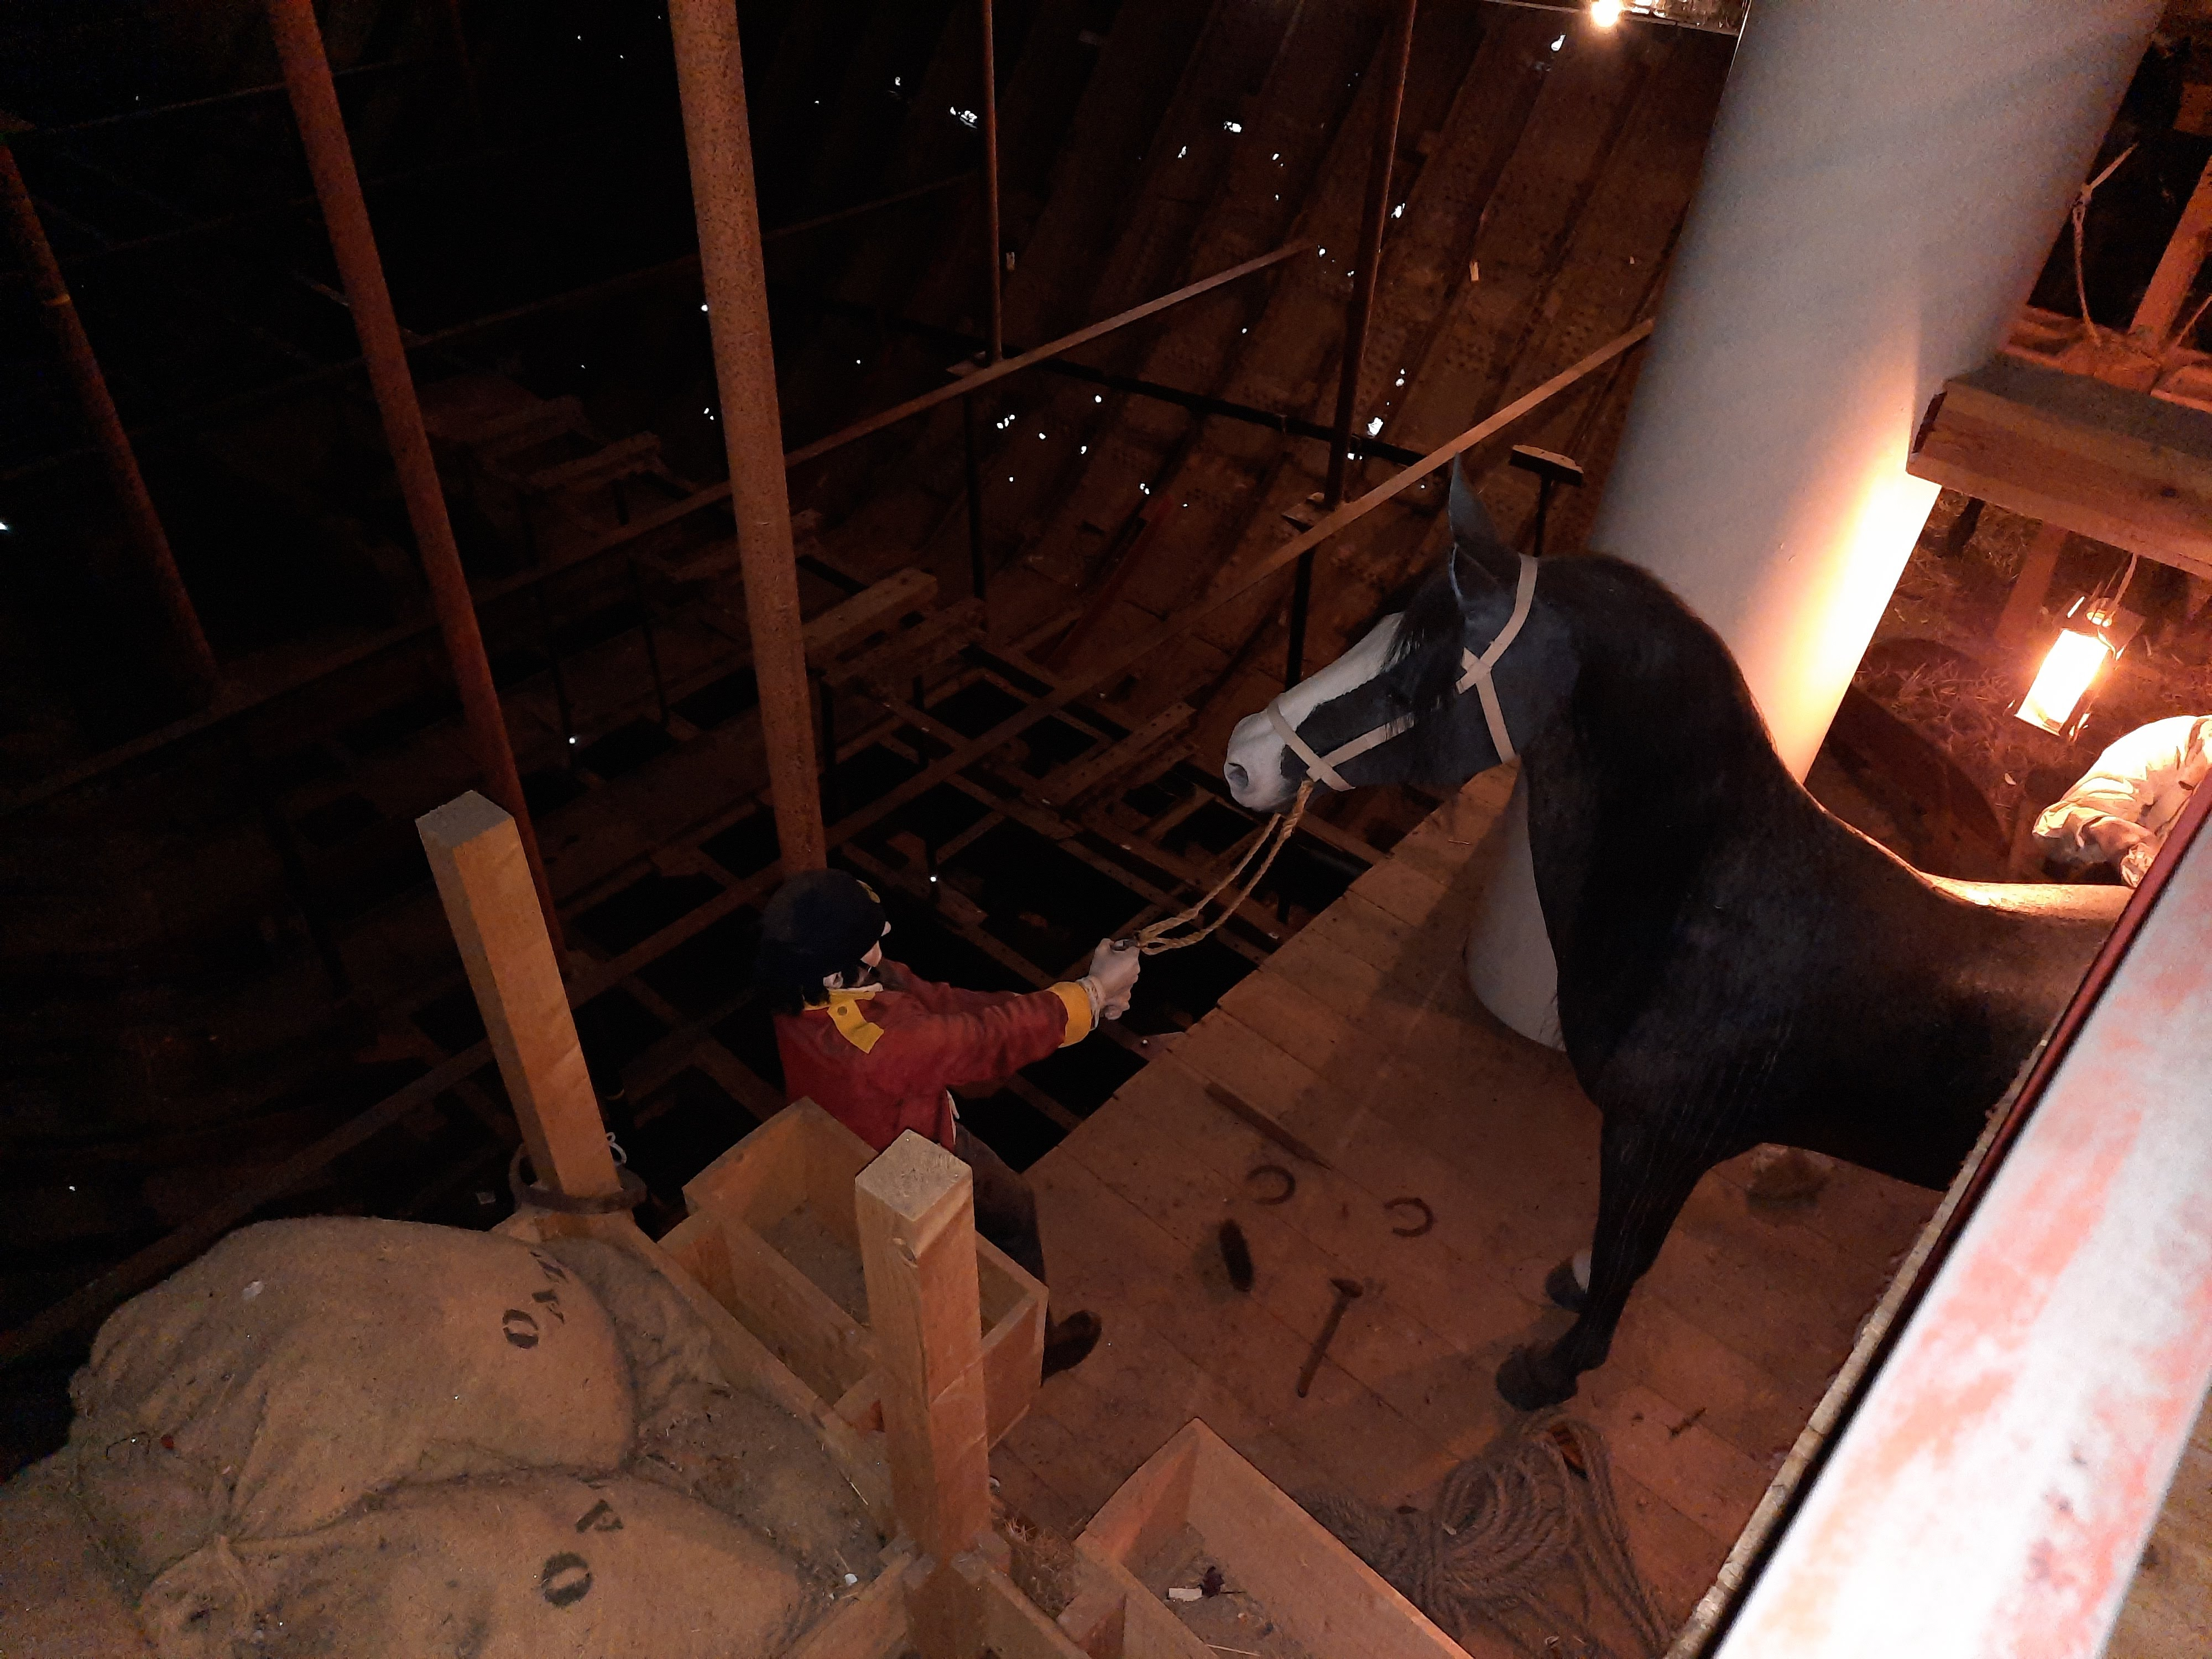
Lower Deck Mannequins
1. Annie Henning and Isambard Kingdom Brunel
2. Stokers putting coal into the ship’s furnace
3. Crimean War soldiers looking after their horses

Slide 12
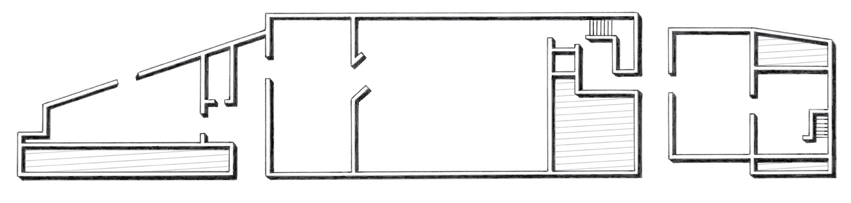
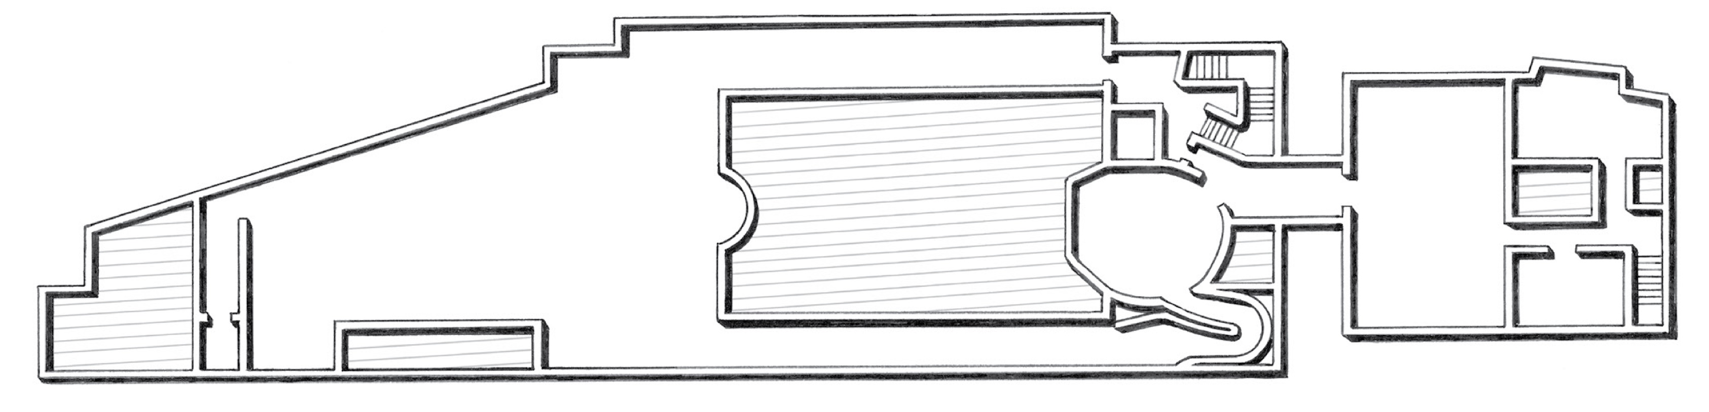
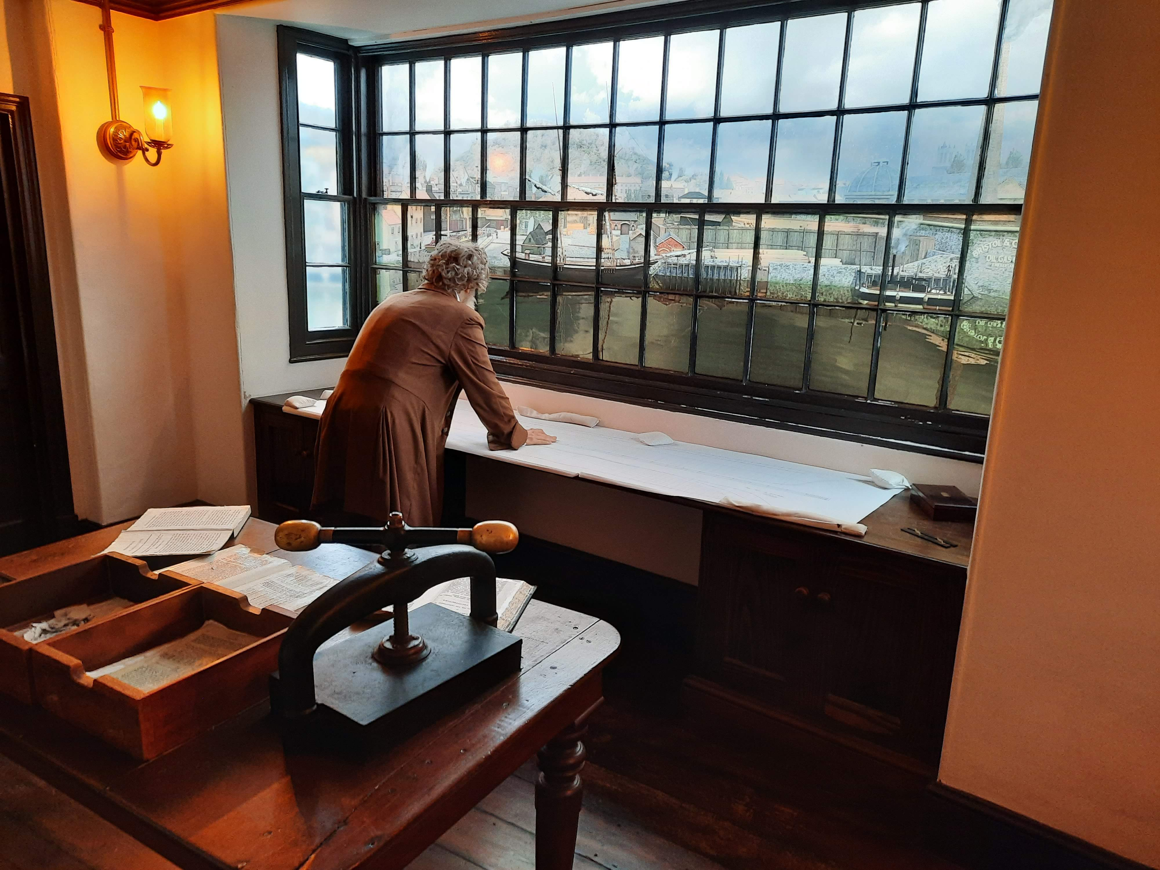
Being Brunel Mannequins
There are no mannequins on the ground floor of Being Brunel.
Ground Floor
1. William Patterson looking at a ship plan
1
First Floor

