Slide 1
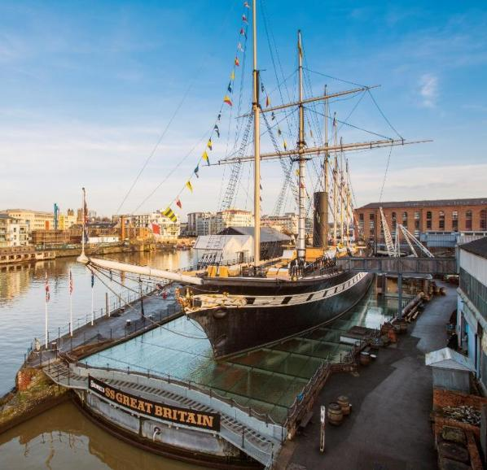

Preparing
for your
visit
Visual Story

Slide 2
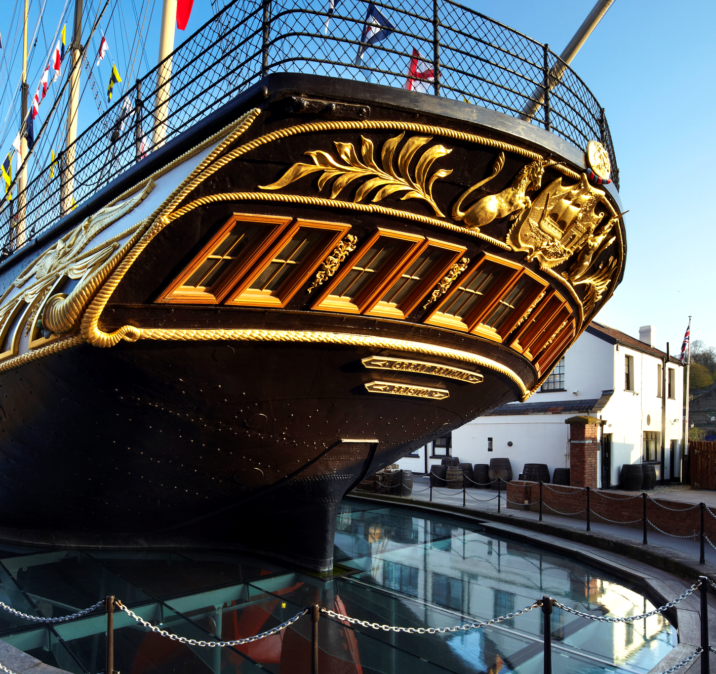
We are going to visit a ship called the SS Great Britain.
It first sailed from Bristol in 1843 and mostly carried passengers between Britain and Australia.
We can go on the ship and see what life was like for people in the past. We can also go into the dry dock and in the museums.

Slide 3
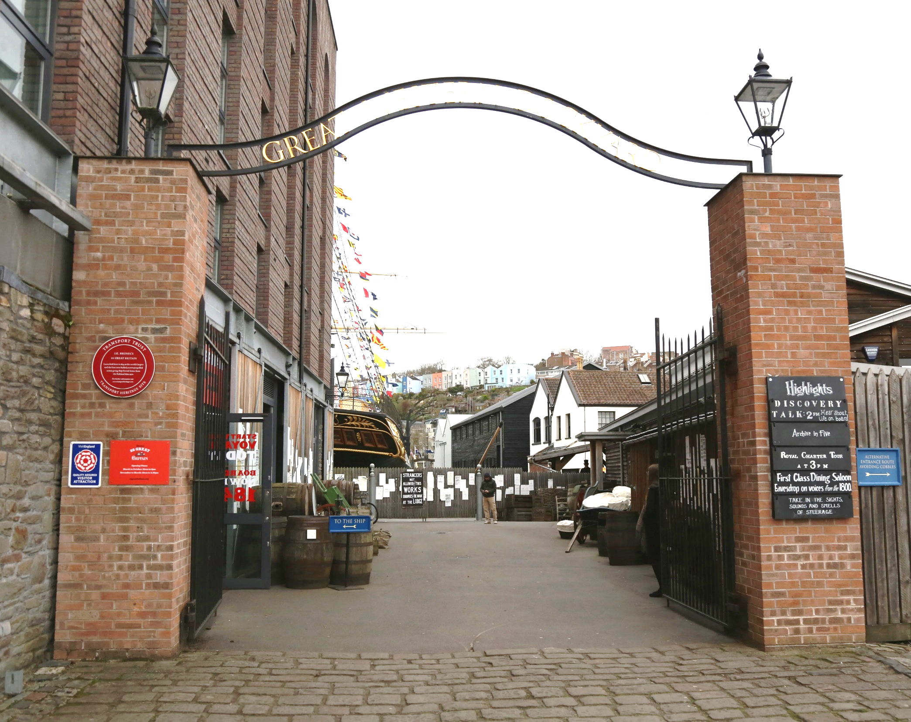
When we arrive
When we arrive at the entrance we will go through these large gates, then turn left into the Visitor Centre.

Slide 4
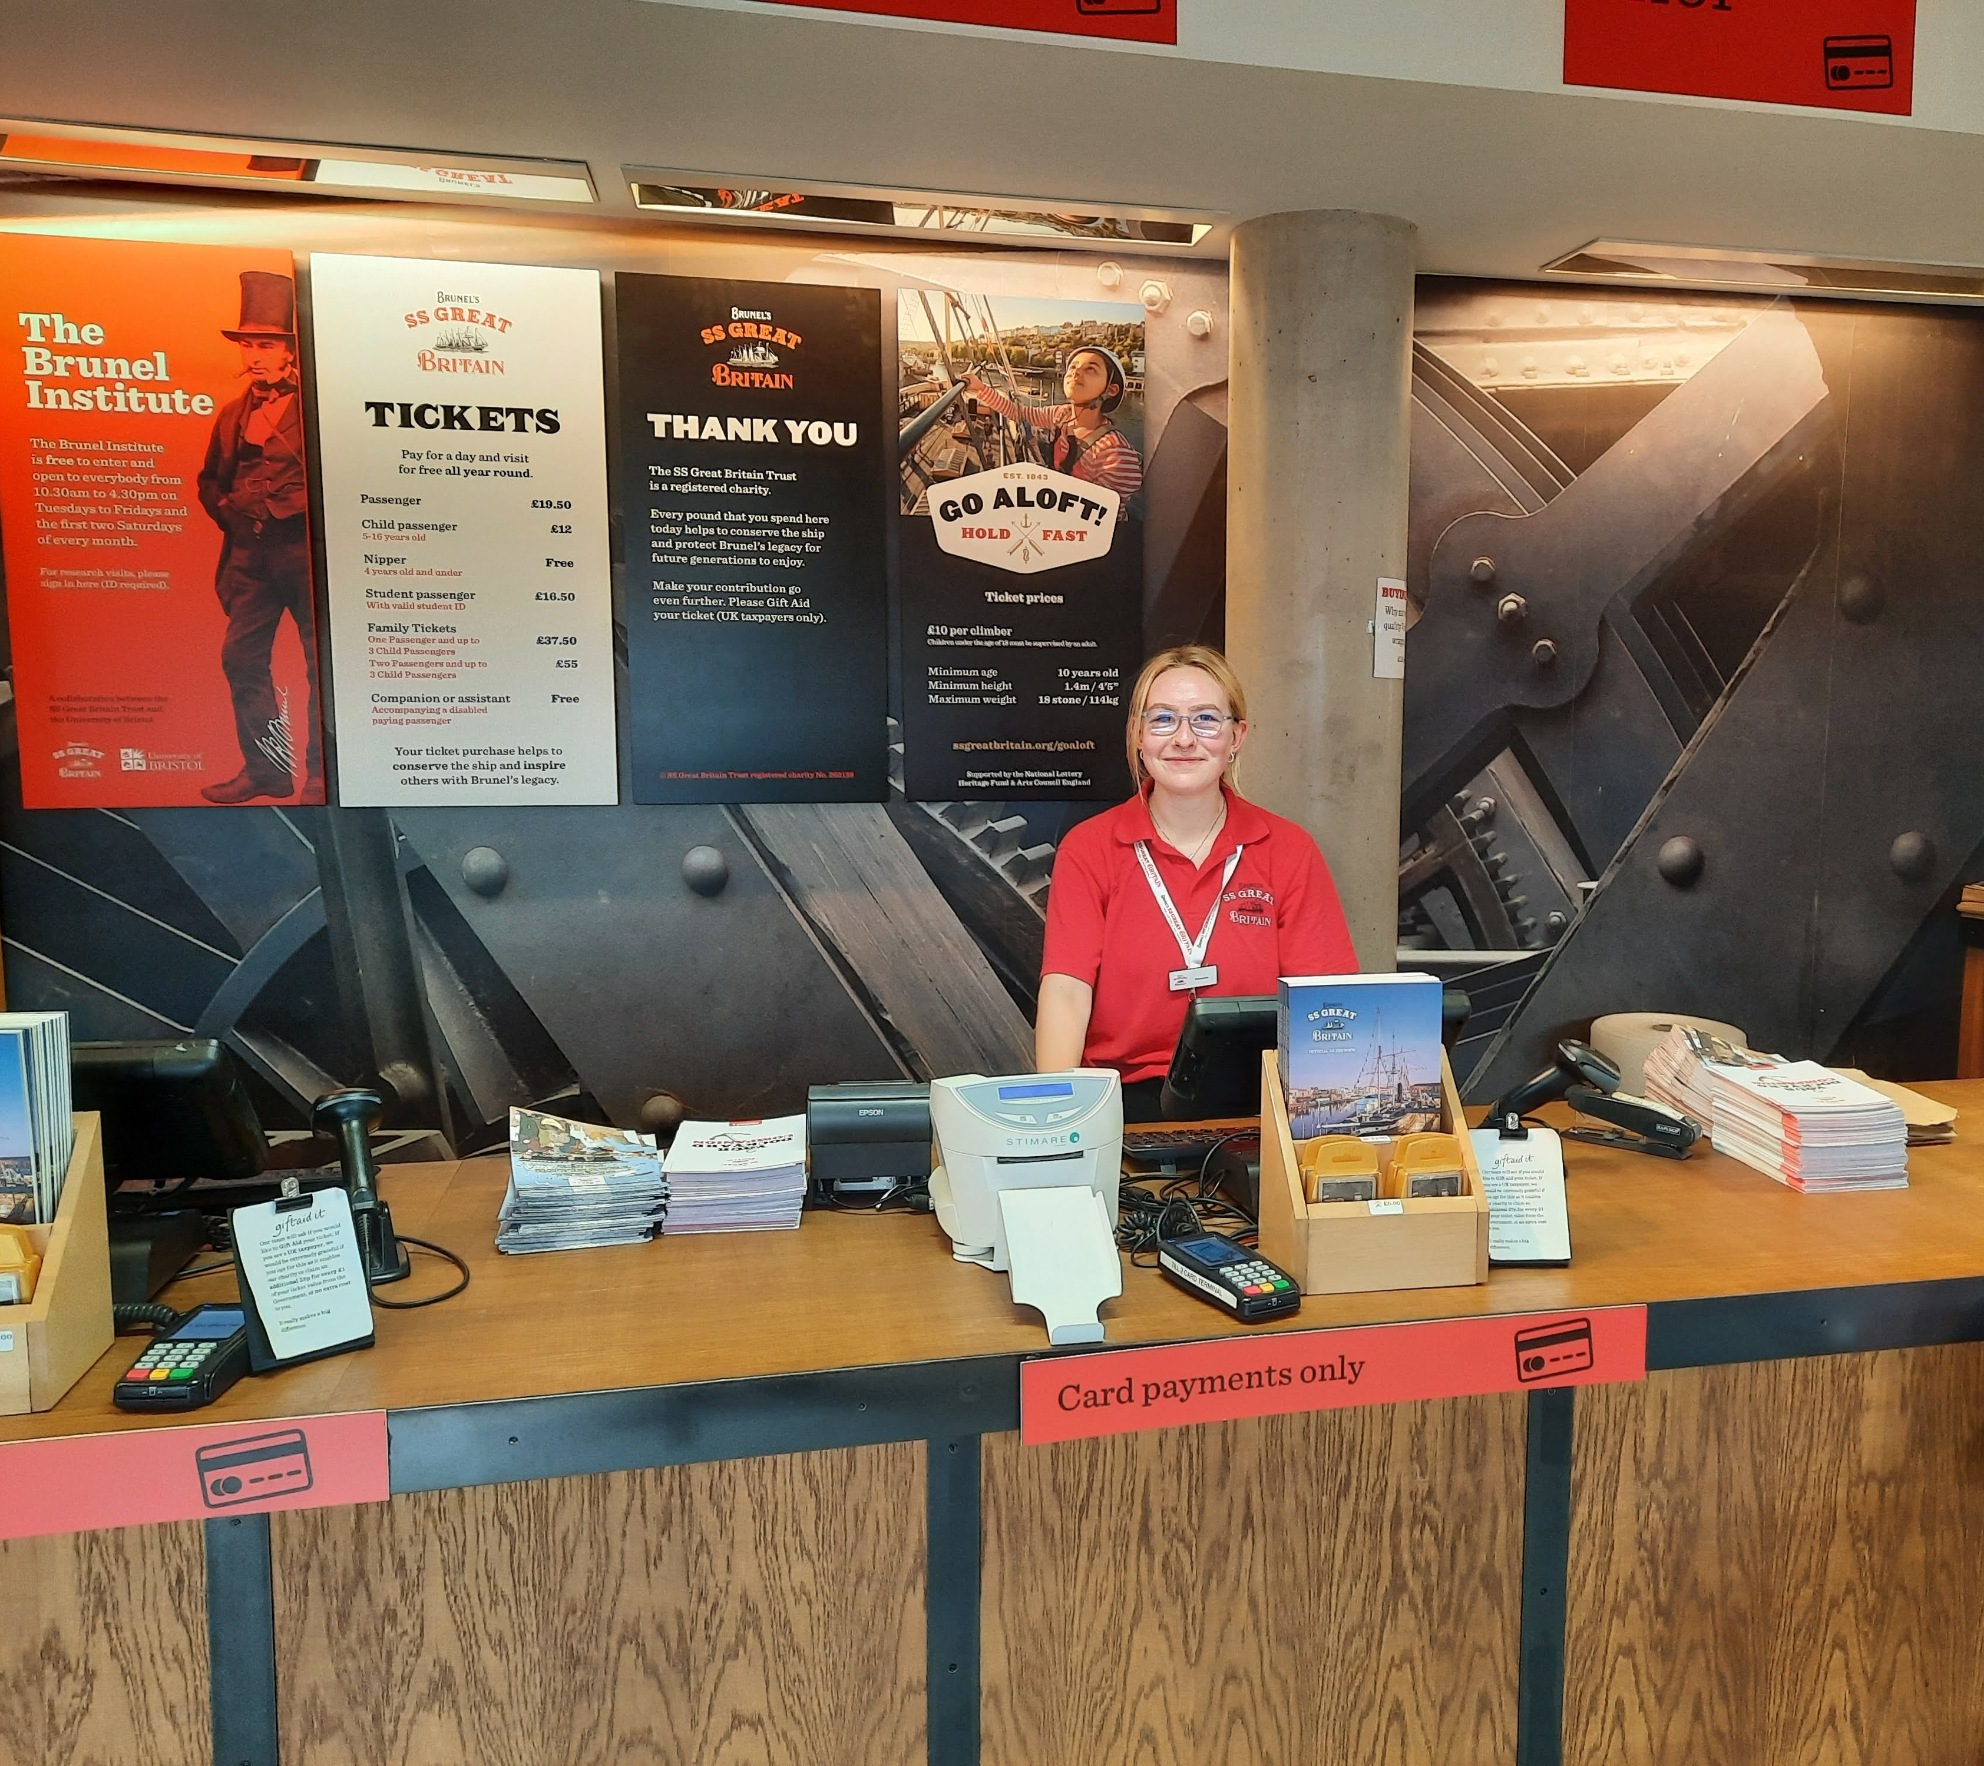
If we need to buy tickets, we will go to the ticket desk.
If it is busy we might need to wait for a few minutes.
If we have pre-booked tickets, we can go straight to the welcome desk.

Slide 5
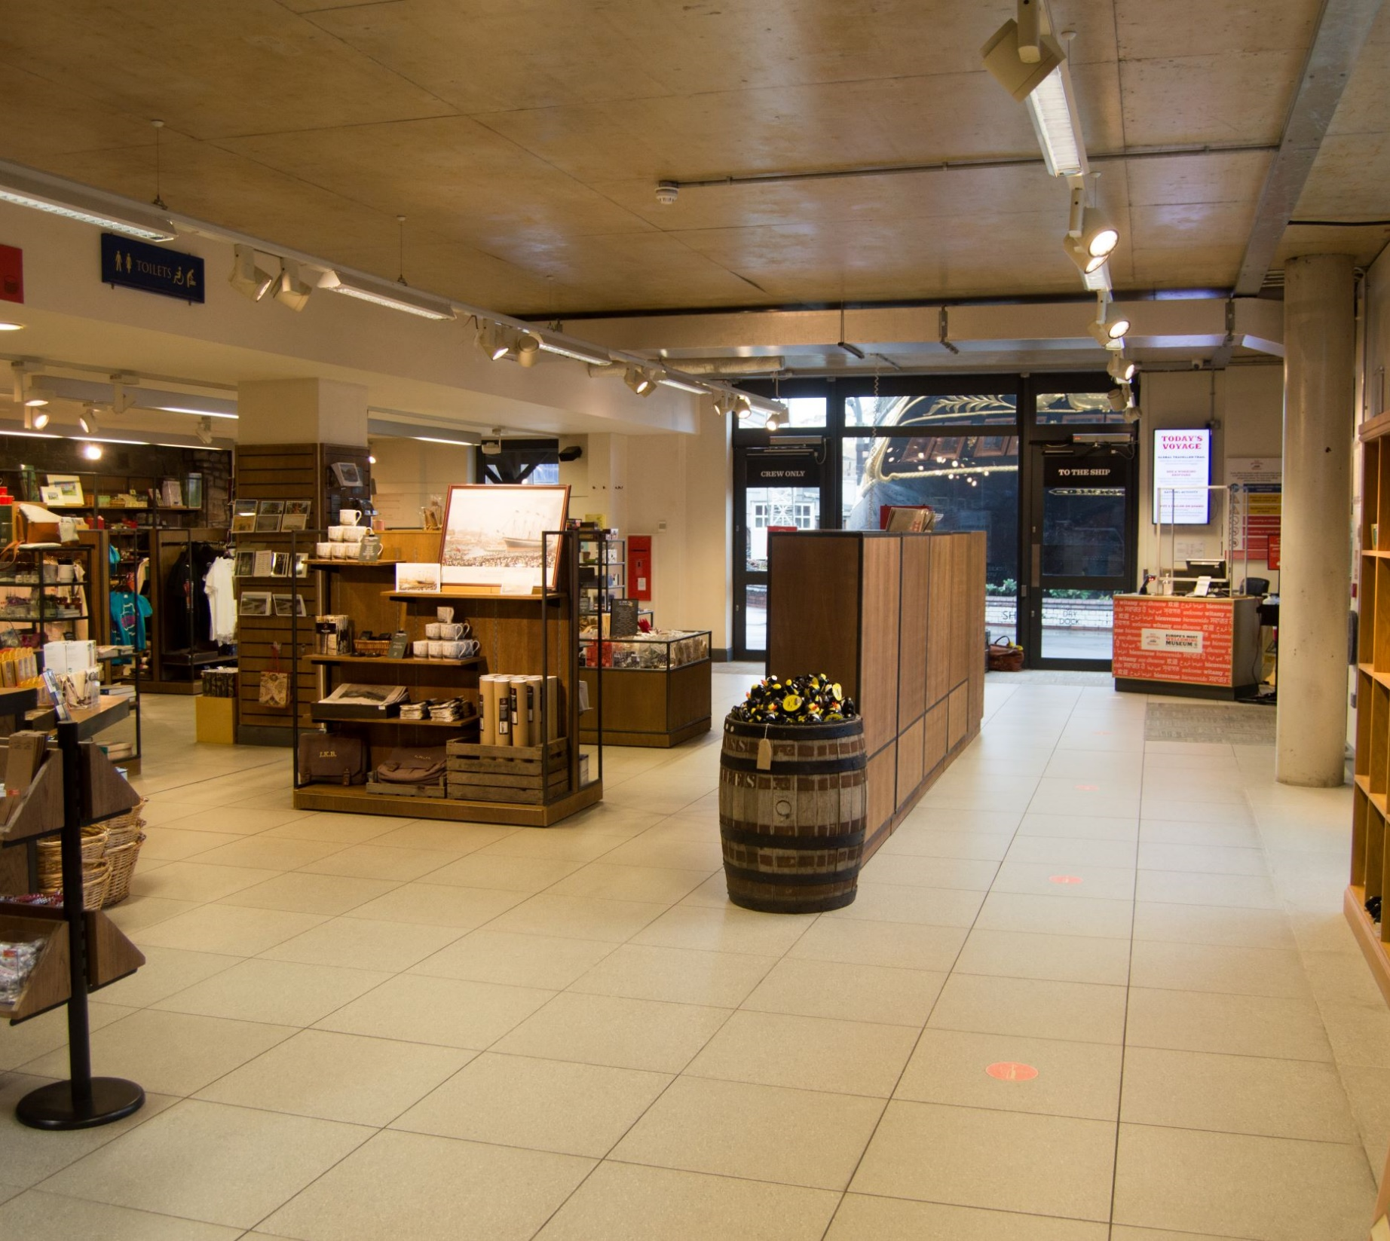
When we have our tickets and are ready, we will walk through the shop to the welcome desk.

Slide 6
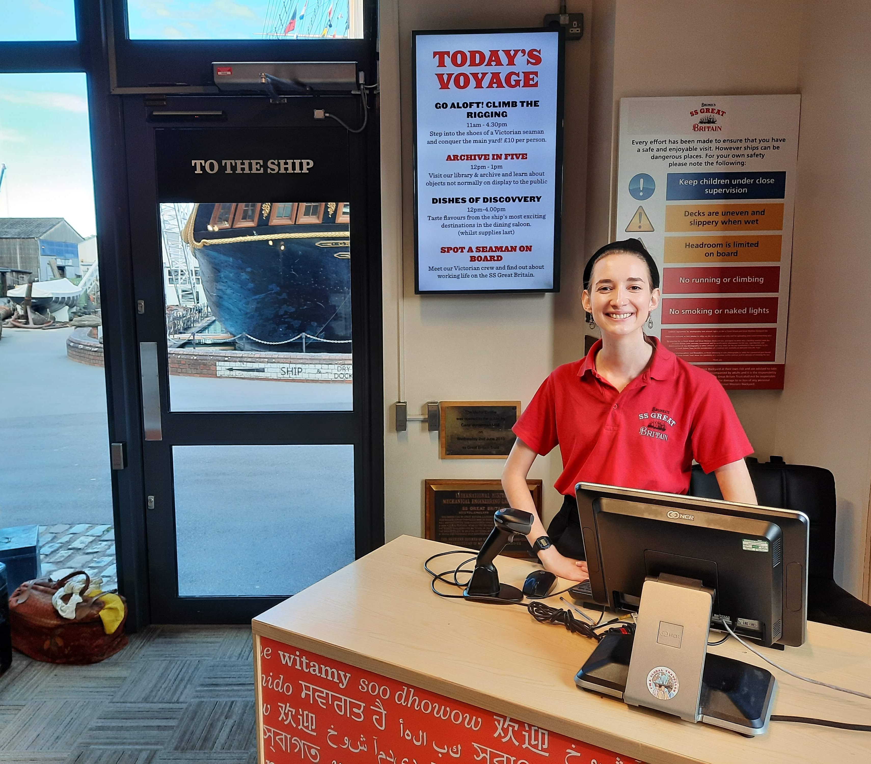
A staff member at the welcome desk will check our tickets and we will walk through the entrance door.
There will be other people visiting so we need to stay with our group.

Slide 7
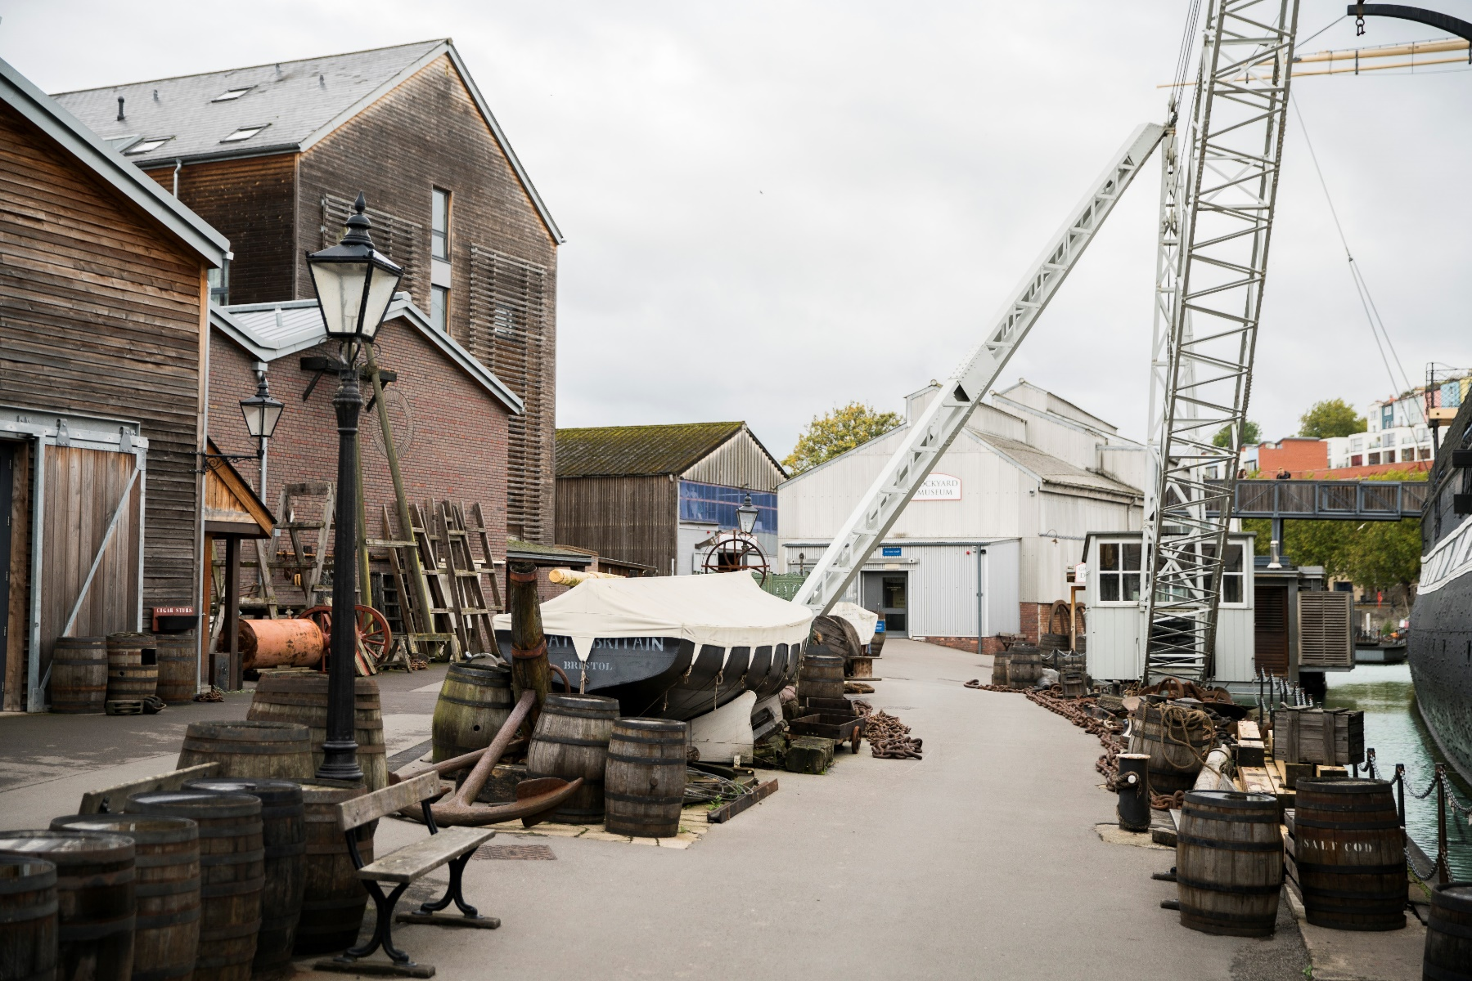
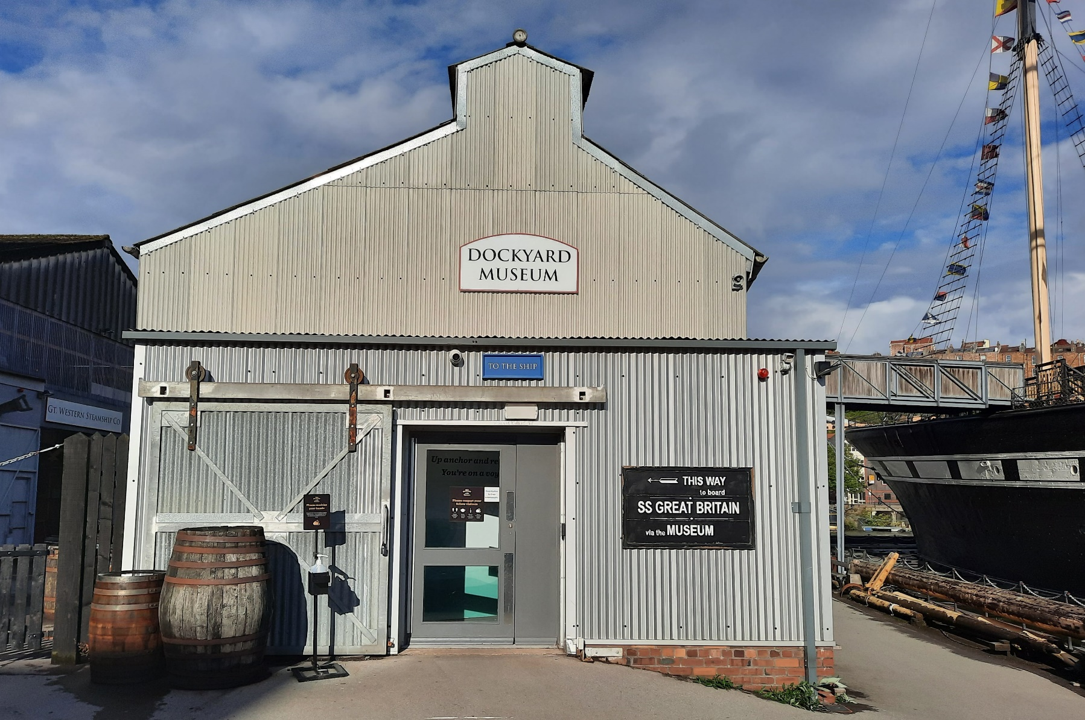
Places we might see or go
The area around the ship is the Great Western Dockyard.
There are barrels, anchors, chains - and lots of other things we can find.
This is the Dockyard Museum. We go through the Museum to get onto the ship.

Slide 8
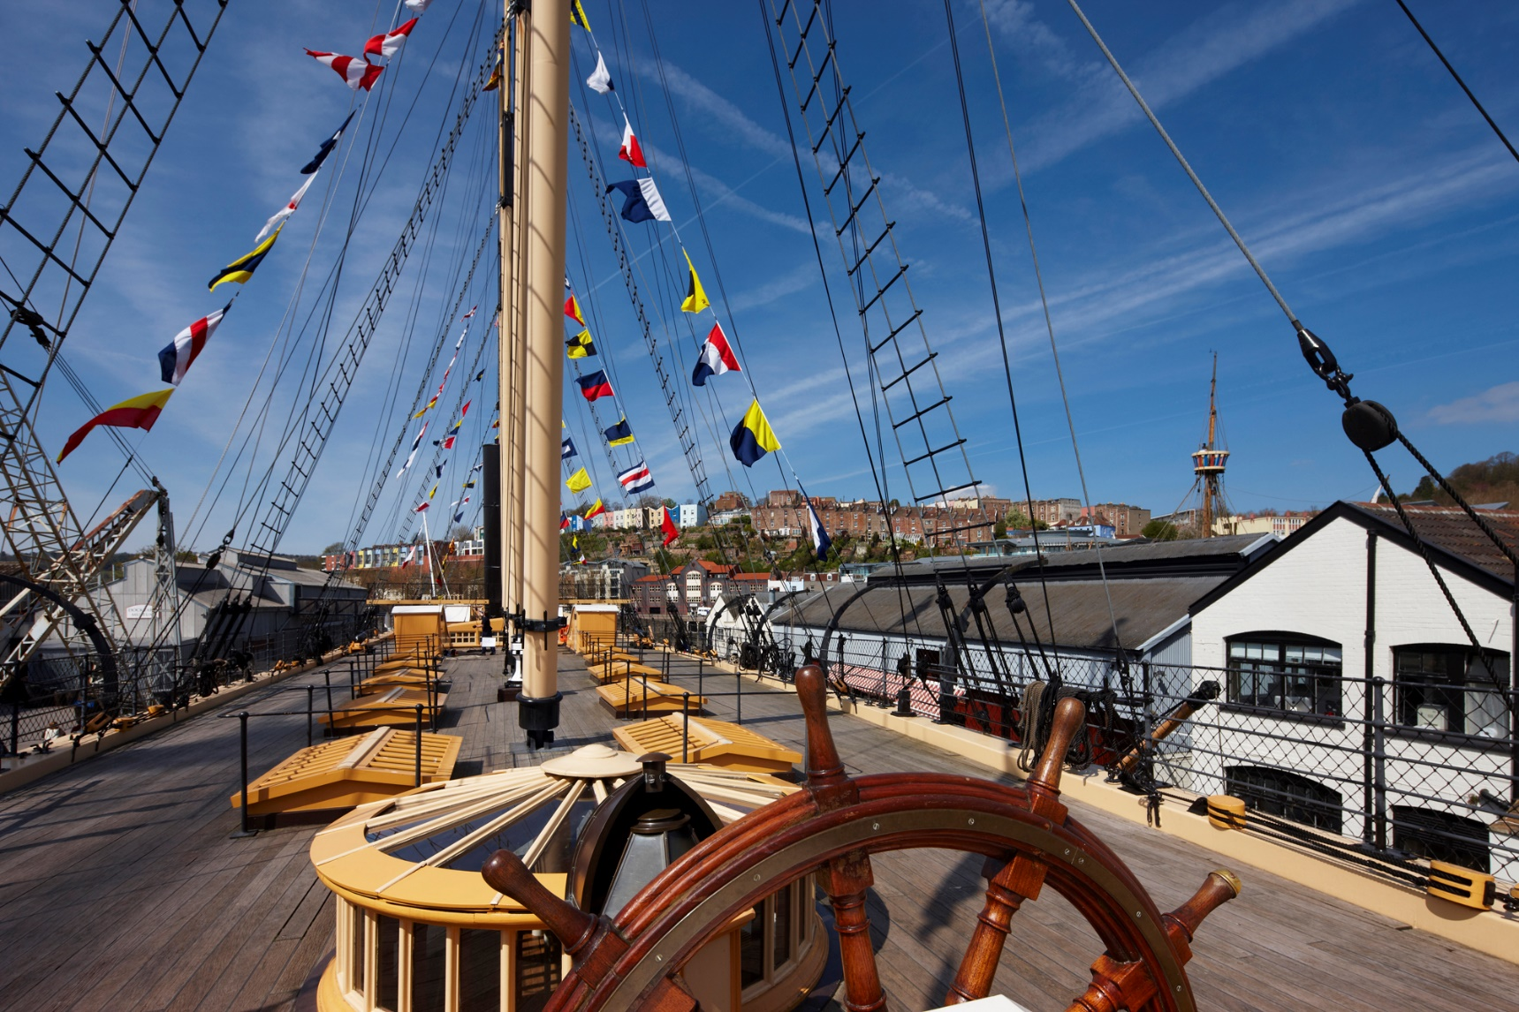
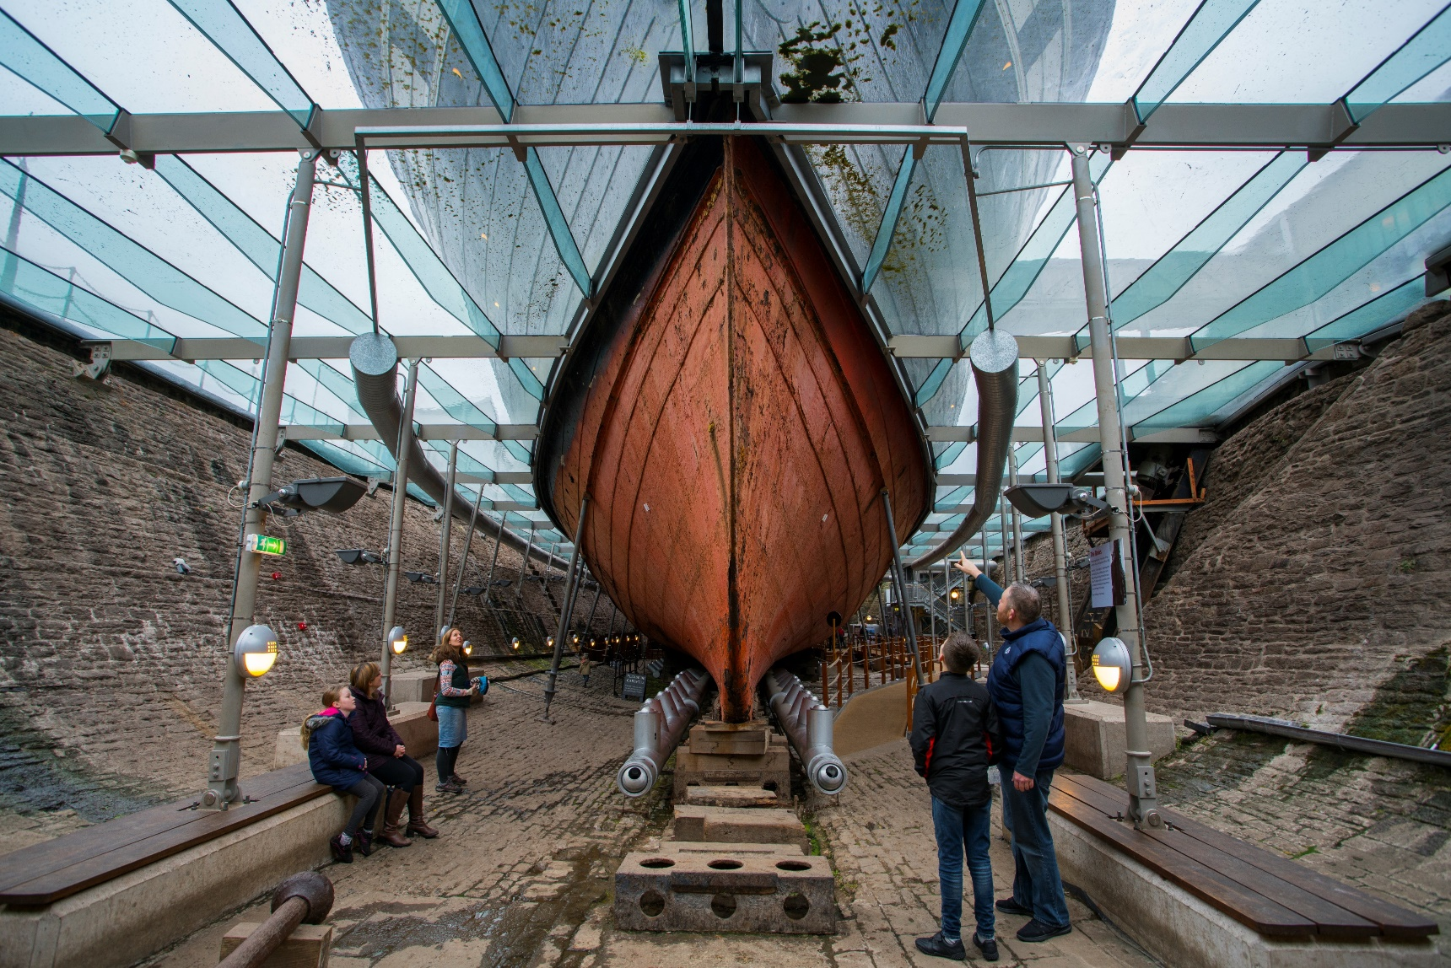
Places we might see or go to
We can go on the ship.
This is the weather deck, which is outside. We can also go inside the ship and explore two more decks.
We can go down into the Dry Dock underneath the ship.
We can see the hull of the ship up close and the propellor. We can feel the warm air from the dehumidifier which stops the ship rusting away.

Slide 9
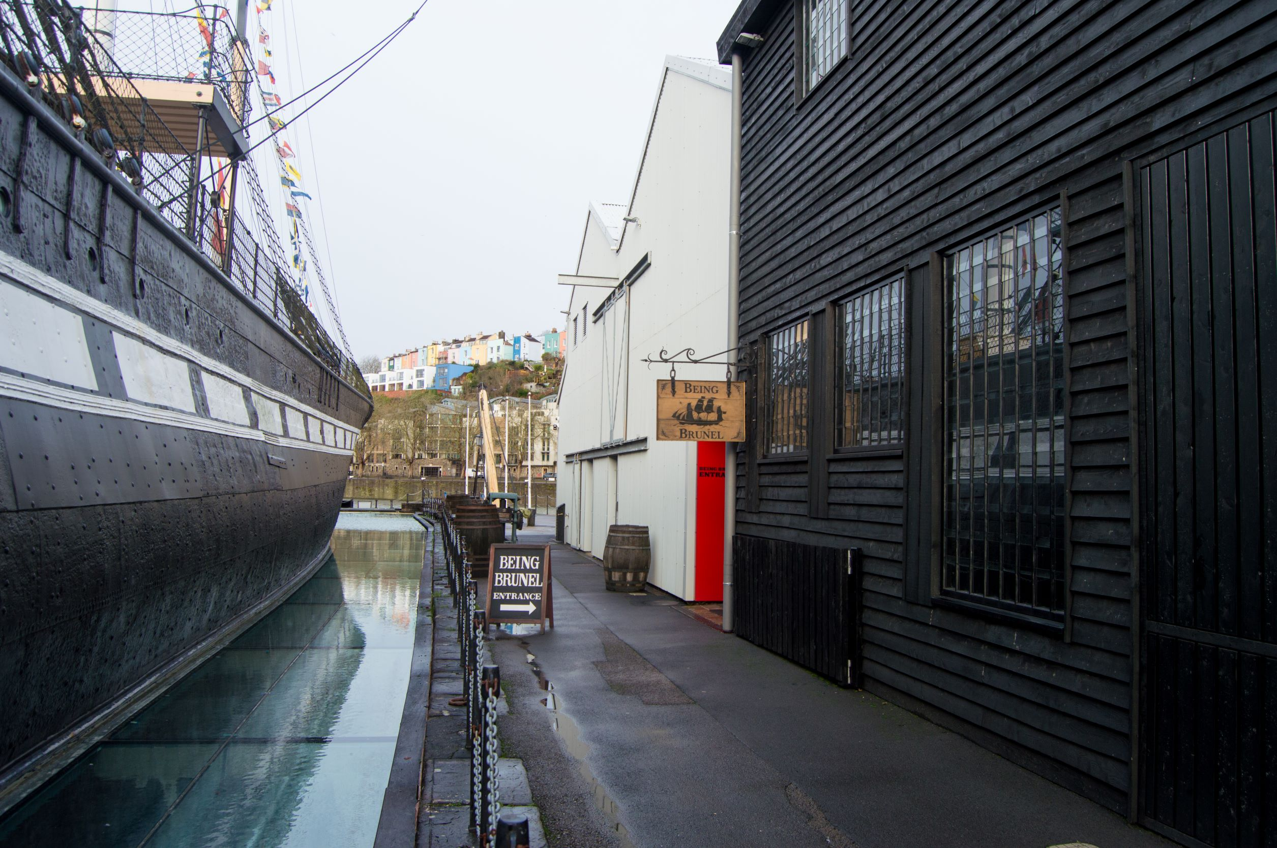
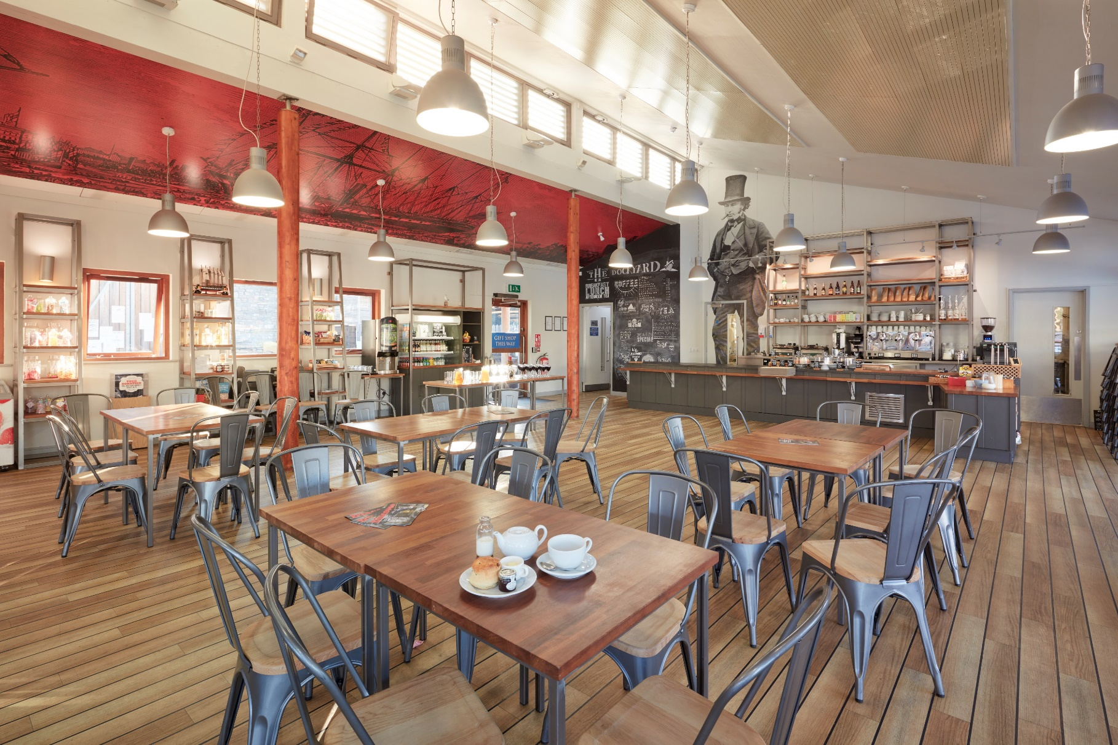
Places we might see or go to
This is the entrance to Being Brunel. In here we can find out more about Isambard Kingdom Brunel, the man who designed the SS Great Britain, the Great Western Railway – and many other things.
This is the Harbourside Café. To get to the café from the dockyard, we go out through the shop and turn left.

Slide 10
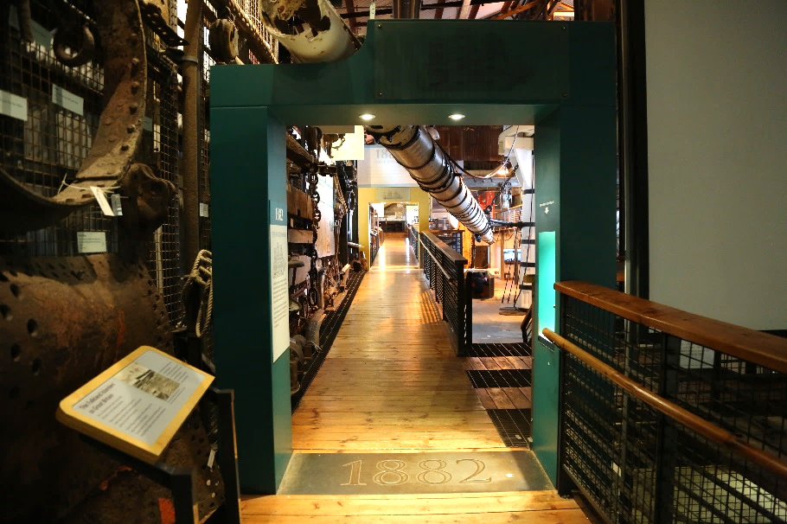
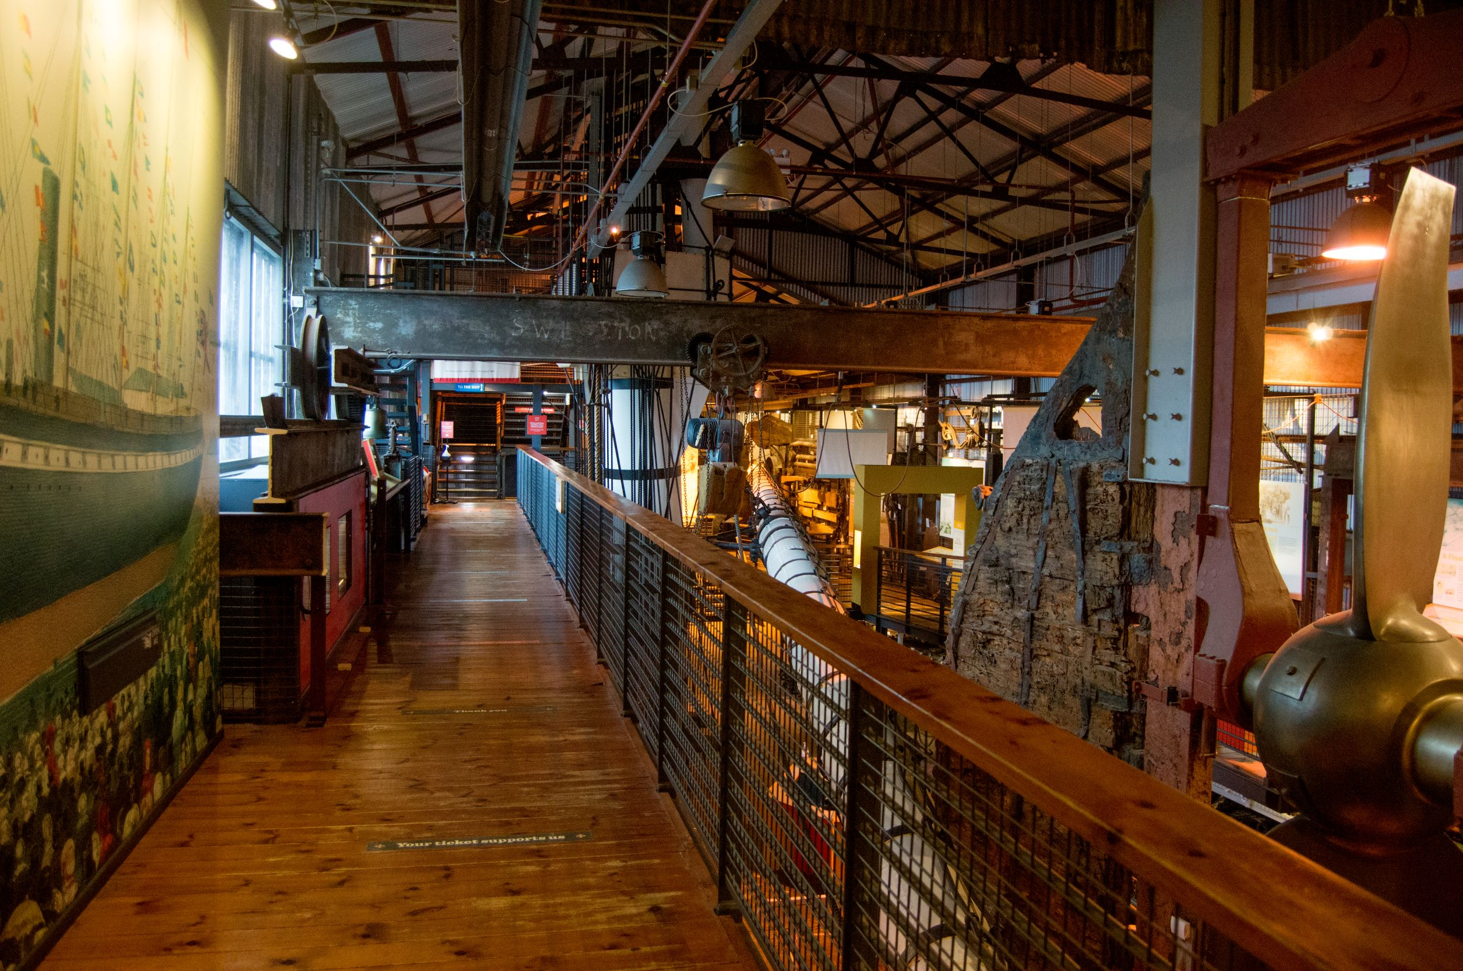
Inside the Dockyard Museum
The Dockyard Museum contains objects and pictures that tell us the story of the ship. We can dress up in Flash, Bang Wallop and climb steps to the crows’ nest at the top of the main mast.
We will follow the walkway then use the stairs or lift to reach the bridge which crosses over onto the ship.

Slide 11
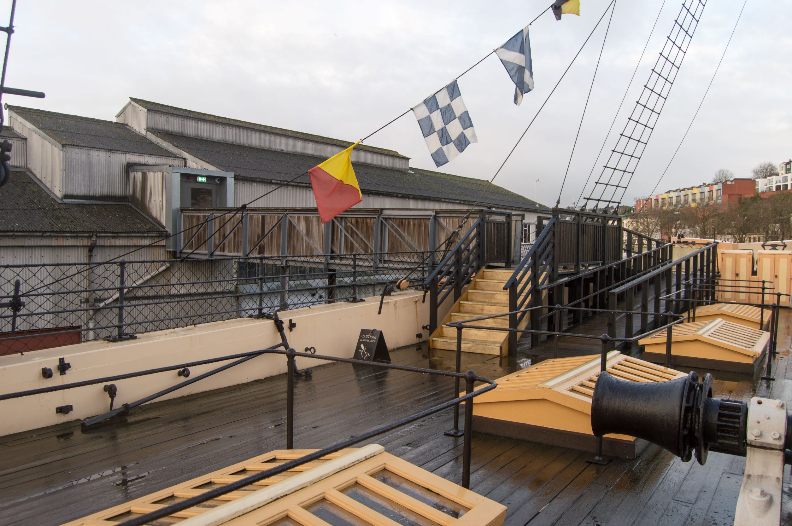
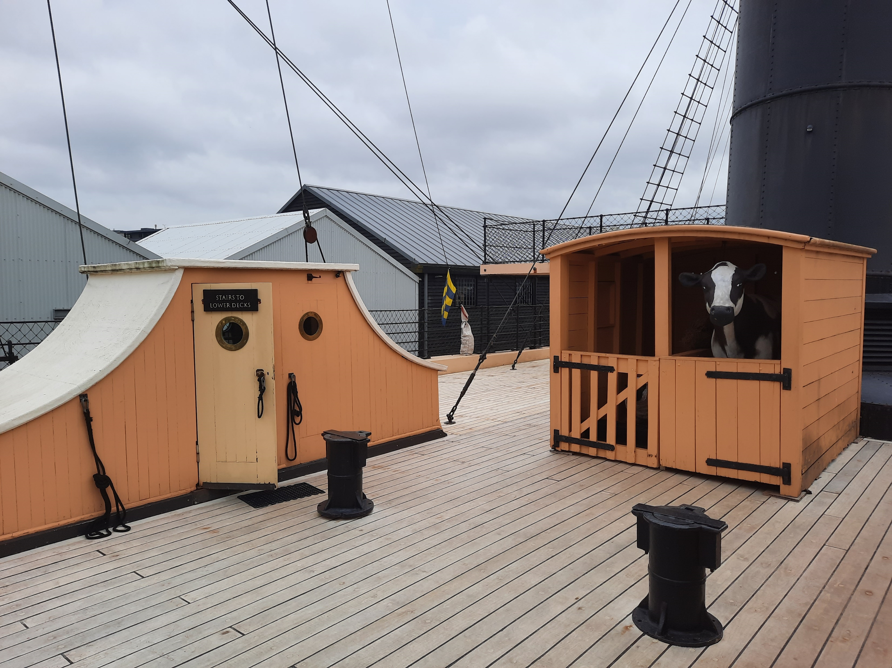
On the ship
This is the Weather deck. We can walk around the deck. We might find some plastic animals, see signal flags and Bristol Harbour.
We can go through a door like this one to get inside the ship. Steep steps lead us down to the promenade deck. There is a lift which also goes to the promenade deck.

Slide 12
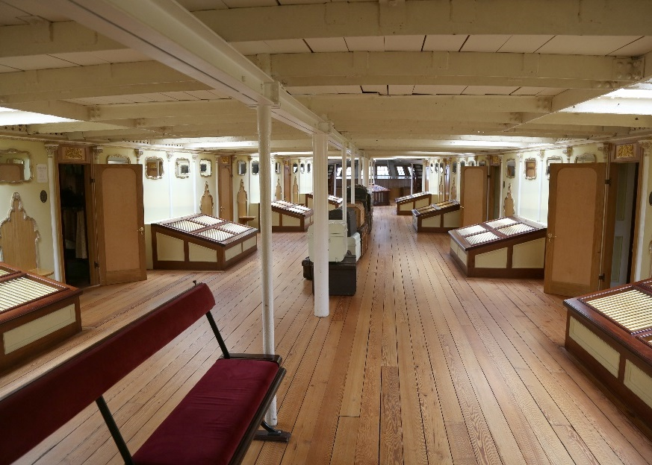
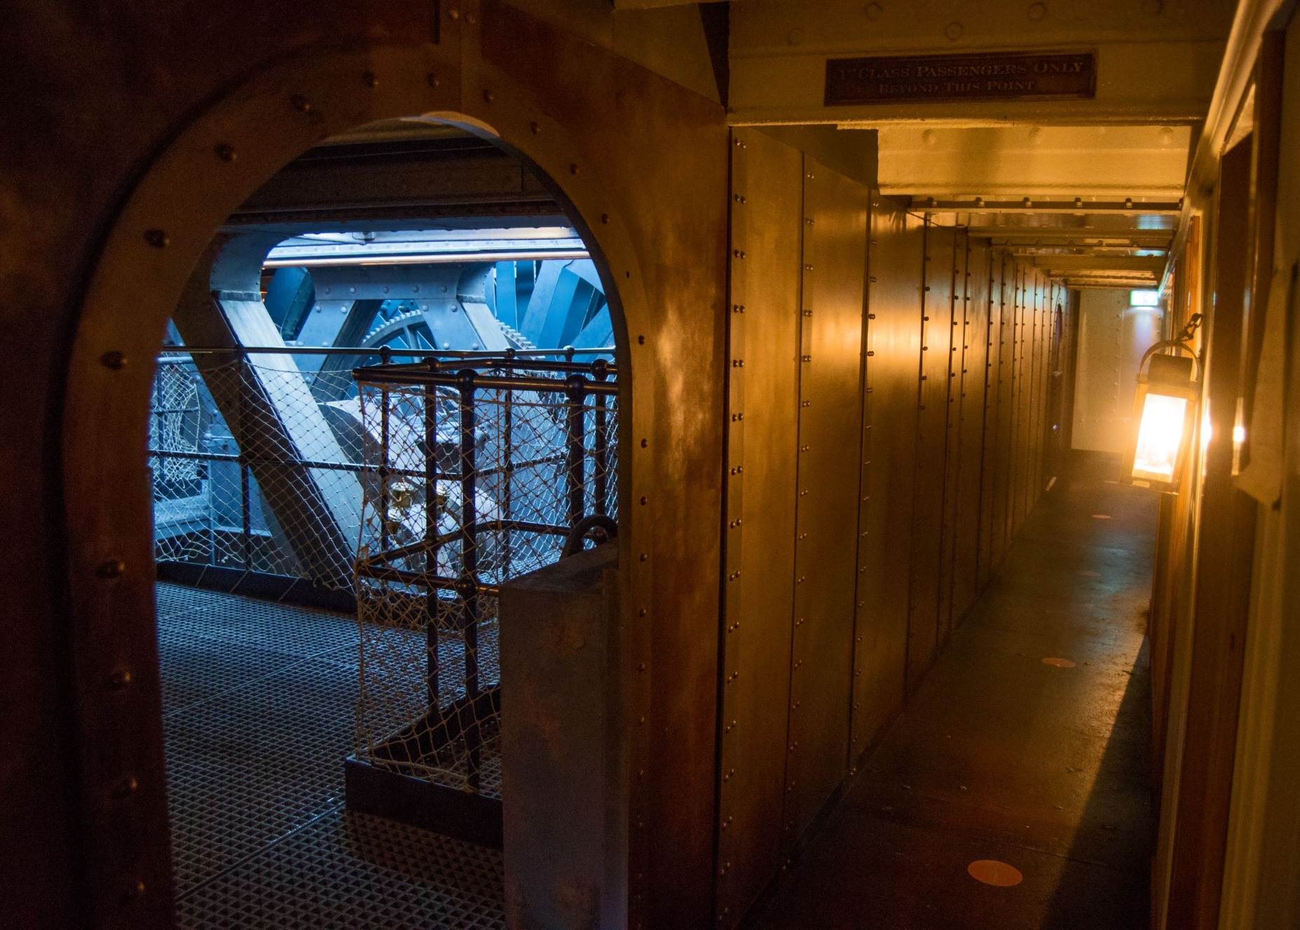
Some parts of the ship are light and open. This is the Promenade Saloon.
The floors are made of wooden planks which are sometimes uneven and have gaps between them but are completely safe.
Other parts might be dark and narrow.
This is the engine room.
The floors here are made of metal.

Slide 13
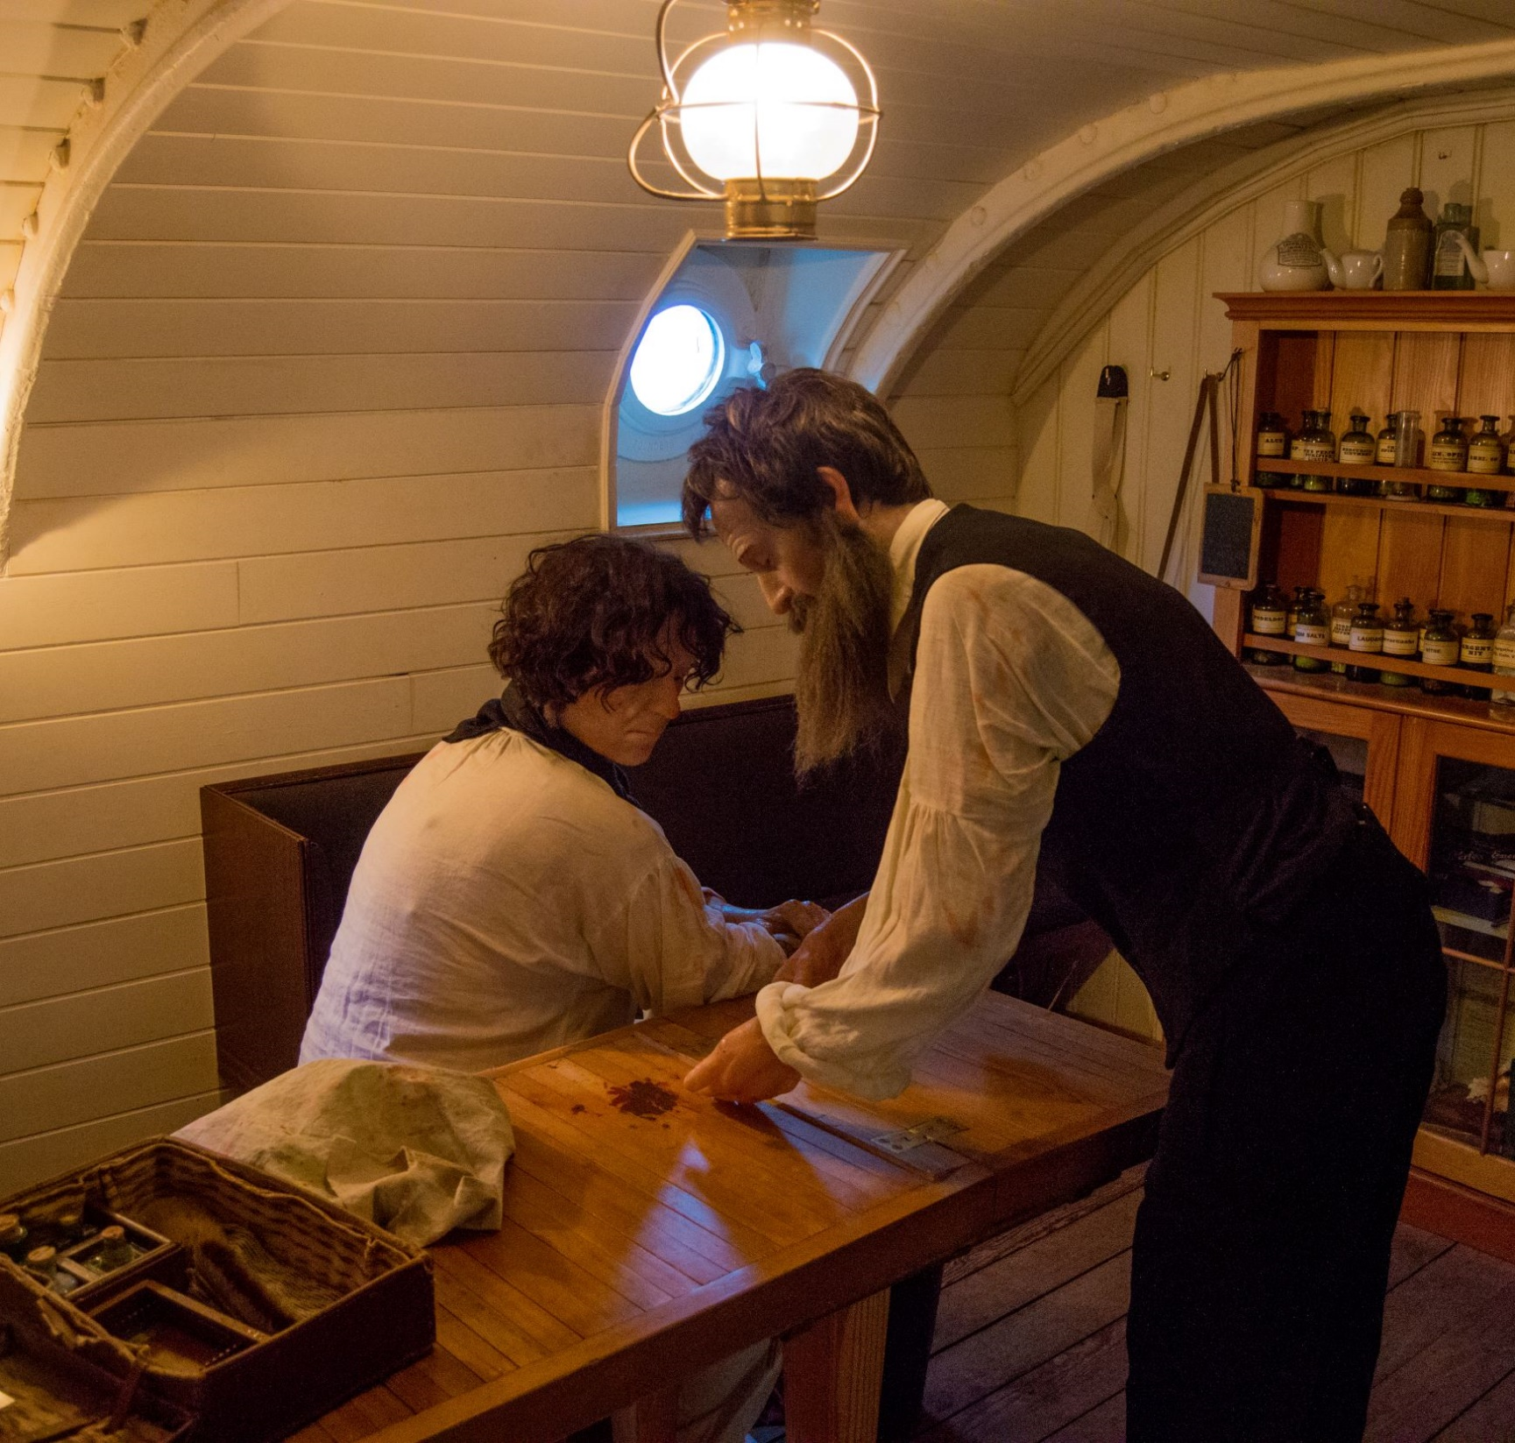
There are mannequins that represent real people who travelled on the ship in the past.
The doctor in this picture was called Samuel Archer. There are mannequins in many rooms on the ship.

Slide 14
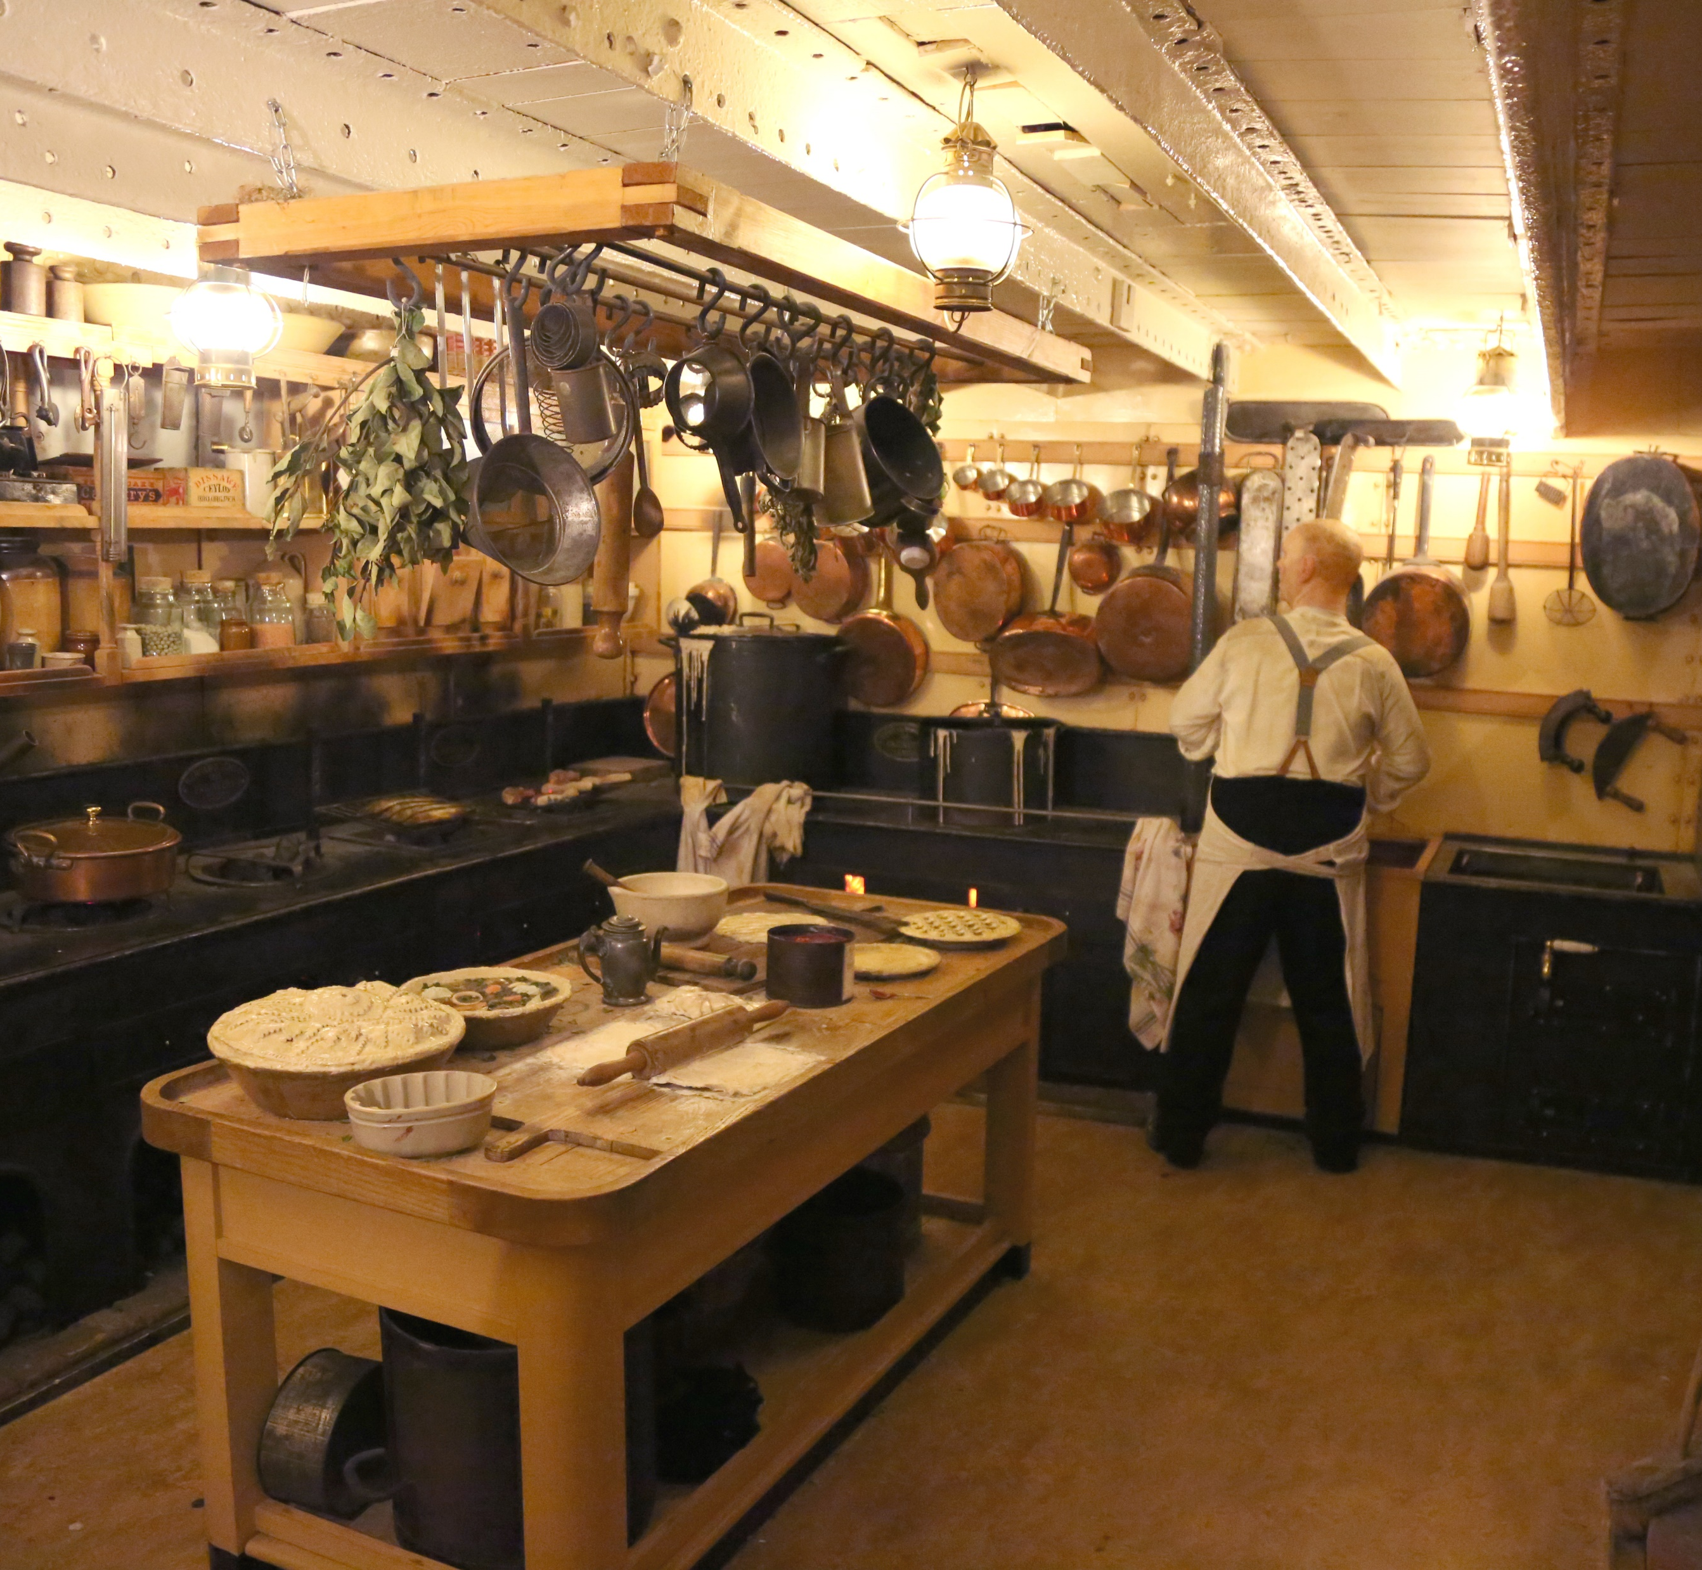
We will hear recordings of sounds like people talking, violins playing and babies crying. We will smell unusual smells. These are designed to help us imagine what life was like in the past.
There are sounds and smells in most rooms. Some of the sounds play automatically and some are trigged by sensors as we pass by.

Slide 15
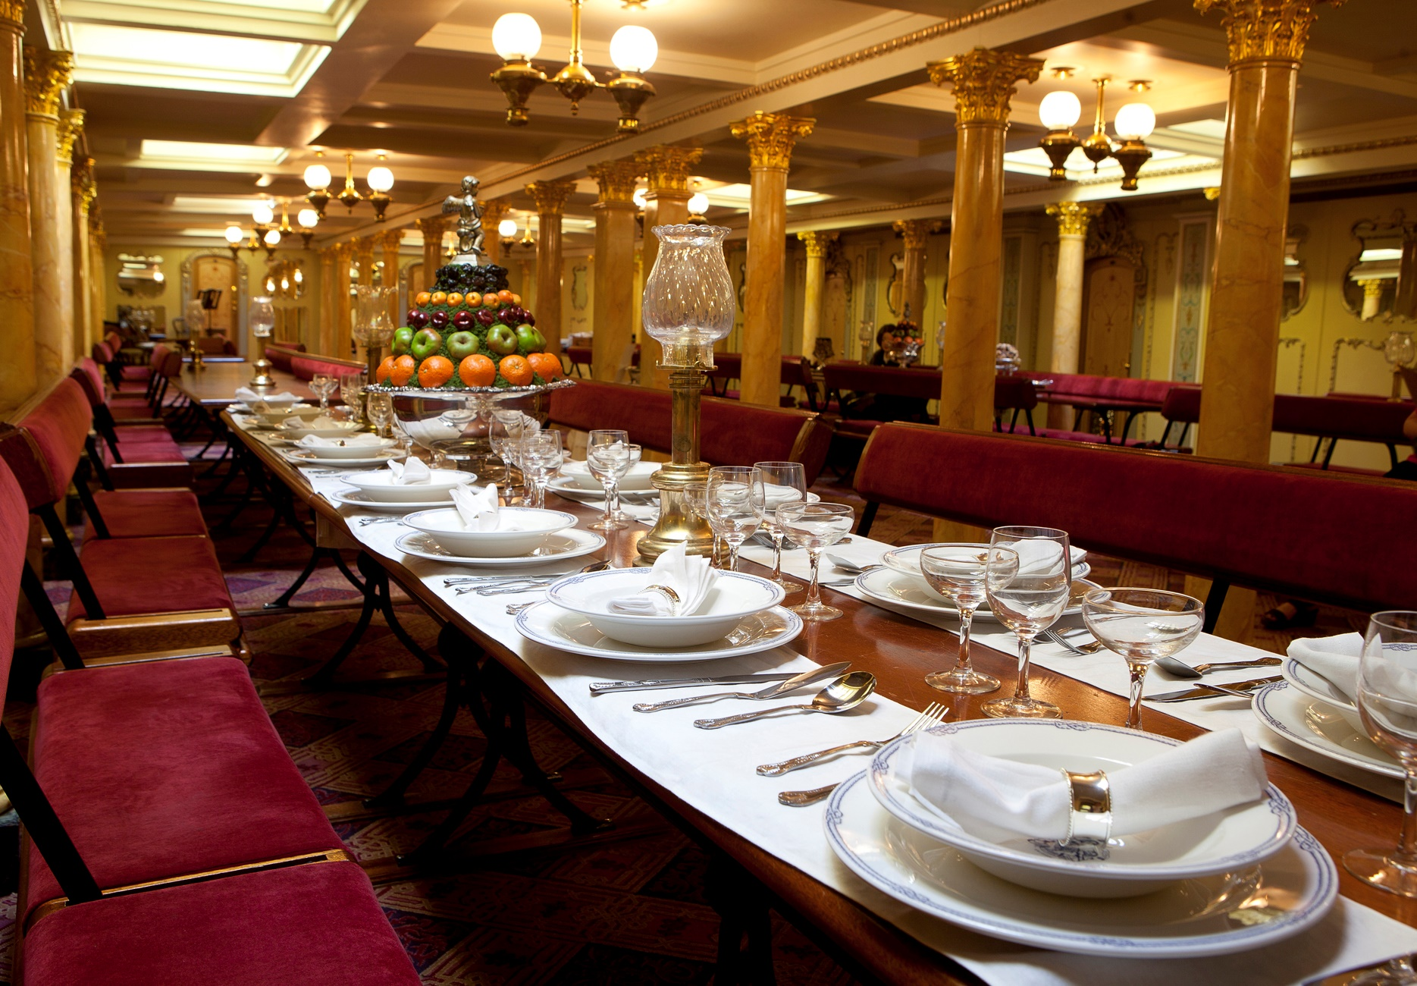
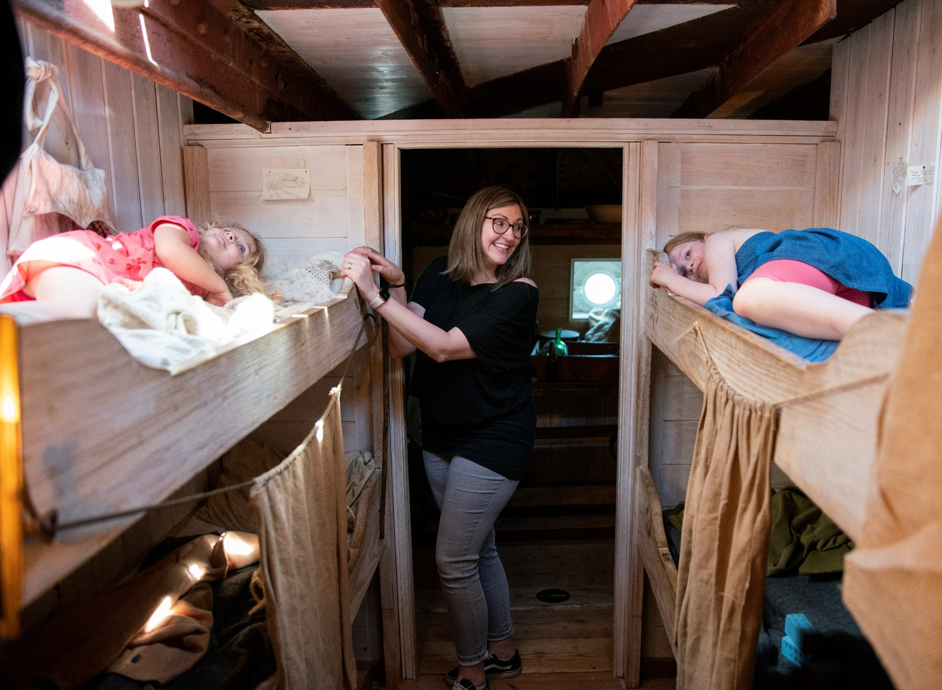
We can touch everything on board. In the dining saloon, we can imagine we are eating a meal and pick up the cutlery and glasses.
We can climb into the bunks and see if they feel comfortable.

Slide 16
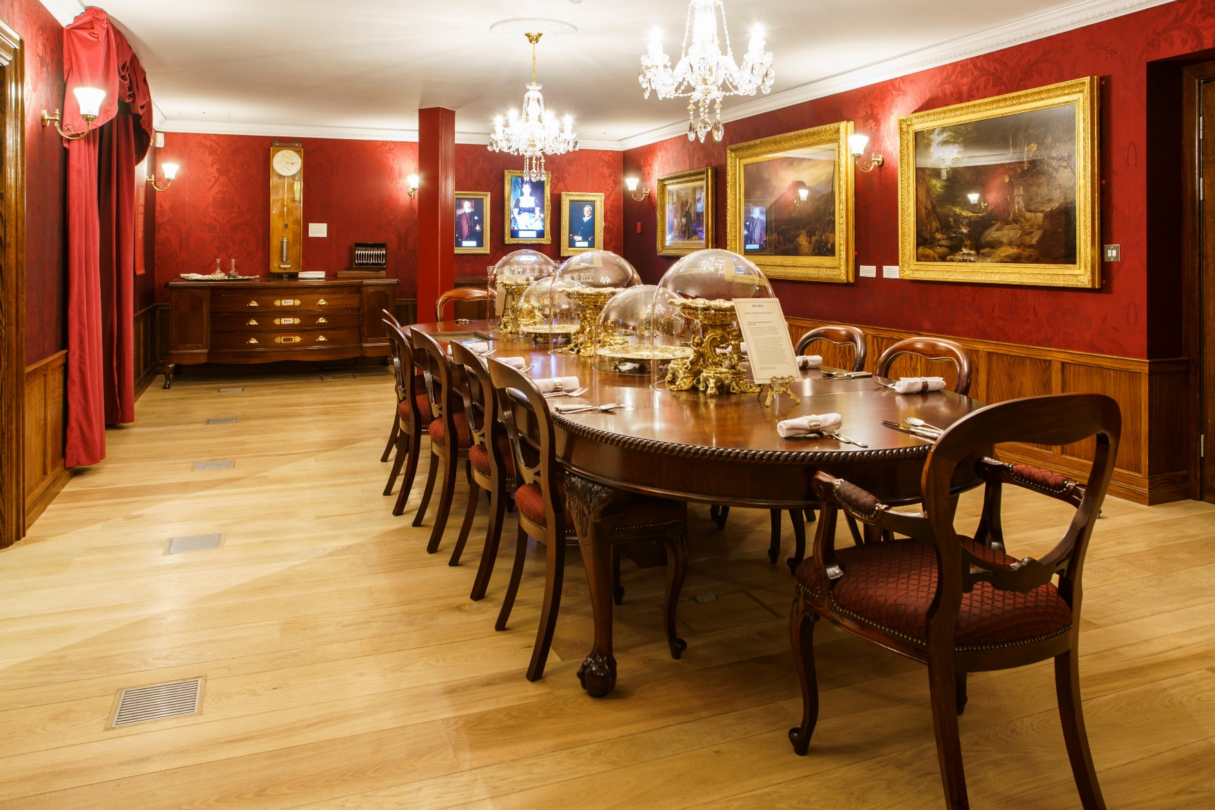
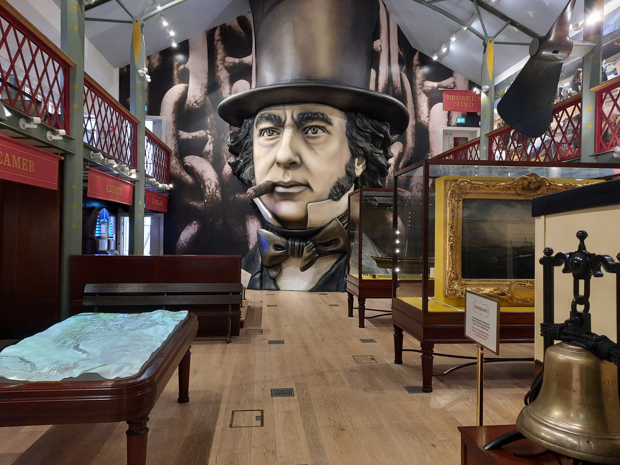
Inside Being Brunel
This is the first room in the museum. It is a recreation of Brunel’s Dining Room at his house in London. We can watch videos of actors playing his family members and play games on computers in the table.
This is the main room in the museum. We can see paintings, drawings and objects and learn about Brunel’s projects. There are drawers we can open and there is a railway carriage we can go inside that slowly rocks as if it was moving on a railway line.

Slide 17
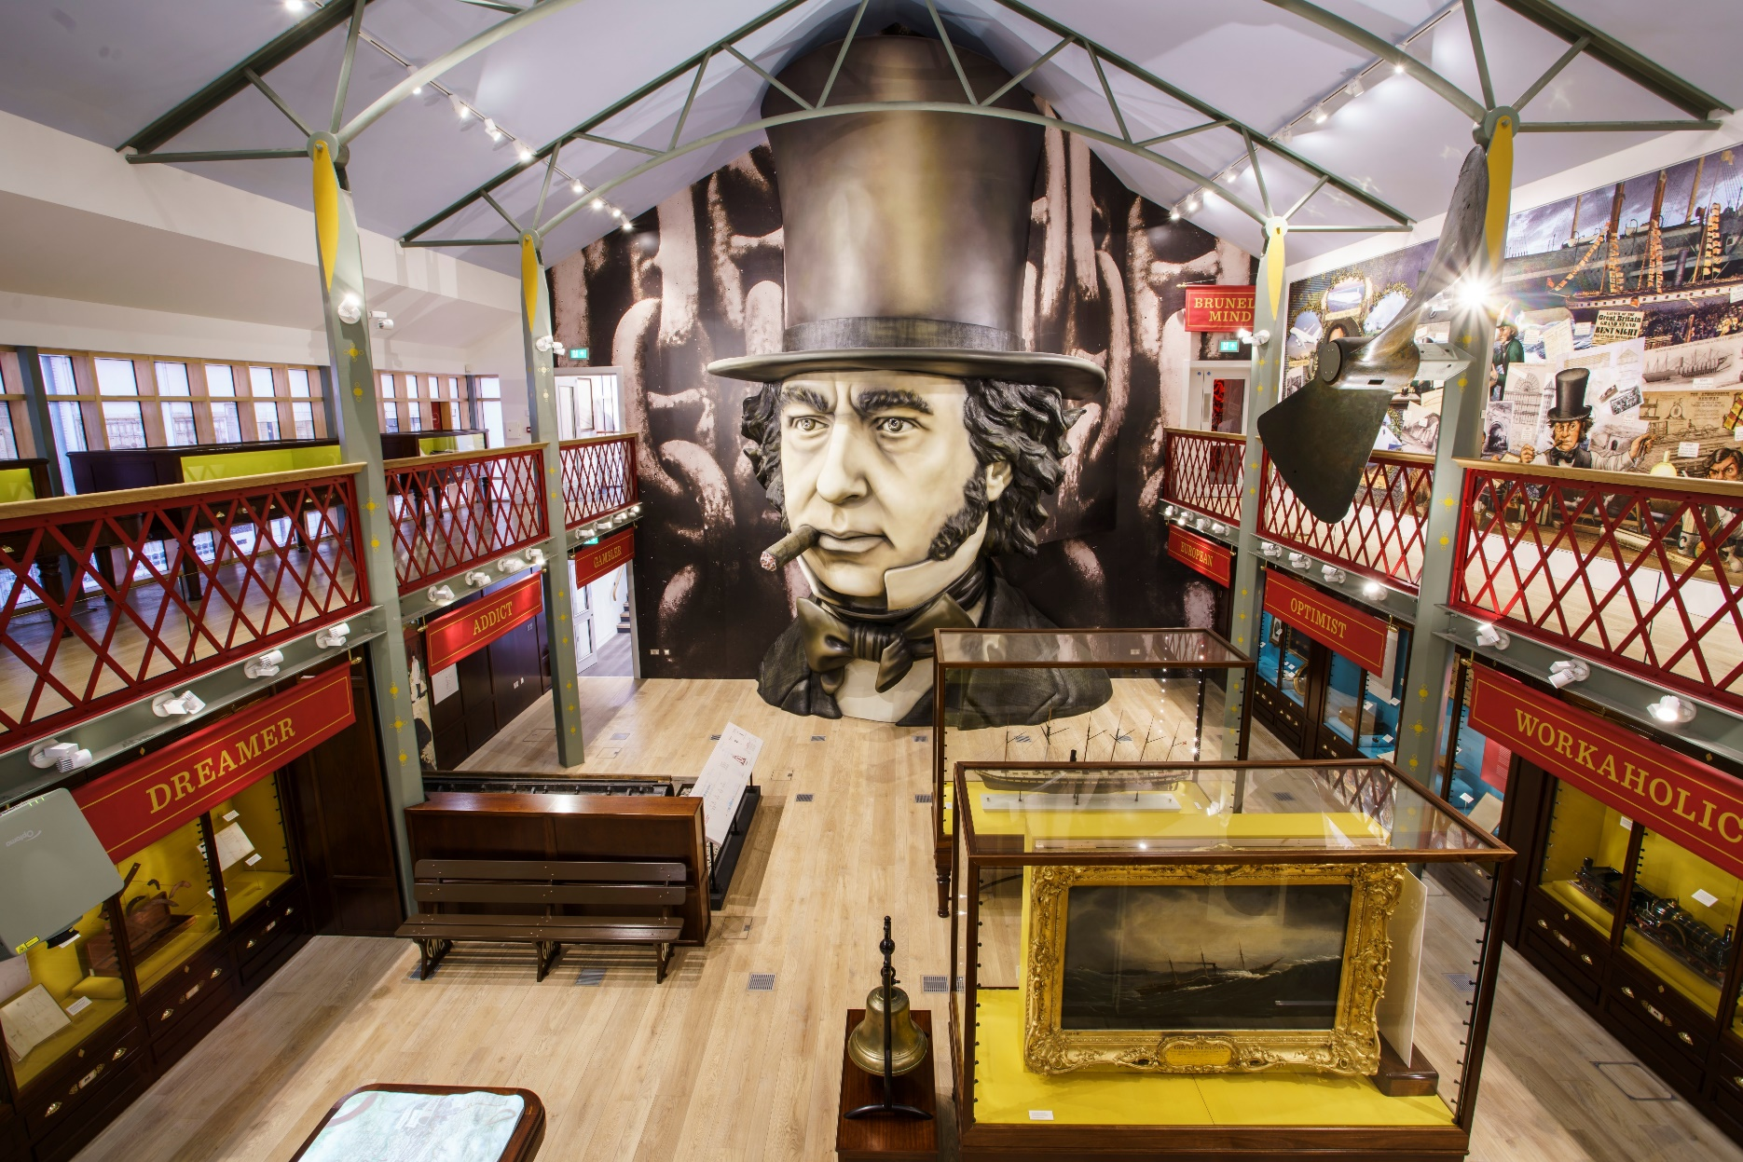
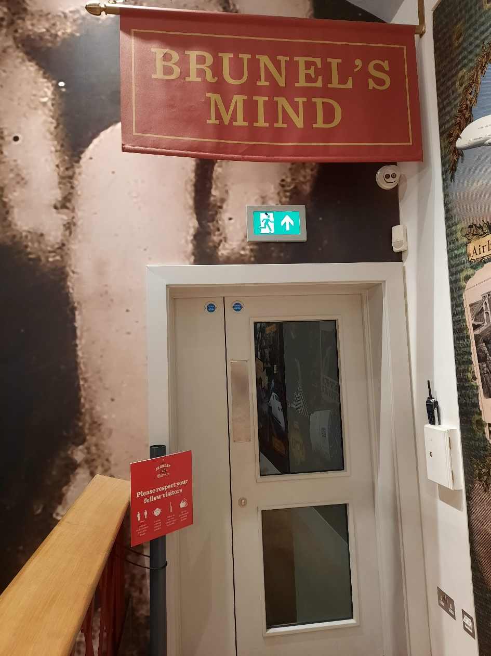
On the first floor of the main room, we have a choice where to explore next. There is always a member of staff or a volunteer in the museum, and they can help us choose which parts of the museum to explore next.
We can choose to go through the door and watch a video about Brunel.

Slide 18
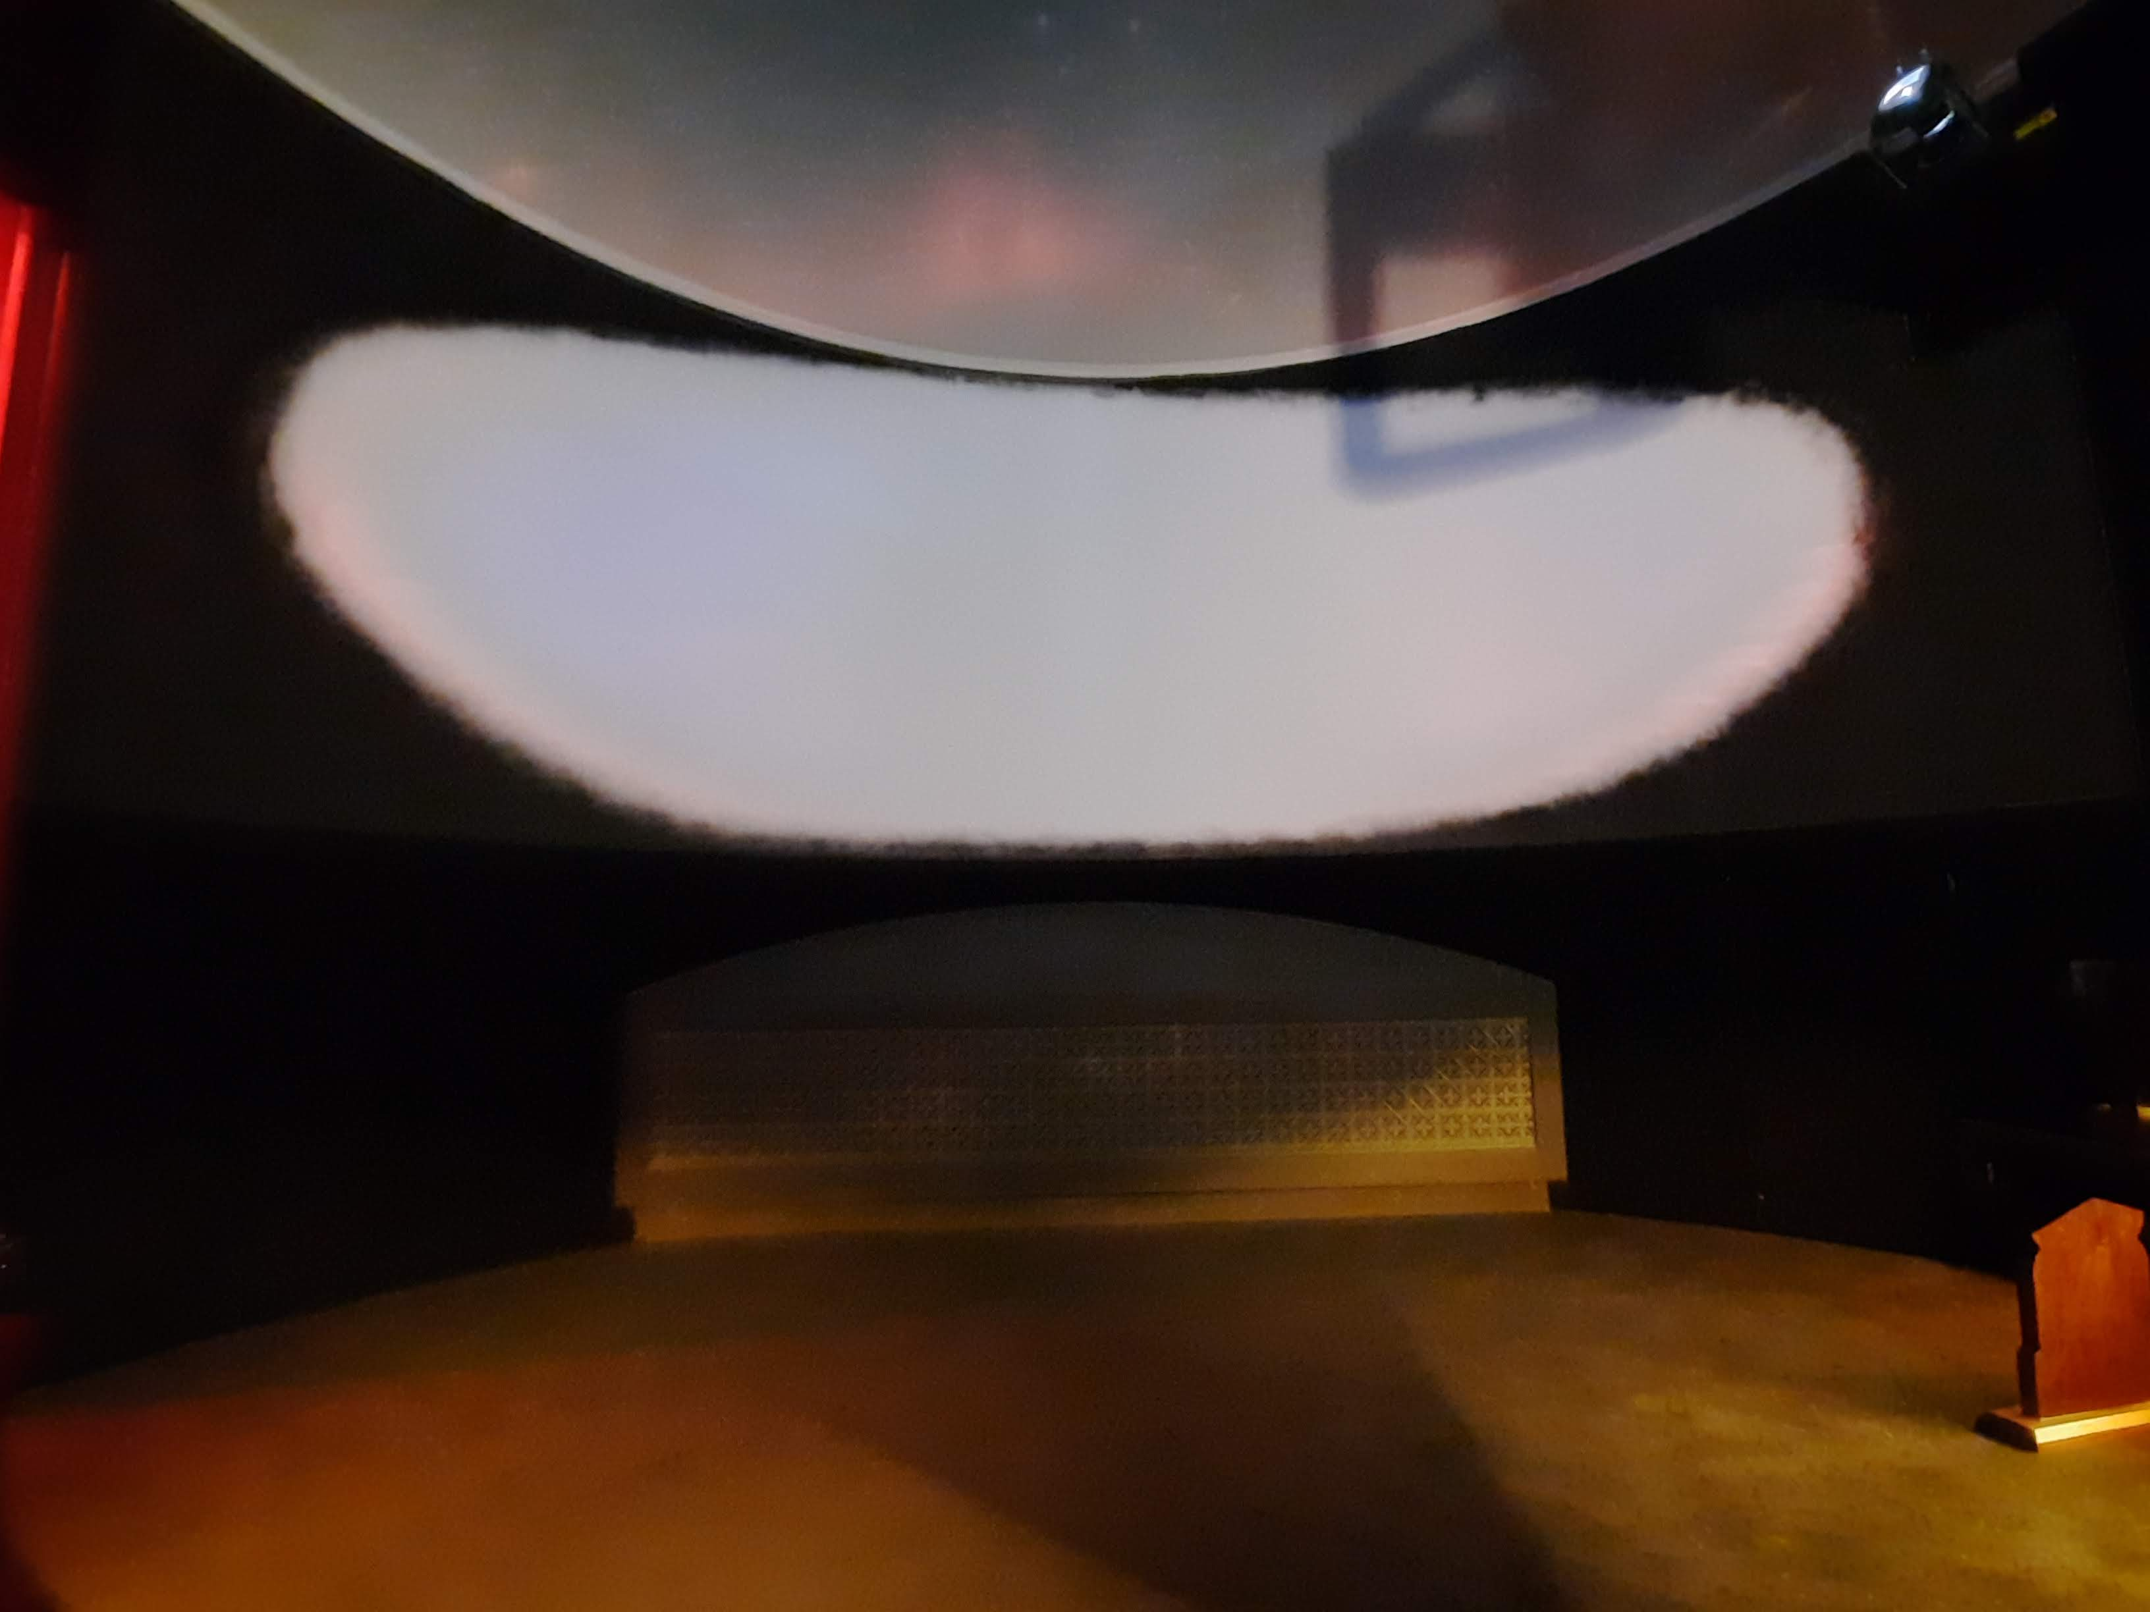
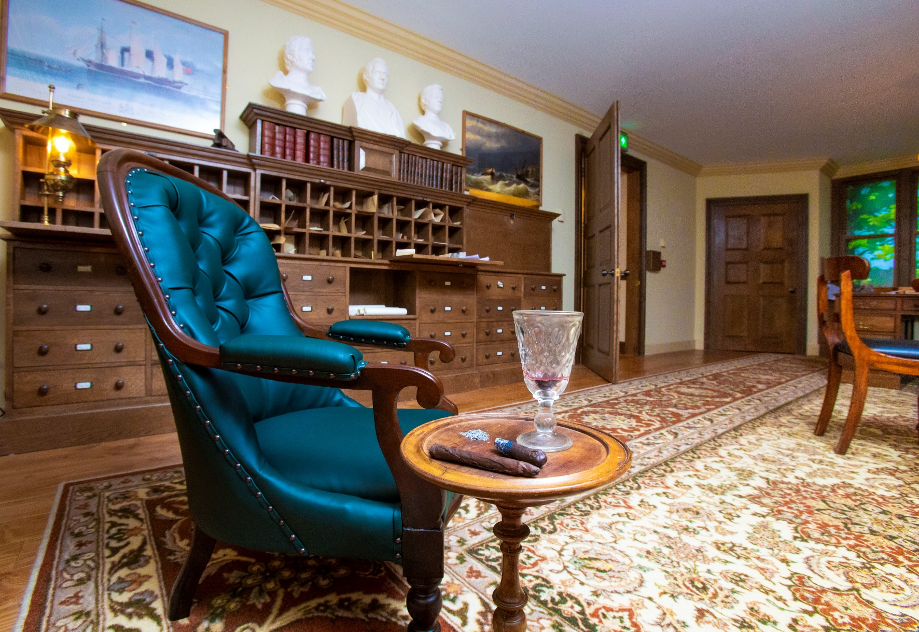
The room is dark and the video is from Brunel’s point of view and features flashing lights and smoke effects.
If we don’t want to watch the video, we can walk through and into the next room.
We might choose to visit Brunel’s office. We can sit in his chair and read his letters.

Slide 19
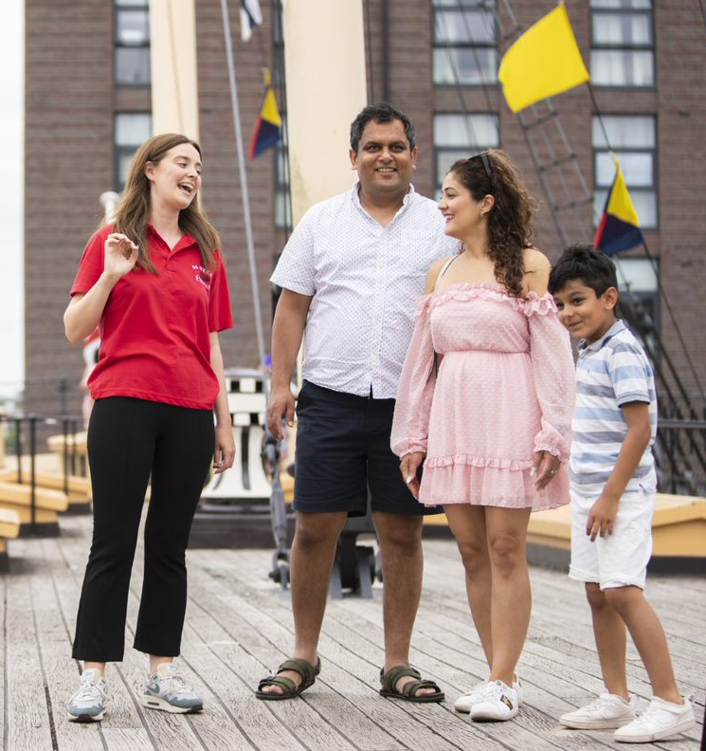
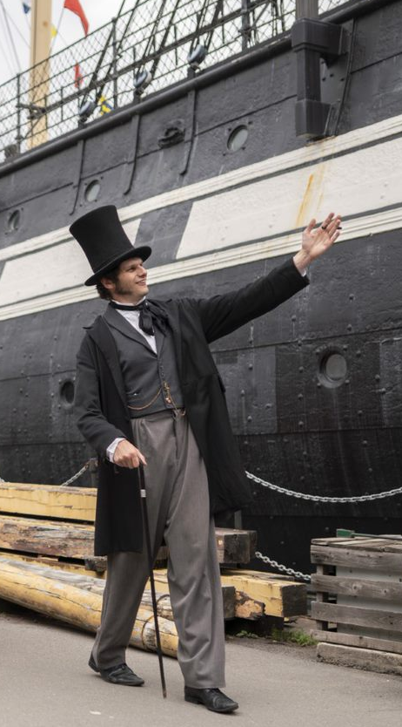
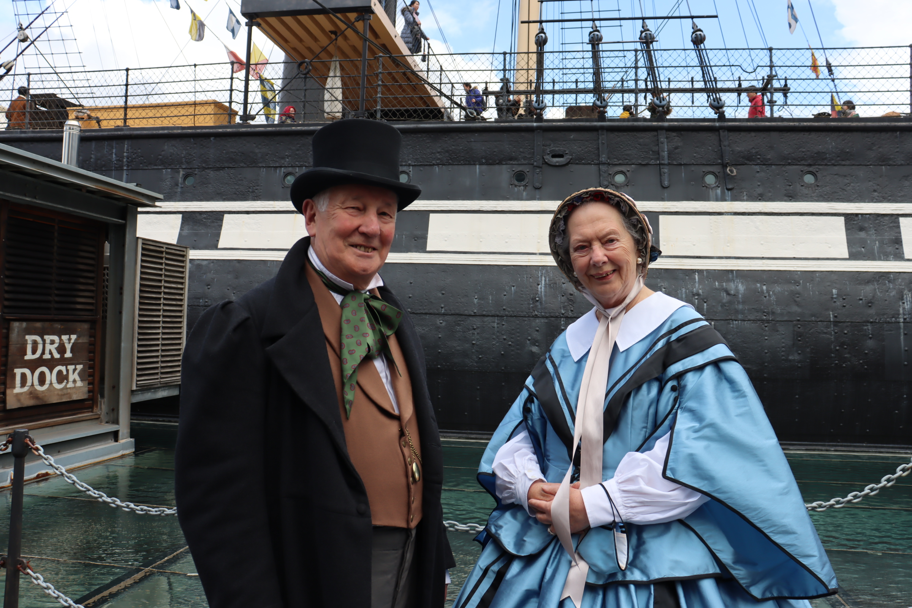
People who can help us
Most staff and volunteers wear red and black uniforms and also wear a name badge.
There are usually also people dressed in Victorian costume. You might meet someone dressed as Isambard Kingdom Brunel, the engineer who designed the ship.

Slide 20
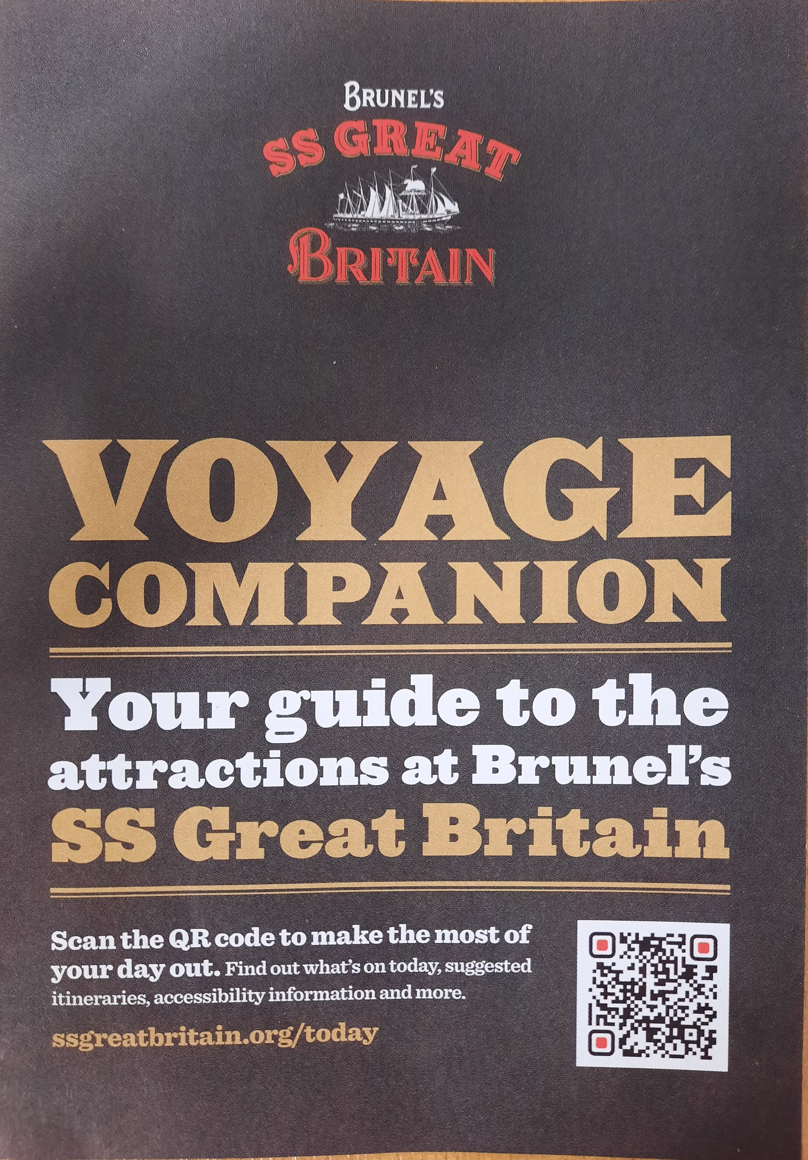
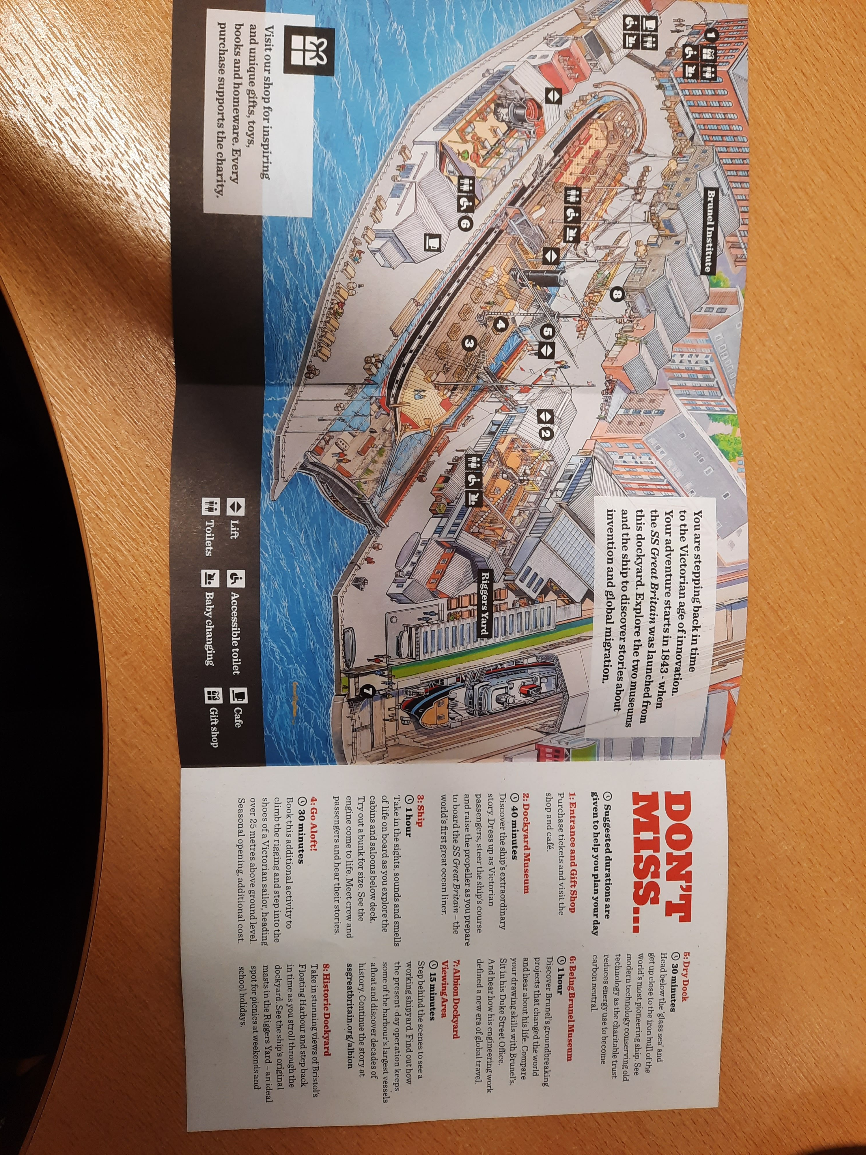
Practical information
We will be given a Voyage Companion, which includes a map of the site.
We can look at this before our visit on the website. Click Menu, then Your Visit, then Access for All.

Slide 21
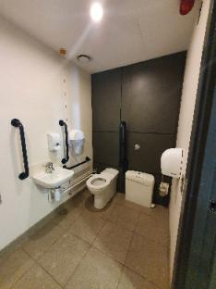
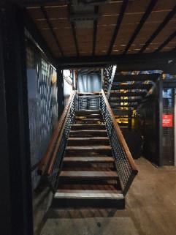
There are male, female and accessible toilets in the shop, in the dockyard museum and on the lowest deck of the ship. There is an accessible toilet in the entrance to Being Brunel.
In the shop toilets there are both paper towels and hand driers.
There are lots of wooden stairs, like these in the dockyard museum.
If we hear a loud alarm at any point in our visit, we should stand still, quietly and calmly. A member of staff will tell us what to do and where to go.

Slide 22
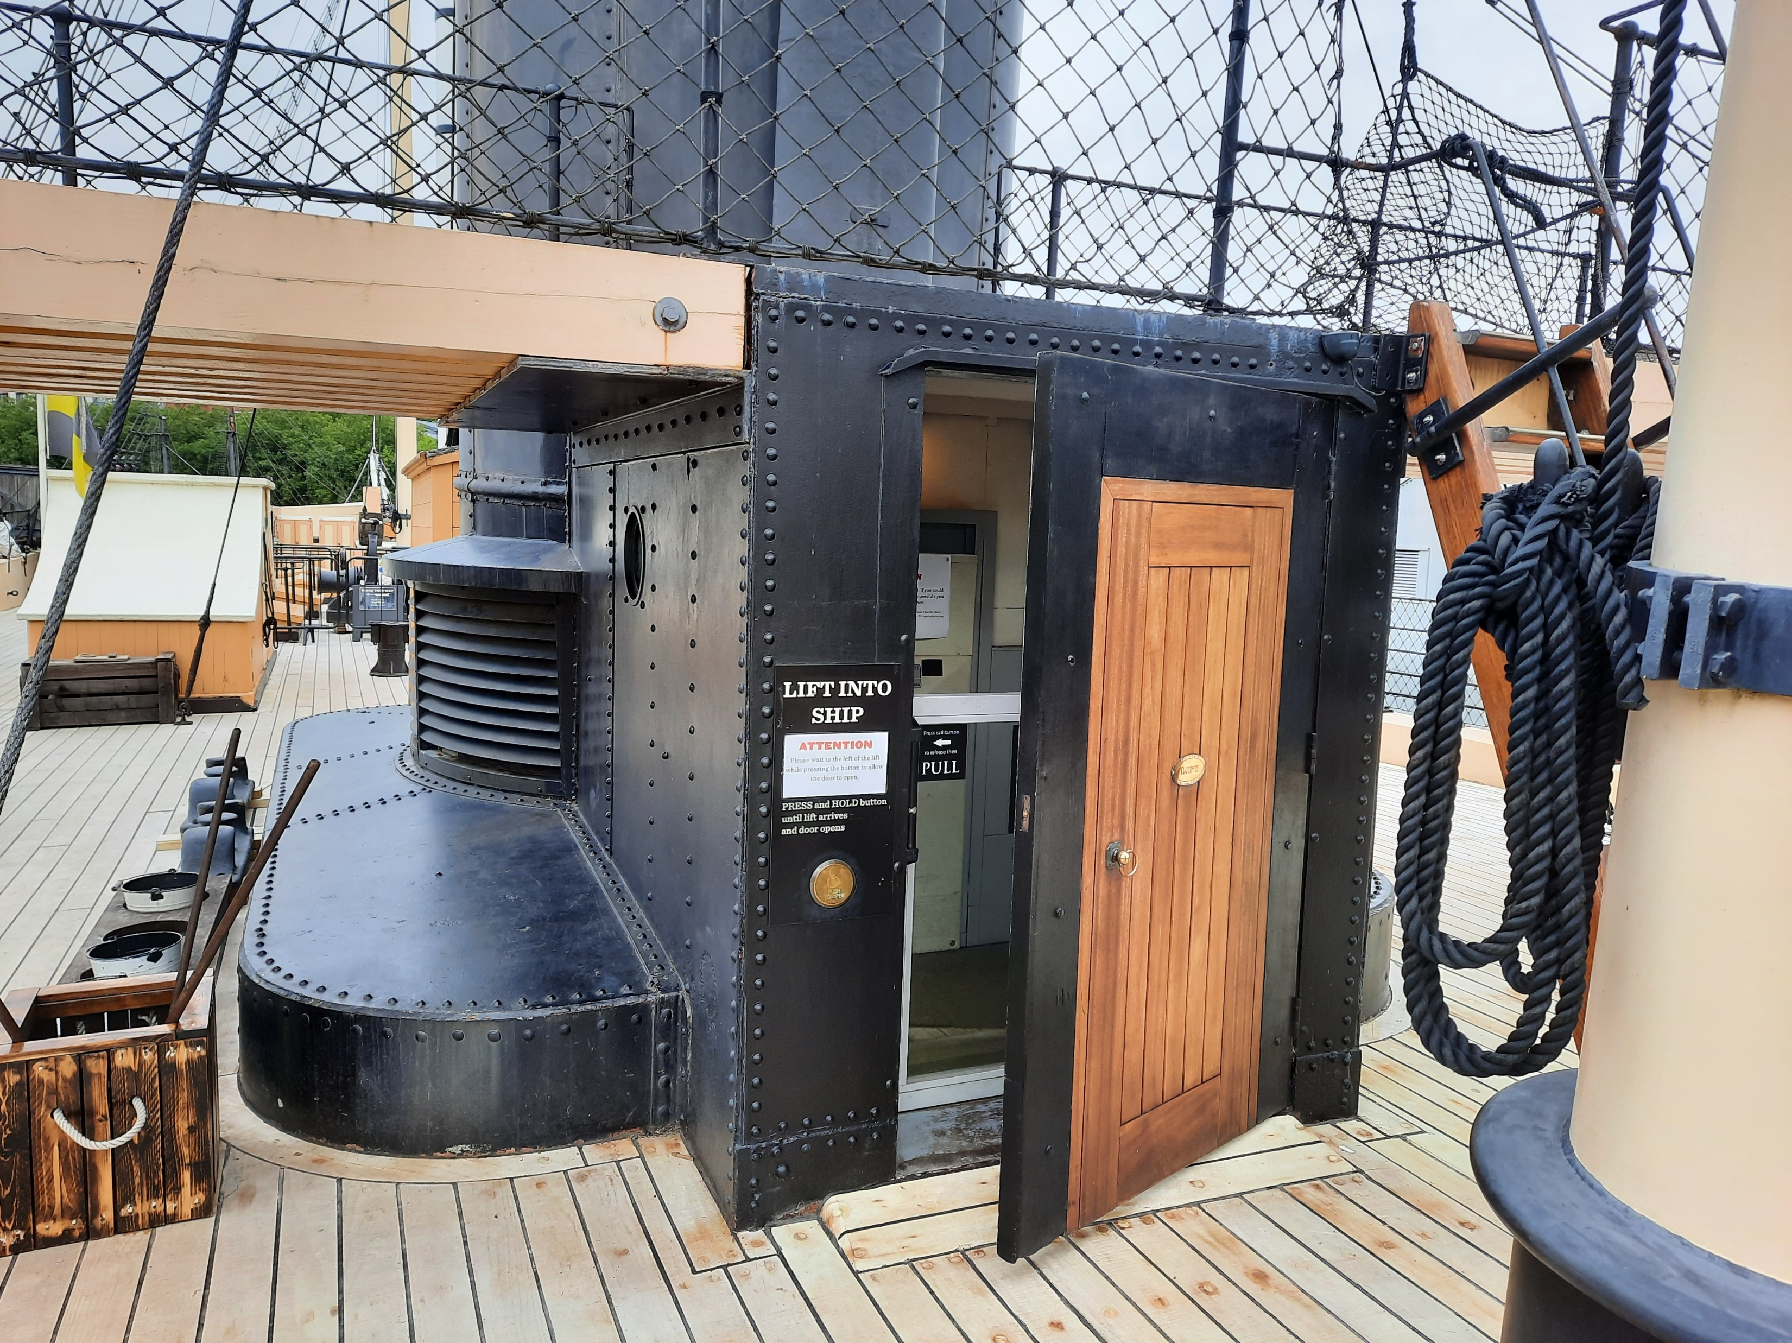
All areas can be accessed by lifts, like this one on the weather deck of the ship.

Slide 23
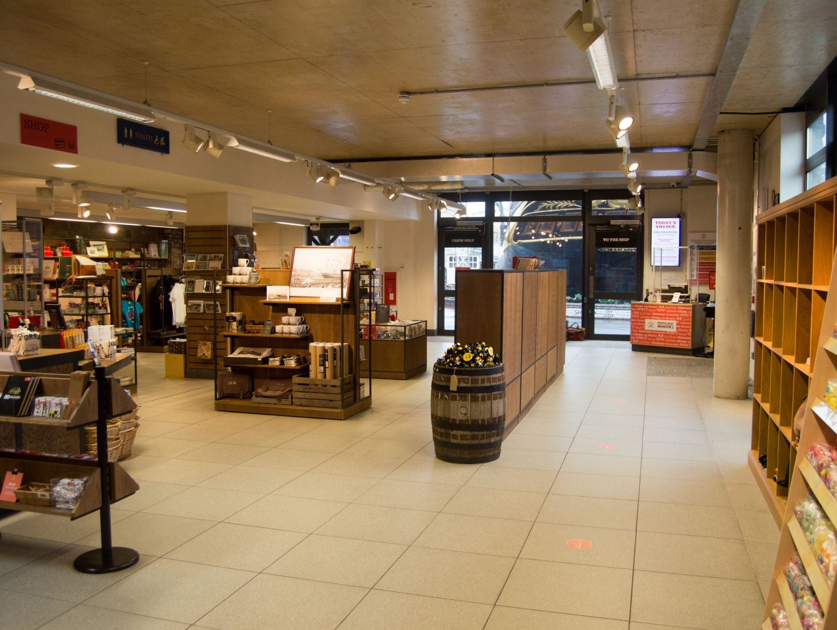
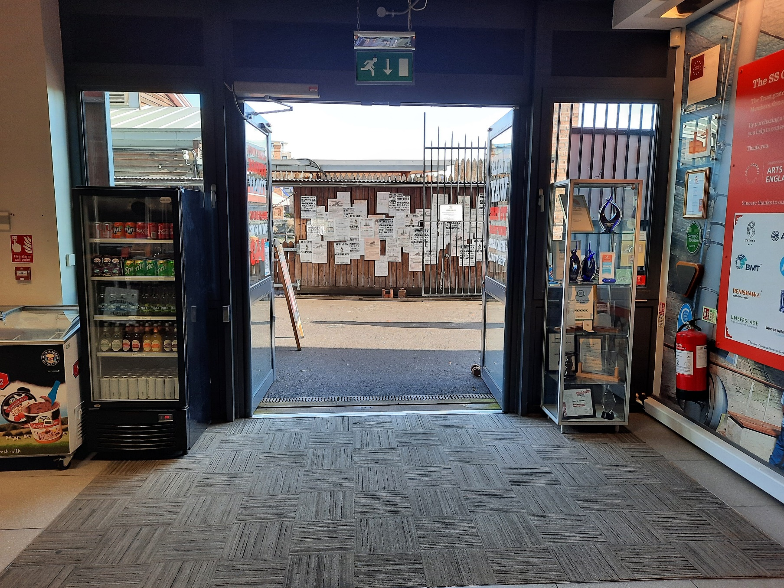
When it is time to go home
We will leave by walking through the shop.
We only leave when our group are all together.

Slide 24
To discuss specific access or educational needs please call 0117 926 0680 and ask to speak to the Visitor Experience team.
Brunel’s SS Great Britain
Great Western Dockyard
Bristol England
United Kingdom
BS1 6TY
Tel: 0117 926 0680
Email: admin@ssgreatbritain.org
Web: ssgreatbritain.org
Photographs by: Adam Gasson, Lottie Morris, Leila Nichols, John Polatch and Sarah Trubshawe

