Slide 1
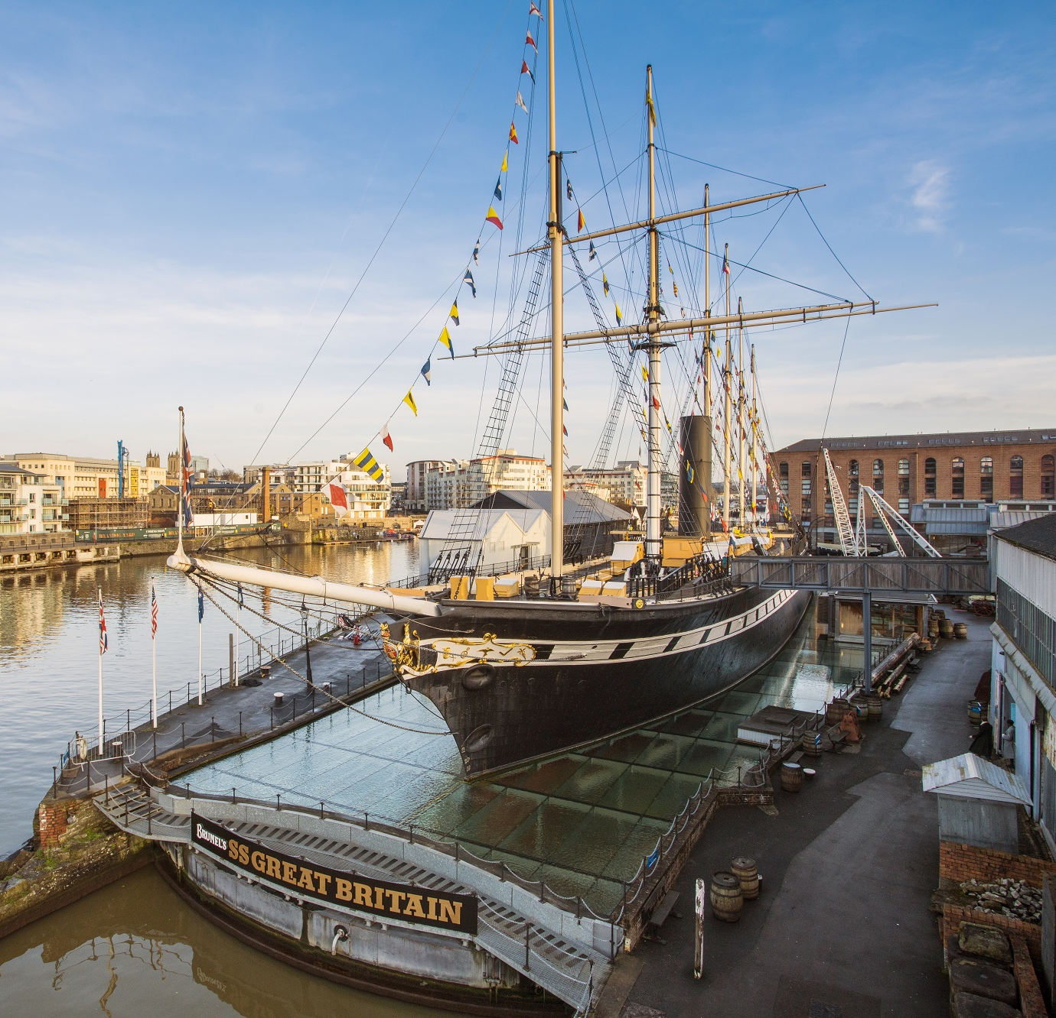

Preparing
for your
visit
Sensory Guide

Slide 2
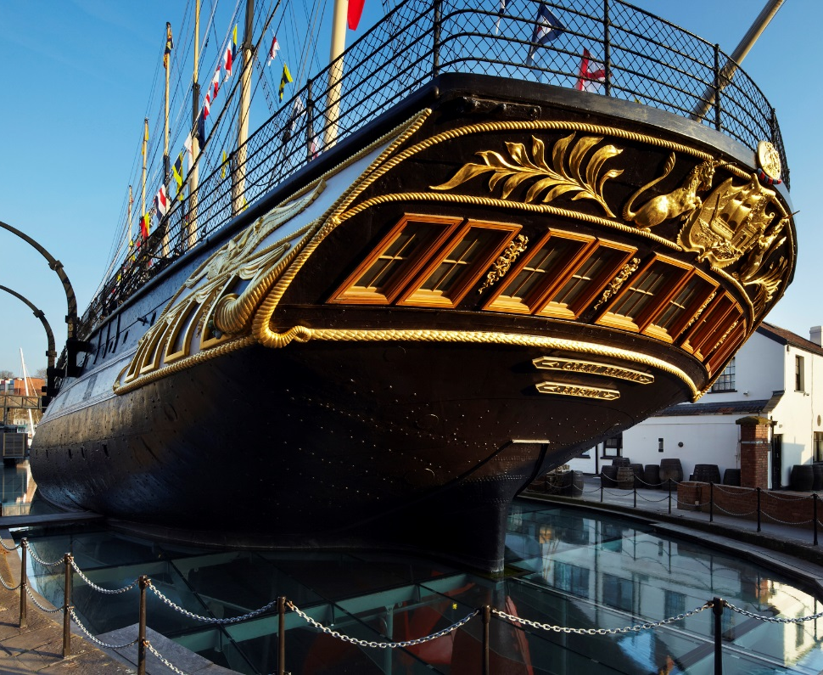
We are going to visit a museum and a very old ship called the SS Great Britain.
We will learn about the ship and have fun exploring.

Slide 3
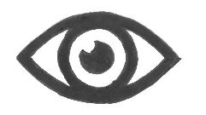



When we visit Brunel’s SS Great Britain there will be lots of things to:
See
Hear
Smell
Touch
These sounds, sights and smells are here to help us pretend we are on the ship in the past. They are for fun and will not hurt us.

Slide 4
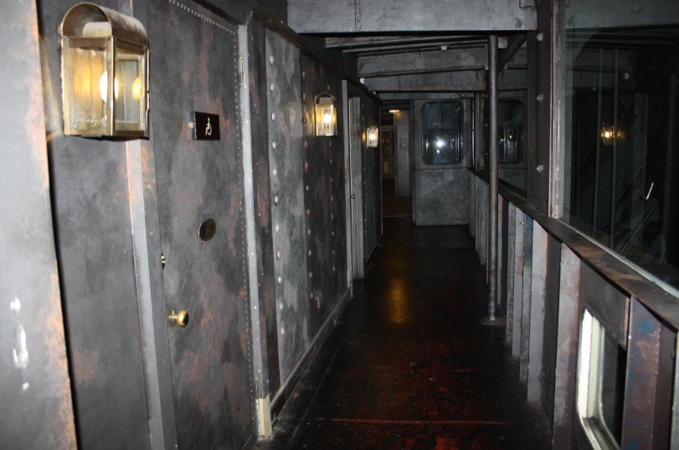
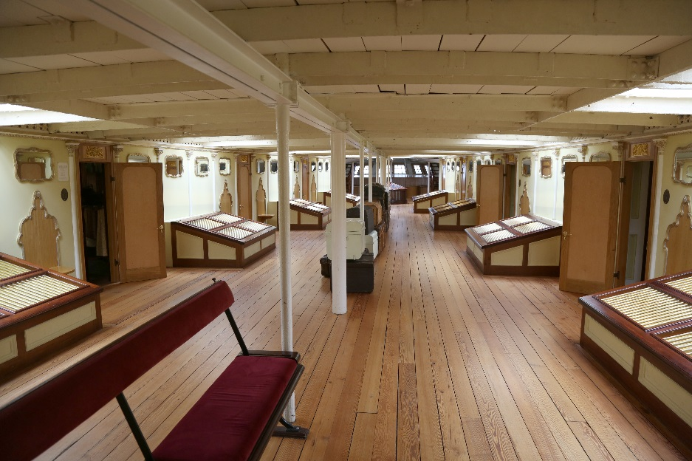

Some areas can be busy, so we might need to wait or come back later.
If we don’t like something or don’t want to be near it, we can tell our helper.
Some parts of the museum and ship might be dark and narrow.
Other parts might be light and open.

Slide 5
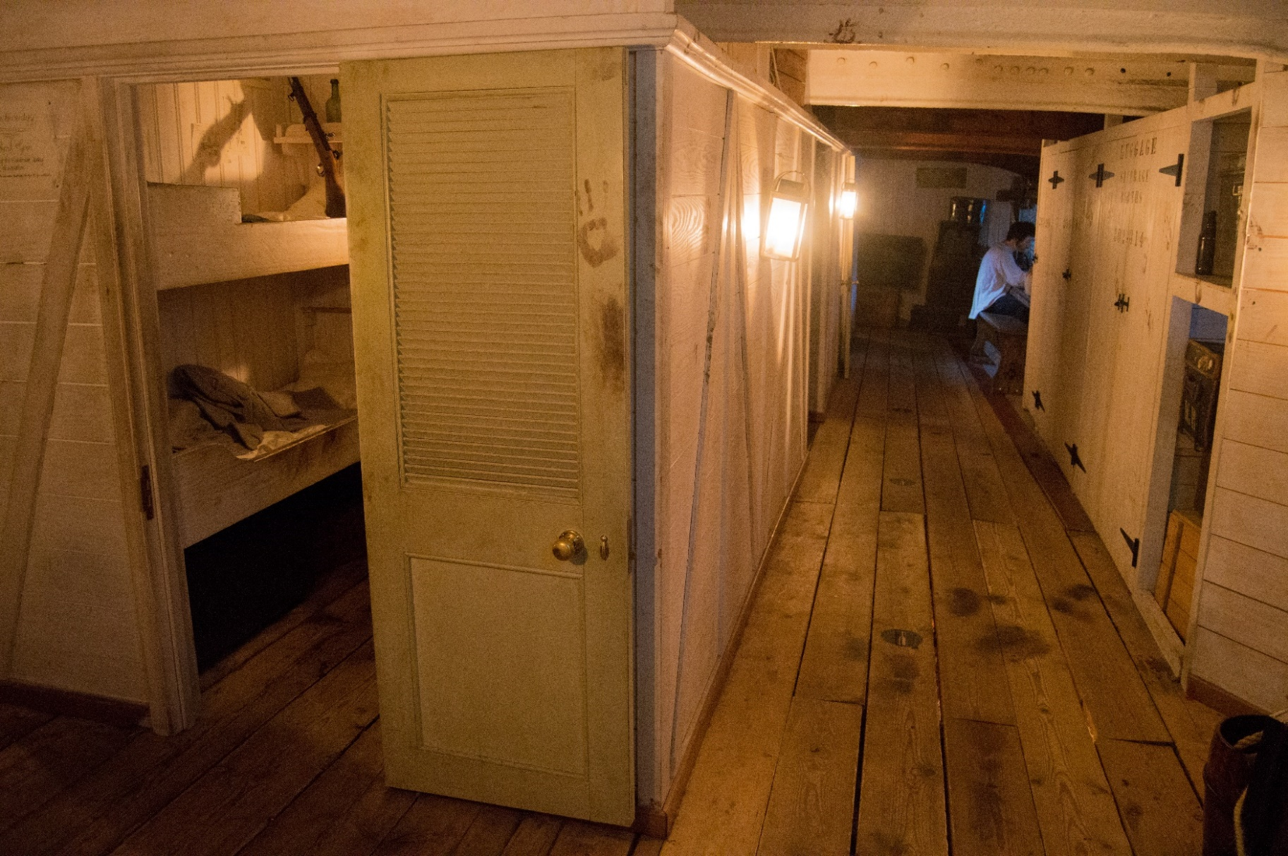

Some places might be loud; we can ask to borrow free ear defenders from the Visitor Centre if we want to.

Slide 6
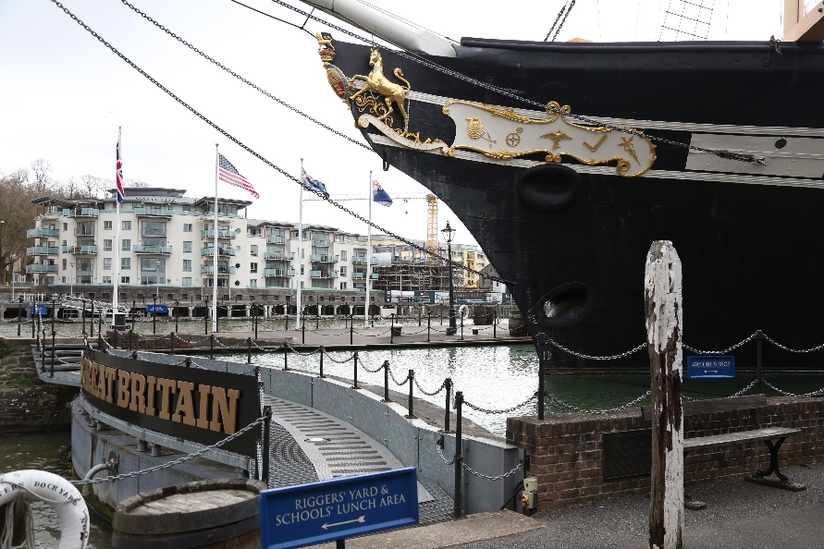

On the Great Western Dockyard
We might see
A big ship that looks like it is floating on water
Flags flapping on the ship
Models of animals and mannequins

Slide 7
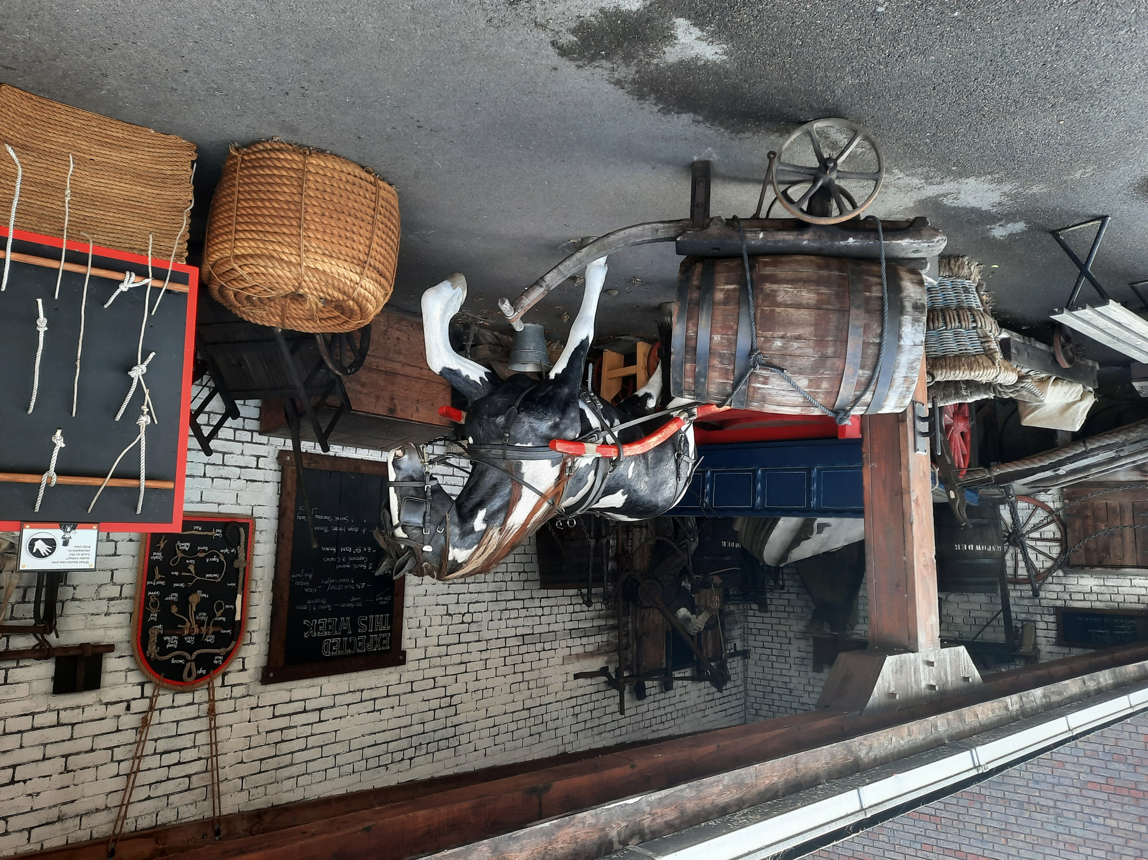

On the Great Western Dockyard
We might hear
Seagulls
Traffic
Water sounds
Pretend animal noises and people’s voices

Slide 8

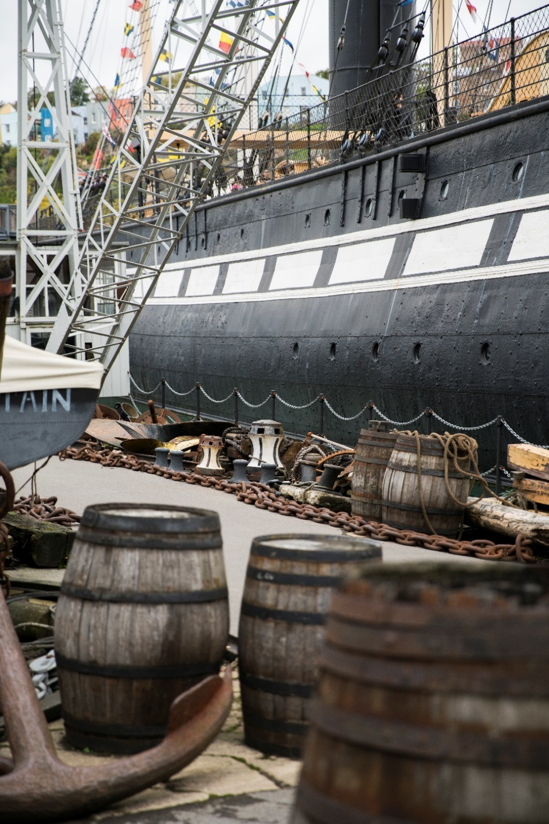
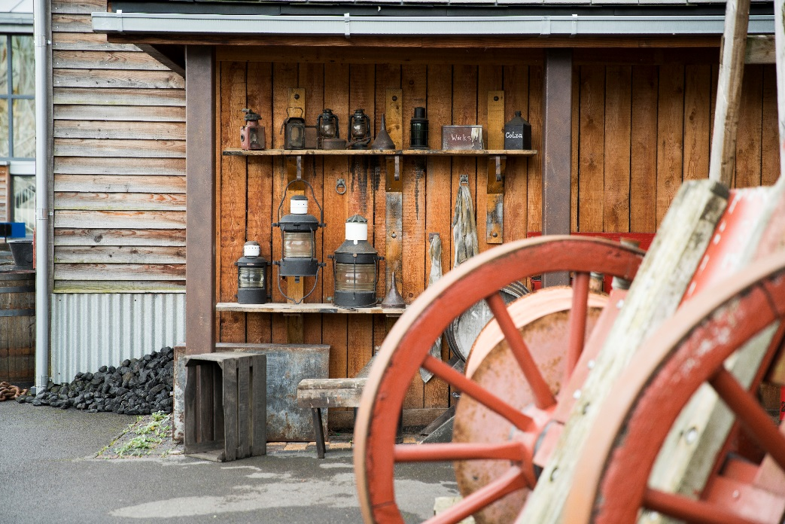
On the Great Western Dockyard
We might touch
The chains around the water
Barrels and ropes on the dock
Pretend luggage and crates

Slide 9
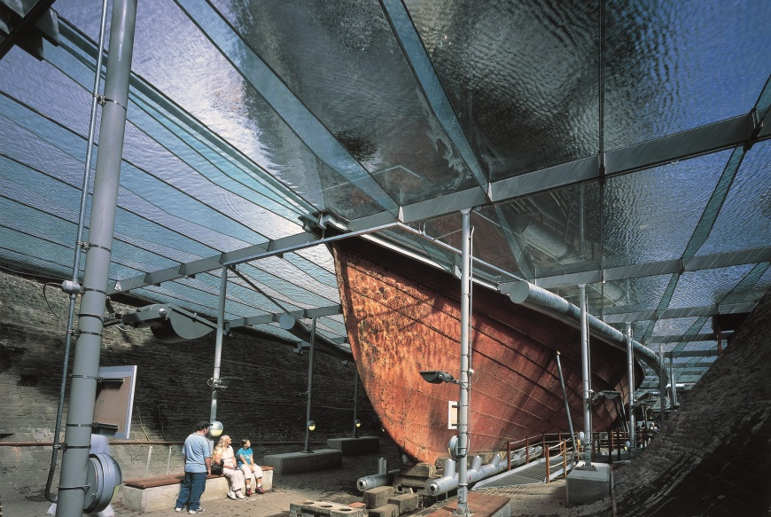
In the Dry Dock
We might see
Underneath the ship
Water above us - we can pretend we are underneath the water
The ship’s big propeller and rudder
Rust holes because the ship is very old

Slide 10
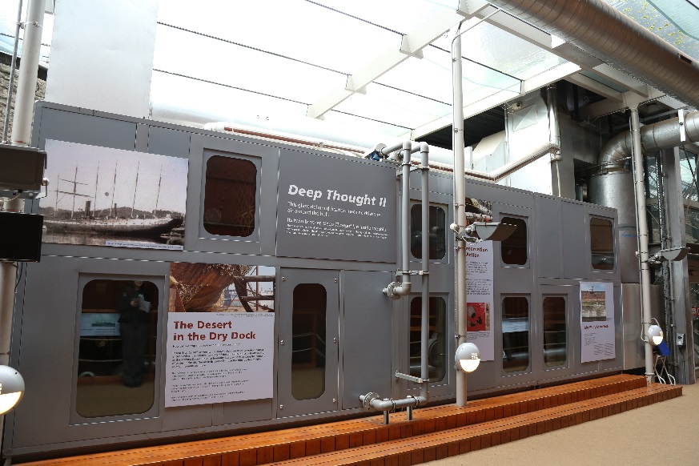
In the Dry Dock
We might hear
A whirring noise - this is the big machine working to keep the ship safe and dry

Slide 11
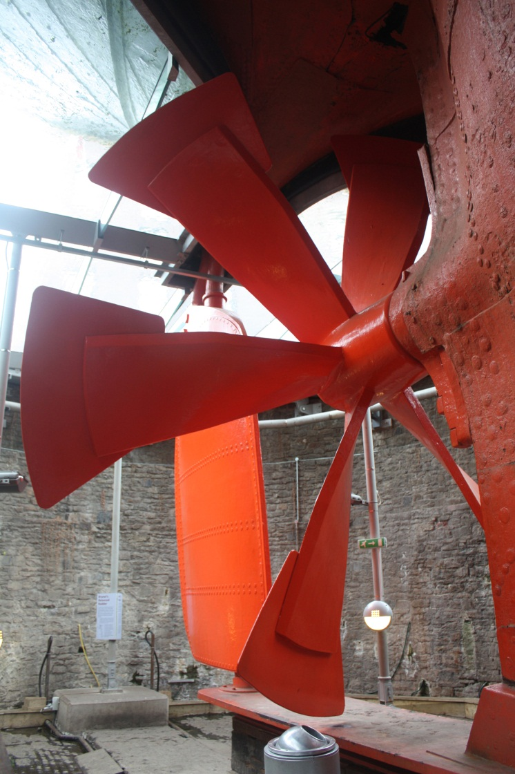
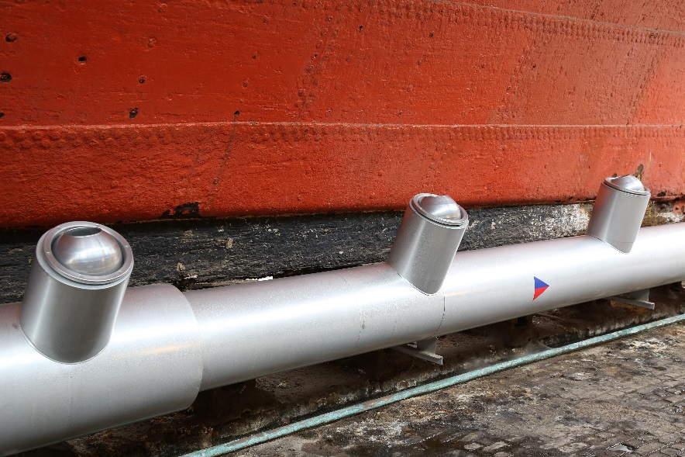
In the Dry Dock
We might touch
Old anchor in front of the ship
Warm air coming out of the pipes
It will feel dry and warm.
We will feel the vibrations of the dehumidifier working.
There might be some water on the floor and walls.

Slide 12
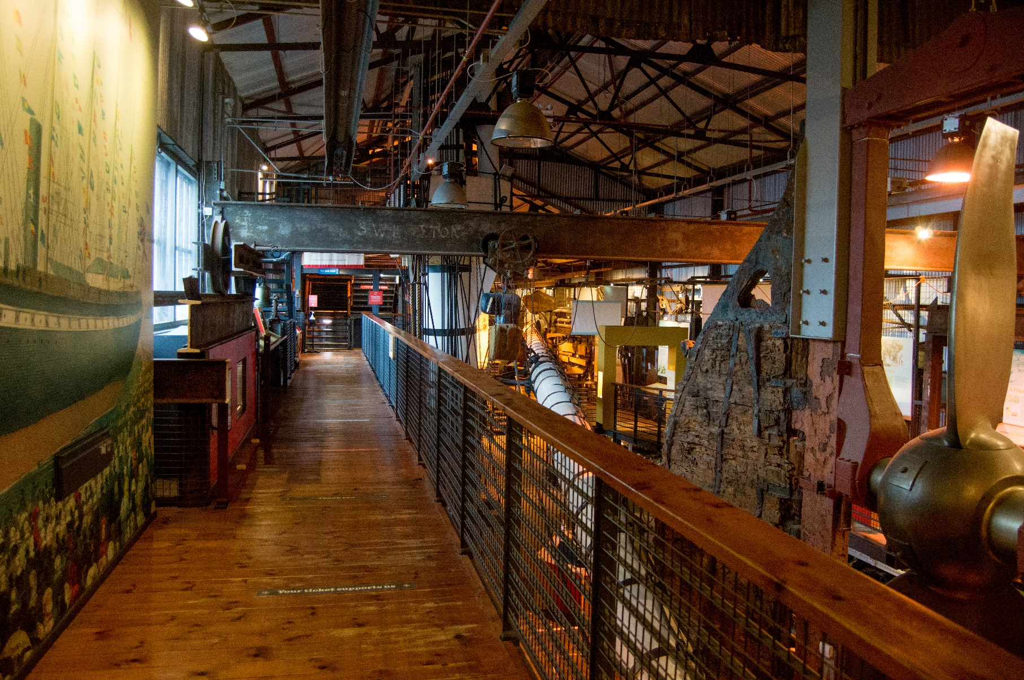
In the Dockyard Museum
We might see
Lots of old objects from the ship
Videos and pictures of the ship
Activities where we can pretend to steer the ship or find out about the ship’s passengers

Slide 13
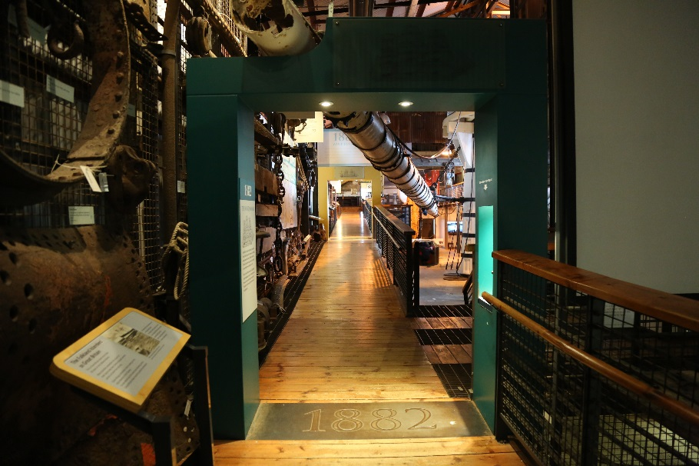
In the Dockyard Museum
We might hear
Sounds of people talking and cheering
Videos of the wind and sea
Birds

Slide 14
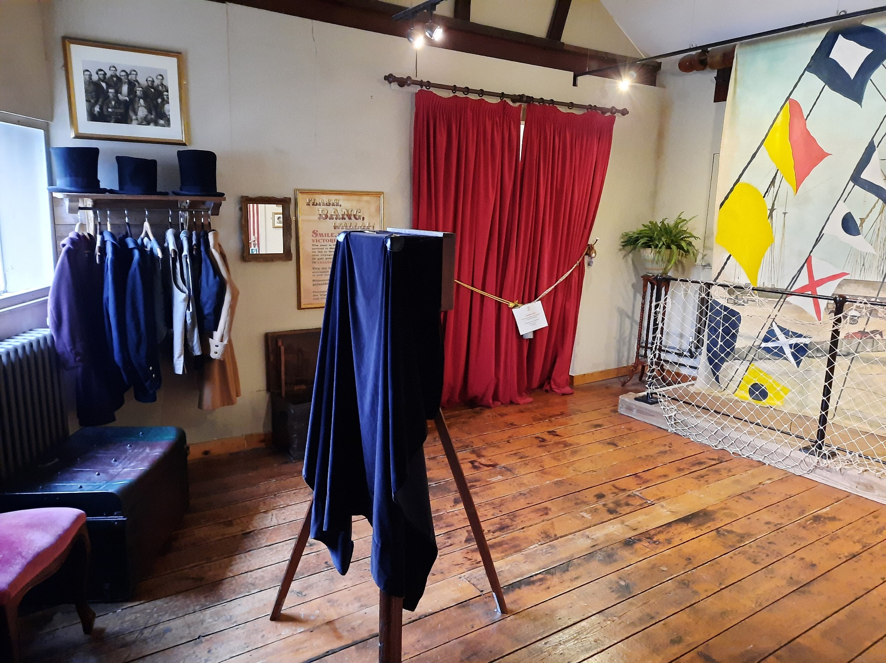
In the Dockyard Museum
We might touch
A ship’s wheel
Drawers we can open
Screens where we can find out about passengers
Dressing up clothes
We might feel the vibrations of the machine moving the lifting frame and propeller.

Slide 15
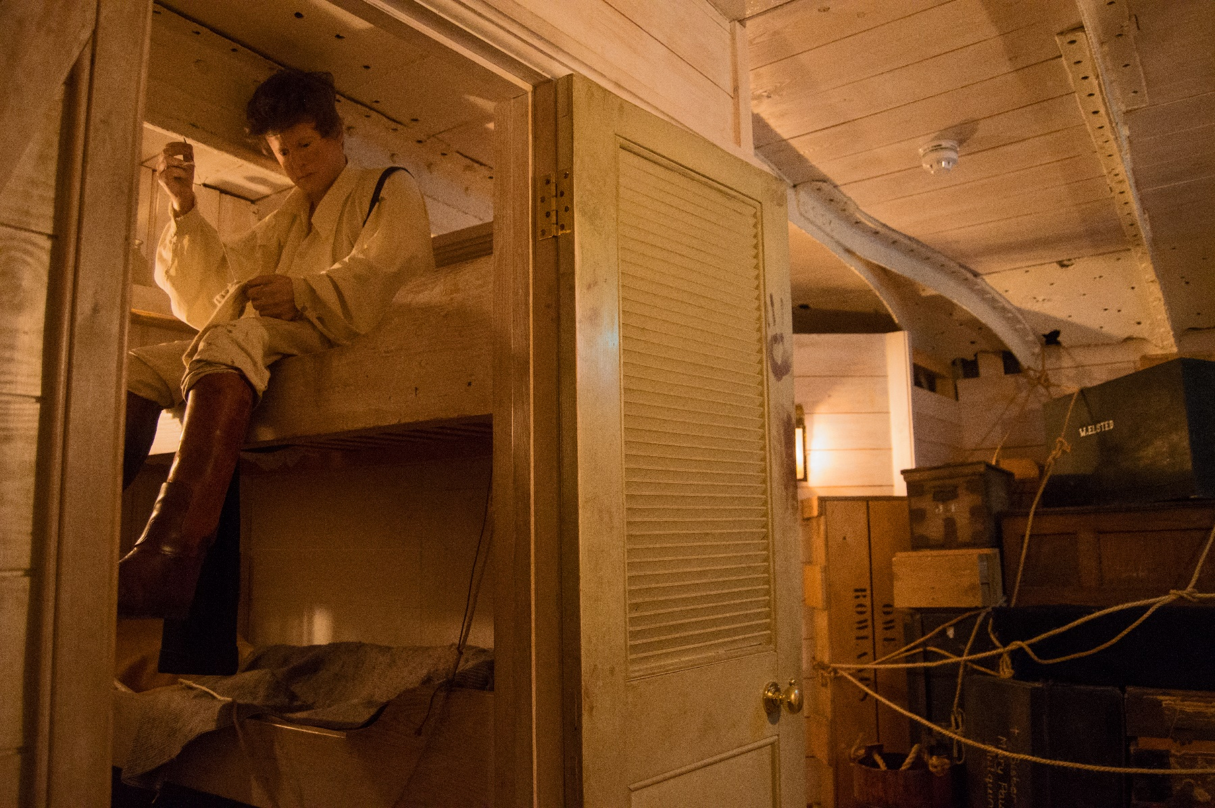
On the Ship
We might see
Mannequins, model animals, food and luggage
Things moving on their own, like saucepan lids and the big model engine
Long, slightly dark corridors

Slide 16
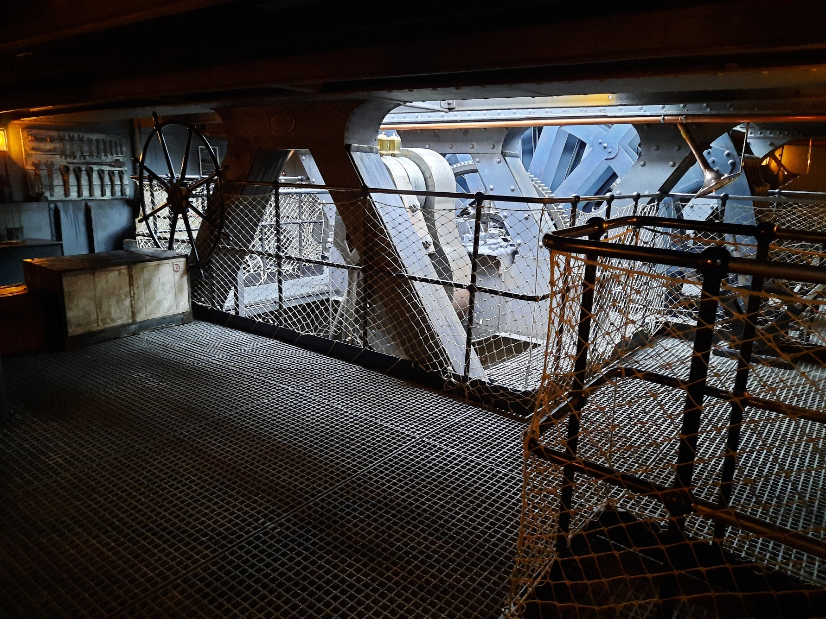
On the Ship
We might hear
Noises that sound like we’re on the ship in the past
People talking, music, animals and a shouting cook
The whirring of the pretend engine going around

Slide 17

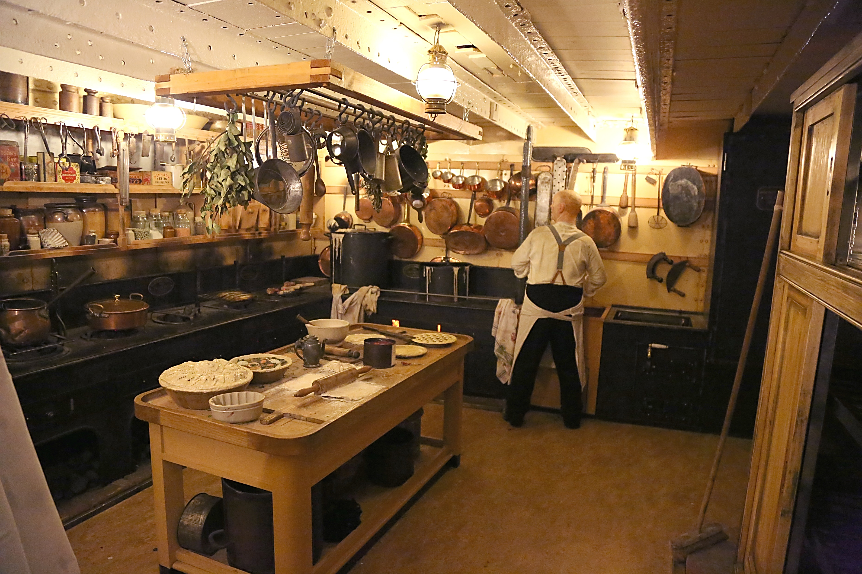
On the Ship
We might smell
Nice smells like food cooking, bread baking and fresh laundry
Unusual or stronger smells like animal smells, sick and medicine

Slide 18
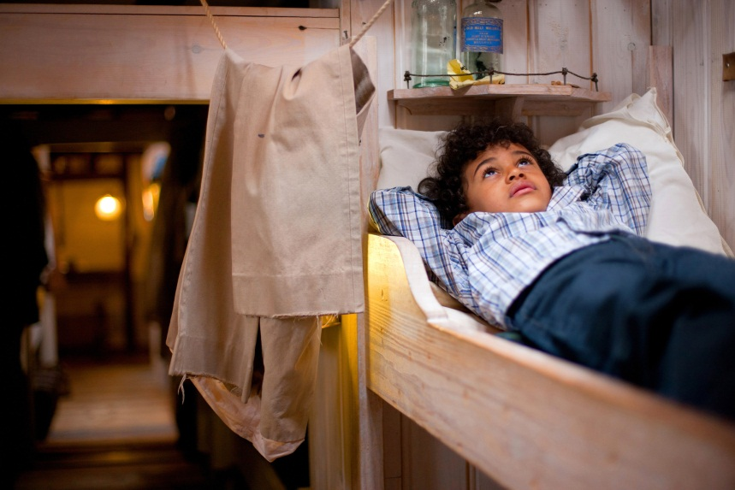
On the Ship
We might touch
Lots of things - we can even climb in the bunks
Wobbly floorboards under our feet, they might feel strange, but they are safe
The ship’s wheel - we can even turn it

Slide 19
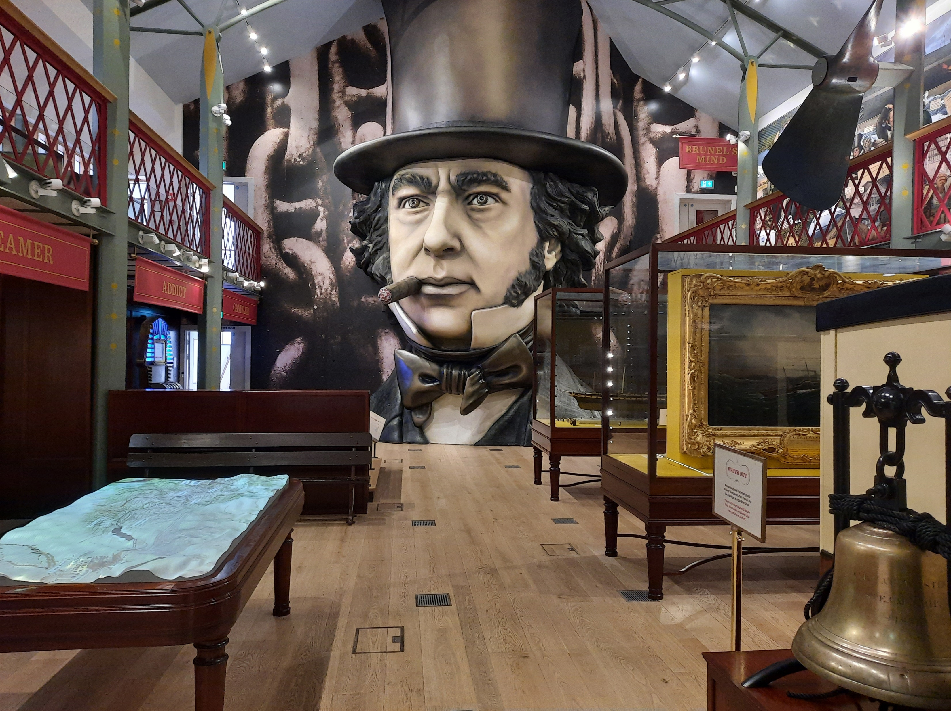
In the Being Brunel Museum
We might see
A giant pretend head of Brunel
Old objects linked to Brunel and his life
Rooms that look like they used to in the past
A video in a dark room about Brunel with flashing images and pretend smoke

Slide 20
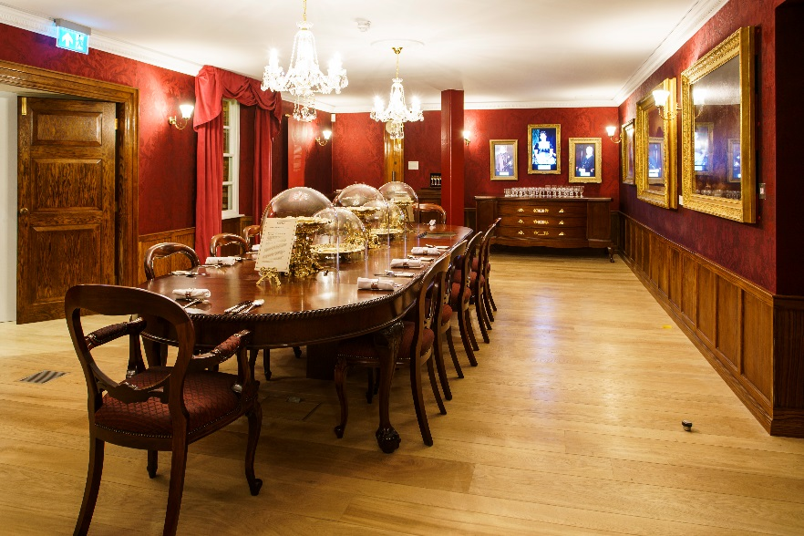
In the Being Brunel Museum
We might hear
People talking or shouting
Pretend animals
A pretend railway carriage moving
Ship’s whistle

Slide 21
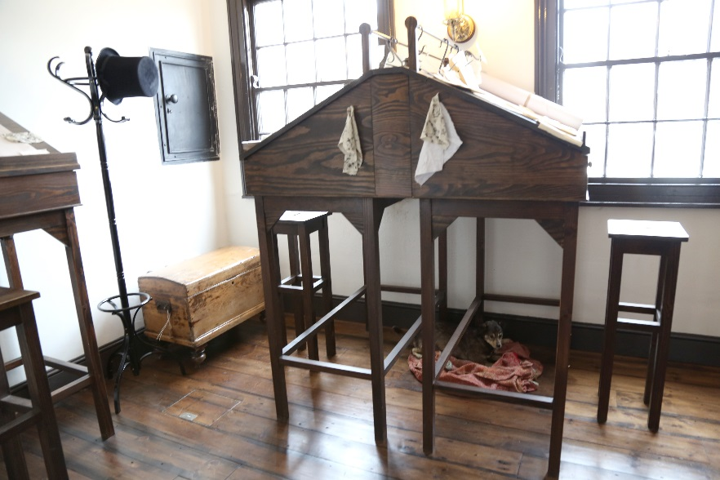
In the Being Brunel Museum
We might smell
Pretend cigar smoke
Damp canvas
Oil

Slide 22
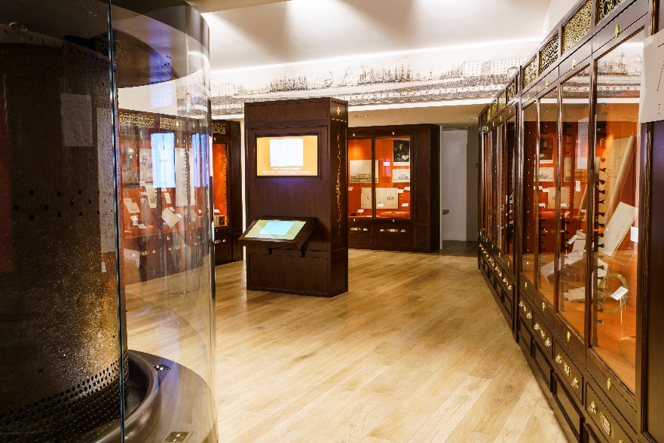
In the Being Brunel Museum
We might touch
Hats we can try on
Drawers we can open
Touch screens to take part in games
Things in the Dock Office

Slide 23
To discuss specific access or educational needs please call 0117 926 0680 and ask to speak to the Visitor Experience Team.
Brunel’s SS Great Britain
Great Western Dockyard
Bristol England
United Kingdom
BS1 6TY
Tel: 0117 926 0680
Email: admim@ssgreatbritain.org
Web: ssgreatbritain.org
Photographs by: Adam Gasson, Lottie Morris, Leila Nichols, John Polatch and Sarah Trubshawe

