Slide 1
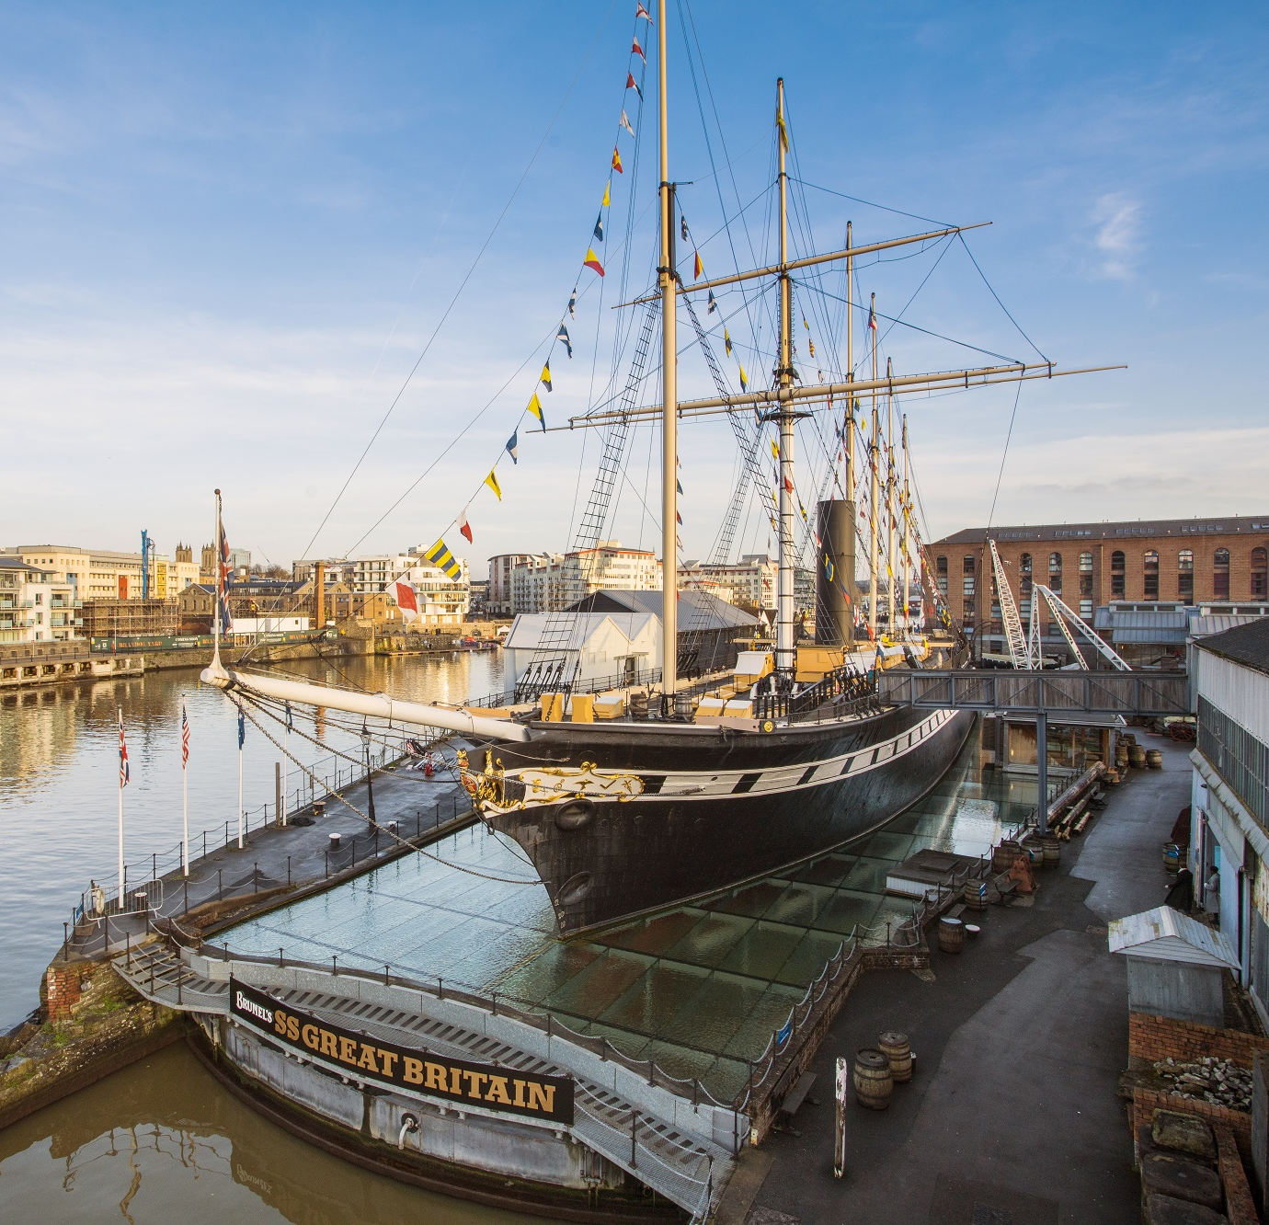
School
Workshop
Guide
Victorians at Sea

Slide 2
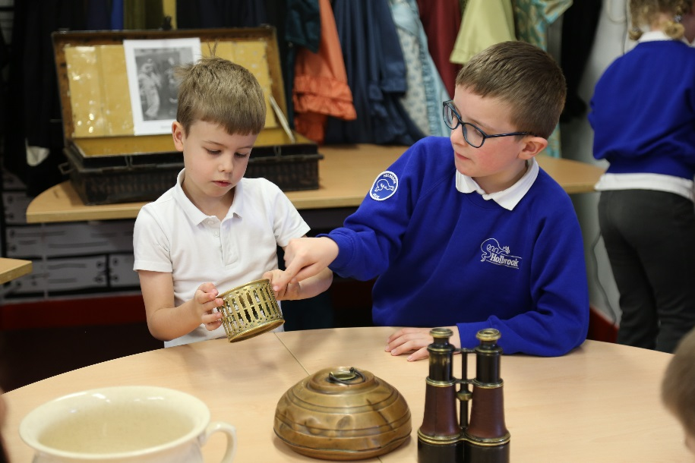
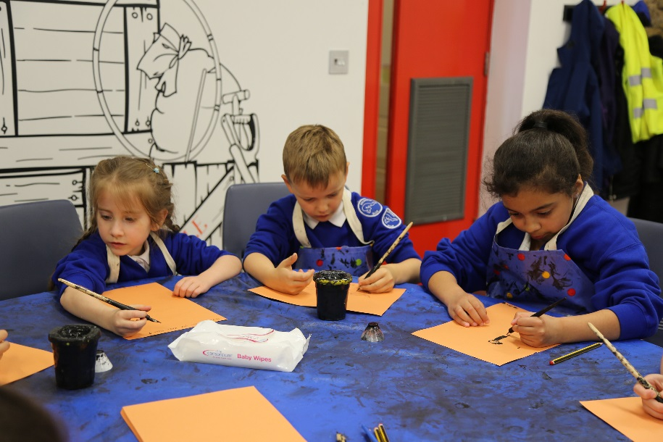
During our visit, we are going to pretend to go on a 60 day voyage to Australia on the SS Great Britain.
We will discover what passengers did on the ship whilst on a long journey.
We will look at objects, play games and use dip pens.

Slide 3
To discuss specific access or educational needs please call 0117 926 0680 and ask to speak to the Education Team.
Brunel’s SS Great Britain
Great Western Dockyard
Bristol England
United Kingdom
BS1 6TY
Tel: 0117 926 0680
Email: learning@ssgreatbritain.org
Web: ssgreatbritain.org
Photographs by: Lottie Morris

