Slide 1
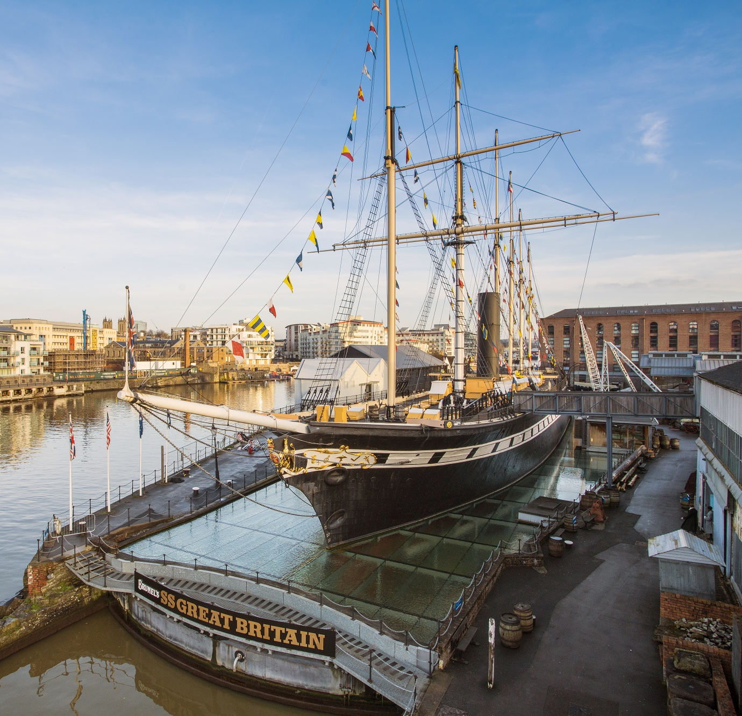
School
Workshop
Guide
Passenger Investigation

Slide 2
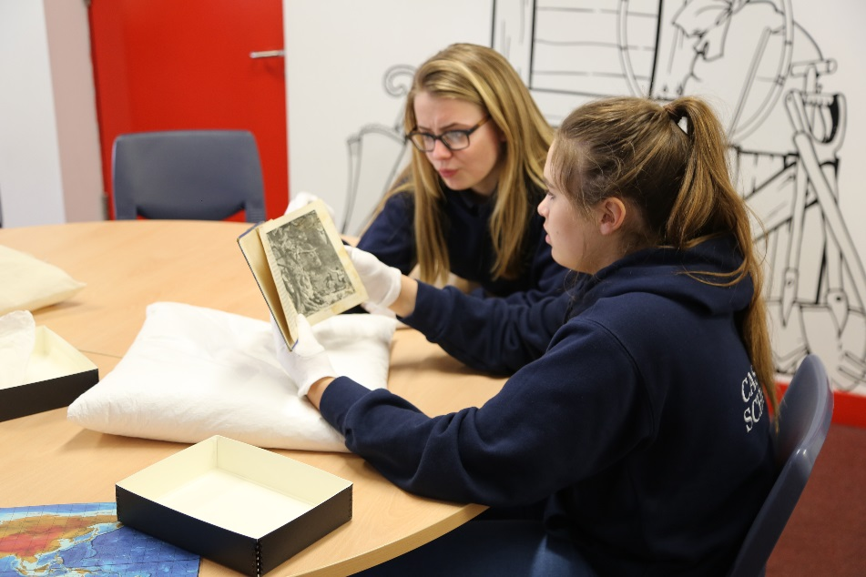
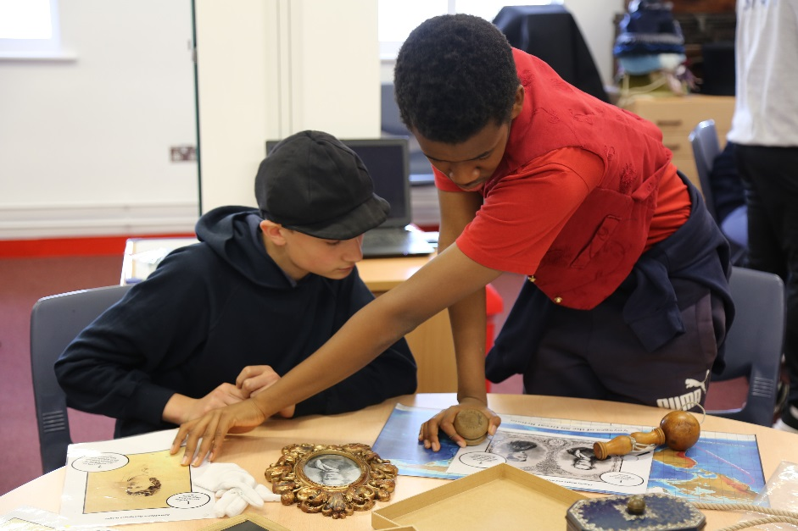
During our visit, we are going to find out who travelled on the SS Great Britain in the past and what it was like.
We will use objects, letters and pictures to investigate.
We will discover stories about passengers who made life-changing journeys.

Slide 3
To discuss specific access or educational needs please call 0117 926 0680 and ask to speak to the Education Team.
Brunel’s SS Great Britain
Great Western Dockyard
Bristol England
United Kingdom
BS1 6TY
Tel: 0117 926 0680
Email: learning@ssgreatbritain.org
Web: ssgreatbritain.org
Photographs by: Lottie Morris

