Slide 1
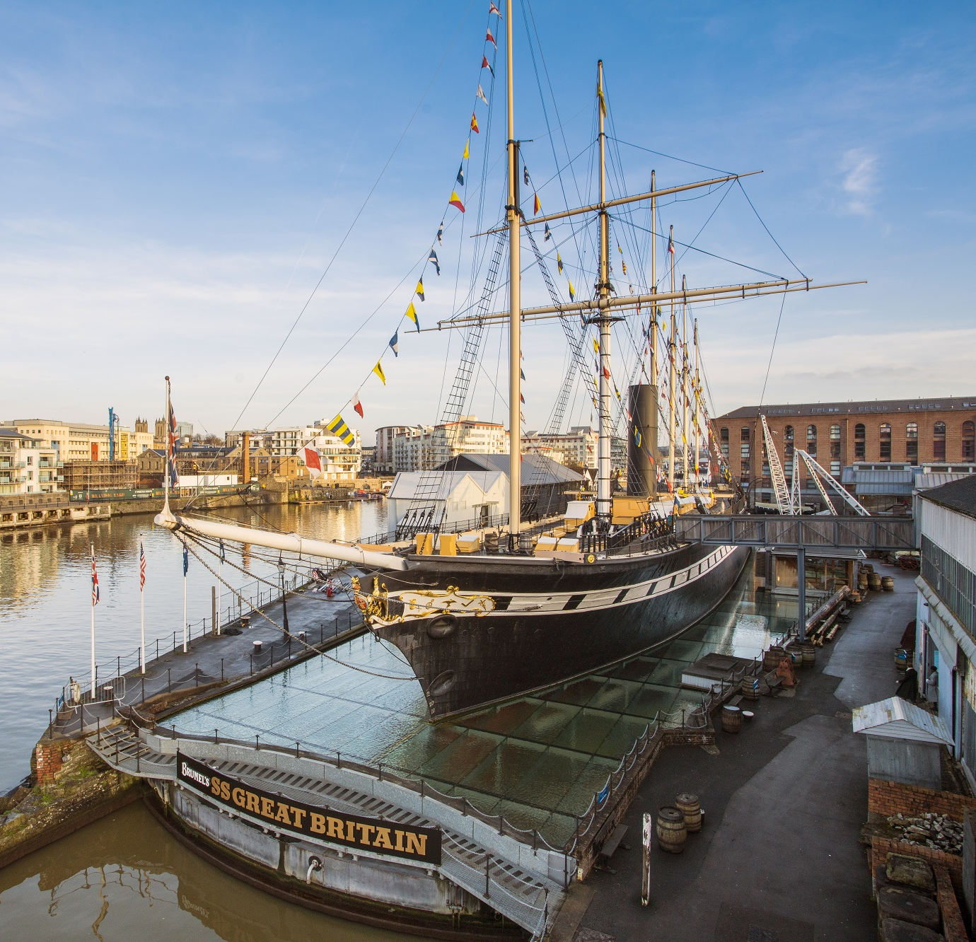
School
Workshop
Guide
Guided Tour

Slide 2
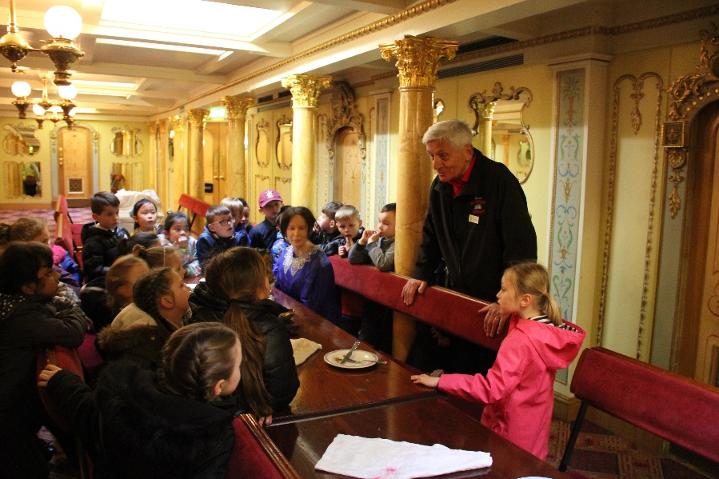
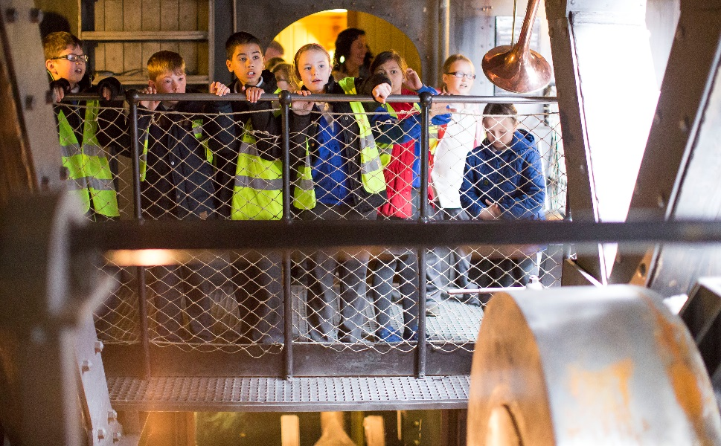
During our visit, we will go on a guided tour around the SS Great Britain.
Someone will show us around the ship so we can explore together in a group.
It will be time to listen as they tell us all about the ship.

Slide 3
To discuss specific access or educational needs please call 0117 926 0680 and ask to speak to the Education Team.
Brunel’s SS Great Britain
Great Western Dockyard
Bristol England
United Kingdom
BS1 6TY
Tel: 0117 926 0680
Email: learning@ssgreatbritain.org
Web: ssgreatbritain.org
Photographs by: Lottie Morris and Adam Gasson.

