Slide 1
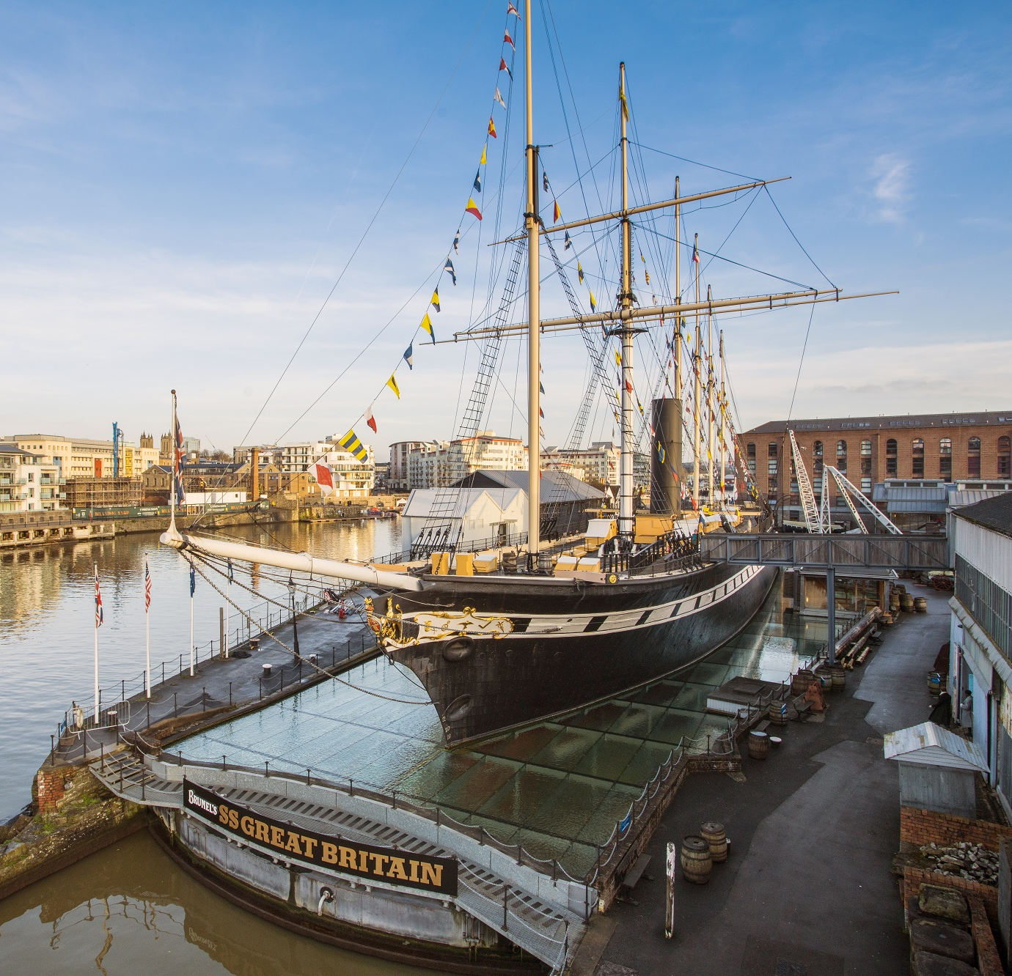

School
Workshop
Guide
Brunel the Engineer

Slide 2
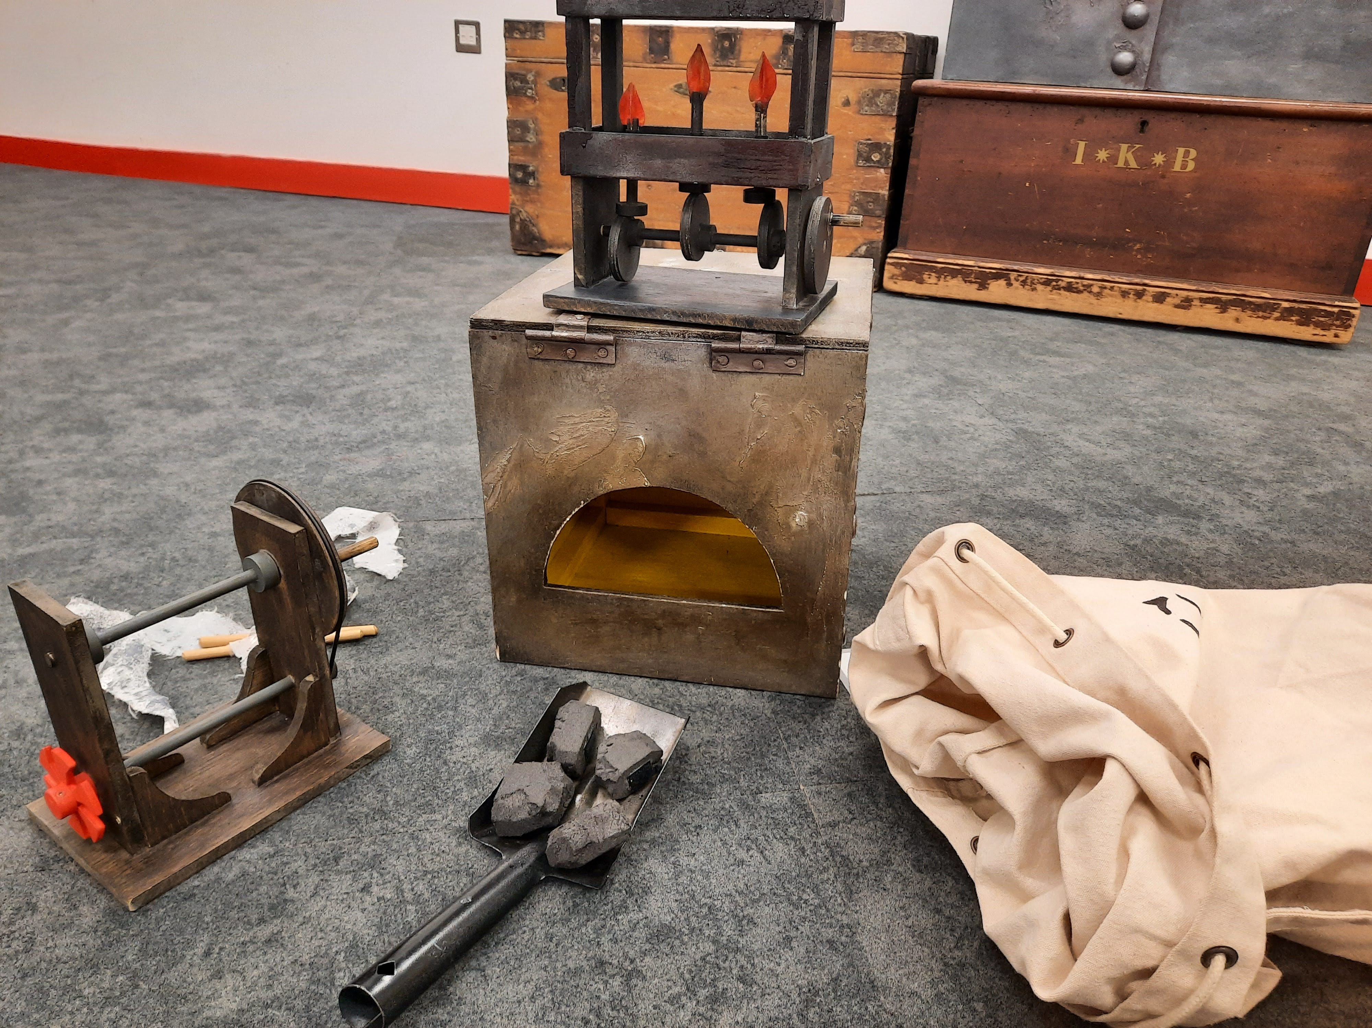
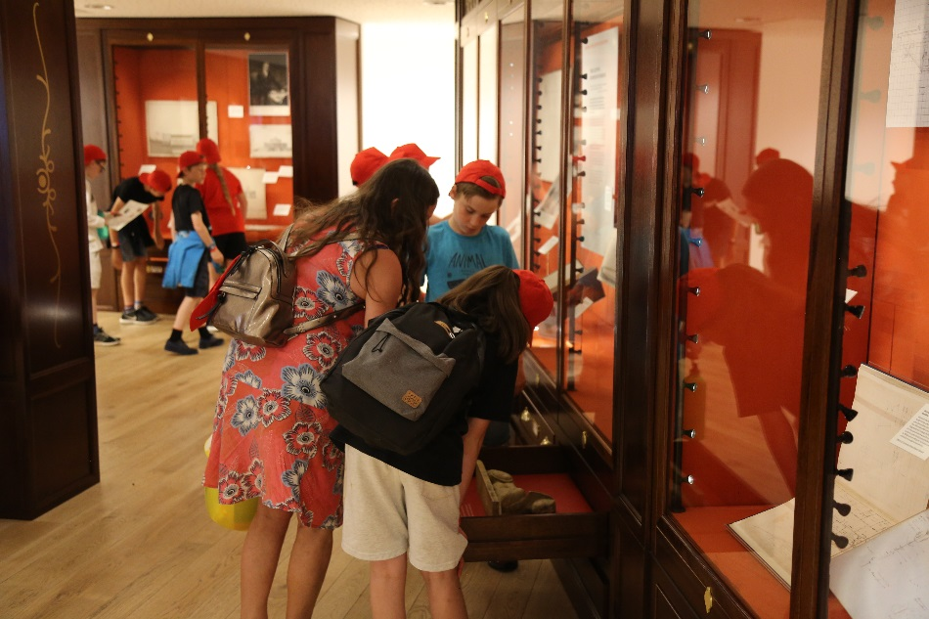
During our visit we are going to find out about Isambard Kingdom Brunel.
We will learn about some of the projects Brunel was involved in and find out how the SS Great Britain’s steam engine works.
Then we will go into the Being Brunel museum to look for objects linked to Brunel and his work.

Slide 3
To discuss specific access or educational needs please call 0117 926 0680 and ask to speak to the Education Team.
Brunel’s SS Great Britain
Great Western Dockyard
Bristol
United Kingdom
BS1 6TY
Tel: 0117 926 0680
Email: learning@ssgreatbritain.org
Web: ssgreatbritain.org
Photographs by: Lottie Morris and Sarah Trubshawe

