Slide 1
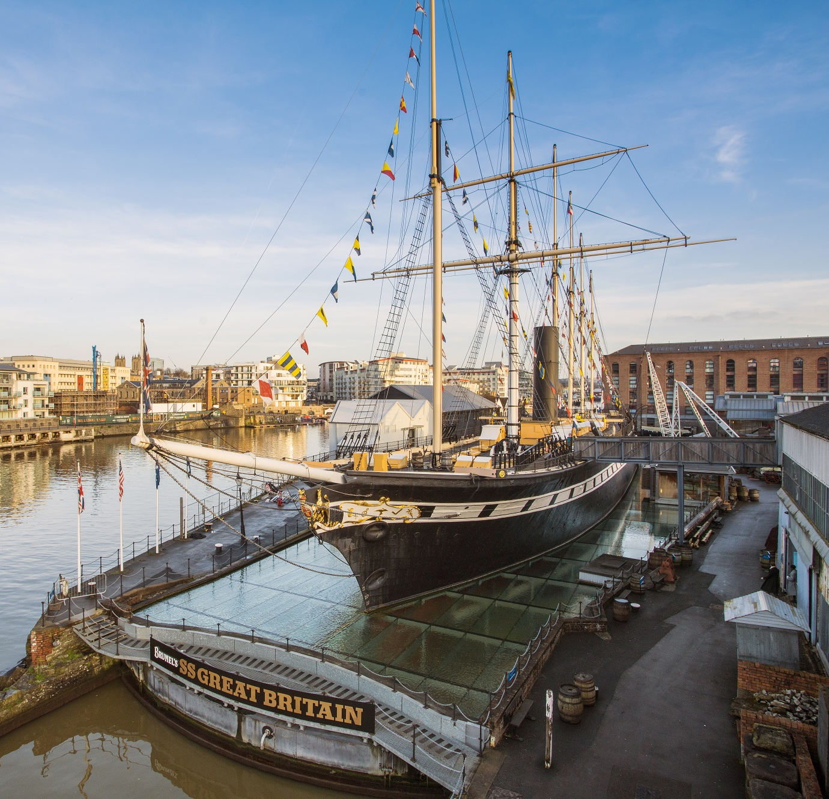
School
Workshop
Guide
Brunel and his Ship

Slide 2
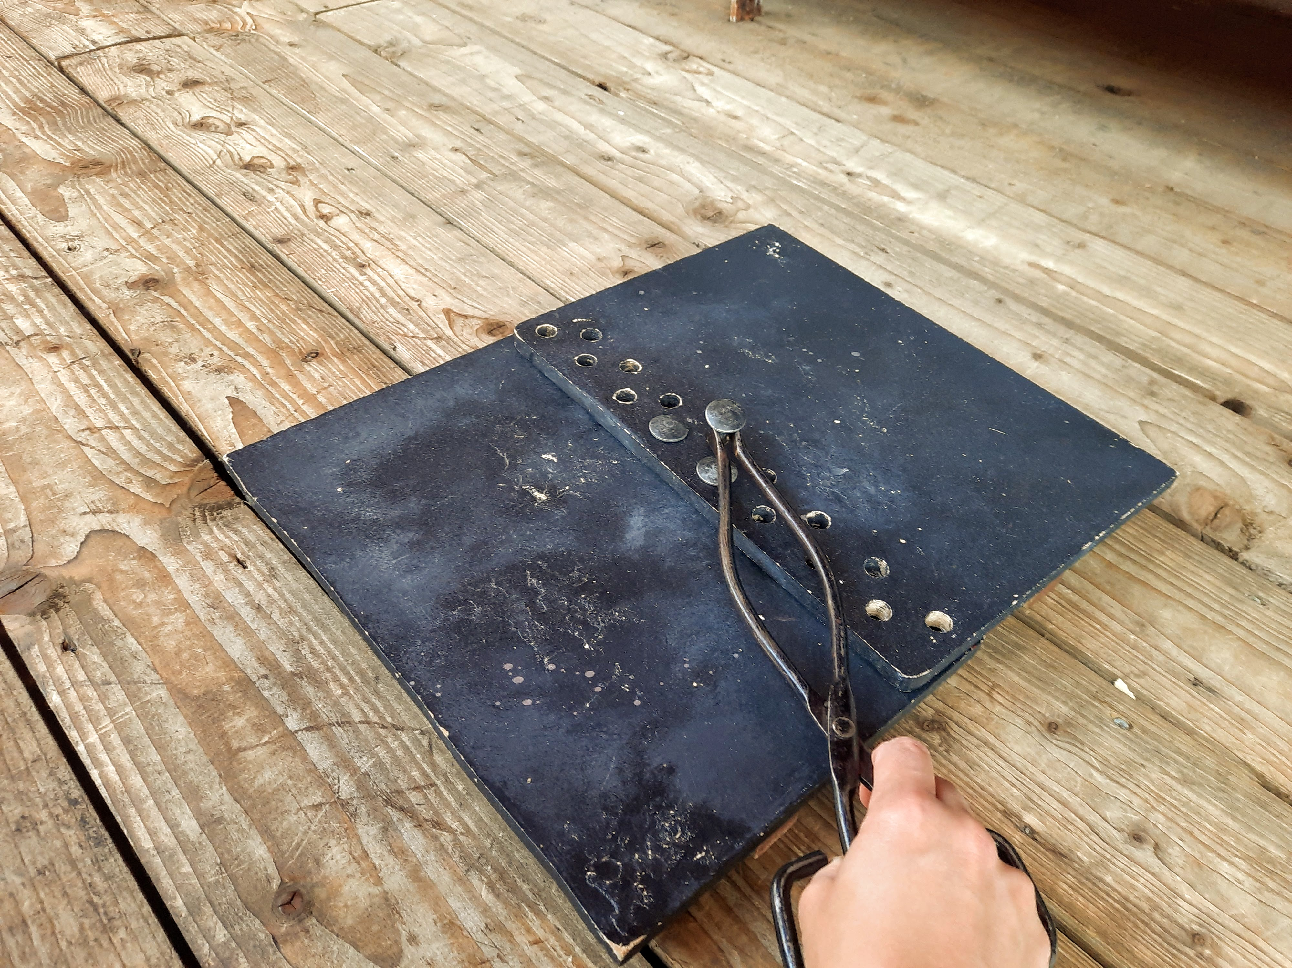
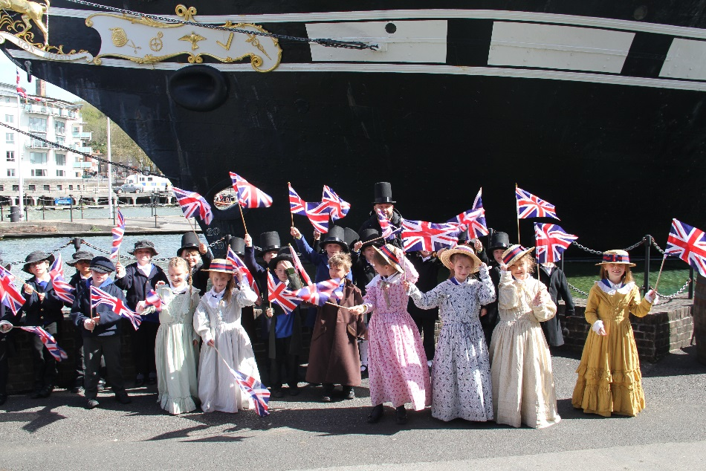
During our visit we are going to pretend to go back to the Victorian times.
We will pretend to go back in time and help to build the SS Great Britain.
We can dress up and pretend to go to the launch of the ship!

Slide 3
To discuss specific access or educational needs please call 0117 926 0680 and ask to speak to the Education Team.
Brunel’s SS Great Britain
Great Western Dockyard
Bristol England
United Kingdom
BS1 6TY
Tel: 0117 926 0680
Email: learning@ssgreatbritain.org
Web: ssgreatbritain.org
Photographs by: Lottie Morris & Sarah Trubshawe

